Slide 1
Non-invasive ventilation
Keith J Barrington
CHU Sainte Justine

Slide 2
Objectives
Know the different modalities of non-invasive respiratory support, and their indications
Know how to monitor, and wean, a child on non-invasive ventilation
  CPAP
  LNHD
    NIV

Slide 3
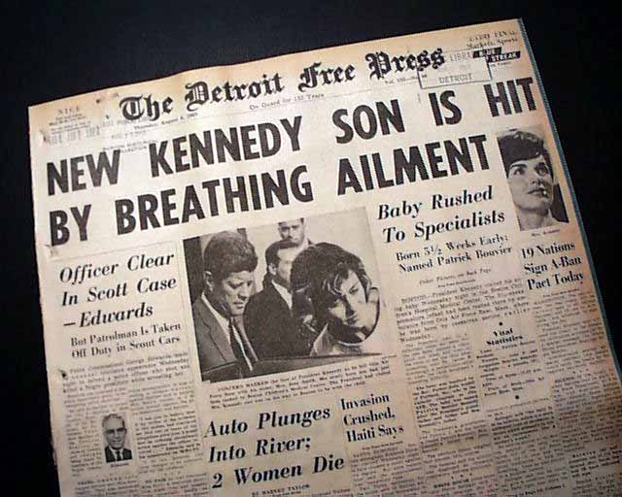
50 years ago

Slide 4


Slide 5
CPAP
Purely mechanical effects
  Increase in intra-pharyngeal pressure
  Increase in lung volume at the end of expiration
Secondary physiological effects
  Increased oxygenation
  Stabilization of the rib cage
  Respiratory stimulation
  Changes in respiratory work and lung mechanics

Slide 6
CPAP
Increased Intra-pharyngeal and airway pressure
  Variable degree of increase in pressure
  Cannula resistance very important.
  Nasal masks or Hudson prongs or wide binasal prongs have low resistance
  If you set +6 on the device (bubble or machine) baby receives +5 to +5.5
  RAM cannulae are very high resistance, and give much less real CPAP.
  +6cmH20 on the ventilator (or the bubble device) really give +2cmH20 at the pharyngeal/airway level with RAM cannulae

Slide 7
CPAP
Keeps the upper airways open, and prevents closure during inspiration
  Decreases airway resistance, and total respiratory resistance accordingly
    Miller MJ et al. J Appl Physiol 1990 Jan;68(1):141-6

Slide 8
CPAP
Laryngeal dilation
      Gaon P, Lee S, Hannan S, Ingram D, Milner AD. Assessment of effect of nasal continuous positive pressure on laryngeal opening using fibre optic laryngoscopy. Arch. Dis. Child. Fetal Neonatal Ed. 1999 May;80(3):F230-2.
Increase in lung volume at the end of expiration
Increased oxygenation
Compliance may be decreased in healthy lungs, because of overdistension
Compliance may be increased in HMD
Resistance also decreased, often a reduction in breathing work, but not always.

Slide 9
Indications for CPAP
For respiratory support, especially in diseases associated with decreased lung volume
  RDS
  Pneumonia
Less effective for diseases with increased lung volume
  TTN
  Some Meconium

Slide 10
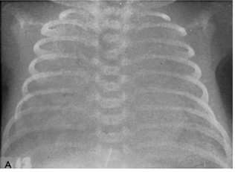
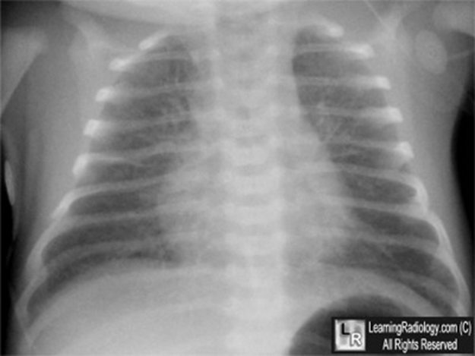

Slide 11
Indications for CPAP
Routine use starting from birth for infants of 32 weeks or less
Infant of >32 weeks with RDS
  even without oxygen requirements (to prevent deterioration)
Infant with RDS requiring oxygen
Infant who has received surfactant

Slide 12
Indications for CPAP
Heterogeneous lung diseases.. Maybe
  Meconium aspiration, (clinical trial)
Apnea
  Very effective for the obstructive part
  Not very effective for central apnea

Slide 13
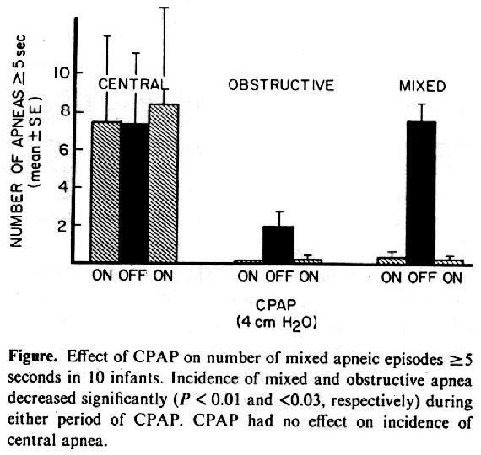
Miller M, Carlo W, Martin R. Continuous positive airway pressure selectively reduces obstructive apnea in preterm infants. J Pediatr 1985;106(1):91-4.

Slide 14
How?
If acute respiratory distress
  At least 6 cmH2O
  Short bilateral cannulas
  Nasal mask
    Naso-pharyngeal cannula less effective and more likely to become obstructed.
  Bubble CPAP
  Ventilator
  Infantflow

Slide 15
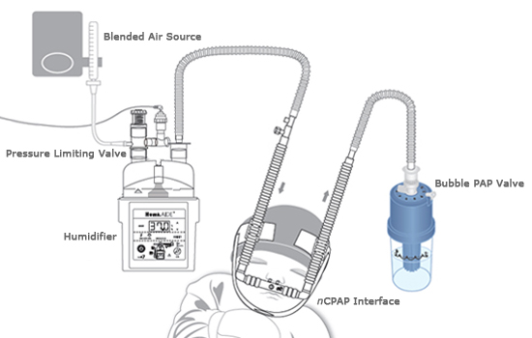
Machines
Bubble CPAP

Slide 16
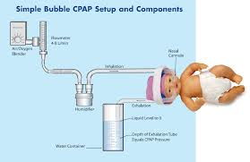

Slide 17
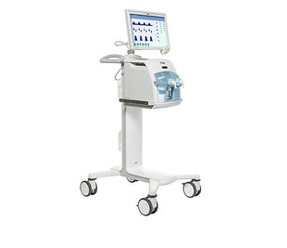
Machines
Respirator

Slide 18
Which pressure source?
No clinical difference between bubble CPAP and ventilator derived CPAP

Slide 19
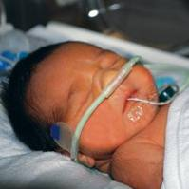
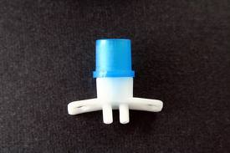
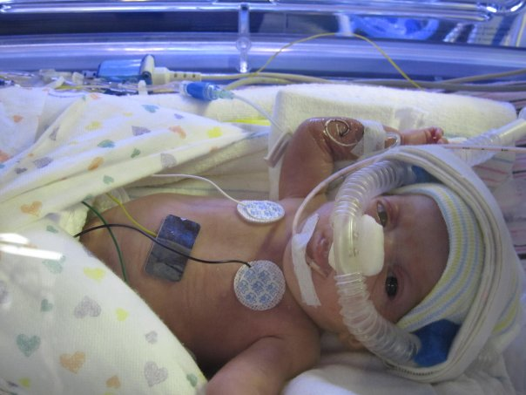
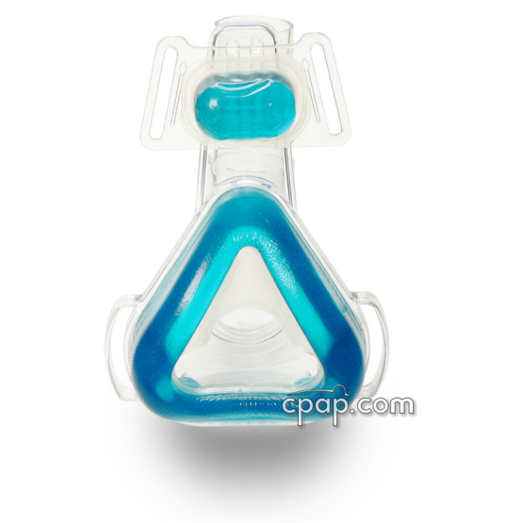
Interfaces

Slide 20
Which interface?
Cochrane review (De Paoli 2008)
  Short binasal cannulas preferable to naso-pharyngeal tubes
  No studies on masks
  No studies on RAM cannulae

Slide 21
Kieran EA, et al: Randomized trial of prongs or mask for nasal continuous positive airway pressure in preterm infants. Pediatrics 2012, 130(5):e1170-1176.
RCT, n = 120, children <31 weeks
Mask a little better

Slide 22
Starting CPAP
Start at +6 cmH2O if the infant in low oxygen (30% or less)
Start at +8 cmH2O if the infant in more than 30% O2
Maximum of +10 cmH2O

Slide 23
CPAP monitoring
Decrease in FiO2 within 20 minutes (not necessarily immediate)
Breathing work should also decrease
  VS q15 minutes then q1h
  BP q1h initially
  Continuous oximetry
  FiO2 adjusted for SpO2 90 to 95%

Slide 24
CPAP monitoring
If reduction in FiO2, that remains less than 30%, decrease in CPAP to +5 to consider
If increase to more than 40% surfactant consideration

Slide 25
CPAP monitoring
Surfactant reduces the incidence of pneumothorax
So: keeping a child on CPAP without surfactant risks increasing pneumothorax, especially if you wait too long
  Indications for surfactant/intubation?
  For children < 32 weeks with RDS, surfactant at FiO2 of 30%,(40%?) either by LISA or INSURE
  More mature children, variable depending on progression and diagnosis and local practices

Slide 26
CPAP monitoring
Surfactant reduces the incidence of pneumothorax
So: keeping a child on CPAP without surfactant risks increasing pneumothorax, especially if you wait too long
  Indications for intubation?
  For children < 32 weeks with RDS, intubation at FiO2 of 30%, followed immediately by surfactant
  More mature children, variable depending on progression and diagnosis and local practices

Slide 27

High-flow nasal cannula

Slide 28
Controlled HFNC data
Yoder BA, et al: Heated, Humidified High-Flow Nasal Cannula Versus Nasal CPAP for Respiratory Support in Neonates. Pediatrics 2013.
Multicenter RCT, HFNC vs CPAP for primary or post-extubation support, children >28 weeks, n = 432.
Also effective for treatment failure (need for intubation)
Collins CL, et al: A Randomized Controlled Trial to Compare Heated Humidified High-Flow Nasal Cannulae with Nasal Continuous Positive Airway Pressure Postextubation in Premature Infants. J Pediatrics 2012.
RCT, HFNC vs CPAP post-extubation, children <32 weeks, n= 130.
Equivalent extubation failure, fewer nasal traumas
Manley BJ, et al: High-Flow Nasal Cannulae in Very Preterm Infants after Extubation. NEJM 2013, 369(15):1425-1433.
RCT, HFNC vs CPAP post-extubation, children <32 weeks, n=303.
Equivalent extubation failure, fewer nasal traumas

Slide 29
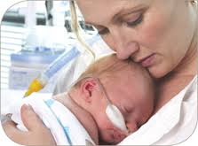
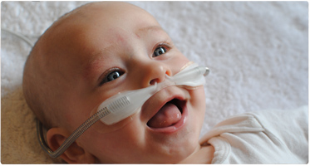
HFNC Comfort
And less nasal trauma

Slide 30
HFNC effectiveness
3 RCTs
  Post-extubation, similar effectiveness to CPAP
  Primary treatment of RDS, less data
Probably works like 'cheap CPAP’
    Measured pressures in the airways very variable, depends on flow, body size, and leak
  Probably also dead space washout

Slide 31
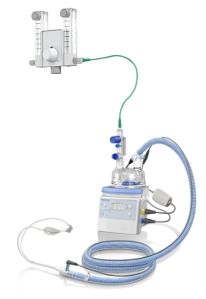
HFNC how?
Heated and humidified
Commercial systems
  F&P
  Vapotherm
Possible with 'homemade' systems, but be careful:
  Can generate high pressures, so a ‘pop-off’ or pressure relief valve is preferable
  Need to ensure humidity and temperature

Slide 32
HFNC how?
Pressure delivered depends on flow and leakage
Leakage depends on cannula seal
Even with optimal conditions, very variable delivered pressures
  FP system has a safety valve
Often start between 5 and 8 liters per minute
  CPAP between +1 and +22 cmH2O!! (usually around 3-4)
Indications similar to CPAP

Slide 33
CPAP weaning
Gradual reduction of pressure to 4 cmH2O
Monitoring of O2 needs and distress
From 4 cm H2O to 0

Slide 34
HFNC weaning
Decrease in flow, 8,6,4,2,0
Clinical and FiO2 monitoring

Slide 35
In case of failure
From HFNC, CPAP trial.
One of the RCTs, many babies with HFNC failure: improvement with CPAP

Slide 36
Non-invasive positive pressure ventilation
Clinical effects
Interface resistance even more important
RAM cannulae very ineffective

Slide 37
Are we ventilating?
Very little direct ventilation
Mouth often open, (but mouth resistance... Some pressures maintained)
Sometimes thoracic impedance recording demonstrates excursions

Slide 38
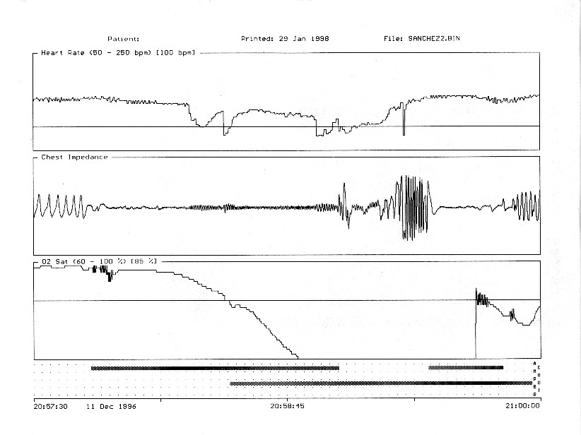

Slide 39
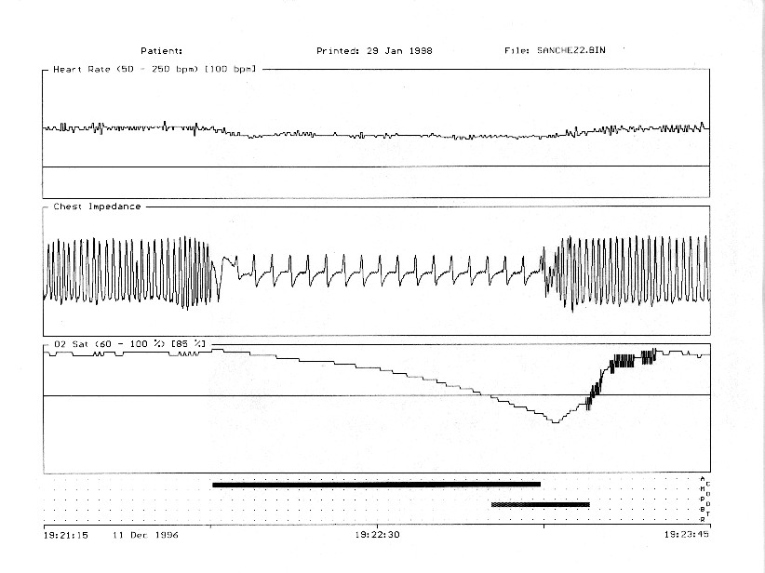

Slide 40
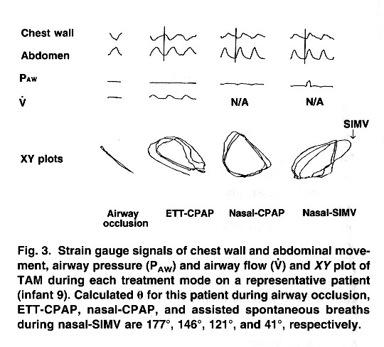
    Kiciman NM, Andreasson B, Bernstein G, Mannino FL, Rich W, Henderson C, et al. Thoracoabdominal motion in newborns during ventilation delivered by endotracheal tube or nasal prongs. Pediatr Pulmonol 1998 Mar;25(3):175-81.

Slide 41
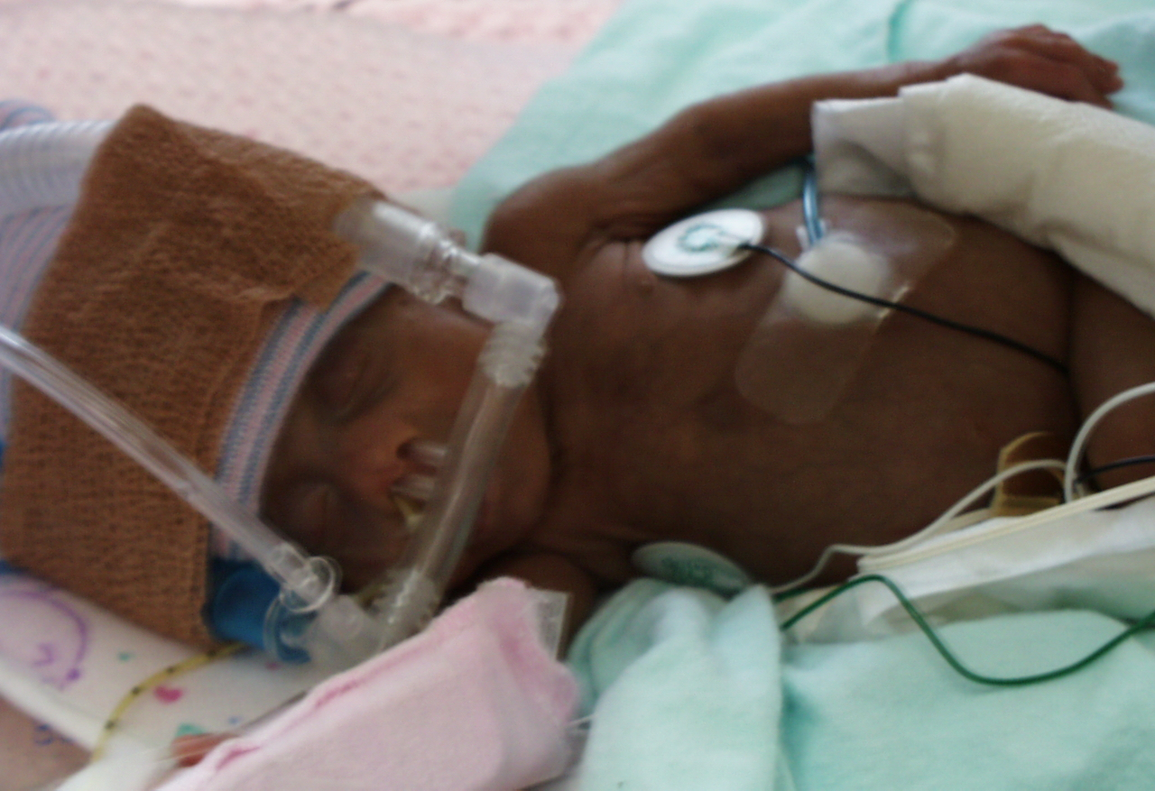
Methods

Slide 42
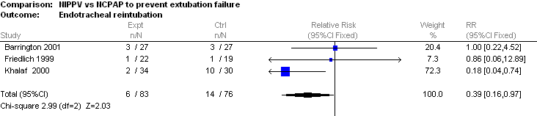
Nasal ventilation
Post-extubation studies demonstrate increased extubation success

Slide 43
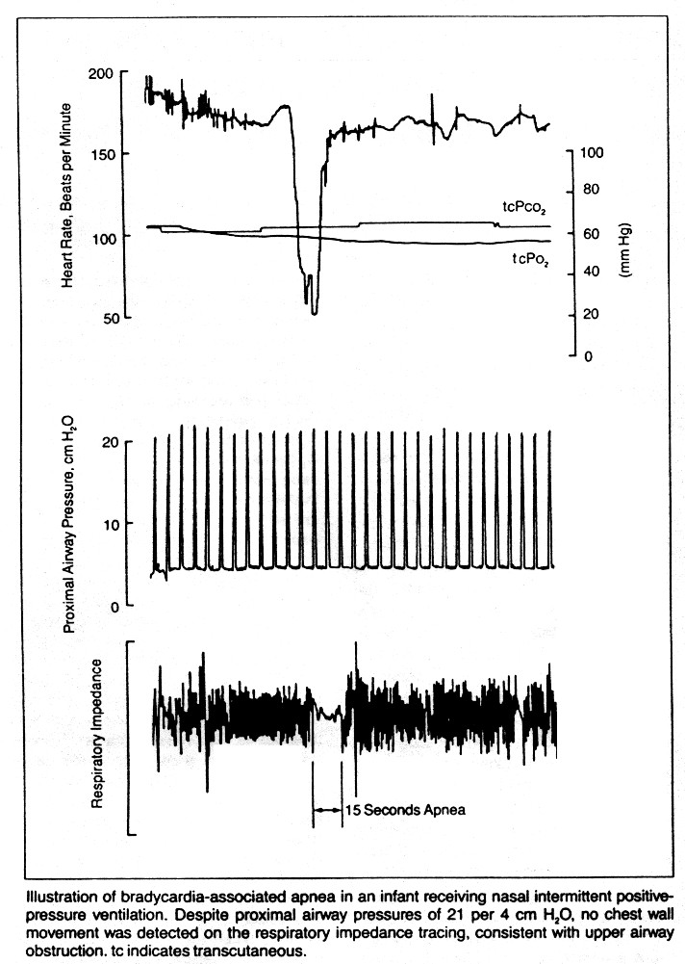

Slide 44
RCT
Kirpalani H, et al: A trial comparing noninvasive ventilation strategies in preterm infants. The New England journal of medicine 2013, 369(7):611-620.
1009 children <1kg BW, either nIPPV or CPAP for all periods of non-invasive support
No difference between the modes.

Slide 45
Use of nIPPV?
Routine in the more immature infants
  Along with routine early caffeine
As rescue in infants having difficulty with CPAP
  O2 needs remain over 30 %
  Multiple apneas
  Clinical distress not improving

Slide 46
Avoiding intubation
MIST compared to intubation
Less-invasive surfactant administration:
Fewer babies intubated
Better long term outcomes

Slide 47
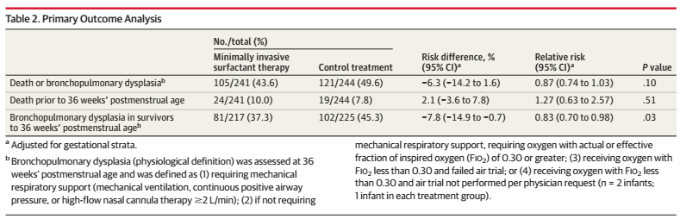
OPTIMIST trial
Dargaville PA, al. Effect of Minimally Invasive Surfactant Therapy vs Sham Treatment on Death or Bronchopulmonary Dysplasia in Preterm Infants With Respiratory Distress Syndrome: The OPTIMIST-A Randomized Clinical Trial. JAMA. 2021;326(24):2478-87.

Slide 48
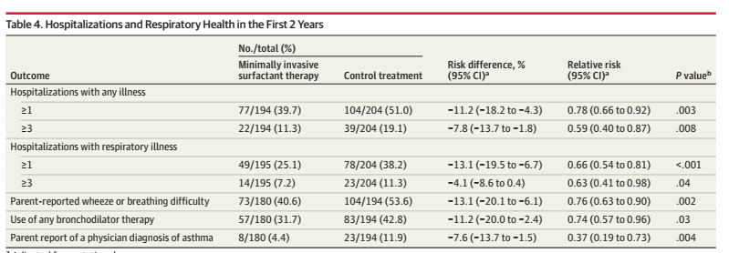
OPTIMIST long term
Dargaville PA, et al. Two-Year Outcomes After Minimally Invasive Surfactant Therapy in Preterm Infants: Follow-Up of the OPTIMIST-A Randomized Clinical Trial. JAMA. 2023.

Slide 49
SALSA?
Surfactant Administration by Laryngeal mask/Supraglottic Airway
Not studied in large RCT, but same benefit of avoiding intubation
Potentially as beneficial as MIST
Need proof, but easier to learn than laryngoscopy/thin catheter surfactant admin.

