Slide 1
Neonatal surfactant therapy: all you need to know!
The FNC statement and beyond

Slide 2
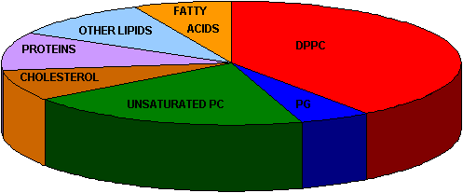
Natural Surfactant

Slide 3
TABLE 1 SP-B AND SP-C IN NATIVE AND COMMERCIAL PORCINE AND BOVINE SURFACTANT PREPARATIONS*
 |  | Bovine |  |  |  |  |  | Porcine
 |  | Native (n = 3) |  | Alveofact (n = 8) |  | Survanta (n = 4) |  | Native (n = 10) |  | Curosurf (n = 3)
SP-B, µg/µmol PL |  | 10.9 ± 1.1 |  | 5.2 ± 0.6 |  | 1.3 ± 0.2 |  | 9.8 ± 1.0 |  | 3.2 ± 0.5§¶
SP-C, µg/µmol PL |  | 34.1 ± 4.7 |  | 12.9 ± 1.7 |  | 16.5 ± 3.7§ |  | 20.8 ± 2.8 |  | 10.1 ± 1.5§**
* 500 to 1,200 µmol phospholipid were applied on a Sephadex LH60 column and SP-B and SP-C were separated from the bulk phospholipid peak with dichloromethane:methanol:0.1 N hydrochloric acid (30:65:5; vol/vol) at a flow of 0.4 ml/min. Data are presented as mean ± SD of the indicated numbers of determinations (n).
p < 0.001 versus native bovine.
p < 0.001 versus Alveofact.
§ p < 0.01 versus native bovine.
p < 0.001 versus native porcine.
¶ p < 0.05 versus Alveofact.
** p < 0.01 versus native porcine.

Slide 4
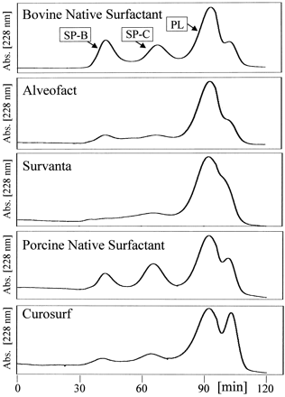

Slide 5
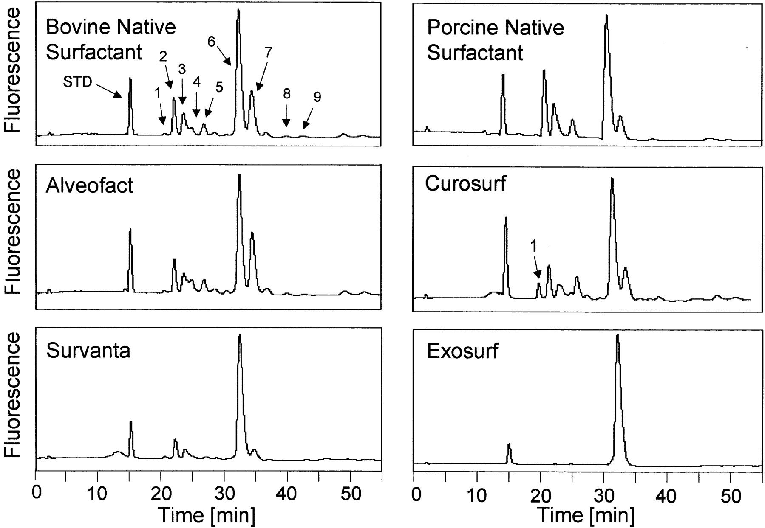
Abbreviations: 1: sphingomyelin; 2: palmitoylmyristoyl-PC; 3: palmitoylpalmitoleoyl-PC; 4: palmitoylarachidonoyl-PC; 5: palmitoyllinoleyl-PC; 6: dipalmitoyl-PC; 7: palmitoyloleoyl-PC; 8: stearoylarachidonoyl-PC; 9: stearoyllinoleyl-PC.

Slide 6
Survanta ou beractant
A natural product isolated from bovine lung extracts (Bovine Lung Lipids) containing phospholipids, neutral lipids, fatty acids and protein.
It is fortified by the addition of the synthetic lipids, namely dipalmitoyl-phosphotidylcholine (colfosceril palmitate), palmitic acid and tripalmitin (fortification lipids).
Components Quantities (mg/mL)
Total Phospholipids 25
Disaturated Phosphatidylcholine 11.0-15.5
Triglycerides 0.5-1.75
Free Fatty Acids 1.4-3.5
Protein 0.1-0.4
Sodium Chloride 9.0

Slide 7
Curosurf ou poractant
Phospholipids (mg/mL) 76
Dipalmitoylphosphatidyl-choline (mg/mL) 30
SP-B (mg/mL) 0.45
SP-C (μg protein/μmol • L-1
phospholipid) 5.0–11.6
Additives No

Slide 8
What Are The Indications For And Benefits Of Surfactant Replacement Therapy?
Surfactant replacement, either rescue or prophylaxis, reduces mortality (Evidence level 1a)
  Also reduces pulmonary air leaks (pneumothorax and PIE); and the duration of ventilatory support (Evidence level 1a).
  Surfactant replacement increases the likelihood of surviving without BPD, largely by improving survival rather than the incidence of BPD.
  Surfactant decreases length of hospital stay and decreases cost of intensive care treatment vs controls.
  No increase in adverse neurodevelopmental outcome (Evidence level 1a).

Slide 9
Recommendation 1
Intubated infants with RDS should receive exogenous surfactant therapy.
Recommendation grade A.

Slide 10
Other Indications for Surfactant
Secondary surfactant deficiency or dysfunction occurs in other disorders, including MAS, pneumonia, and pulmonary haemorrhage.
Surfactant is inactivated and displaced by meconium (both water and fat soluble components)

Slide 11
Meconium Aspiration
There are now 4 RCTs, all small of meconium replacement.
The Cochrane systematic review reported no difference in mortality or pneumothorax but a decrease in the requirement for ECMO (Evidence level 1a).

Slide 12
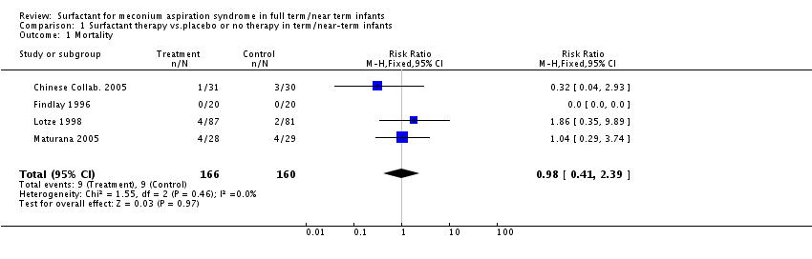

Surfactant for meconium aspiration syndrome in full term/near term infants
El Shahed, Amr I; Dargaville, Peter A; Ohlsson, Arne; Soll, Roger
Cochrane Database of Systematic Reviews. Issue 1, 2009.
Comparison 1 Surfactant therapy vs.placebo or no therapy in term/near-term infants, Outcome 1 Mortality.
The Cochrane Library, Copyright 2010, The Cochrane Collaboration.
2

Slide 13
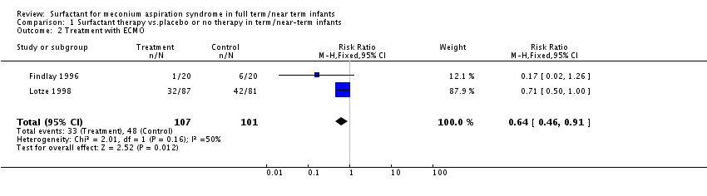

Slide 14
Recommendation 2
Intubated infants with meconium aspiration syndrome requiring more than 50% oxygen should receive exogenous surfactant therapy
    Based on the entry criteria of the studies that were available at that time.
Recommendation grade A.

Slide 15
Indications
Surfactant lavage for MAS may be effective
  One small RCT previously published: possible short term physiologic benefits but no clinically significant benefits compared to restricted rescue surfactant.
  Recent RCT with 66 infants,

Slide 16
Dargaville P et al, J Pediatr 2011
Table II. Main outcomes
All continuous variables epressed as median (interquartile range); dichotomous variables expressed as n (%).
* P values from Mann-Whitney test (continuous outcomes) and Fisher exact test (dichotomous outcomes).
Outcome | Lavage (n = 30) | Control (n = 35) | P value*
Days on respiratory support | 5.5 (3.4-12) | 6.0 (4.3-10) | .77
Days on respiratory support (survivors) | 8.0 (4-13) | 7.8 (4.7-10) | .86
Died | 3 (10%) | 8 (23%) | .20
Received ECMO | 0 (0%) | 3 (9%) | .24
Died or received ECMO | 3 (10%) | 11 (31%) | .067
Days of intubation (survivors) | 5.0 (3.3-8.7) | 6.3 (3.9-8.1) | .57
Days of oxygen therapy (survivors) | 14 (6.7-21) | 14 (11-18) | .48
Days in any hospital | 16 (9.7-23) | 18 (10-24) | .70
Days in any hospital (survivors) | 17 (11-25) | 19 (15-25) | .46
Days of HFOV (survivors) | 2.1 (0-5.3) | 3.9 (0.8-6.0) | .34
Days of iNO therapy (survivors) | 2.9 (0-4.0) | 2 (0-6.0) | .70
Pneumothorax | 7 (23%) | 8 (23%) | 1.0
Pneumothorax after randomization | 1 (3.3%) | 5 (14%) | .21

Slide 17
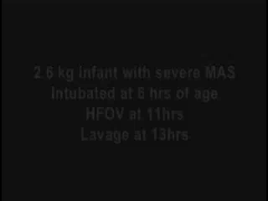

Slide 18
Surfactant lavage for Meconium aspiration
Promising, but needs more study

Slide 19
Other Indications
The use of surfactant replacement therapy in neonatal pneumonia has not been adequately studied.
  Sub-group analysis of near term babies with respiratory failure from an RCT: those who had sepsis and were treated with surfactant had a 40% decrease in the need for ECMO. Other case series of neonatal bacterial pneumonia appear to show benefits (Evidence level 4)

Slide 20
Recommendation
Sick newborn infants with pneumonia and an oxygenation index >15 should receive exogenous surfactant therapy.
Recommendation grade C.

Slide 21
Indications
Surfactant therapy increases the incidence of pulmonary haemorrhage.
  haemoglobin and other blood components, such as fibrinogen, have serious adverse effects on surfactant function, surfactant replacement therapy has also been used to treat pulmonary haemorrhage.
There are no RCTs.
A retrospective cohort study showed a substantial acute improvement in oxygenation, in very sick babies with pulmonary haemorrhage, when given surfactant (Evidence level 4).

Slide 22
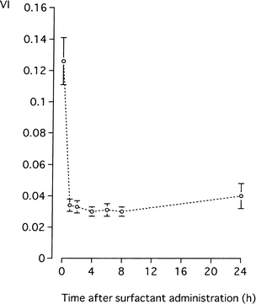
A 2nd study
Amizuka et al
27 bébés
VI=FiO2*MAP/PO2
Sudden major improvement

Slide 23
Recommendation
Intubated newborn infants with pulmonary haemorrhage that leads to clinical deterioration should receive exogenous surfactant therapy as one aspect of clinical care.
Recommendation grade C

Slide 24
What are the risks?
Pulmonary haemorrhage
Acute overdistension of lung
No evidence of immune effects from exogenous bovine protein
No evidence of transmission of infective agents, including prions

Slide 25
Which is Better: Natural or Synthetic?
Systematic review: mortality is decreased by natural vs. synthetic surfactant
  (RR = 0.86, 95% CI 0.75, 0.99; ARD = 0.025, 95% CI –0.047, -0.003; number needed to treat with natural rather than synthetic surfactant to prevent one death = 40, 95% CI 21, 333).
Natural surfactant: lower needs for O2 and ventilatory support for at least 3 days
Air leaks are less common with natural surfactants
  (RR of pneumothorax = 0.63, 95% CI 0.52, 0.76; ARD = 0.044, 95% CI –0.061, -0.027; NNT = 23, 95% CI 16, 37, Evidence level 1a).

Slide 26
Natural vs. synthetic
Incidence of BPD not different, but mortality is reduced by natural surfactant, so combined outcome of death or BPD is reduced
  (RR = 0.95, 95% CI 0.90, 1.01).
No reliable information about long term outcomes comparing natural or synthetic surfactant.
  Synthetic preparations did not contain surfactant protein analogues.
  New synthetic surfactants have been developed.

Slide 27
Recommendation
Natural surfactant should be used in preference to any of the artificial surfactants available at the time of publication of this statement.
Recommendation grade A.
What about Surfaxin (lucinactant)?

Slide 28
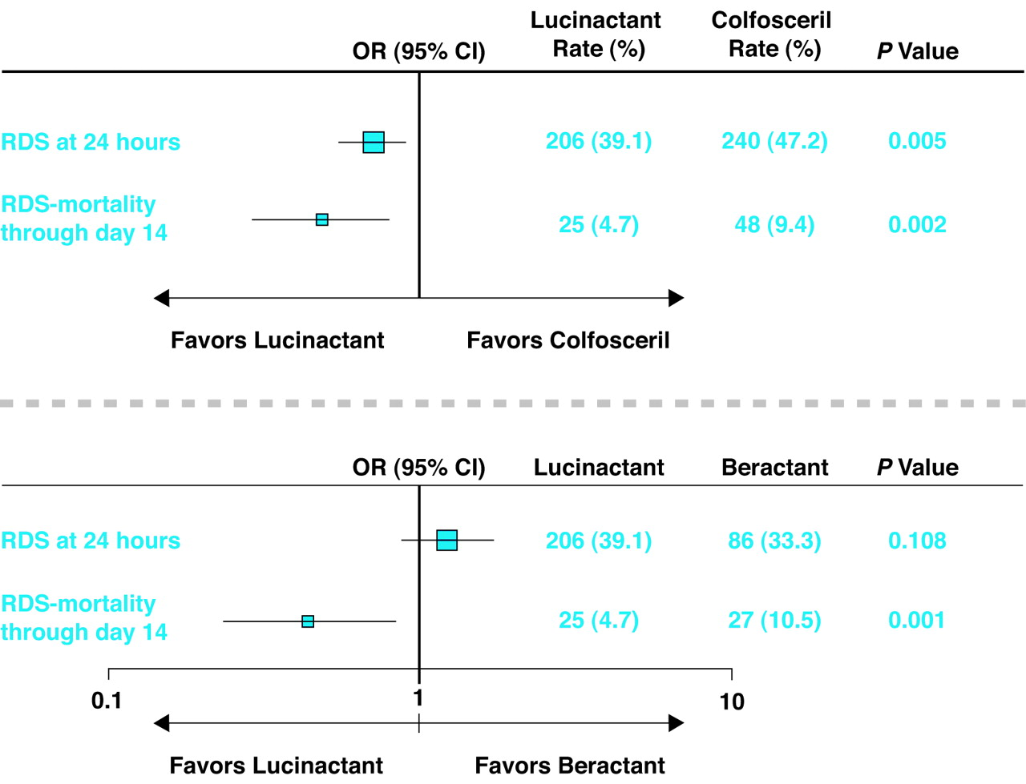

Primary outcome variables.
Moya F R et al. Pediatrics 2005;115:1018-1029
©2005 by American Academy of Pediatrics
Notes:
Primary outcome variables. ORs and 95% CIs for treatment differences between lucinactant and colfosceril palmitate (top) and between lucinactant and beractant (bottom) are shown. The box size is proportional to the event rate. The data reflect the number of events in each treatment group for each variable; the percentage of randomized infants is shown in parentheses. The P values denote the significance of the between-group difference for each end point.

Slide 29
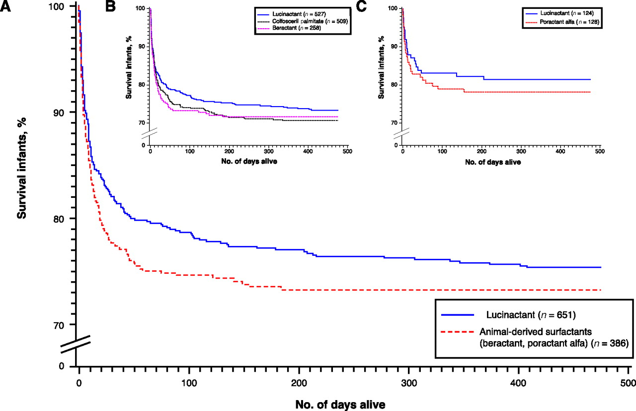
Kaplan-Meier survival plots showing all-cause mortality through 1 year corrected age: A, data from the SELECT trial; B, data from the STAR trial; C, combined data from infants in both trials who received either lucinactant or animal-derived surfactants.
Moya F et al. Pediatrics 2007;119:e1361-e1370
©2007 by American Academy of Pediatrics
Notes:
Kaplan-Meier survival plots showing all-cause mortality through 1 year corrected age: A, data from the SELECT trial; B, data from the STAR trial; C, combined data from infants in both trials who received either lucinactant or animal-derived surfactants. All-cause mortality through 1 year corrected age favored lucinactant (Wilcoxon test) over poractant alfa (P = .04) and the animal-derived surfactants (P = .05).

Slide 30
Which Is Better: Surfactant Given As Prophylaxis Or Rescue Therapy For Preterm Babies With Rds?
7 RCTs of prophylactic versus rescue therapy; (all used natural surfactants).
  Six enrolled babies < 30 wk 1 was 29-32 wk of gestation.
  Mortality reduced by prophylactic surfactant (Evidence level 1a) RR of neonatal mortality = 0.61, 95% CI 0.48, 0.77; ARD = -0.046, 95% CI –0.067, -0.024; NNT = 22, 95% CI 15, 42).

Slide 31
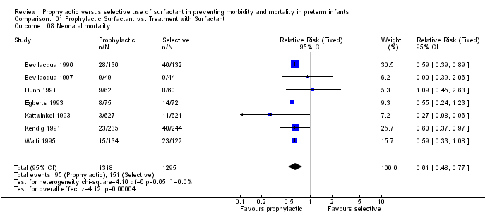
Prophylaxis vs Rescue
Mortality

Slide 32
Prophylaxis vs. Rescue
The incidence of RDS,
Pneumothorax (RR = 0.62, 95% CI 0.42, 0.89; ARD = -0.021, 95% CI –0.037, -0.005; NNT = 50, 95% CI 27, 200), and
PIE (RR = 0.54, 95% CI 0.36, 0.82; ARD = -0.026, 95% CI –0.043, -0.009, NNT = 38, 95% CI 23, 111) were all decreased in babies treated prophylactically.
No difference in BPD, combined outcome of BPD or death was lower with prophylaxis
No difference in NEC, RoP, IVH, PVL

Slide 33
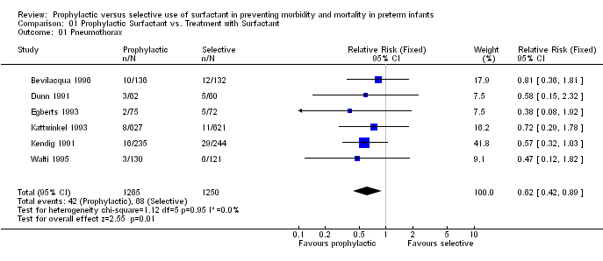
Prophylaxis vs Rescue
Pneumothorax

Slide 34
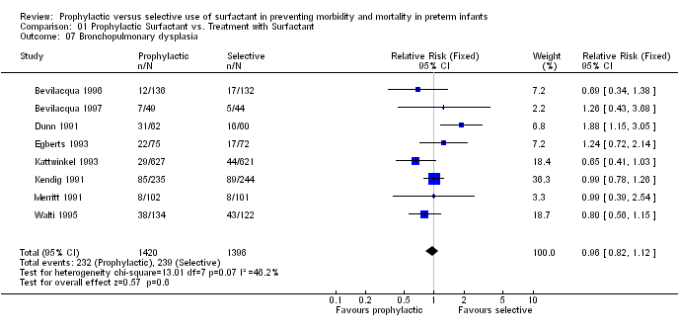
Prophylaxis vs Rescue
BPD

Slide 35
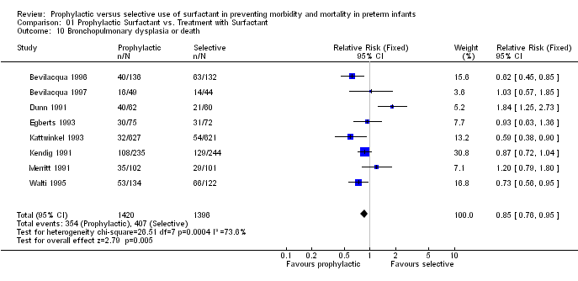
Prophylaxis vs Rescue
BPD or death

Slide 36
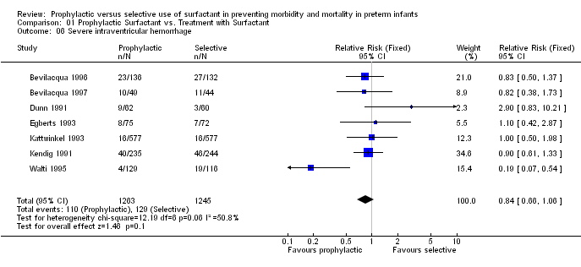
Prophylaxis vs. Rescue
Severe IVH

Slide 37
Prophylaxis vs. Rescue
The Cochrane review and meta-analysis indicated 2 fewer pneumothoraces and 5 fewer deaths for every 100 babies treated prophylactically with surfactant.
If a prophylactic treatment approach is used for all infants < 32 week, approximately twice as many babies at risk for respiratory distress syndrome will receive surfactant than if a rescue approach is used.

Slide 38
Prophylaxis vs rescue: timing
Multi-centre RCT (n=651) showed no clinically significant difference between immediate prophylaxis surfactant and administration at 10 mins of age after brief stabilization (Evidence level 1b).
It is important to give the surfactant as soon as possible after stabilization.
  The OSIRIS study demonstrated that the combined incidence of death or BPD was reduced by about 11% when surfactant was given at a mean postnatal age of 2 rather than 3 hours (RR 0.89, 95% CI 0.79 – 1.00, Evidence level 1b); even fairly short delays in therapy worsen outcomes

Slide 39
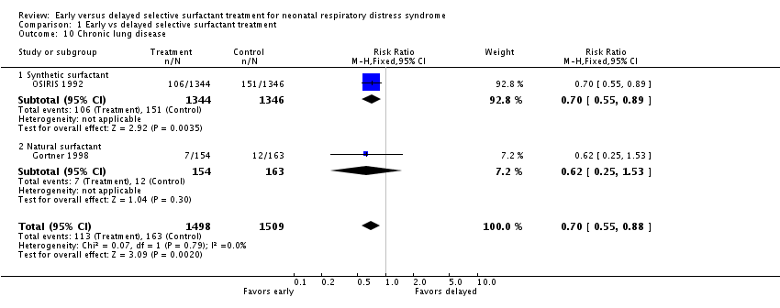

Slide 40
Prophylaxis
RR of death (with prophylaxis cf rescue) is very similar whatever the underlying risk. However, the absolute risk of death, (and therefore the NNT), will differ according to the absolute risk among untreated patients.
  In the Cochrane review the RR is identical for the whole group (0.61) and for < 30 wks (0.62), despite different ARD (0.11 vs 0.16).
Decision to use prophylaxis should depend on the availability of competent personnel and centre specific mortality rates

Slide 41
Prophylaxis
In the review, antenatal steroid use ranged from 14% to 50%.
The RR of death for prophylactic compared to rescue surfactant is not related to the frequency of steroid treatment; however, the ARD will differ based on the underlying risk, which is affected.
With current mortality rates at tertiary centres, a reasonable option would be to give surfactant prophylactically to all infants < 26 wk, and to those of 26-27 wk who have not had steroids.

Slide 42
Recommendation
Infants who are at a significant risk of RDS should receive prophylactic natural surfactant therapy as soon as they are stable within a few minutes after intubation.
Recommendation grade A.

Slide 43
Prophylaxis vs early rescue?
The RCTs of prophylaxis have compared praophylaxis to « traditional » rescue of babies with well established RDS, usually with a strict oxygenation criterion.
Early rescue is now more usual
2 large multicenter RCTs have compared prophylaxis to CPAP with early rescue.
COIN and SUPPORT
Both show some advantage of CPAP with early rescue (rescue criteria quite different)

Slide 44
Prophylaxis or early rescue
If you need surfactant the sooner the better
If you can avoid intubation, the better off you are
What to do….
Early selection of infnats who need surfactant, for individualized treatment.

Slide 45
Should Multiple Or Single Doses Of Surfactant Be Used?
2 RCTs (n=394). Compared: only 1 dose allowed to either: up to 3 further doses at < 72 h for a 0.1 increase in FIO2 after initial response; or, up to 3 further doses at 12 and 24 h if remained intubated and required any O2.
  Gestation ranged from 30 to 36 wk in one study and birthweight of 700 to 2000 g in the other.
  Meta-analysis showed reduction in pneumothorax (RR 0.51, 95% CI 0.30, 0.88; ARD -0.09, 95% CI -0.15, -0.02); trend towards reduction in mortality (RR 0.63, 95% CI 0.39, 1.02; ARD -0.07, 95% CI -0.14, 00.00). No complications (Evidence level 1a).

Slide 46
Recommendation
Infants with RDS who have persistent or recurrent oxygen and ventilatory requirements within the first 72 hours of life should have repeated doses of surfactant. Administering more than 3 doses has not been shown to have a benefit.
Recommendation grade A.

Slide 47
What Are The Criteria For, And Timing Of, Retreatment?
There are extremely limited data
decided arbitrarily in the two trials just described.
  1 RCT compared low (FiO2 > 0.30, still requiring intubation) and high (FiO2 > 0.40, mean airway pressure > 7 cm H₂O) retreatment thresholds, after a minimum of 6 hours.
  They noted no benefit from retreating at the lower threshold, except in those babies with complicated RDS (evidence of perinatal compromise or sepsis) who had a lower mortality with low threshold retreatment. (Evidence level 1b).

Slide 48
Retreatment: timing
Timing of retreatment arbitrarily decided in most of the surfactant trials,
Actual comparisons of timing limited to 1 small RCT.
  randomly compared retreatment at 2 h to 6 h. Some short-term advantage to earlier re-dosing in the smallest infants, but no clinically important benefits were shown (Evidence level 2).

Slide 49
Recommendation
Retreatment should be considered when there is a persistent or recurrent oxygen requirement of 30% or more and may be given as early as 2 hours or more commonly 4 to 6 hours after the initial dose.
Recommendation grade A.

Slide 50
How Should Ventilatory Management After Surfactant Be Approached?
Rapid changes in lung mechanics and VQ matching after rescue surfactant
Prevention of serious lung disease by prophylaxis
Many infants can be very rapidly weaned and extubated to nasal CPAP within an hour of intubation and surfactant administration.
  Premedication used for intubation should only cause brief duration of respiratory depression, and staff must be skilled in rapid ventilator weaning.
  Such weaning is often performed with few or no blood gases, relying on clinical condition, spontaneous efforts, pulse oximetry and sometimes TcCO2

Slide 51
Ventilation after Surfactant
There is currently no proof that a rapid wean and extubation approach improves long term outcomes compared to a more traditional weaning approach. In 2 small randomized trials such an approach lead to a decrease in the need for more than an hour of mechanical ventilation (Evidence level 2b). Definitive recommendations will require further evidence.
Protocol driven weaning seems to shorten intubation times.

Slide 52
Recommendation
Options for ventilatory management to be considered after prophylactic surfactant therapy include very rapid weaning and extubation to CPAP within one hour.
Recommendation grade B

Slide 53
If We Can Give Surfactant, Do We Still Need To Use Antenatal Steroids?
Large cohort study: combination of surfactant and steroids more effective than surfactant alone (Evidence level 2b).
Secondary analysis of surfactant trials: disease severity reduction in babies who received antenatal steroids (Evidence level 4).
2 RCTs confirm antenatal steroids reduce risk of poor outcome even where surfactant is available; one showed reduction in RDS & an increase in survival without ventilatory support, both showed reductions in severe IVH.

Slide 54
Recommendation
Mothers at risk of delivering babies <34 weeks gestation should be given antenatal steroids according to established guidelines regardless of the availability of postnatal surfactant therapy.
Recommendation grade A.

Slide 55
Should Surfactant Be Given Prior To Transport Of A Baby With RDS?
Using surfactant prior to transport studied retrospectively and found to be safe.
In one of the studies lower O2 requirements during transport and fewer days of ventilation compared to controls (Evidence level 3b).
Prospective studies would be required to clearly answer whether outcomes are improved.
Significantly reduced risk for pneumothorax after surfactant is a potential benefit, given the difficulties managing this during transport.

Slide 56
Recommendation
Intubated infants with RDS should receive exogenous surfactant therapy prior to transport.
Recommendation grade C.

Slide 57
Levels of Evidence used in This Statement
Level
1a
Systematic Review (with homogeneity) of Randomized Controlled Trials
1b
Individual Randomized controlled trial (with narrow Confidence Interval)
2a
Systematic Review (with homogeneity) of cohort studies
2b
Individual cohort study (or low quality RCT; e.g., <80% follow-up)
3a
Systematic Review (with homogeneity) of case-control studies
3b
Individual Case-Control Study
4
Case-series (and poor quality cohort and case-control studies)
5
Expert opinion without explicit critical appraisal, or based on physiology, bench research or "first principles"

Slide 58
Grades of Recommendation
A
consistent level 1 studies
B
consistent level 2 or 3 studies
C
level 4 studies
D
level 5 evidence or troublingly inconsistent or inconclusive studies of any level

