Slide 1
Patient assessment

Slide 2
Neonatal ventilation
Respiratory assessment
 | 0 | 1 | 2
Nasal flaring | None | Moderate (+) | Marked (++)
Expiratory grunt | None | Audible with stethoscope | Audible to the ear
Xiphoid retraction | None | Moderate (+) | Marked (++)
Chest movement | Synchronized with the abdomen | Slight asynchrony | Marked asynchrony, Thoracoabdominal rocking See-Saw
Intercostal retraction | Absent | Moderate (+) | Marked (++)
Notes:
Toujours l’examen physique en premier!!!!!
Pourquoi le tirage sous costal n’en fait pas partie?
Normal en contexte de DBP
Respiration abdominale chez le bébé

Slide 3
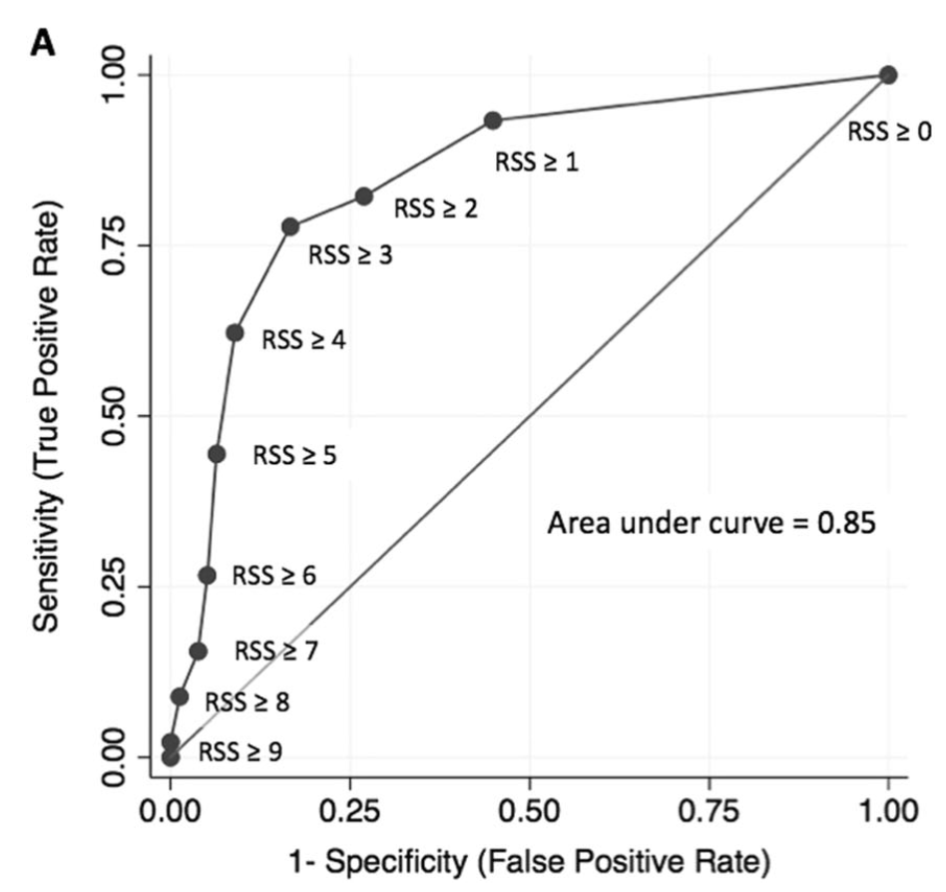
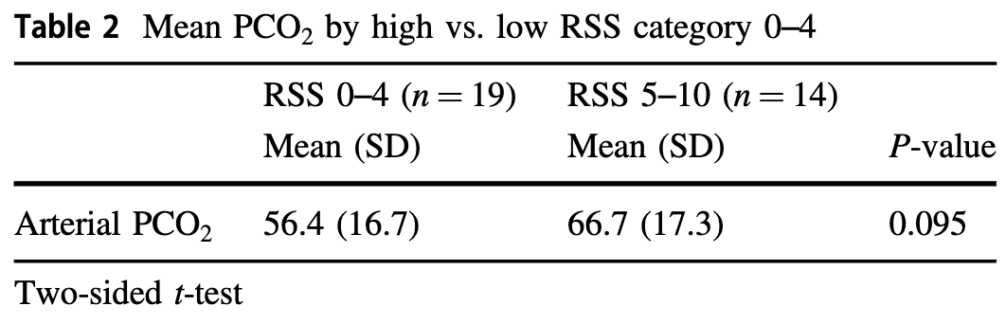
Why the silverman score
Hedstrom, A. B., Gove, N. E., Mayock, D. E. & Batra, M. Performance of the Silverman Andersen Respiratory Severity Score in predicting PCO2 and respiratory support in newborns: a prospective cohort study. J Perinatol 38, 505–511 (2018).

Slide 4
Neonatal ventilation
Why?
Administer surfactant…..
        Although – LISA
Apnea of prematurity…..
        Although – Caffeine,
ENT abnormalities
Central or neuromuscular problems
Sedation/pain relief
Respiratory failure

Slide 5
Indications
Either based on clinical presentation
Or
Blood gas results
Or
Difficulties with oxygenation

Slide 6
Indications
Either based on clinical presentation
  EG Silverman score >6
Or
Blood gas results
  EG acute PCO2>65
Or
Difficulties with oxygenation
  EG, more than 75% FiO2 on CPAP at 8 cmH2O

Slide 7
Basic terms

Slide 8
Basic terms
Pressure
Ti
Ppeak
Or
PIP
∆P
Te
PEEP
Time

Slide 9
Basic terms
Volume
Inspired volume
Te
Ti
Time
Expired volume

Slide 10

Basic terms
Pressure
Ti
Ppeak
Volume

Slide 11
Invasive ventilation

Slide 12
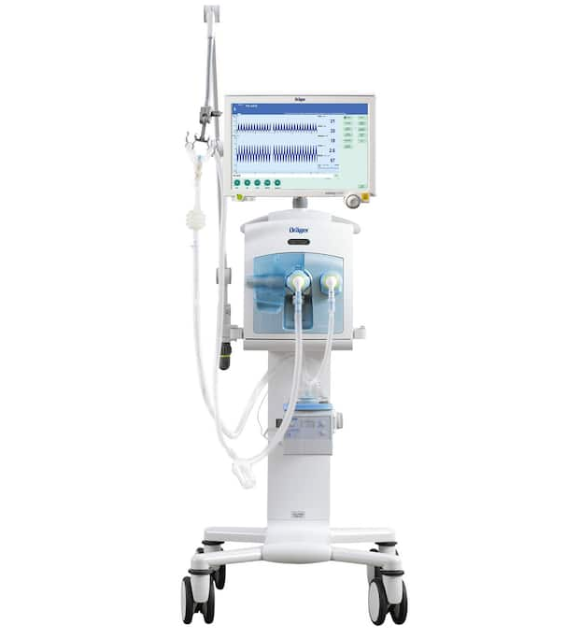
Conventional ventilation

Slide 13
nomenclature
Volumetric ventilation
Assist/control ventilation (VAC)
      PC-VAC-VG
Intermittent assisted controlled ventilation (VACi)
  Or called Synchronized Intermittent Mandatory Ventilation (SIMV)
Barometric ventilation
Assist/control ventilation (VAC)
      PC-VAC
Intermittent assisted controlled ventilation (VACi)
  Or called Synchronized Intermittent Mandatory Ventilation (SIMV)
Pressure Support

Slide 14
Oxygenation
PaO2 is increased by increases in mean airway pressure
This is true in any low volume, atelectatic lung disease.
And not true in other diseases!
Because of improved V/Q matching.
  Above a certain point increases in mean airway pressure may lead to decreases in cardiac output, even though PaO2 continues to increase.
  This point depends on the stiffness of the lungs

Slide 15
PaO2
Cardiac Output
O2 delivery
Mean Airway Pressure

Slide 16
Oxygenation
The mean airway pressure is the average airway pressure over one minute.
The mean airway pressure can be increased by
  Increasing PEEP
  Increasing pip
  Lengthening inspiratory time (Ti)
  Shortening expiratory time (Te)
  Increasing the flow rate will increase how fast you get up to the peak pressure, so achieves more of a “square wave”.

Slide 17
Oxygenation
Effects of those changes on Oxygenation are not identical
Eficacity of Peep > pip > increasing Ti >changing flow rate
Come back to this later

Slide 18
CO2 Removal
VCO2 α V_{A} (minute alveolar ventilation)
V_{A} = (RR x V_{d}-V_{t})
Therefore increasing respiratory rate, or increasing tidal volume, or decreasing dead space will increase CO2 removal.
If expiratory time gets too short, then tidal volume will fall, due to lack of sufficient time for the lungs to empty.
Thus there is a limit to how fast you can go with conventional ventilation

Slide 19
CO2 removal
The lungs empty passively based on the static recoil of the lung and chest wall system, and on the resistance to airflow of the airways.
Need to have time to exhale
Otherwise, even with a faster rate, gas trapping and reduced tidal volue and less CO2 removal

Slide 20
Patient interaction with the ventilator
Five patterns described
  Apnea
  Asynchrony
  Synchrony
  Active expiration against ventilator inflation.
We now always use synchronized ventilation so No 2 no longer occurs. (as long as it is working!)
If Ti is too long, the babies can begin to expire against the vent.

Slide 21
Modes of ventilation used
SIMV
A/C
  Can be purely pressure, or ‘volume guaranteed’
HFV
  Oscillator
  Jet

Slide 22
IMV
Neonatal ventilators all have continuous flow through the circuit to allow the infant to breathe spontaneously at any time.
This flow can be in a pressurized circuit, to give CPAP
This continuous positive pressure is supplemented by cyclic elevations in circuit pressure to a higher level, the peak inspiratory pressure.
Traditionally the pressures have been cycled on a strict temporal basis.
This is “pressure limited time cycled” ventilation

Slide 23
SIMV
Ventilators detect neonatal respiratory efforts.
They use either changes in pressure or flow in the circuit to trigger the ventilator to deliver a positive pressure breath with a preset pressure and duration.
The duration of expiration therefore varies.
The number of positive pressure breaths is set by the operator.
If the infant is apneic they will still receive the set, minimum number of breaths.
If the patient breathes faster than the set rate, they still get the same number of positive pressure breaths.

Slide 24
Assist control
Assist control is another mode of triggered ventilation whereby the minimum number of breaths is set by the operator
If the infant is breathing faster than the set rate then the ventilator will deliver more breaths.
The limit is usually determined by the logic in the software and can potentially lead to very short expiratory times.
Some ventilators have no upper limit and can deliver up to 150 breaths per minute leaving little time for expiration

Slide 25
SIMV, A/C
The baby is breathing at a rate of 70
You change the ventilator set rate from 30 to 40 this will have very different effects for SIMV vs A/C, (assume a set inspiratory time of 0.5 sec.)
SIMV, the number of positive pressure breaths will increase from 30 to 40. The expiratory time will decrease from an average of 1.5 to 1.0 (varies from breath to breath)
  The remaining 40 or 30 breaths can either be unsupported, or can trigger a PSV breath
A/C, the number of positive pressure breaths will be unchanged at 70. The expiratory time is unchanged at an average of .36 seconds (varies from breath to breath).

Slide 26
Conventional ventilation
Basics
 | PC-VAC-VG | PC-VAC | PC-VACI-VG | PC-VACI
Pressure | Variable ad Pmax | Fixed | Variable on the VG, fixed on the Ai | Fixed on the frequency and fixed on the Ai
Volume | Fixed | Variable | Fixed frequency, variable on the Ai | Variable
Ti | Fixed | Fixed | Fixed on the frequency, Variable on the Ai | Fixed on the frequency, Variable on the Ai
Type of support | All breaths supported in the same way | All breaths supported in the same way | All breaths on the rate are supported in the same way Breaths beyond the rate are supported with pressure support | All breaths on the rate are supported in the same way Breaths beyond the rate are supported with pressure support
Pressure support | No | No | Yes | Yes
PEP | Yes | Yes | Yes | Yes
Frequency | Yes | Yes | Yes | Yes
Notes:
Le choix devrait être basé
1- sur les fuites : si fuites <40%, pas de raison de mettre en pression
2- AG: si préma: pas de raison de mettre en VACI – perd complètement l’avantage de la ventilation en volume

Slide 27
Conventional ventilation
Security
 | PC-VAC-VG | PC-VAC | PC-VACI-VG | PC-VACI
Pressure | PMax | Fixed | VG : Pmax Fixed on the Ai | Fixed
Volume | Variable-target set by clinician Limit of 130% of the target | Variable – no limit | Fixed frequency, Variable on the Ai – No limit The fan will ring | Variable – No limit The fan will ring
Frequency | Yes Alarm based on Ti/Te | Yes Alarm based on Ti/Te | Yes | Yes
Difference between PLimit and PMax

Slide 28
Why volume ventilation?
Notes:
Actuellement pas de données montrant une supériorité de la ventilation par haute fréquence vs la ventilation conventionnelle.
Volumétrique:
Volume courant cible 4-6 ml/kg (souvent un peu plus grand chez les extrêmes prémas vu l’espace mort) 1-5
Réduction de la DBP
Donc, ne fait pas de sens d’utiliser le VACi
Pas de raison de mettre en pression
Sauf: pas extubable ET bébé ne génère pas de volumes plus grand ET gaz anormal sans possibilité d’améliorer la ventilation

Slide 29
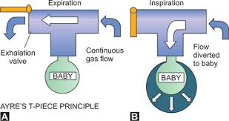
Assisted ventilation in neonates
Historically
  Modified Ayre’s t-piece
  Continuous flow in the circuit
  Baby can inhale at any time
Now
  Inhalation triggered by the child: usually by an inspiratory flow (with flowmeter)
      Possible alternative triggered by pressure reduction
  Duration of inhalation determined by us (VAC)
  Duration of inhalation determined by inspiratory flow (AI)
    Inspiration ends when inspiratory flow decreases to 25% of maximum flow (or other %)

Slide 30
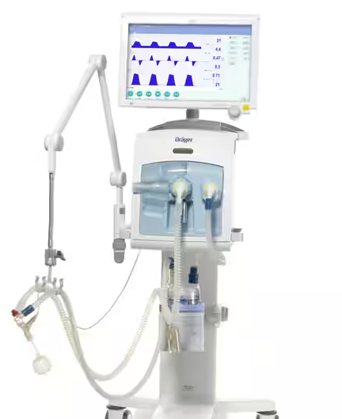

Slide 31
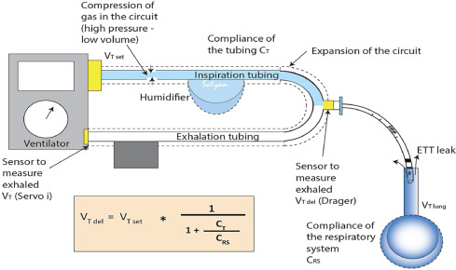

Slide 32
Synchronized ventilation
Even with VAC
Child may begin to exhale against the ventilator's inhalation
Especially when the Ti is too long
Increases risk of pneumothorax

Slide 33
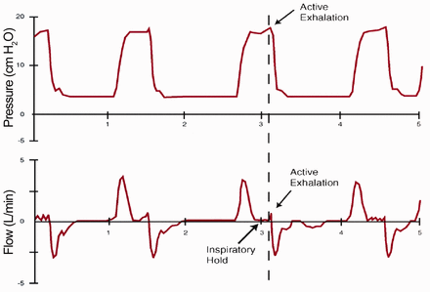
Active expiration against ventilator
Frequent if Ti >0.3 s
Infrequent if Ti<0.2

Slide 34
Pulmonary diseases of small volumes
Increase in MAP increases oxygenation
    Increases SpO2/FiO2 without impact on cardiac output
    Oxygenation = SpO2 x HgB x Cardiac output
  MMH
  Pneumonia
  ARDS
  Few cases of MAS
But NOT for Hypoplastic Lungs
  Increase in MAP decreases Cardiac output without direct impact on SpO2
Or for diseases with normal or increased volumes
  Some cases of MAS have more « air-trapping »

Slide 35
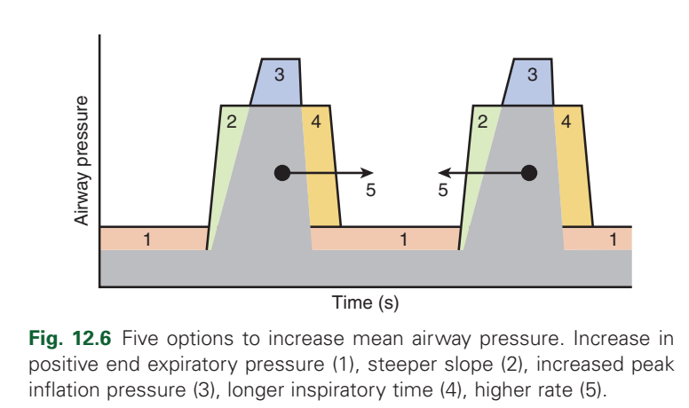
The impacts of increasing MAP on oxygenation depend on the option taken
For the same increase in MAP,
PEEP > pip >Ti

Slide 36
Expiration
Normally, exhalation is passive
Determined by:
Elastic recoil pressure
Expired exchange, based on compliance
Pulmonary resistance
Airway resistance (especially), and tissues
Healthy term NN, reduced compliance, normal resistance
NN preterm MMH, very low compliance, normal strength
Intubated NN MMH, very low compliance, increased resistance
NN DBP, low compliance, increased resistance

Slide 37
Expiration
Exhalation force is the elastic recoil pressure, = compliance
Resistance delays expiration
Expiration is logarithmic

Slide 38
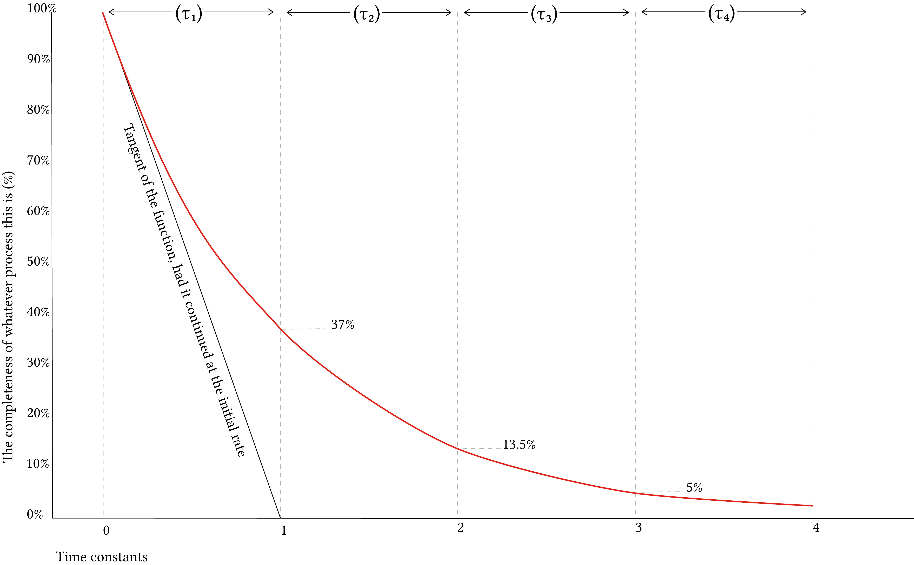

Slide 39
Time constant
τ RS = RxC
Typical compliance = 1.0 normal lungs: = 0.1 for HMD ( mL /cmH2O/kg)
Typical resistance = 100 -300 for ETT 2.5, 50 -150 for 3.0 (cmH2O/L/s)
Time constant = 0.1 - 0.3 s normal lungs,
0.01 -0.05 for HMD

Slide 40
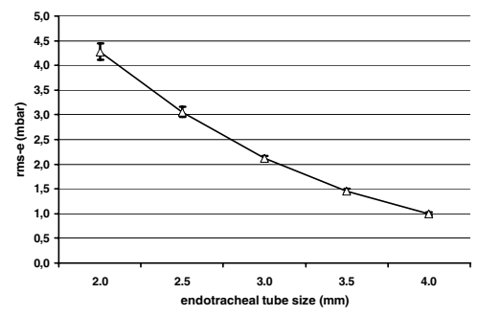
ETT resistance
Even if we're talking about physiology…

Slide 41
Te (assisted breathing)
Te must be > 3 times τRS
VAC, If child is tachypneic and Ti is too long, it is possible that Te would be <3τRS
Possibility of gas trapping, especially with normal compliance
Unlikely with HMD
  Reduced compliance - very low τRS
BPD, high resistance, longer τRS, prolonged expiration required.

Slide 42
Volumetric
When the baby does not breathe, the pressure and volume modes are identical
The ventilation mode has no impact on lung mechanics
If we switch from pressure to volume and the peak pressures rise, it's because the volumes have also increased.
Volume ventilation:
  safety factor (absent in barometric)
  if Vt > 130% of desired volume, valves open, Paw drops to PEEP,
    We set a Ptp limit

Slide 43
Volumetric?
No volume-controlled ventilation in neonates
Targeted volume ventilation
Same inhalation production mechanism
Pressure varies according to integrated algorithm, pip adjusted to reach desired volume
If baby does not breathe, it takes around 3 inhalations to get there
If sudden compliance change
3 inhalations for new Ppeak

Slide 44
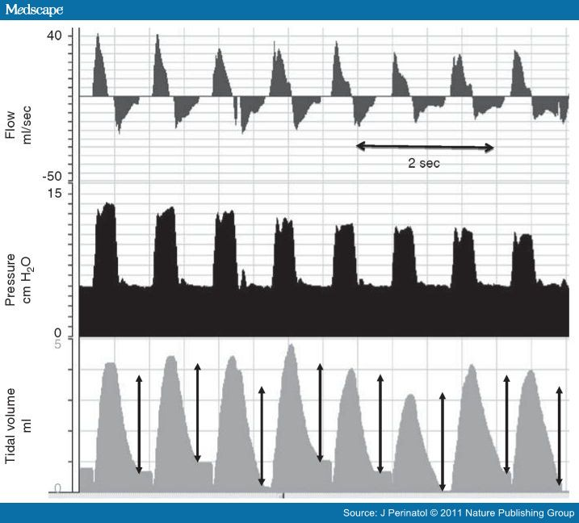

Slide 45
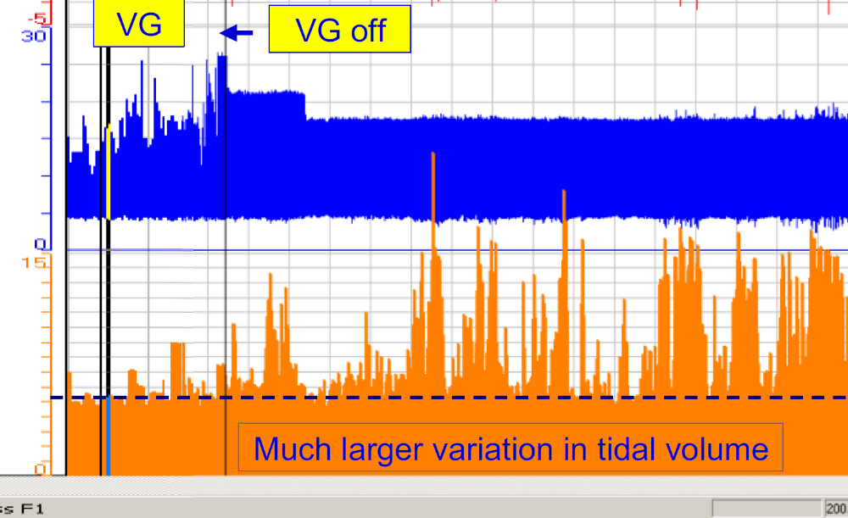
Several very large inspirations = very high Ptp
Several terminated inspirations = Vt>130% VG
Low and stable Ptp

Slide 46
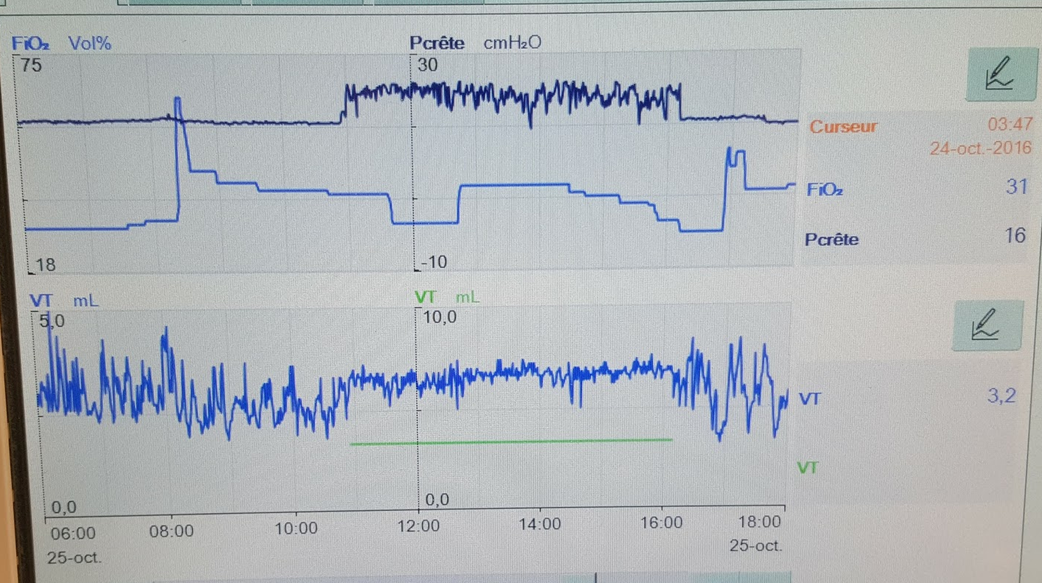
Volume ventilation
23
Ppeak rises up to 24
Vt much more variable in pressure mode, minute volume drops from 0.2 liters to 0.16
Ventilated 17/6,
Vt around 2.3 mL
Volume Guaranti started, Vt 3mL
Volume Guaranti closed

Slide 47
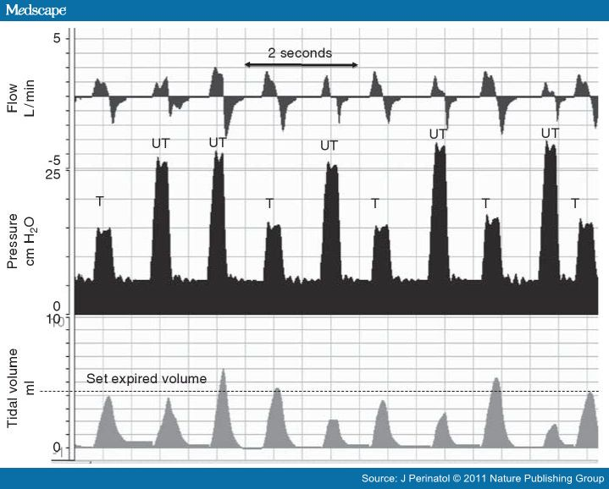
Two algorithms running continuously
One for triggered inhalation, the other for controlled inhalation (UT, untriggered)

Slide 48
Volume ventilation
When the baby breathes well
Sometimes the Ppeak drops and there is little « delta-P »
This happens because the child is receiving adequate volumes, so it is not necessarily a problem
There is only a problem if the baby still needs a higher average pressure for its VQ « matching », and the FiO2 rises
If the FiO2 rises, the most logical response is to increase the PEEP
Rather than changing to barometric
If the FiO2 does not rise… extubate

Slide 49
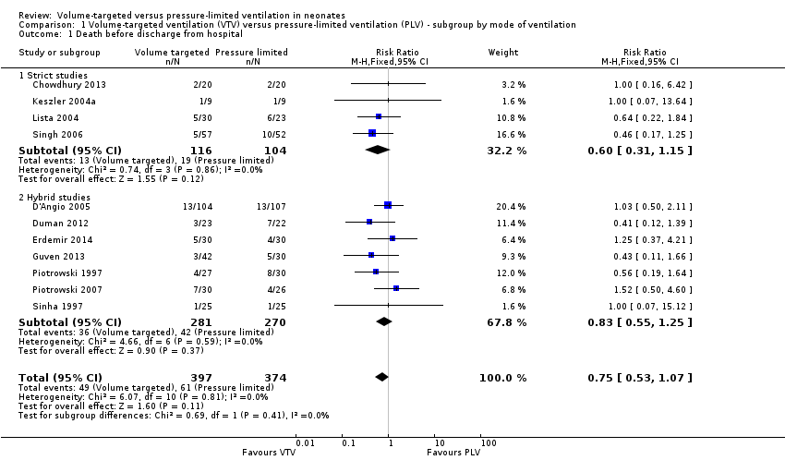

Slide 50
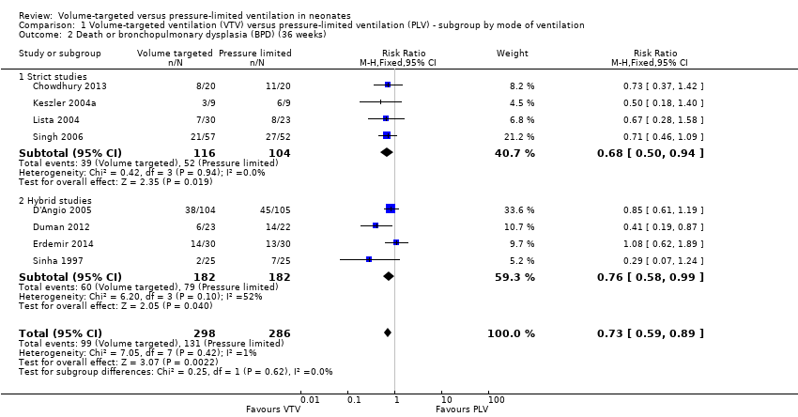

Slide 52
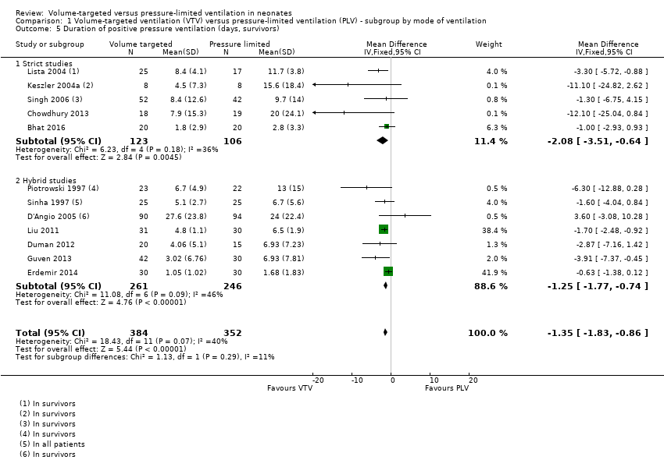

Slide 53
Preventing Atelectasis
Requires adequate PEEP
  varies by patient, depending on static compliance
Adequate tidal volume
  Less variable but pressures required very variable
What is the right tidal volume?
  Probably between 3 and 6 mL/kg
  Normal physiologic Vt lies between 3 and 8 mL/kg

Slide 54
Ventilator Parameters
Volume ventilation mode (VGV or volume control)
4 to 5 mL/kg (or 4 mL/kg plus 0.5 mL for the ETT)
If in more than 21% O2: PEEP of 5 to 8 before surfactant, increase PEEP to keep FiO2 less than 60%
Surfactant as early as possible
After surfactant reduce PEEP to 4 if in 21% O2, if remains in 21% reduce to 3, if remains in 21%, WEAN.

Slide 55
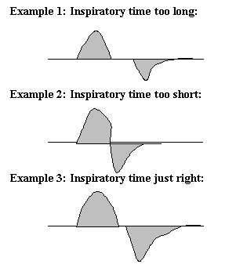
A potential useful application of ventilator graphics

Slide 56
Ventilator paramteres
What are you going to wean, and what are you going to monitor?
If on an SIMV mode, wean rate, but if your ventilator gives PSV then you are switching to pressure ventilation….
If on an A/C mode watch pressures and spontaneous rate, reduce the back up rate progressively (maybe) and extubate when the pip is below a certain thershold.
What to do about CO2?

Slide 57
Permissive hypercapnia
Increasing ventilation to normalize a CO2 risks increasing lung injury for questionable benefit
Permissive hypercapnia does not mean forcing the CO2 to increase!!
It means not chasing the CO2 if the tidal volume is OK, the FiO2 is OK and the baby is clinically OK
It means being prepared to wean the vent if all those factors are OK, even in the face of elevated CO2
But is there a limit?

Slide 58
Early extubation
Removing the tube as fast as appropriate
Or not intubating if you can avoid it
Self-evident that never being ventilated is better than being ventilated (BPD does occur in never intubated babies, but only mild forms)
But if you need surfactant: the sooner the better, even an hour of delay makes a difference
The challenge to identify quickly infants who will need surfactant

Slide 59
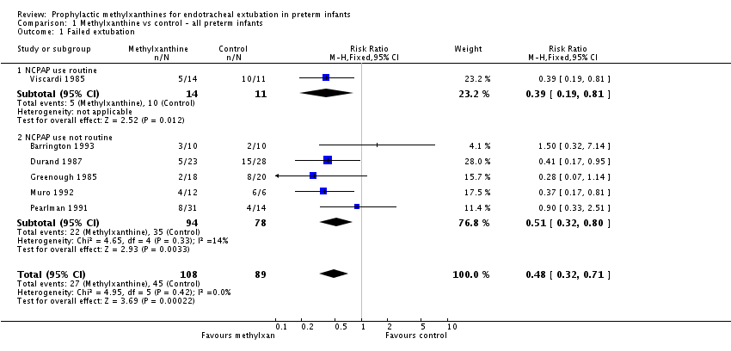
Improving the success of early extubation
Caffeine

Slide 60
3 questions
When we give surfactant, what happens to lung compliance?
If we decrease the PEEP and Pl by 2 each, what happens to the tidal volume?
If we put a child on volume ventilation, and we give surfactant, will there be an « automatic » weaning?

Slide 61
Effects of Surfactant on dynamic compliance
 | Surfactant |  | Control
 | Before | After | Before | After
Compliance (ml/cm H20/kg) | 0.43 _+ 0.21 | 0.45 _+ 0.45 | 0.33 _+ 0.14 | 0.33 ___ 0.13
Resistance (cm H20/L/sec) | 141 _+ 90 | 175 _+ 97 | 160 _+ 90 | 173 + 98
Tidal volume (ml/kg) | 6.3 _+ 1.7 | 5.3 _+ 1.5 | 6.9 _+ 2.1 | 6.0 + 1.9
Table II. Combined pulmonary mechanics data
Values are expressed as mean _+ SD.
Immediately before and 1 hour after
Couser, R., T. Ferrara, et al. (1990). "Effects of exogenous surfactant therapy on dynamic compliance during mechanical breathing in preterm infants with hyaline membrane disease." The Journal of Pediatrics 116(1): 119-124.

Slide 62
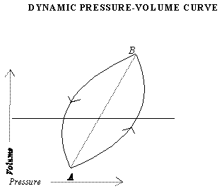
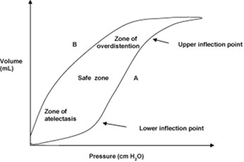
STATIC PRESSURE-VOLUME CURVE

Slide 63
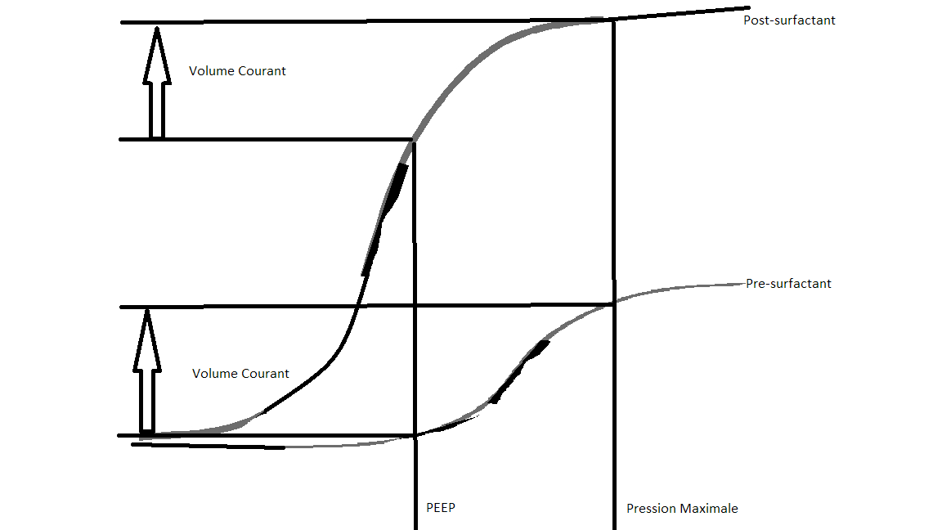
Effects of surfactant

Slide 64
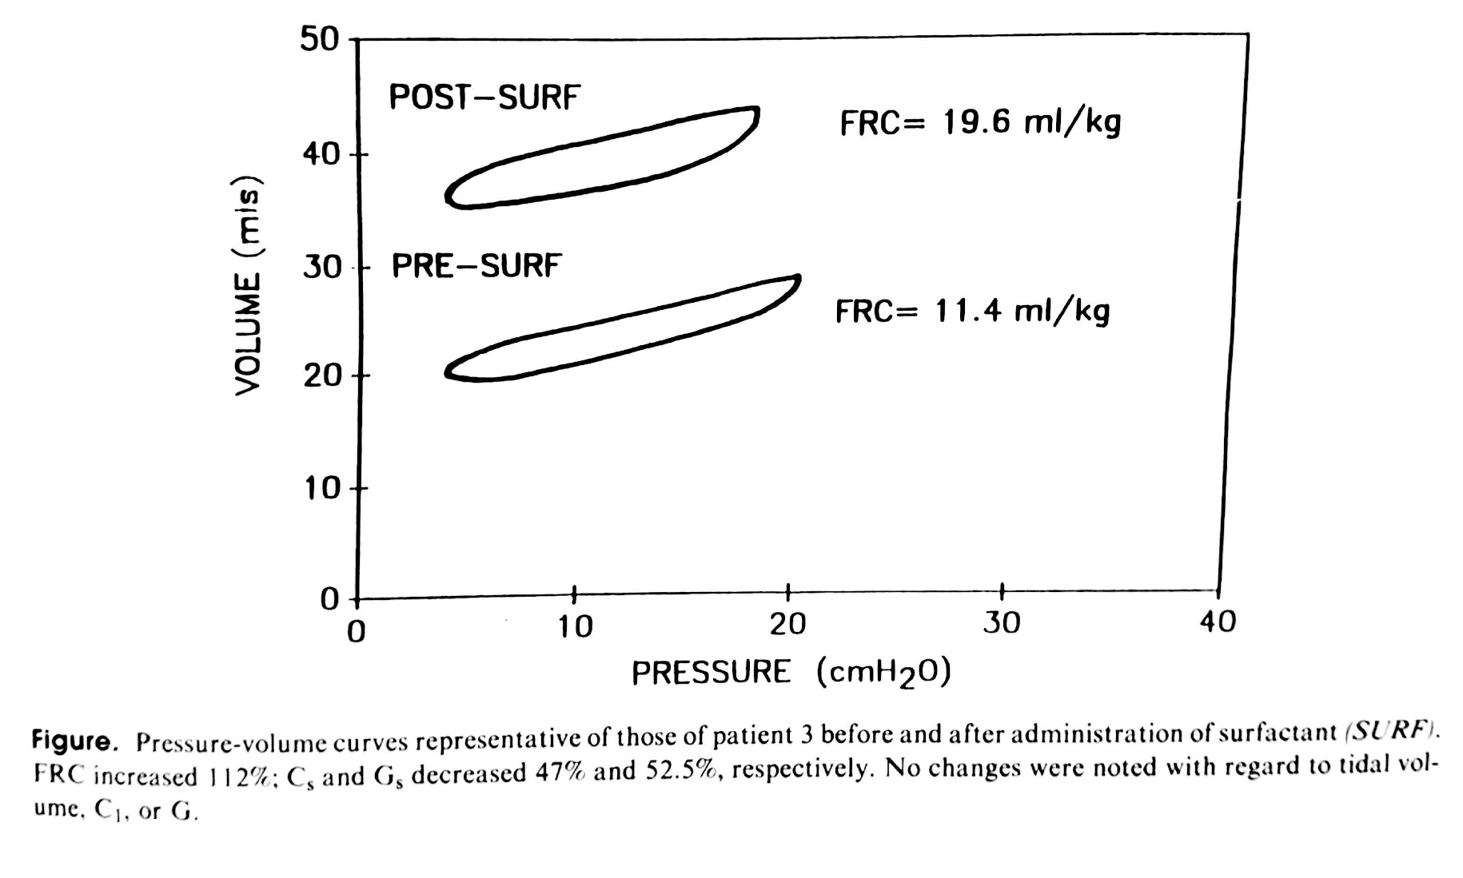
Goldsmith LS et al. Immediate Improvement in Lung Volume After Exogenous Surfactant: Alveolar Recruitment Versus Increased Distention. The Journal of pediatrics. 1991;119:424.

Slide 65
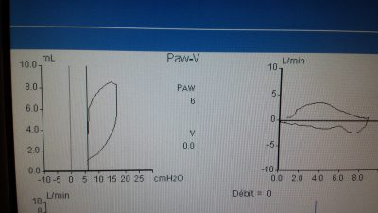

Slide 66
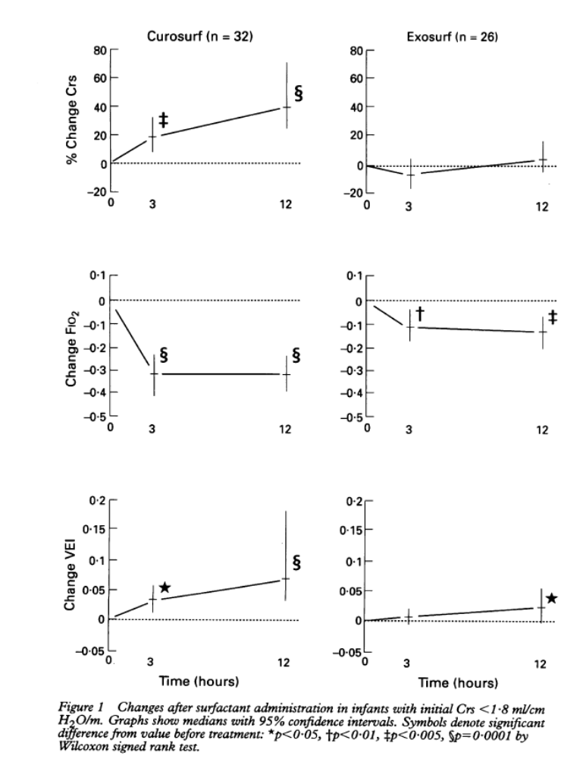
Static Compliance
Stenson, B. J., R. M. Glover, et al. (1994). "Static respiratory compliance in the newborn. III: Early changes after exogenous surfactant treatment." Arch Dis Child Fetal Neonatal Ed 70(1): F19-24.

Slide 67
3 questions
When you give surfactant, what happens to pulmonary compliance?
If we decrease the PEEP and the PIP by 2 each, what happens to the tidal volume?
If we put a child on volume ventilation, and we give surfactant, will there be an "automatic" weaning?

Slide 68
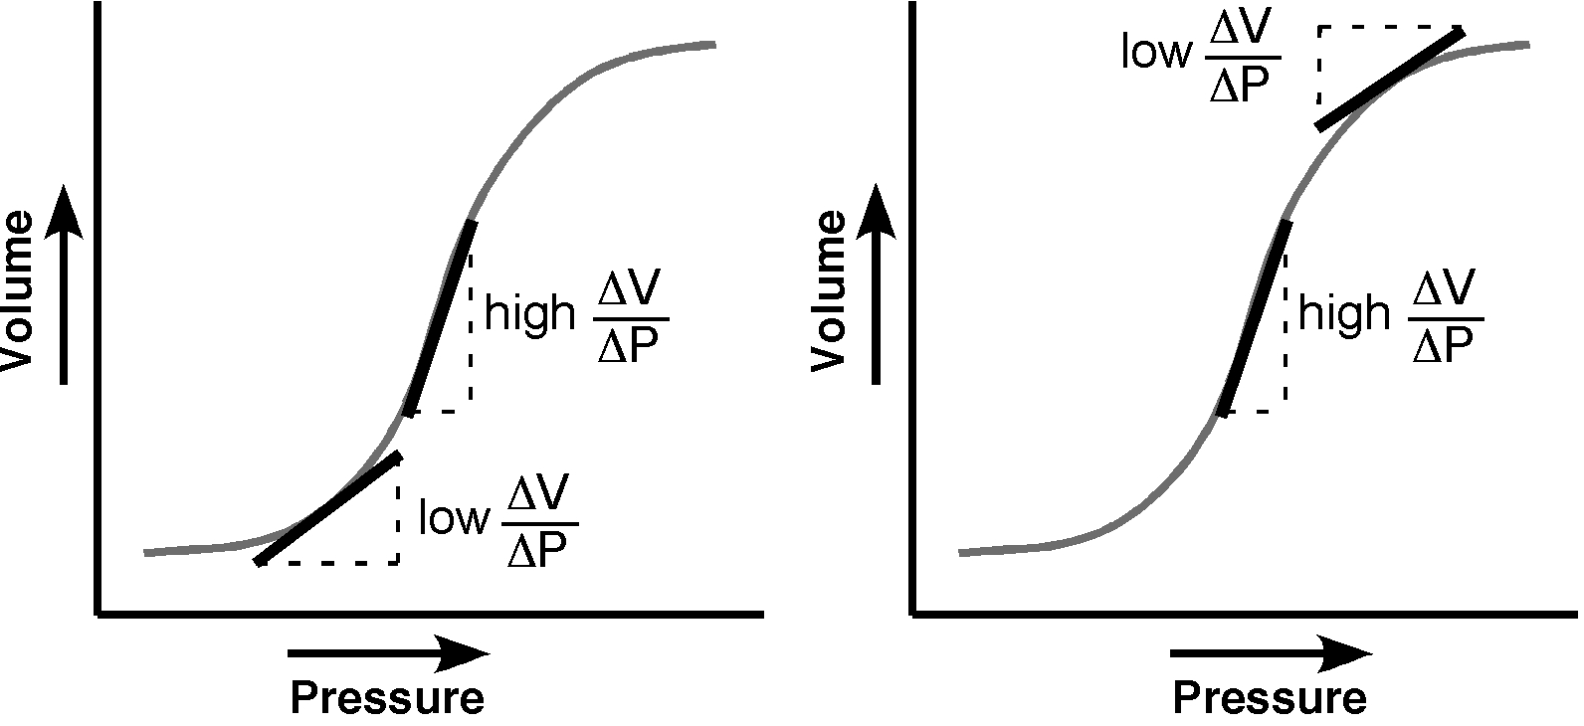

Slide 69
3 questions
When you give surfactant, what happens to pulmonary compliance?
If we decrease the PEEP and the PIP by 2 each, what happens to the tidal volume?
If we put a child on volume ventilation, and we give surfactant, will there be an "automatic" weaning?

Slide 70
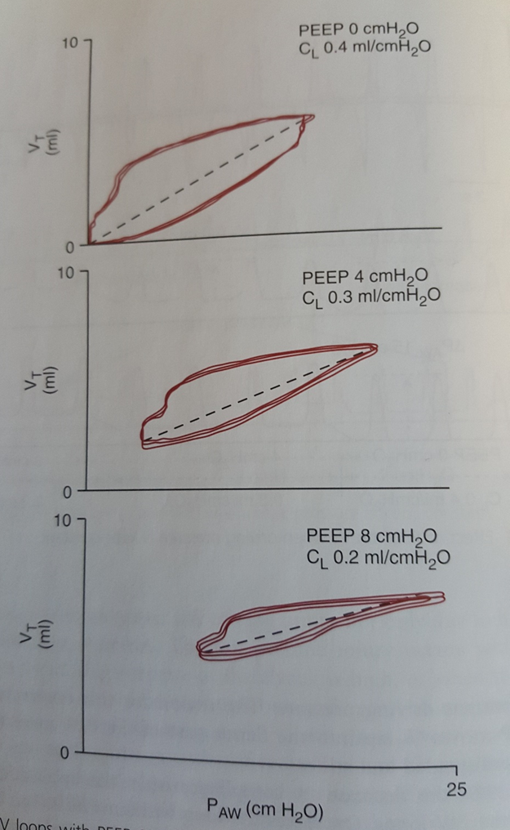
Volume ventilation and surfactant
If the PEEP is not reduced, there will not necessarily be a reduction in Peak pressure.
On the other hand, a reduction of PEEP by 1 cmH2O often leads to a much larger reduction in Peak pressures.
If we ventilate by pressure, a reduction of PEEP and PIP by 4, can greatly increase volumes

Slide 71
We cannot use the graphs to determine if the PEEP is optimal or if the baby is ready for weaning
Look at the FiO2
When the FiO2 drops, reduce the PEEP. We will see that the Peak pressure drops (volumetric) or the volume increases (barometric)
If at 21% after surfactant, PEEP can be reduced to 3 cmH2O,
    Dimitriou, G., A. Greenough, et al. (1999). "Appropriate positive end expiratory pressure level in surfactant-treated preterm infants." Eur J Pediatr 158: 888-891.
    at 4 and 5 cmH2O they were over-distended.
Or at 2 cmH2O,
    Sandberg K et al, 2007. Pediatr Res
    overdistension even at 4 cmH2O

Slide 72
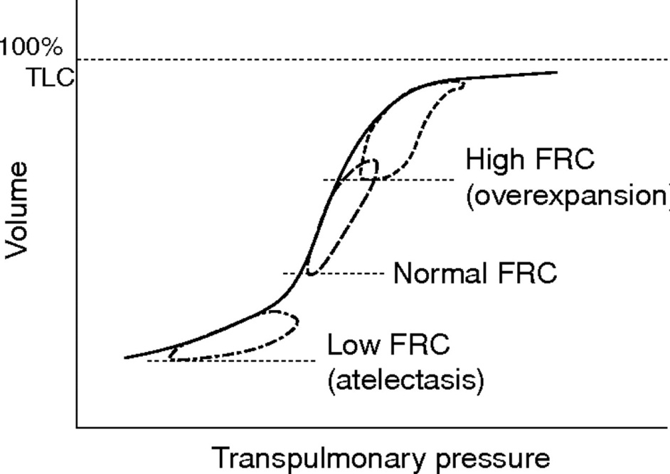
Prevention of over-distension
  Prevent excessive expiratory volumes
  Prevent excessive tidal volumes

Slide 73
Lung damage
Over-distension more important than too much pressure
Tracheal pressures little impact if over-distension is avoided
  Several animal studies demonstrate that reduced mobility of the rib cages eliminates the effects of very high pressure.
  If the tidal volumes remain normal, no barotrauma
How can we know if there is over-distension?

Slide 74
Reduction of over-distension
Graphs on the ventilator?
No data that they are useful for limiting lung damage
Why not?
  Leaks
  Dynamic not Static
  Change with each breath

Slide 75
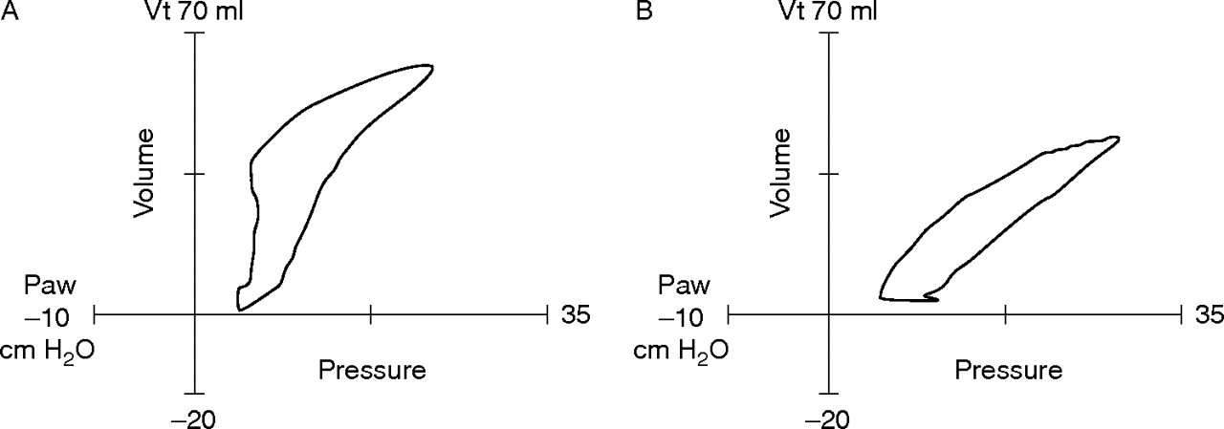

Pressure-volume loops.
Donn S M , Sinha S K Arch Dis Child Fetal Neonatal Ed 2006;91:F226-F230
Pressure-volume loops. (A) The loop shows hyperinflation, with an upper inflection point on the inspiratory limb. (B) The loop has been normalised by reducing the peak inspiratory pressure. Vt, Tidal volume; Paw, peak airways pressure.
Notes:
Pressure-volume loops. (A) The loop shows hyperinflation, with an upper inflection point on the inspiratory limb. (B) The loop has been normalised by reducing the peak inspiratory pressure. Vt, Tidal volume; Paw, peak airways pressure.

Slide 76
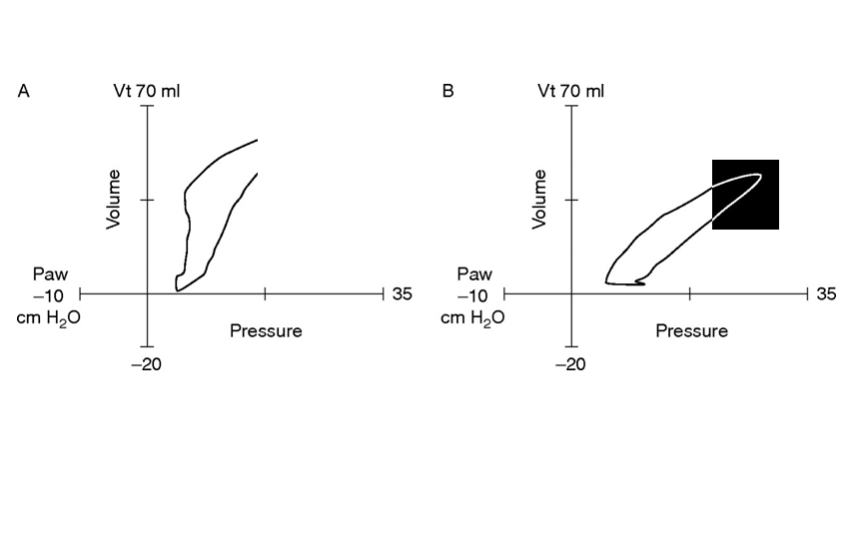

Slide 77
Overdistension
Due to leaks and volume variability, the ventilation graphs return to zero at the end of expiration.
It is impossible to know the pulmonary volume at the end of expiration, or even if there has been a change,
  methods exist; but research

Slide 78
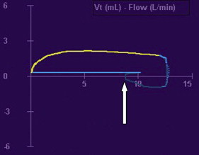
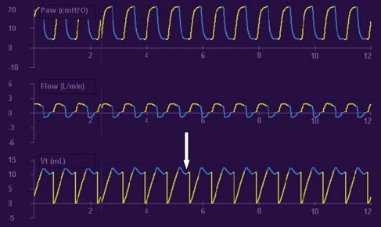

Slide 79
Animal models
Prevention of over-distension avoids pulmonary damage
If there is restriction of the rib cage, tracheal pressure rises during inhalation (PPV), intrapleural pressure also rises, less transpulmonary pressure
Physiological situation: correlation between administered pressure and tidal volume for apneic patient

Slide 80
To avoid pulmonary damage
Reduction of overdistension
  Optimal PEEP
  Optimal tidal volume
Prevention of atelectasis
Intubation only when necessary
Give surfactant immediately when required
Prevention of infections

Slide 81
Conventional ventilation
Parameters
Optimal PEEP?
  Difficult to determine in the newborn
  Low FiO2 21-23% = try to decrease the PEEP
  Oxygenation improved with higher PEEP only if recruitable disease
  Risks
      Decreased venous return
      Increased shunt
      Increased lung damage
      Decreased oxygenation
      Decreased cardiac function
        When in doubt – Lung X-ray helps a little

Slide 82
Conventional ventilation
parameters
Volume:
  Target 4-6 ml/kg
  Contribution of dead space
      The smaller the baby, the more volume it needs
      Some centers use 4 mL/kg plus 0.5 mL for the EM

Slide 83
Conventional ventilation
parameters
Barometric/Pressure (Delta-P):
  To be used ONLY in the presence of >40% leaks
  Delta-Pressure required to have a satisfactory gas – the volume is no longer reliable due to the leaks

Slide 84
Conventional ventilation
parameters
Frequency/Ti:
  Start at 50/min.
  Ti: At the discretion of the resp. therapist, re-evaluate at each shift to promote recruitment without causing air tapping.
  Ensure Ti<0.3s if baby is breathing

Slide 85
Conventional ventilation
parameters
Ai:
  Pressure ventilation mode
    Variable Ti depending on inspiratory flow
    Inhalation ends when inspi flow <25% of max
  To be used only in conscious term infants without risk of pulmonary disease (Cooling, Tachypneic Pt)
  May allow more comfort

Slide 86
Conventional ventilation
Approach to severe BPD
PEEP: Consider the possibility of malacia
Volume: Often requires larger volumes (may exceed 6 mL/kg)
Frequency: Low (30-40/min.)
Ti: longer (be careful of inverted ratio)
Requires a long Te
Notes:
Quels sont les signes de malacie?
Début de vie:
Système respiratoire relativement uniforme
Short time constant
Fréquence plus haute avec Ti courts
Petits volumes
DBP sévère établie
Système respiratoire hétérogène
Résistances différentes
Faible fréquence (le plus bas possible si le bébé ne veut pas être tachypnéique), Ti longs
Grand volumes
Croissance!!!!!! – peuvent nécessiter jusqu’à >130 kcal/kg/jour, par contre on vise une bonne croissance staturo-pondérale, le poids n’est pas un bon indicateur seul! – PROTÉINES!!! – apports liquidiens plus bas, avec de bonnes calories

Slide 87
Situation:
I'm calling you because baby X no longer has Delta-P, “it should be put on pressure”
Notes:
Quelle est votre réponse?
Qu’est-ce qui DOIT être évalué?
Examen physique – est-ce que le bébé a beaucoup de détresse respiratoire?
Besoins en O2 – pareils ou augmentés
TRS +/- extubation – est-ce que le bébé est extubable?
Volumes générés – est-ce que le bébé génère des volumes + grands que ceux réglés? Si oui, c’est le volume qu’il faut augmenter
Gaz – est-ce que le dernier gaz était bien, de quand date le dernier gaz?
Décision doit être rapide, tendances, évaluation au chevet

Slide 88
High frequency ventilation
Notes:
VN500 ou SM3100

Slide 89
Basic terms
Volume
Amplitude
A
Time
I : E

Slide 90
High frequency ventilation
Indication:
  Persistent respiratory acidosis (<7.2 with pCO2>60)
      With frequency >60-70
      Volume 6 ml/kg with PL >25 or PIP >25
      Adequate PEEP
  FiO2>60 after surfactant
  Any newborn <25 weeks

Slide 91
High frequency ventilation
Parameters
Volume:
Same principles as in CMV
Starting volume = 2 mL/kg
      May require a larger volume
      Adjust according to PCO2
Notes:
DOVE trial
Même raisonnement qu’en conventionnel, il est normal que les bébés les plus petits aient besoin d’un volume plus grand vu l’espace mort

Slide 92
High frequency ventilation
Parameters
Average pressure:
Consideration
      Change for PCO2 vs FiO2
        Any MAP increase of ≥2 requires an RXP
        OR
        Any increase in MAP that does not lead to improvement
Notes:
Si changement pour FiO2 : MAP = MAP en conventionnel +2
Si changement pour PCO2 : MAP = MAP en conventionnel
Toute augmentation de MAP nécessite un RXP

Slide 93
High frequency ventilation
Parameters
Hz:
10 Hz:
      Do not change the Hz, the VN500 is not powerful enough to be effective with Hz >10
I:E:
Should be 1:2 (33%)
      Limits air-trapping
Notes:
Études d’australie : Tingay : perte de puissance sur la méthode de créer la VHF, Piston versus valves + tubulure rigide

Slide 94
Situation:
I'm calling because BB S continues to deteriorate in HFF on the VN500

Slide 95
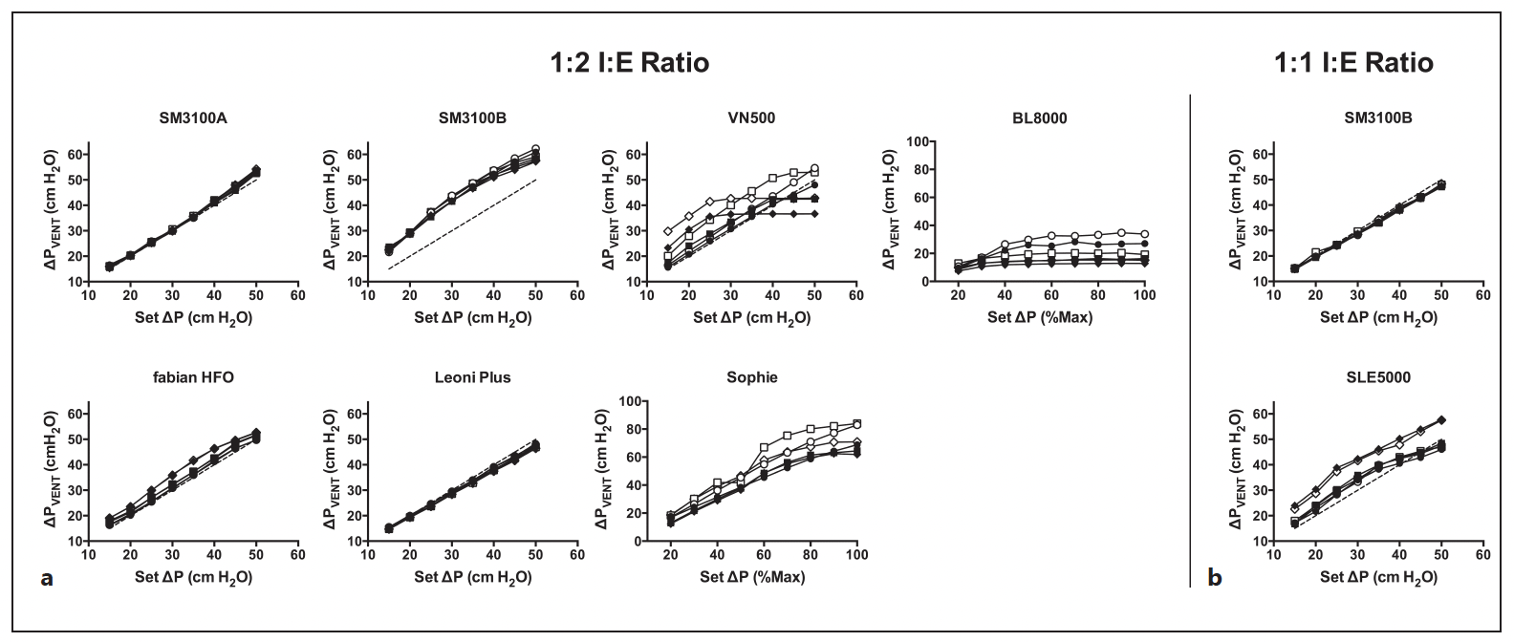
VN500
Tingay, D. G. et al. Are All Oscillators Created Equal? In vitro Performance Characteristics of Eight High-Frequency Oscillatory Ventilators. Neonatology 108, 220–228 (2015).
Notes:
Amplitude vs amplitude mesurée
Symboles ouverts tube 2.5
Symboles fermés tube 3.5
5 hz cercles
10 Hz carrés
15 Hz Losanges

Slide 96
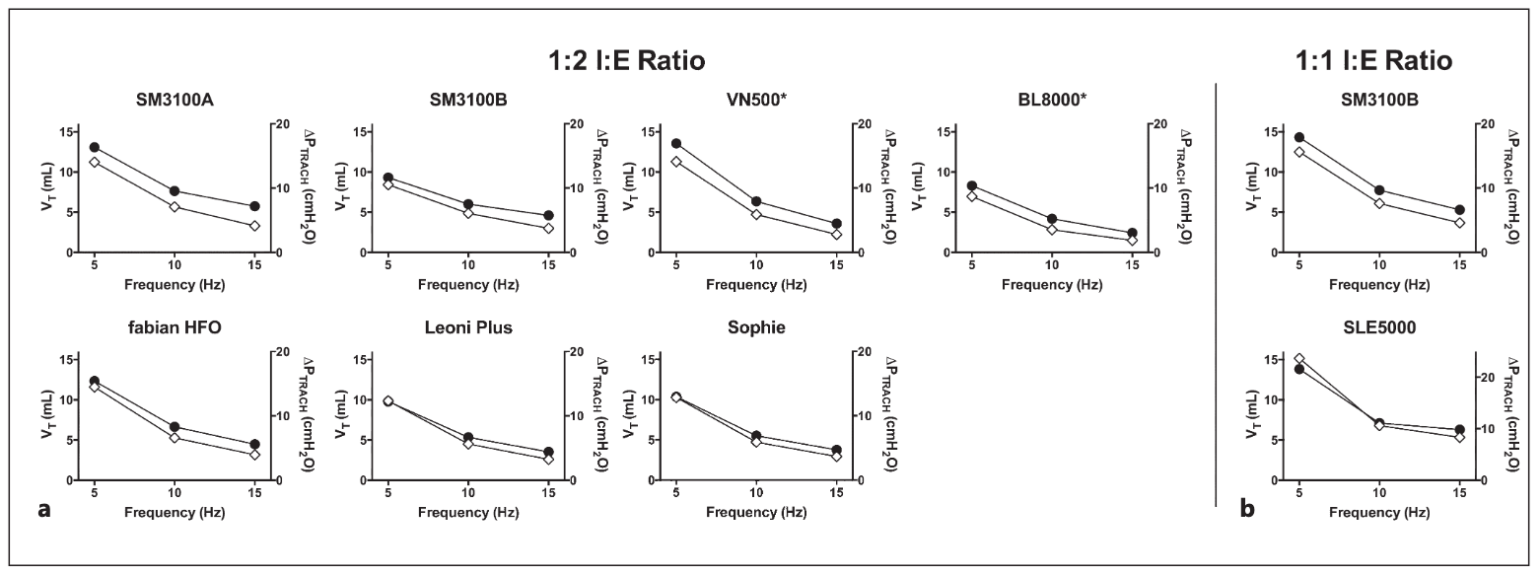
VN500
Tingay, D. G. et al. Are All Oscillators Created Equal? In vitro Performance Characteristics of Eight High-Frequency Oscillatory Ventilators. Neonatology 108, 220–228 (2015).
Notes:
Relationship between frequency and ΔPTRACH (black circles) and VT at the airway opening (open diamonds) at a maximum ΔPVENT or ΔPVENT closest to 50 cm H2O (Sophie and BL8000), CL of 1.0 ml/cm H2O, PAW of 10 cm H2O and a 2.5-mm ETT. Data at a 1:2 I:E ratio (a) and 1:1 I:E ratio (b).
* Unable to generate ΔPVENT >45 cm H2O at 15 Hz (VN500) or all frequencies (BL8000).

Slide 97
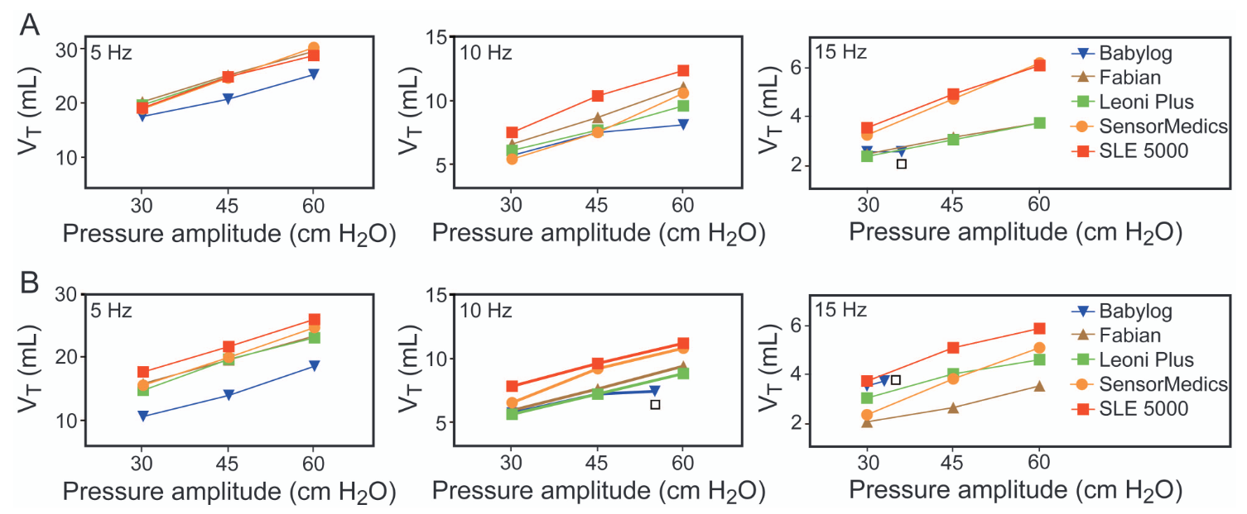
Vn500
Grazioli, S., Karam, O. & Rimensberger, P. C. New Generation Neonatal High Frequency Ventilators: Effect of Oscillatory Frequency and Working Principles on Performance. Respir Care 60, 363–370 (2015).
Notes:
A: modèle enfant à terme
B: Modèle enfant prématuré
M15 et I:E 1:1
Max à 10hz = 55
Max à 15hz = 33

Slide 98
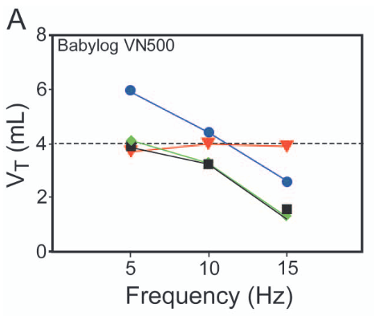
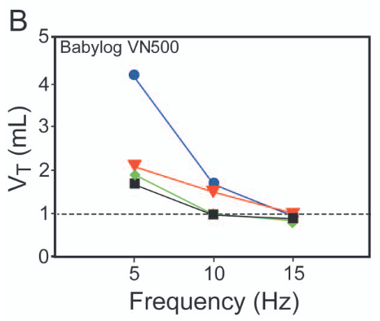
vn500
Grazioli, S., Karam, O. & Rimensberger, P. C. New Generation Neonatal High Frequency Ventilators: Effect of Oscillatory Frequency and Working Principles on Performance. Respir Care 60, 363–370 (2015).
Notes:
A: Full term infant setting for the test – Cible 4 mL
B: preterm infant settings for the test – Cible 1 mL
Mean à 15
I:E 1:1
Amplitude Max non limitée
Bleu : Modèle normal
Triangle orange: Modèle restrictif
Losanges verts: Modèle obstructif
Carrés noirs: modèle mixte

Slide 99
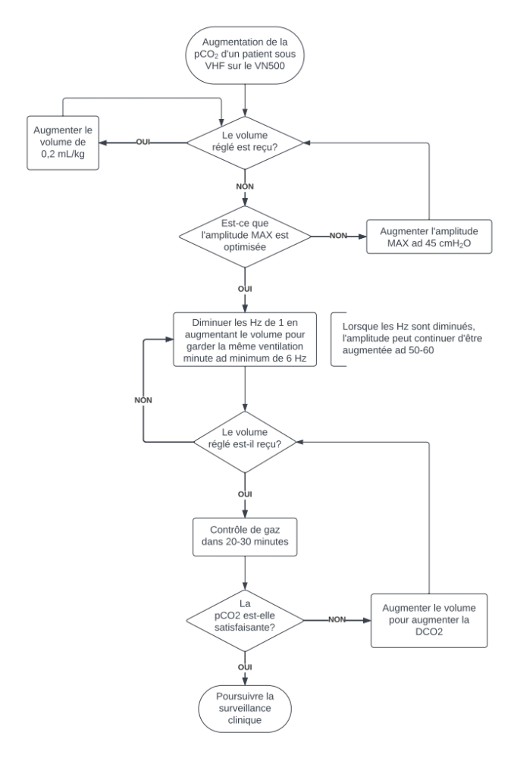
Optimization of HFF on the VN500

Slide 100
Situation:
I changed BB S to amplitude because it wasn't working in volume

Slide 101
What questions to ask?

Slide 102
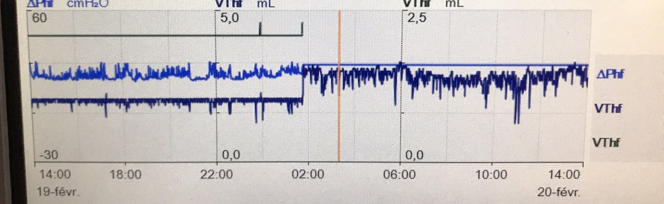
Amplitude vs Volume
Amplitude
VG
Notes:
Pourquoi ça a « fonctionné » en amplitude?

Slide 103
extubation

Slide 104
Spontaneous breathing test
Who: Patients <1250g
What: CPAP ET x 3 minutes
Failure if:
      Bradycardia
      Desaturation <85% despite 15% increase in FiO2
      Increase of >15% FiO2
Apnea ≠ Failure

Slide 105
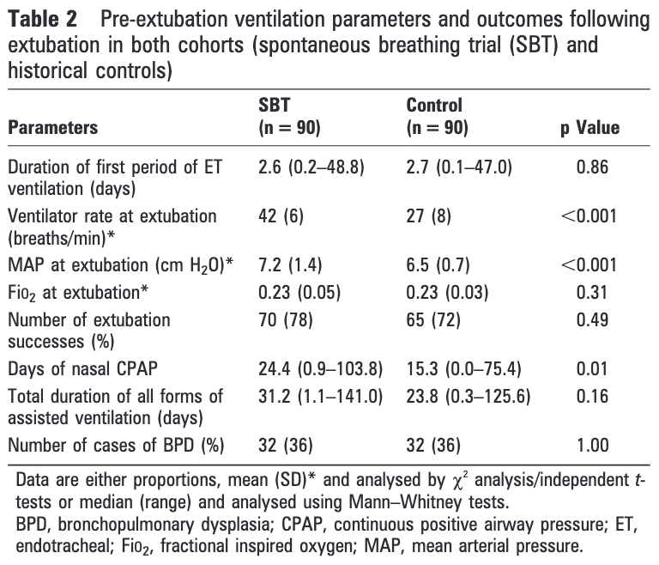
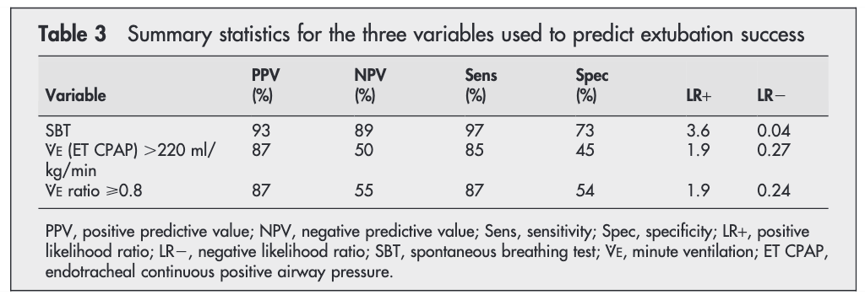
Spontaneous breathing test
Kamlin, C. O. F., Davis, P. G., Argus, B., Mills, B. & Morley, C. J. A trial of spontaneous breathing to determine the readiness for extubation in very low birth weight infants: a prospective evaluation. Arch. Dis. Child. - Fetal Neonatal Ed. 93, F305 (2008).
Kamlin, C. O. F., Davis, P. G. & Morley, C. J. Predicting successful extubation of very low birthweight infants. Archives of Disease in Childhood - Fetal and Neonatal Edition 91, F180-3 (2006).
Notes:
Comparaison entre
VM
TRS
Ration VM
TRS:
Extubation + précoce
Souvent à des paramètres plus élevés

Slide 106
Spontaneous breathing test
Comment:
    CPAP ET (VS-PEP) without Ai and without apnea ventilation
    If HFF:
      MAP > 12 : PEEP +8
      MAP ≤ 12 : PEEP + 6-7

Slide 107
Invasive ventilation
D: Displaced
O: Obstructed
P: Pneumothorax
E: Equipment

Slide 108
QUESTIONS?

