Slide 1



INTRODUCTION TO NEONATAL MECHANICAL VENTILATION
CHU Ste-Justine
CHU Ste-Justine

Slide 2
Adapted objectives
4
Terminology drowned in synonyms
Learning according to the parameters:
  FiO2, PEEP, PIP, ΔP, Frequency and Inspiratory assistance
Physiology and basic principles
  Neonatal ventilation
No pathology or prolonged ventilation

Slide 3
Plan
5
Physiology
Non-invasive ventilation
Conventional ventilation
High-frequency oscillatory ventilation
Weaning from ventilation (for RDS)

Slide 4
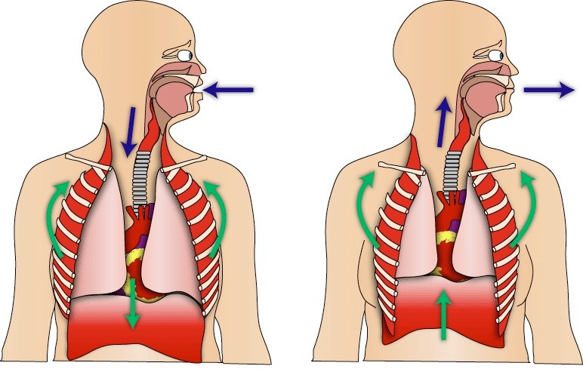
Respiratory physiology
6
Respiratory center
Responds to CO2 > pH > O2

Slide 5
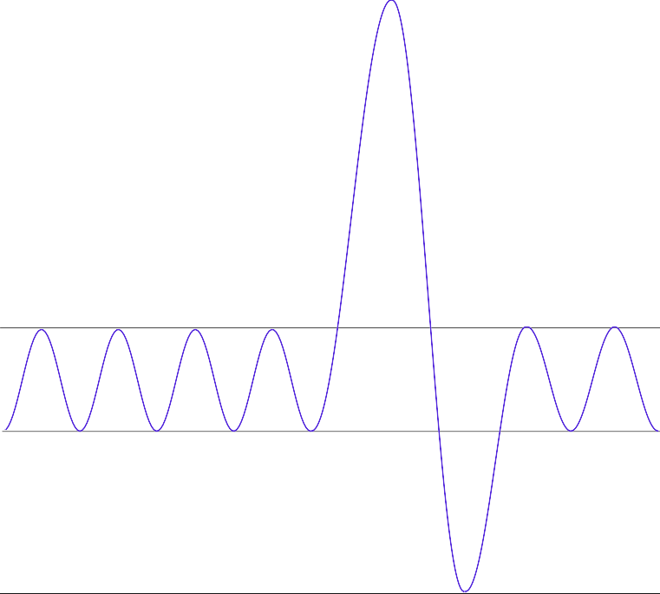
Respiratory physiology – spiro
7
80
Volume (mL/Kg)
37
Tidal volume
30
15
Functional residual capacity
0

Slide 6
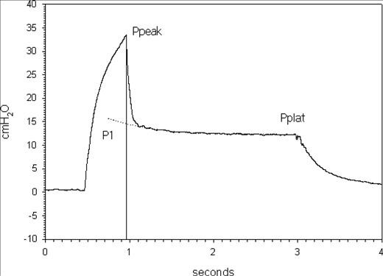
Respiratory physiology
8
Pulmonary compliance
^{Δvolume with Δpressure}
Static (Pplateau)
Δς =
ΔΠ
VT
Dynamic (P )
peak
^{P[ plat|crête]  PEP}

Slide 7
Types of ventilation
9
Non-invasive ventilation (mask, nasal prongs, nasal CPAP)
  1 or 2 pressure levels
  High-flow nasal cannula (HFNC)
Invasive ventilation (ETT, tracheostomy)
  Conventional: barometric / volumetric
  Non conventional
    High-frequency oscillation
    Others: Hayek, ECMO, etc.

Slide 8
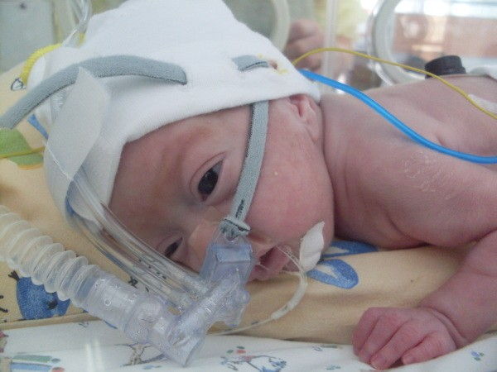
Non-invasive ventilation
10
http://perlbal.hi-pi.com/blog-images/216823/gd/1220960127.jpg

Slide 9
NIV – CPAP
11
Guarantee a minimum pressure in the pulmonary tree
Alveolar recruitment
Increases functional residual capacity
  Promotes gas exchange (O2 > CO2)
1.
Shaffer, T.H., et al., Neonatal non-invasive respiratory support: physiological implications. Pediatr Pulmonol, 2012. 47(9): p. 837-47

Slide 10
NIV – CPAP
12
↓ pulmonary edema
Support for the work of the left ventricle
Neonatal specificities1:
  Thoracic stability
  Stimulation of surfactant synthesis
1. Shaffer, T.H., et al., Neonatal non-invasive respiratory support: physiological implications. Pediatr Pulmonol, 2012. 47(9): p. 837-47

Slide 11


Impact on cardiac work (LV)
13
Spontaneous
Mechanical
80
80
95
60
-15
+15
1.
Lacroix, J., et al., Urgences et soins intensifs pédiatriques. 2nd ed. 2007: Masson. 1368 p.

Slide 12
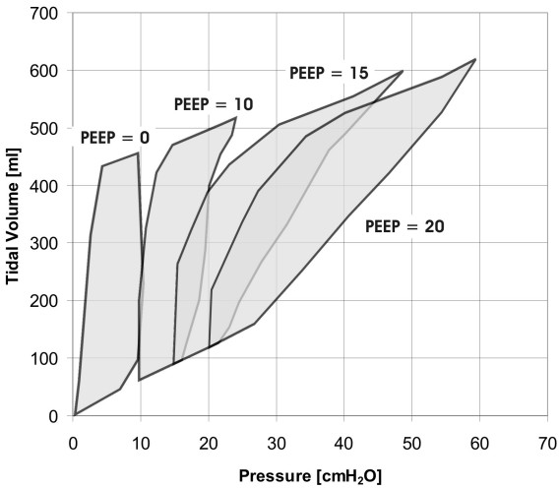
NIV – PEEP and compliance [adult]
14
Adult values

Slide 13
HHHFNC (High-flow nasal cannula)
16
Variable, humidified and heated FiO2
Constant flow, but variable PEEP
  ≈ 6 cmH2O with « massive intra- and interpatient variability » 1
  Max 6±1 cmH2O with 8 L/min2
Possible washing of the nasopharyngeal dead space
Risks low

Slide 14
NIV – nIPPV
17
Biphasic ventilation (Bi-level positive airway pressure)
  1 PEEP level + 1 inspiratory assist level
  ± frequency
Problematic synchronization
  Facial mask seal required or NAVA
Valves (inspiratory and expiratory) open
BiPAP™ ≠ BIPAP ≠ BIPAPEvita™

Slide 15
NIV – nIPPV
18
PC
BPAP
P
cmH2O
time
1
2
3
4
5
6

Slide 16
NIV – BPAP
19
Benefits
  Benefits of CPAP + ↓ respiratory work
  Preventative of intubation1
  Preventative of neonatal re-intubation2 (vs CPAP)
Risks
  Barotrauma
  Inappropriate use (age, state of consciousness, etc.)

Slide 17

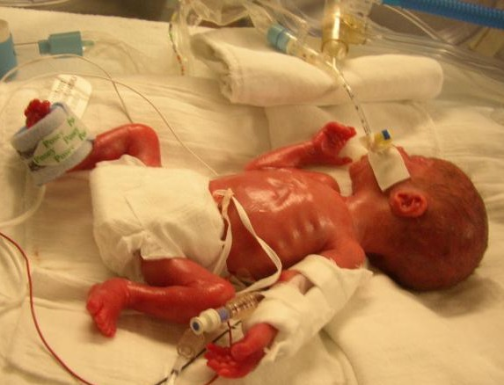

Conventional ventilation
20
Not normal
http://kadiera.quicksilverdragon.com/gallery2/d/140-2/p6130500.jpg

Slide 18
Conventional ventilation
21
FiO2 and PEEP
PIP (=Pinspiration =Plimit, =Pmax, =Ppeak)
Tidal volume
Minimum respiratory rate
Type of assistance (“breathing surplus”)
  With inspiratory assistance [sIMV-Ai] or without [sIMV]
Inspiratory time (or I:E ratio)
Alarms and flow thresholds

Slide 19
Barometric ventilation
22
Volume
Pressure oriented
Time
Pressure
Time
Flow-phase
Pause- phase
Flow-phase
Pause- phase
Inspiration
Expiration

Slide 20
Conventional ventilation
23
Volume
Pressure oriented
Time
Time
Flow
Flow
Time
Time
Pressure
Pressure
Time
Time
Pause-
Flow-phase phase Flow-phase
Inspiration Expiration
Pause- phase
Pause-
Flow-phase phase
Inspiration
Expiration

Slide 21
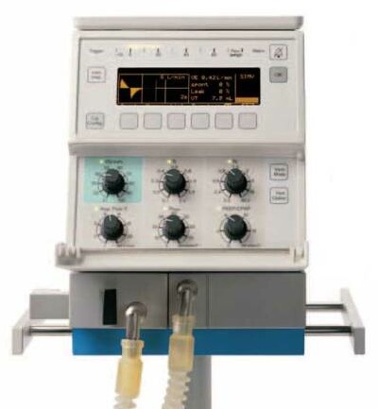
Ventilation – lexicon
25
ACV:
Assisted controlled ventilation
Each breath is supported identically Usable in barometric or volumetric mode
sIMV-PSV: Intermittent VAC
Additional breaths with PSV
"Guaranteed” volume
VG:
(= VCRP,
=PRVC)
Inspiratory pressure adjusted according to a target volume Barometric mode, even if a volume is set

Slide 22
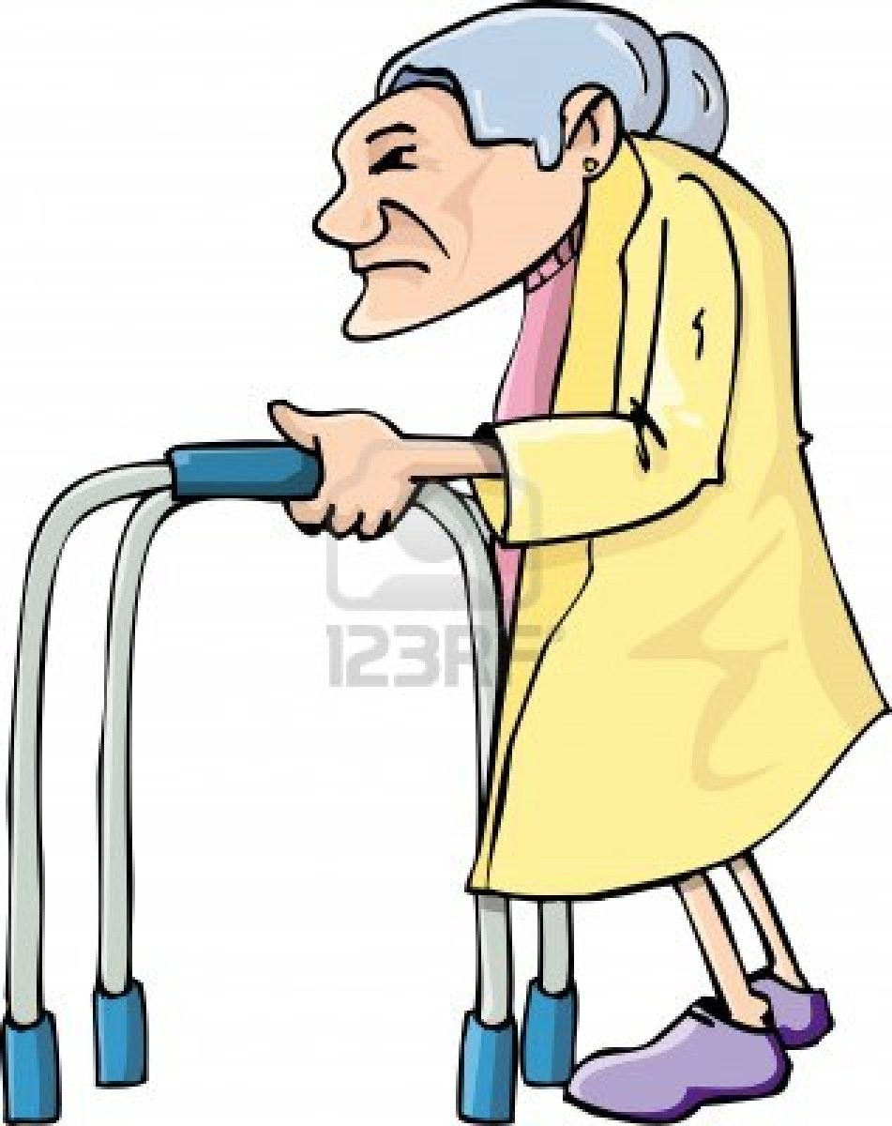
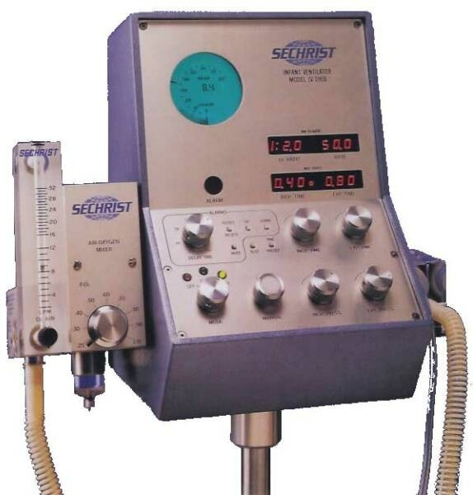
Ventilation – ventilators
26
Sechrist
Babylog 8000

Slide 23
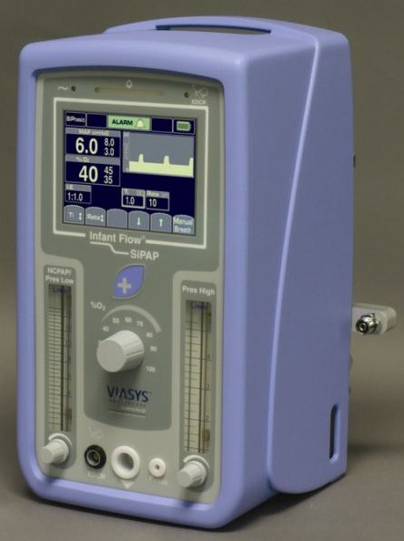
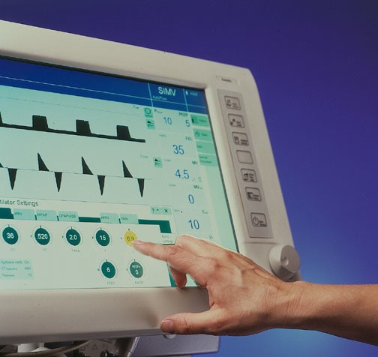
Ventilation – ventilators
27
InfantFlow (NIV only)
Evita XL

Slide 24
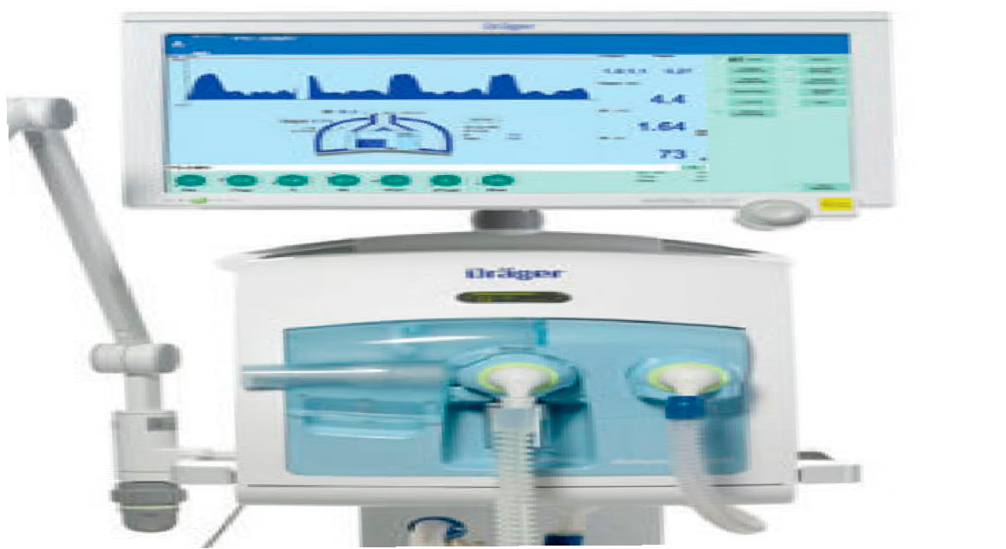
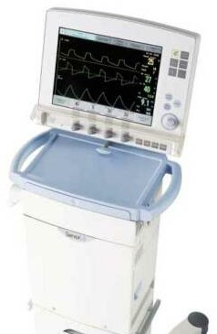
Ventilation – ventilators
28
Servo-i
VN500

Slide 25
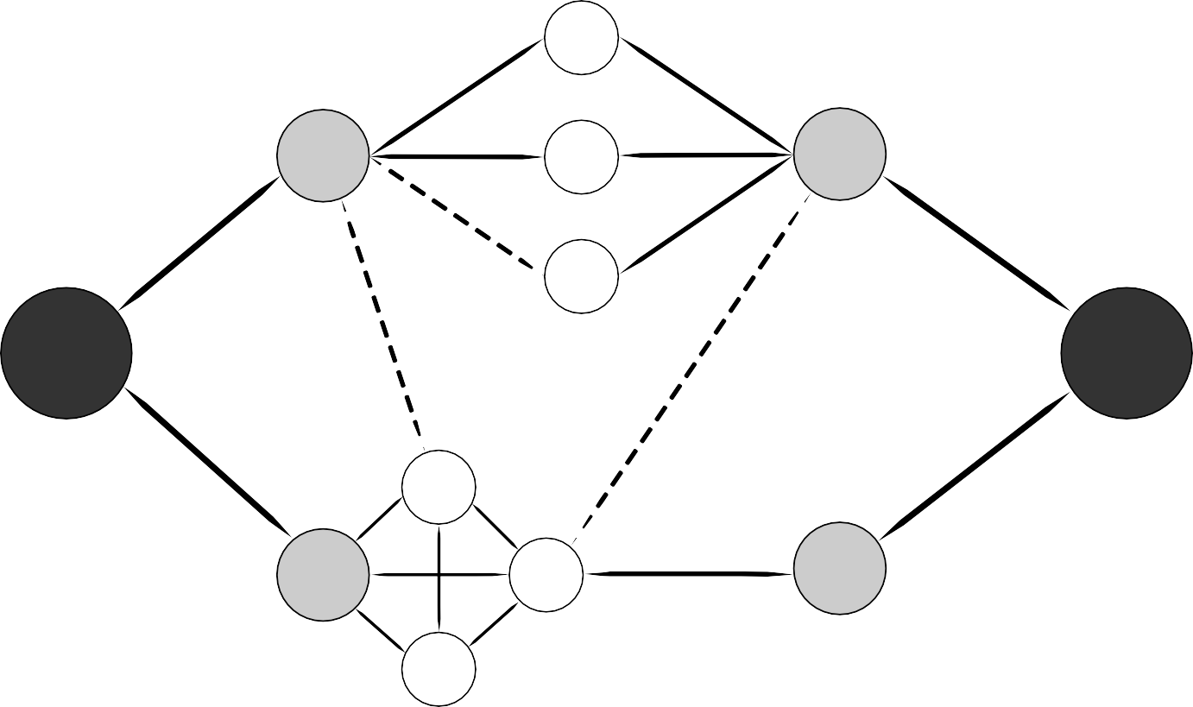
Ventilation – summary
29
^{Pmax}
VT
PEEP
^{Pavg}
CO2
Ventilation
O2
Oxygenation
Instantaneous flow
TI
Frequency
Ratio I/E
FiO2
TE
1.
Lacroix, J., et al., Urgences et soins intensifs pédiatriques. 2nd ed. 2007: Masson. 1368 p.

Slide 26
Conventional vent weaning
30

Slide 27
Weaning
31
Depends on the mode chosen and
  Child's age
  Underlying pathology
  Duration of ventilation
Overall principle:
  Lower the support with the goal of extubation
Possible to extubate from HFOV

Slide 28
Criteria
32
Spontaneous respiratory rate (neuro, sedation)
No airway obstruction
  Before intubation or after (s-glottic stenosis)
Sufficient neurological status
  Spontaneous RR, secretion management
Stable hemodynamics
  Reinversion of thoracic pressures

Slide 29
Criteria – parameters
33
No consensus, many variables
Alternatives (BPAP, LNHD) constantly evolving Less high step for patients
Probably:
  PEEP < 7 with FiO2 < 50%
  PIP < 25

Slide 30
HMD weaning
34
Reliable PTCCO2, FiO2 <40%
Guarantee PEEP at all times
Volumetric sIMV mode
Maintain Vt 4-5 mL/kg, MV/kg 240-360 mL/min/kg
Decrease PEEP to 5 cmH2O; if FiO2 ≤ 30%, decrease PEEP to 4 cmH2O
If Al: set Al to 50% of ΔP, decrease Al by 1-2 cmH2O every 2 hours to 5 cmH2O
Decrease RR by 10/min every 1-2 hours to RR 20/min, according to astrup or PtcCO2 45-55 mmHg
Inform the doctor that the patient is ready for extubation if PIP is between 12-16 cmH20
Barometric sIMV mode
Decrease PIP by 1-2 cmH2O every 2 hours to 12-16 cmH2O
Maintain Vt 4-5 mL/kg, MV/kg 240-360 mL/min/kg
Decrease PEEP to 5 cmH2O; if FiO2 ≤ 30%, decrease PEEP to 4 cmH2O
If Al: set Al to 50% of ΔP, decrease Al by 1-2 cmH2O every 2 hours to 5 cmH2O
Decrease RR by 10/min every 1-2 hours to RR 20/min, according to astrup or PtcCO2 45-55 mmHg
Inform the doctor that the patient is ready for extubation

Slide 31
Extubation <28 weeks <1000g
35
In summary:
PEEP at all times
Caffeine
No bath, minimize care
Great surveillance

Slide 32
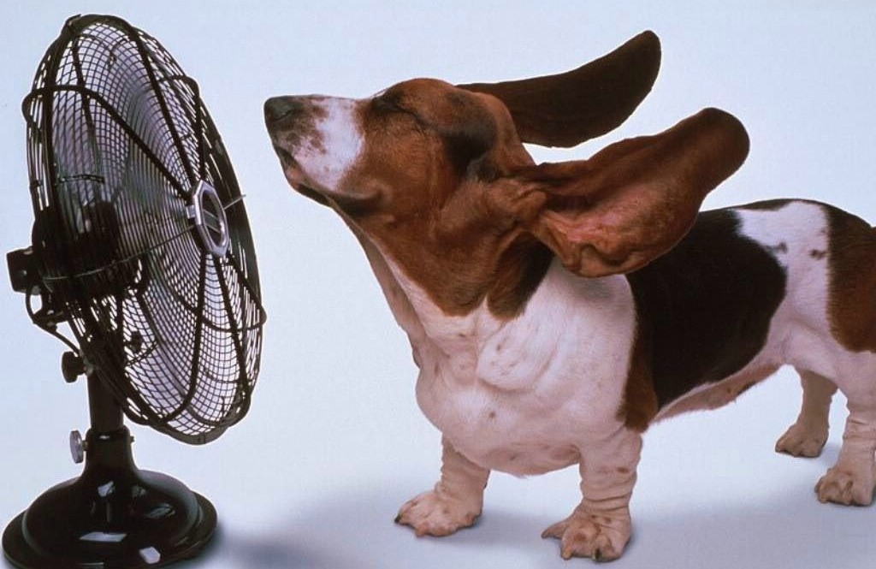
High-frequency
36

Slide 33
High frequency ventilation
37
VT less than dead space Frequency > 60/min (>1 Hz)
4 different types:
  Oscillations: most used (and the only one available HSJ)
  Jet: very specific (ENT, emergency crico)
  Positive pressure: abandoned
  Percussion: mixed mode, few studies

Slide 34
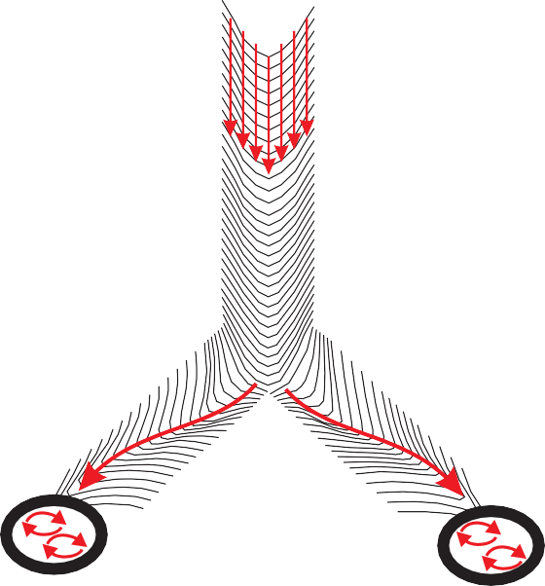






HFOV – Main principles
38
Fresh Gas Bias Flow
Piston Pump
Low-Pass Filter
Lung
By piston (SensorMedic™)
Taylor principle

Slide 35
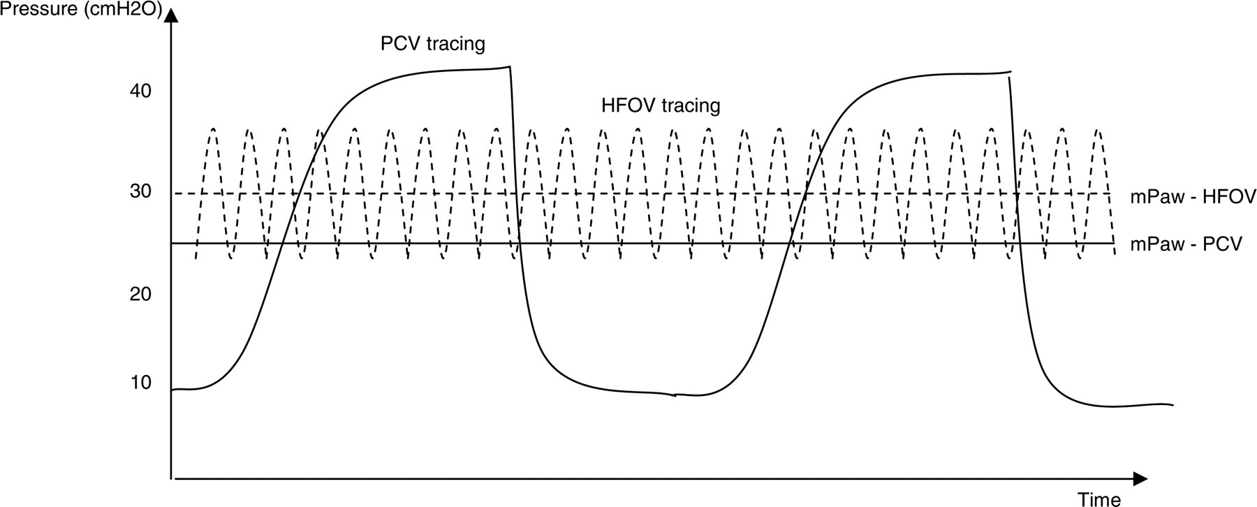
HFOV – Main principles
39
* Adult scale

Slide 36

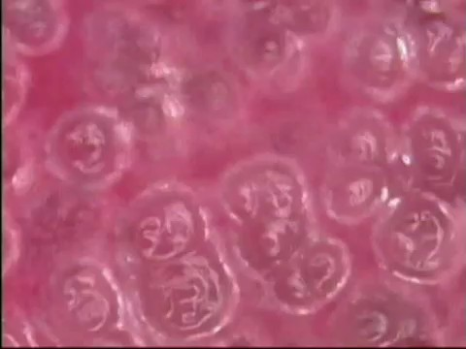
The magic of oscillation
40

Slide 37
HFOV – indications
41
Early vs late
  Multiple studies in babies, no advantage o early HFOV
  Pediatric indication in sharp decline
    Almost obsolete in adults
Particularly effective: (i.e: avoids ECMO)
  Meconium pneumonitis

Slide 38
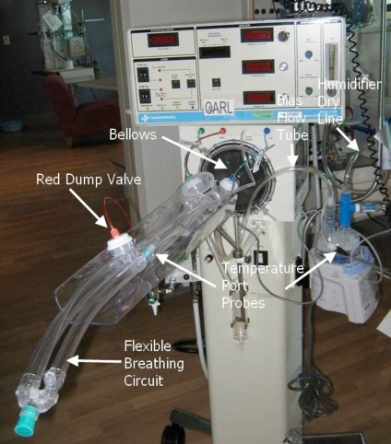
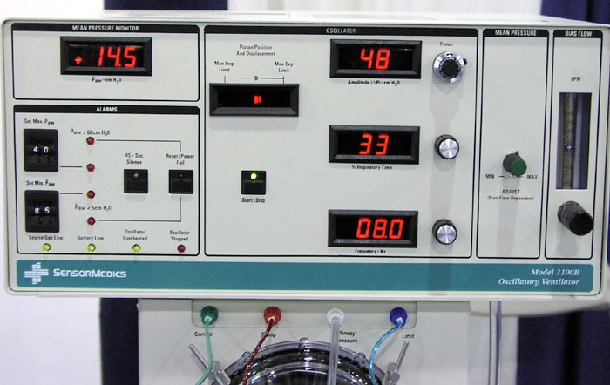
HFOV – device
42

Slide 39
Adjust the HFOV
43
MAP: action on oxygenation especially
  Adjustment according to CXR and SpO2, be careful of overdistension
Amplitude
  Obtain a visible chest vibration
  Adjust according to PCO2
Guaranteed volume
  About 2 mL/Kg
  Monitor the amplitudes generated

Slide 40
Adjust HFOV – frequency
44
Frequency
  Initial: high frequency (10 Hz)
  Adjustment only if you absolutely have to
    Volumetric: ↑frequency, ↑ventilation
    Barometric, it's the opposite…
  ETT size

Slide 41
HFOV – frequency
45
Flow
mL/s
time
1
2
3
4
5
6
1. Effect of frequency on tidal volume (∫flow)

Slide 42
Weaning from HFOV
48
Spontaneous breathing rate
No airway obstruction
  Present before intubation or after (s-glottic stenosis)
  Secretion management
Sufficient neurological status
Stable hemodynamics
  Reinversion of thoracic pressures

Slide 43
Ventilation – usual parameters
50
PEEP:
PIP:
TV:
Resp rate:
4-8 cmH2O
10-30 cmH2O
4-6 mL/Kg
normal for age
Inspiratory assist: 5-10 cmH2O or 50% ΔP
FiO2:
Ti (or I:E ratio)
According to SpO2
According to TV and frequency

Slide 44
VHFO – usual parameters
51
Average pressure:
Amplitude: Guaranteed volume:
Frequency:
Inspi:Expi Ratio
10-18 cmH2O
Pmean conv. + 2-4 cmH2O
≈8 intercostal spaces
10-35 cmH2O (chest vibration)
≈ 2 mL/Kg (?)
8-12 Hz
1:2 (33%)

Slide 45
Thank you for your attention
52

