Slide 1
Bonjour

Slide 2
Keith and Jennifer
Personal introduction

Slide 3
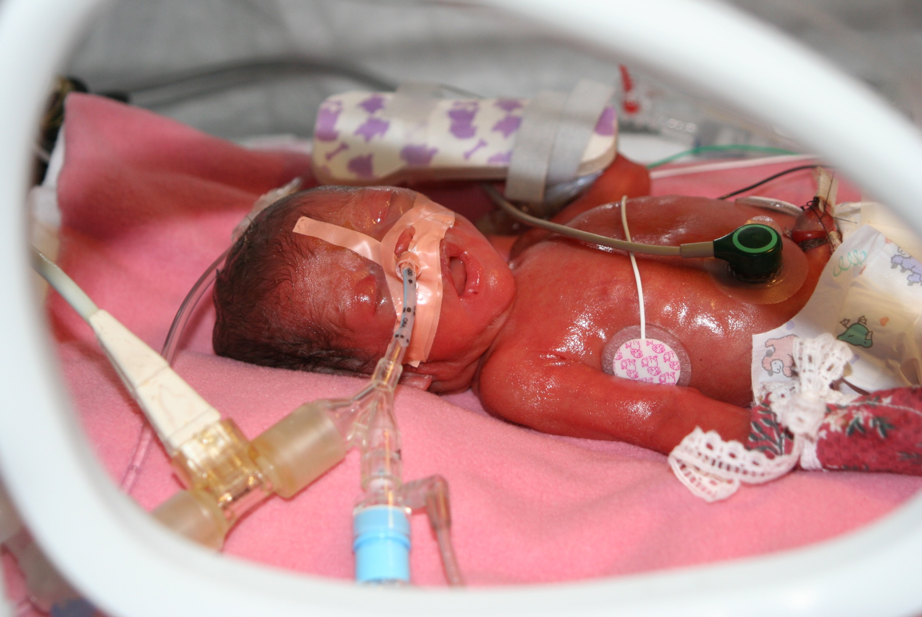
Violette day 1

Slide 4
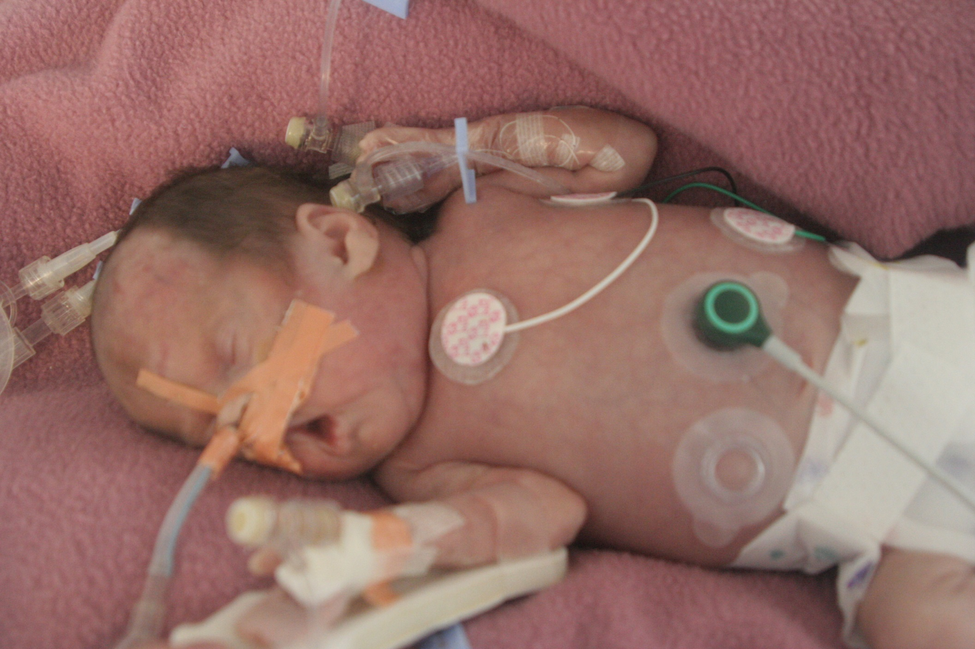
Violette
Day 14

Slide 5

Violette day 7300

Slide 6
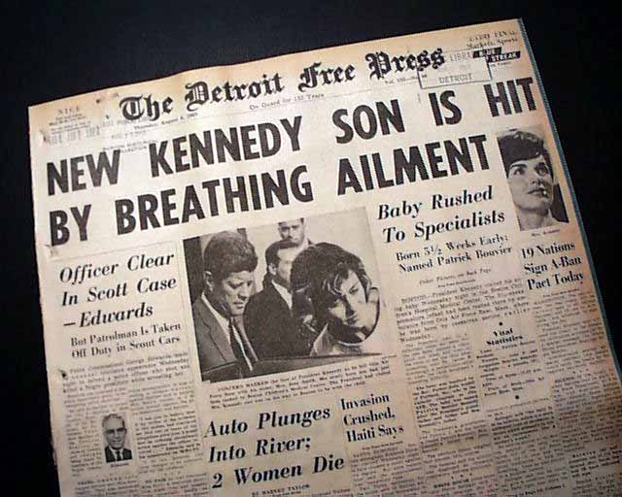
70 years ago

Slide 7


Slide 8
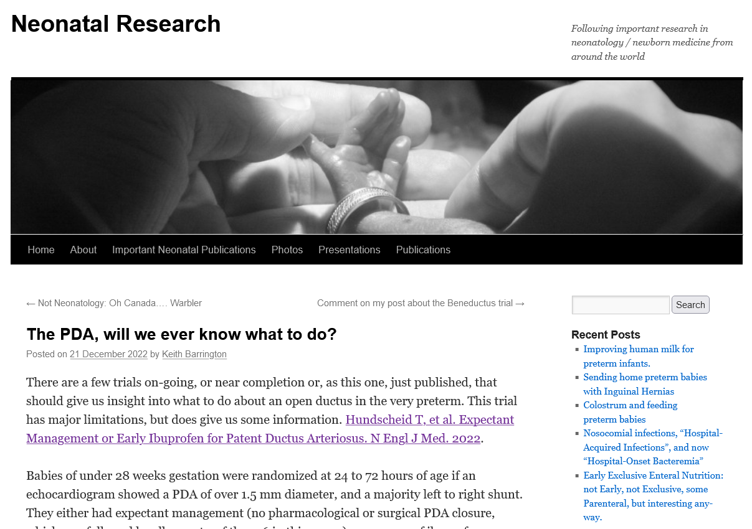
Always more to read!
www.neonatalresearch.org

Slide 9
Day 1
Focus on general principles, physiology and development
Focus on the preterm baby and their lung diseases
Especially HMD (RDS)

Slide 10
Intro
Brief review of embryology
Gestational age at birth; relevance for organ maturation
Developmental physiology
Physiologic maturation before and after birth
Timing of maturation; birth events and programmed events.

Slide 11
Maturation
Switch from fetal to adult Hgb production
Skin maturation
Pulmonary maturation
  Renal maturation
  Neurological maturation
  Cardiovascular maturation

Slide 12
Hemoglobin
Hgb: tetramer of polypeptide chains and Heme groups
Adult Hgb 2 α and 2 β chains
Fetal 2 α and 2 γ chains
Embryonic hemoglobins Gower1, Gower 2 and Portland disappear by 10 wk of gestation
HbA production begins at about 10 wk, is < 10% of total Hb production until 30 wk and about 20-30% at term.

Slide 13
Neonatal Hgb production
Fetus producing Hgb when born
Increase in PO2 suppresses erythropoietin and thus decreases RBC production
When production re-commences e.g. in an infant born at 28 wks both HbF and HbA are formed in the same proportions as is the infant was not born.
The fetal bone marrow switches to adult Hgb production starting at about 30 weeks and accelerating at about term.

Slide 14
HbF synthesis rate
HbF synthesis decreases rapidly after term to reach negligible levels by 20 weeks.
Term neonates have between 40 and 80% fetal Hgb, averaging about 60%..
Infants delivered at 26 weeks usually have >90% HbF.

Slide 15
Neonatal Hgb
The P50 is the PO2 at which Hgb is 50% saturated.
The P50 of adult Hgb is 26.6 mmHg
P50 of fetal Hgb is about 18 mmHg

Slide 16
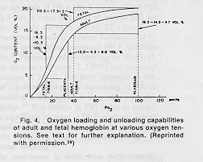
Fetal Hemoglobin
Fetal Hb ODC

Slide 17
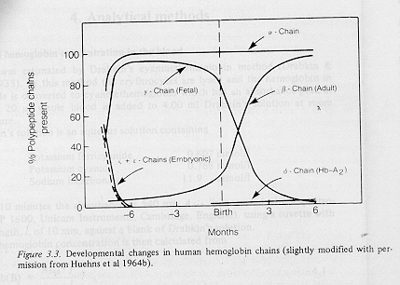
Hemoglobin chains
Relative concentrations of Hemoglobin chains

Slide 18
Neonatal skin maturation
Relatively little work in humans
Much more description in rats
Gradual development of skin barrier during latter 3rd of gestation
Premature delivery induces rapid maturation of the skin.

Slide 19
Neonatal Skin
Permeable to drugs
Permeable to gases
Emollients and other agents not normally absorbed may be toxic in newborns.
Iodine, for example, is absorbed in the newborn and may lead to hypothyroidism

Slide 20
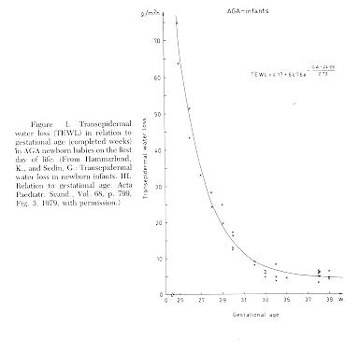
Skin maturation
Progressive decrease in transepidermal water loss with gestational age at birth

Slide 21
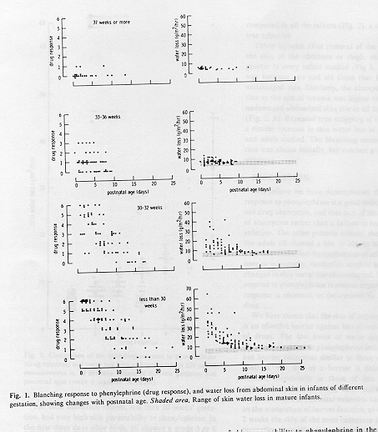
Preterm skin
Ex-utero the skin matures more quickly
By 15 days, an infant born at 28 weeks has a skin water barrier similar to a term infant.

Slide 22
Lung development
Embryonic period……… to 5 weeks
Pseudoglandular period… 5 to 17 weeks
Canalicular period……… 16 to 25 weeks
Terminal sac period……. 24 to 36 weeks
Alveolar period………… to 8 years

Slide 23
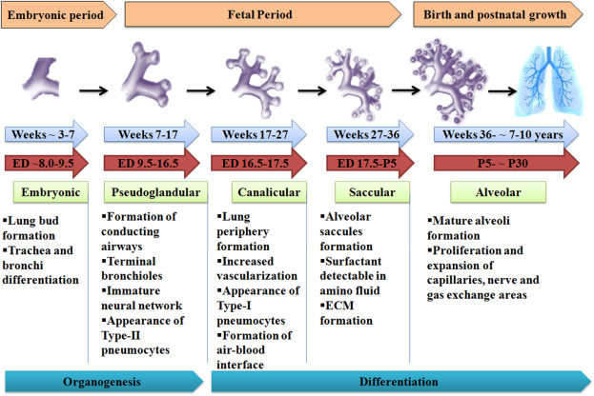

Slide 24
Lung growth and maturation
The canalicular period
  lung tissue becomes highly vascular,
  each terminal bronchiole gives rise to 2 or more respiratory bronchioles,
  vessels gradually approach the future respiratory epithelium and some terminal sacs develop

Slide 25
Lung growth and maturation
The terminal sac period
  Development of huge numbers of sacs
  Capillaries bulge into the sacs
  Epithelium becomes very thin
  Capillary network proliferates

Slide 26
Lung growth and maturation
Requires repeated rhythmic stretching of the lung
Fetal respiration with active control of the glottis.
Lung fluid is produced by the type 1 alveolar cells under the influence of a transmembrane Cl pump
When the fetus breathes, glottis is partially closed during expiration, leading to increased pressure in the lungs and stimulating lung growth
If the glottis is blocked the on-going production of lung fluid when it cannot leave the lung leads to pulmonary hyperplasia

Slide 27
Lung growth and maturation
If fetal lambs undergo tracheostomy they develop pulmonary hypoplasia
Also if the phrenic nerves are cut they develop pulmonary hypoplasia
If there are space occupying lesions in the thorax (such as pleural fluid, or a diaphragmatic hernia) there is also pulmonary hypoplasia
Lack of amniotic fluid will also lead to pulmonary hypoplasia
  Especially if membranes rupture before 24 weeks
  Or if due to renal abnormalities

Slide 28
Surfactant
Type 2 pneumocytes produce it
Appear at about 20 weeks
Produce surfactant in very tiny amounts
Big increase around 28 weeks, still increasing at term

Slide 29
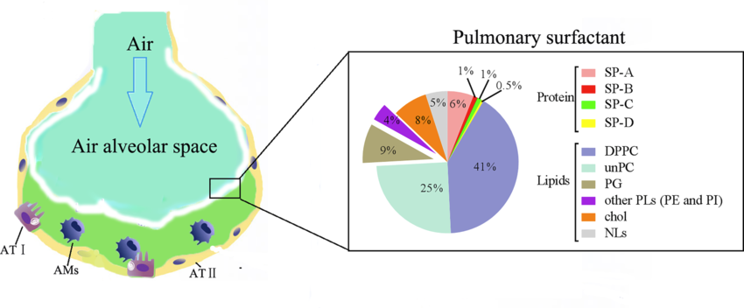
Composants of natural surfactant

Slide 30
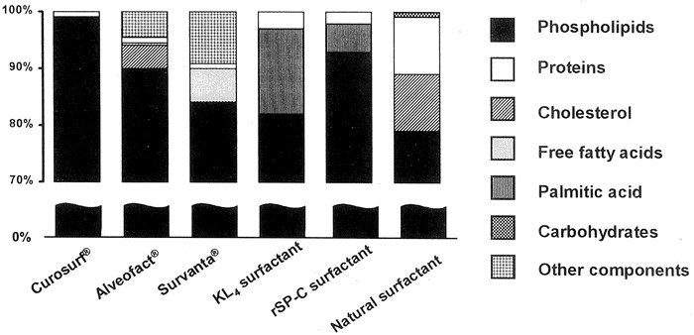
Composants of exogenous surfactant

Slide 31
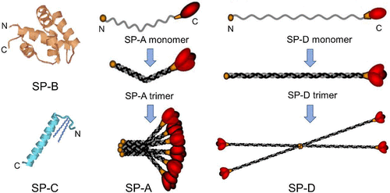
SP-A and SP-D hydrophilic
SP-B and SP-C hydrophobic
No A&D in exogenous surfactants

Slide 32
Risk factors for HMD
Prematurity
Cesarean Delivery
Especially if No labour
Maternal Diabetes
No antenatal Steroids

Slide 33
HMD is not just lack of Surfactant
Lung is also immature
Other impacts of prematurity on lung function
Chest wall is immature and soft
Secondary effects of surfactant deficiency
Pulmonary hypertension
Atelectasis
Oxygen toxicity

Slide 34
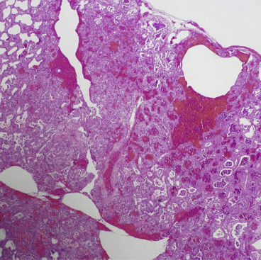
Pink glasslike « hyaline » membranes on pathology

Slide 35
Describe How Preterms Breathe with HMD
Tachypnea
Retractions
  Intercostal, xiphoid
‘Seesaw »
Grunting
Nasal Flaring

Slide 36
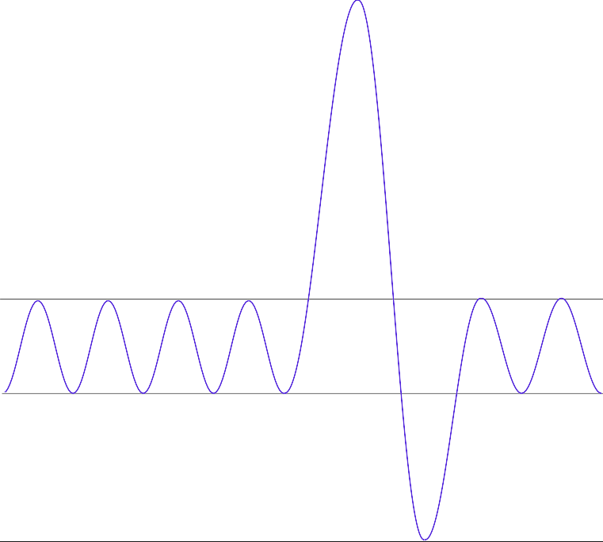
Respiratory physiology– spirometry
7
80
Volume (mL/Kg)
37
Tidal Volume
30
Closing Volume
Functional Residual Capacity
15
0

Slide 37
FRC
Determined by the pulmonary compliance balance and rib cage compliance
It is passive
The NN's rib cage is much more compliant
The NN’s lungs are less compliant, even when healthy
FRC is therefore relatively lower
Child with MMH (and therefore lung compliance even lower), FRC is even lower, < closing volume

Slide 38
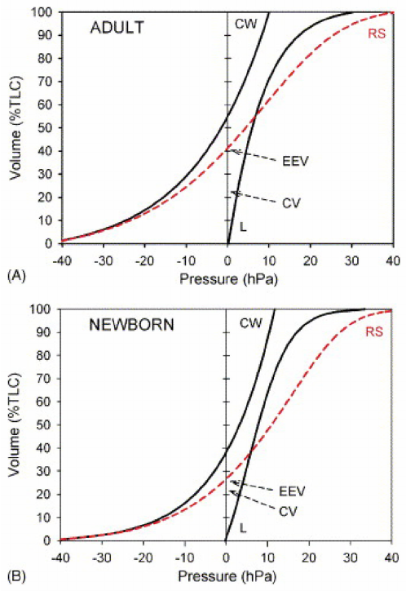
MMH
EEV:MMH

Slide 39
Infant with HMD/RDS
Each exhalation, closure of a few channels, distal resorption, even lower compliance.
A progressive disease
NNs preterms keep their volume at the end of expiration higher than the residual functional capacity
Physiologic compensation
Expiration is shorter
Expiratory braking
Laryngeal
"Grunting"
Diaphragmatic braking
“piida”

Slide 40
Respiratory distress
Is a physiologic response to the decreasing lung volume caused by low lung compliance
Tachypnea
Grunting
Retractions caused by pressure impacts

Slide 41
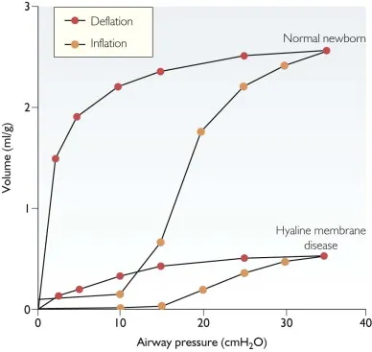

Slide 42
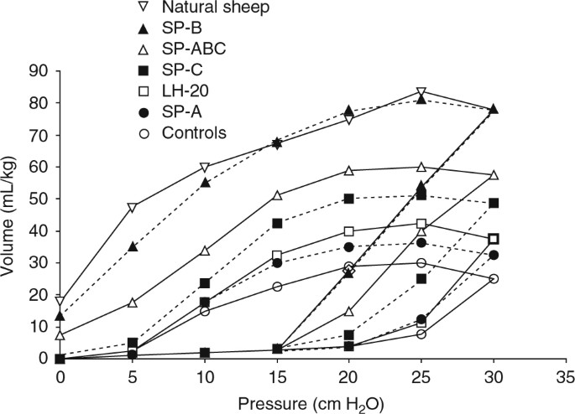
Efficacité de surfactant

Slide 43
Importance of CPAP
Because low lung volumes at the end of expiration lead to progressive respiratory distress
Applying positive pressure in the airways helps to reduce or prevent that progression.
Universal before 29 weeks
Very frequent up to 32 weeks

