Slide 1
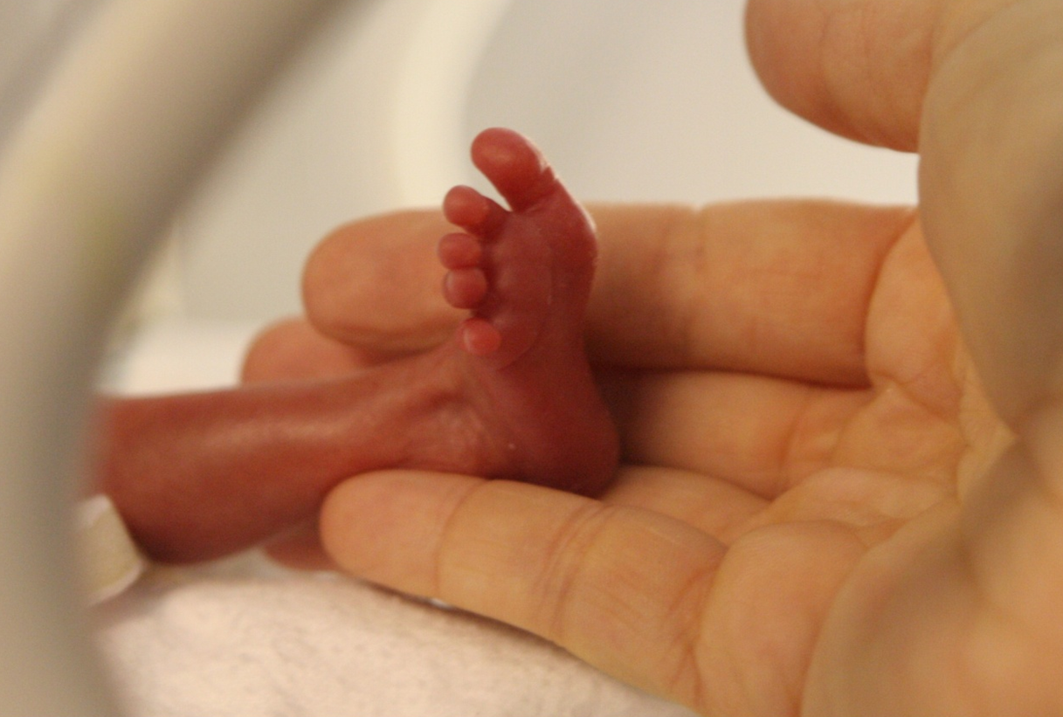

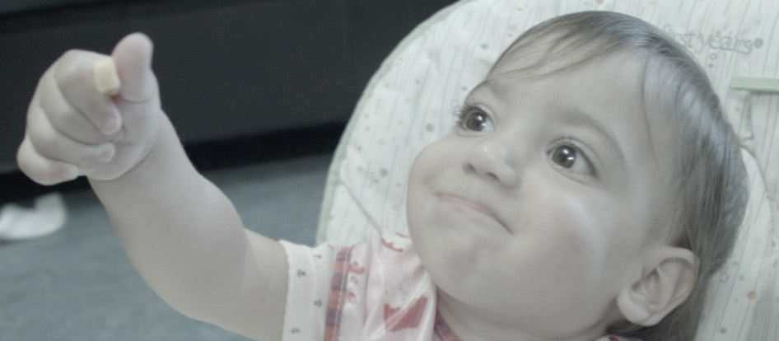
The long term impacts of lung injury:
Bronchopulmonary Dysplasia
Keith Barrington

Slide 2
Outline
History
Importance
Pathophysiology
Risk Factors
Prevention
Treatment

Slide 3
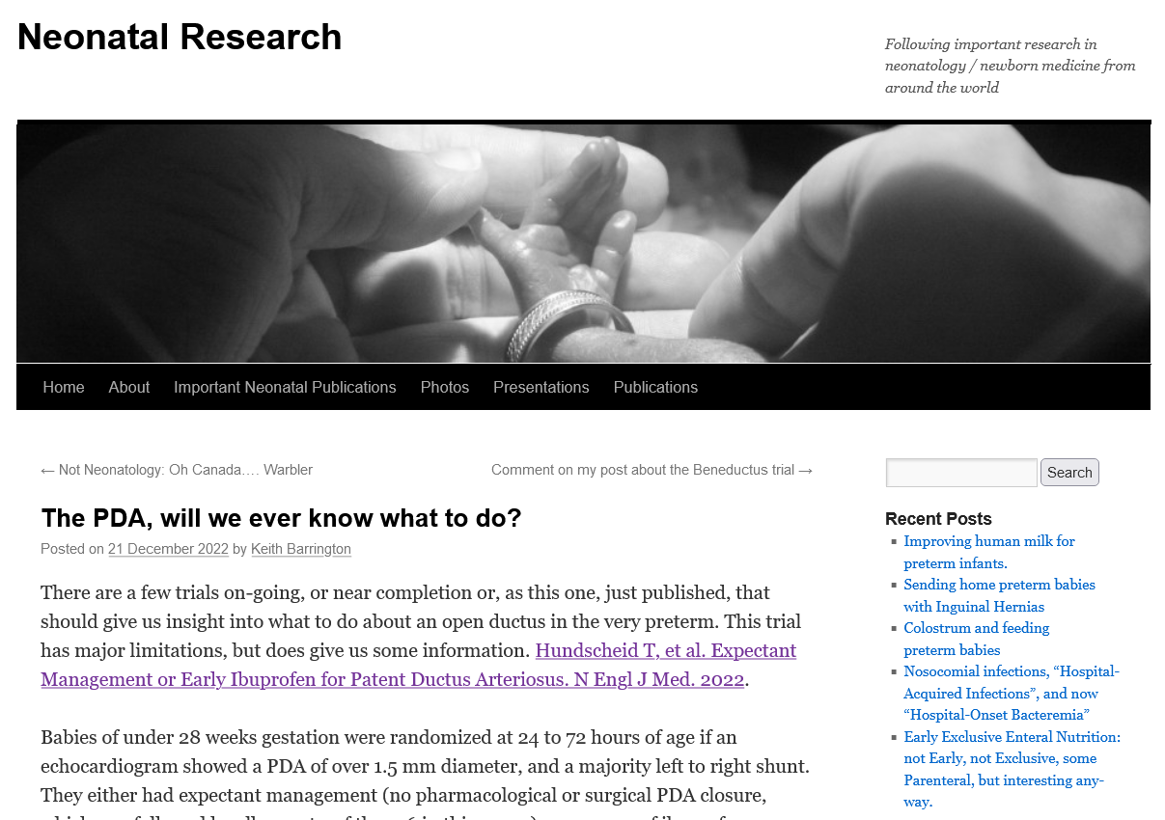
Always more to read!
www.neonatalresearch.org

Slide 4
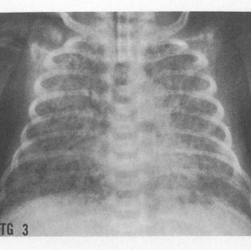
Bronchopulmonary Dysplasia
A term invented in the early days of neonatology, (Northway 1967) to describe infants with persistent gas exchange anomalies, and radiographic signs of injury
First definition, a few years later, a dichotomous outcome, O2 at 28 days of age or not
Revised definition, (still the basis of all our trials, although modified)
O2 requirements for 28 days and also until 36 weeks PMA

Slide 5
Lung injury is common
One of the commonest overt long-term impacts of prematurity
Significant impact on the lives of babies and their families
In order to be able to perform trials to reduce lung injury we must measure it
But lung injury is not a dichotomous outcome!
Variable severity, multiple dimensions
  Dyspnoea, wheeze, cough, exercise limitation, hypoxia, poor growth, poor feeding….

Slide 6
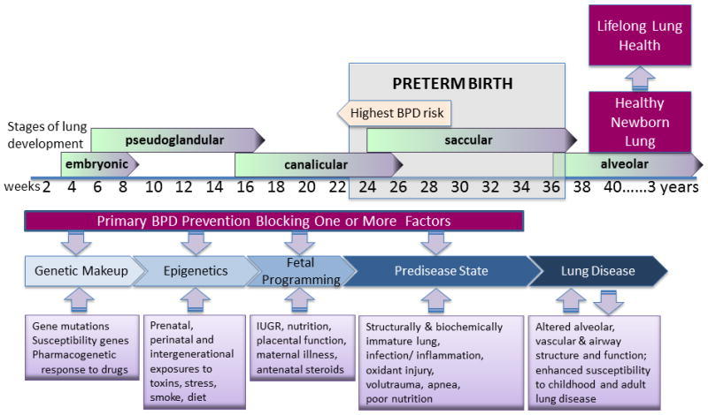

Slide 7
Risk Factors
Prematurity
Rupture of membranes
Antenatal inflammation
Assisted ventilation
Invasive assisted ventilation
Nosocomial sepsis
Patent Ductus Arteriosus

Slide 8
Reducing lung injury: What works
Preventing prematurity
Antenatal steroids
Avoiding intubation : COIN trial, SUPPORT, VON, and meta-analysis.
OPTIMIST
Minimising ventilation duration and toxicity
  Avoiding reintubation, and accidental extubation

Slide 9
Avoiding intubation
Prophylactic CPAP compared to intubation
For infants at risk of respiratory failure, a little less « BPD »
More importantly, lung injury outcomes of interest to parents are reduced
  Fewer on oxygen at 40 weeks
  Less home oxygen
  Less re-hospitalisation
  Less wheezing
  Less emergency room visits
Shown in both SUPPORT and COIN

Slide 10
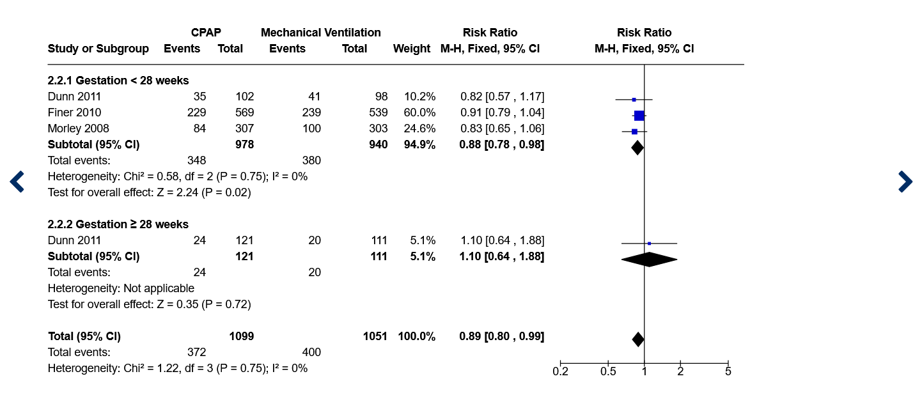

Slide 11
Avoiding intubation
MIST compared to intubation
Less-invasive surfactant administration:
Fewer babies intubated
Better long term outcomes

Slide 12
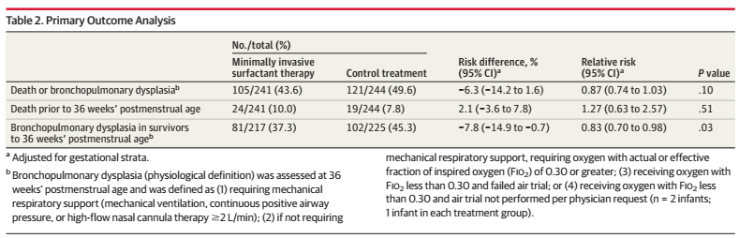
OPTIMIST trial
Dargaville PA, al. Effect of Minimally Invasive Surfactant Therapy vs Sham Treatment on Death or Bronchopulmonary Dysplasia in Preterm Infants With Respiratory Distress Syndrome: The OPTIMIST-A Randomized Clinical Trial. JAMA. 2021;326(24):2478-87.

Slide 13
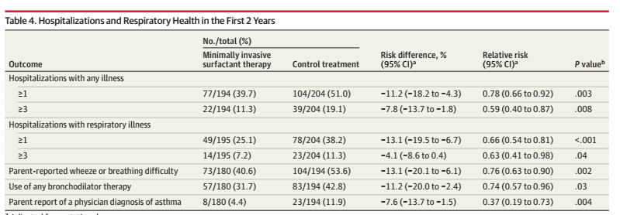
OPTIMIST long term
Dargaville PA, et al. Two-Year Outcomes After Minimally Invasive Surfactant Therapy in Preterm Infants: Follow-Up of the OPTIMIST-A Randomized Clinical Trial. JAMA. 2023.

Slide 14
SALSA?
Surfactant Administration by Laryngeal mask/Supraglottic Airway
Not studied in large RCT, but same benefit of avoiding intubation
Potentially as beneficial as MIST
Need proof, but easier to learn than laryngoscopy/thin catheter surfactant admin.

Slide 15
If ventilation needed
Gentle ventilation
A consensus that decreasing lung injury requires gentle ventilation, but how to achieve it?
Avoid overdistension
Avoid atelectasis

Slide 16
Avoiding overdistension
Tidal volumes of 4 to 6 mL/kg
  On pressure ventilation adjust pip to achieve this, but if the baby takes a large effort may get very large Vt.
Fewer episodes of overdistension if volume ventilation is used
Reduce PEEP after surfactant if FiO2 stays low, down to 3 cmH2O
If O2 supplementation is still needed, PEEP to prevent ‘atelectotrauma’, may be between 5 and 8 (occasionally even higher)

Slide 17
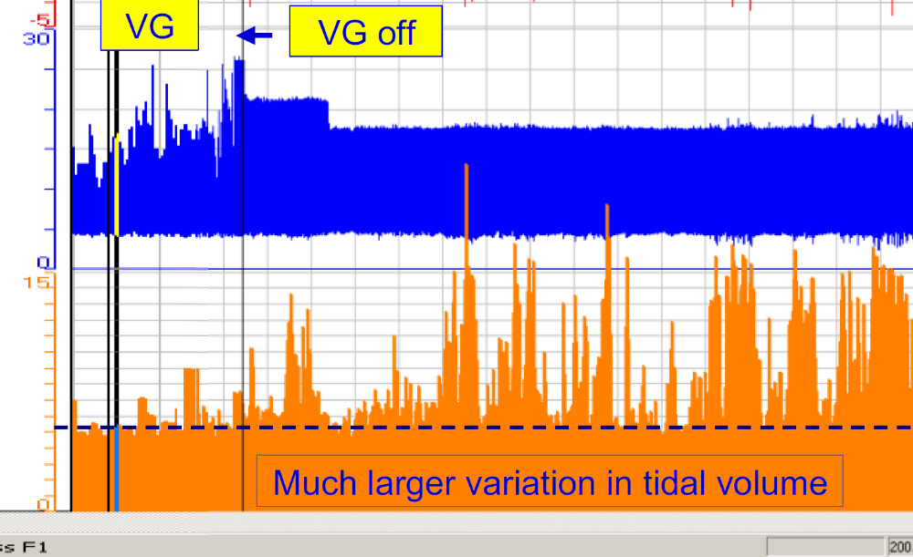
Plusieurs inspirations très grandes = Ptp très élevée
Plusieurs inspirations terminées = Vt>130% VG
Ptp peu élevée et stable

Slide 18
Improving extubation success
Spontaneous Breathing Test
Preterm Infants considered potentially extubatable
Put on CPAP via ETT for 3 minutes.
With pressure equivalent to the PEEP (5–6 cm H2O).
Failure if :
Bradycardia (<100/min) and/or
SpO2 < 85% despite a 15% increase in FiO2
Otherwise, SUCCESS! And extubate

Slide 19
Failed extubation
Associated with more BPD
SBT reduces extubation failure
CPAP after extubation, with pressure of 6 cmH2O if in 21% O2, or 8 cmH2O if in more than 21% O2.
Or nIPPV
  We use 16/6 x 20 if in 21%, or 16/8 x 20 if in >21% O2

Slide 20
NeoPROM
Meta-analysis of several large trials with overlapping design
  SUPPORT
  COT
  BOOST-2 UK
  BOOST-2 Aus
  BOOST-2 NZ
  N=4600
Compared high oxygen saturation goal (91-92%) to low goal (85-89%)

Slide 21
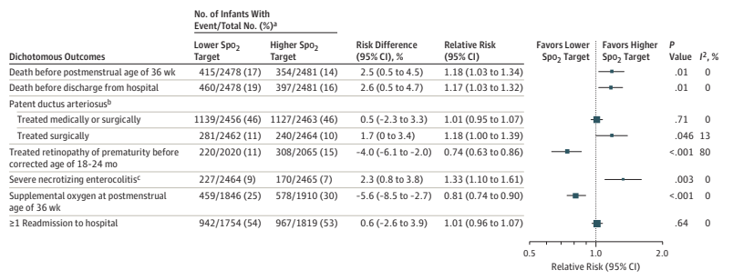
NeoPROM collaboration

Slide 22
Oxygen saturation targets
The NeoPROM trials showed less BPD with the lower saturation target group, but more mortality.
Higher targets mean more support more oxygen and more lung injury. Finding the balance
Aim for 90-95% while in oxygen.
Children with established BPD, higher oxygen targets of no proven value (BOOST)
Continue with same targets.

Slide 23
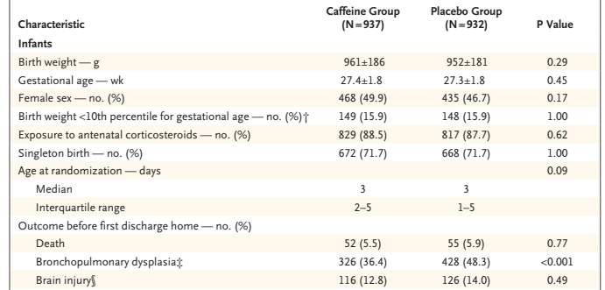
Stimulating respiratory drive
Caffeine
The CAP trial showed a reduction in BPD

Slide 24
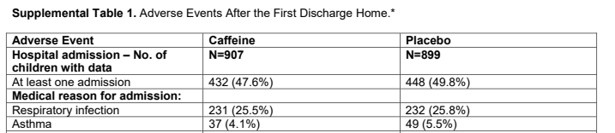
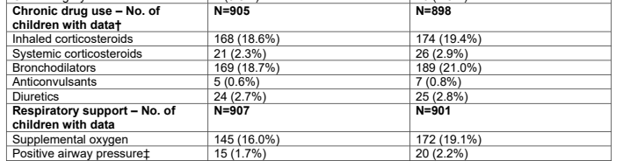
Caffeine
No long term pulmonary benefit

Slide 25
Reducing lung injury: what doesn’t work
High-frequency ventilation (cf conventional)
High-flow nasal cannulae (cf CPAP)
Closing the PDA
Postnatal steroids

Slide 26
Patent Ductus Arteriosus
Statistical link between PDA and BPD
BUT:
No evidence that closing the PDA reduces lung injury
  Recent studies show the opposite.
  RCTs of early ibuprofen, small increase in BPD despite PDA closure

Slide 27
Fluid management
Excessive fluid in first days of life, especially if associated with more sodium administration: increase in BPD

Slide 28
Management of BPD
Fluid and nutritional management
Oxygen targets
Steroids
Diuretics
Bronchodilators

Slide 29
Management : fluids
No evidence that fluid restriction has any benefit in BPD
Only impact of fluid restriction is more concentrated urine; and risk of nutritional impacts
Fluid restriction has no impact on total body water, unless extreme
No impact on lung mechanics or lung water content

Slide 30
Management: nutrition
Calorie requirements are increased by BPD
10 to 30% more calories than babies without BPD
Protein needs not significantly affected by BPD
Increased volume of feeds, and/or increased calorie density
Good nutrition helps lung repair

Slide 31
Management: oxygen targets
BOOST showed that higher targets had no benefit in early/established BPD
More adverse pulmonary events with higher targets
Maintain at 90-95% saturation

Slide 32
Management : diuretics
Some short term benefits on lung mechanics
Little evidence of short term clinical benefit
No evidence of long term clinical benefit
  Sometimes better gas exchange, transiently
Short trials of either furosemide or hydrochlorothiazide, can sometimes have benefit.

Slide 33
Management : bronchodilators
Very little evidence of benefit

Slide 34
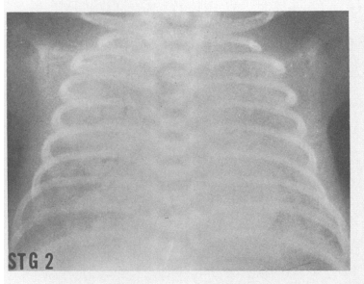
Management :steroids
Enormous complex literature
Recent network meta-analysis 49 RCTs comparing steroids to placebo; 2 more published since
Differences in drug,
    Dexamethasone : extremely potent glucocorticoid
    Hydrocortisone : glucocorticoid with minor mineralocorticoid actions
  Timing
    Day 1, up to day 28
  Duration
    5 day course up to 45 days
  Dose
    Low-dose HC up to High-dose Dexa

Slide 35
Steroids for preventing « BPD »
Most studies of dexamethasone have shown a reduction in oxygen use at 36 weeks
BUT
Steroids negatively impact lung growth and development
No evidence that long term pulmonary health is improved by any use of postnatal steroids

Slide 36
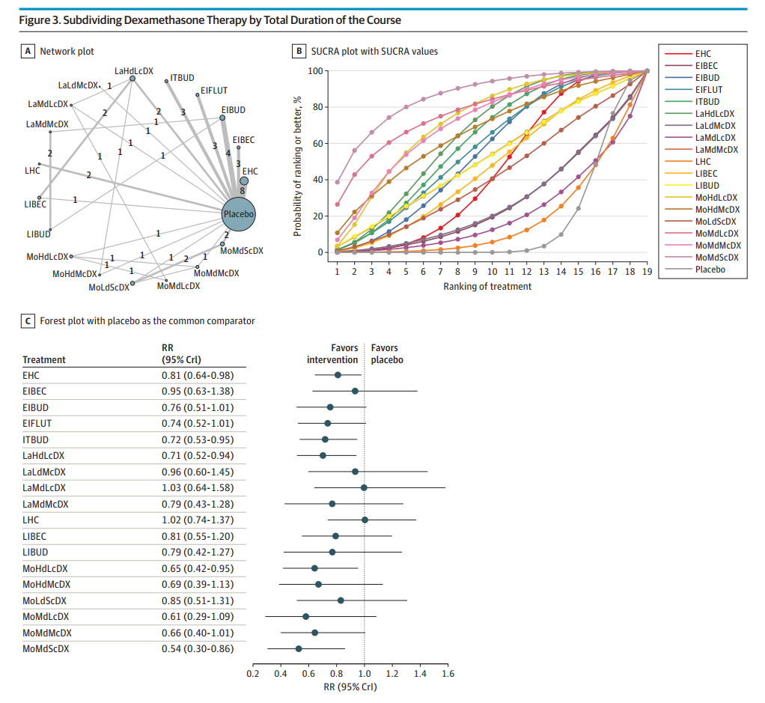
Steroid treatments
E=early <8d
Mo=moderately early 8-15d
La=Late 15-27d
Ld=<2 mg/kg DX cumul
Md=2-4 mg/kg DX cumul.
Hd=>4 mg/kg DX cumul.
Sc=short course
Lc=Long course
HC=hydrocortisone
DX=dexamethasone
LHC=HC>8d
outcome: Death or BPD

Slide 37
Ramaswamy et al
« Moderately early, medium cumulative dose Dexamethasone », greatest reduction of DBP
Low-quality evidence

Slide 38
Recent hydrocortisone studies
Onland et al STOP-BPD
  Multi-centre, Holland and Belgium, n=372
  <30s or <1250g, 7-14d, intubated, Resp Index >0.25 (=MAP 10, 25%),
    GA médiane 25.5, FiO2 moyenne 35%
  72.5 mg/kg HC over 22d, starting at 5 mg/kg/d
  Open HC permitted if Resp Index >10 for > 6 heures or no improvement after 10 d
    28% vs 57% received
Watterberg et al NICHD-HEX
  Multi-center, USA, n=800
  <30s, 14-28d, intubated,
    GA mean 24.8, FiO2 mean 52%
  19 mg/kg HC over 10d, starting at 4 mg/kg/d iv ou po.
  Open DX permitted if not extubated after 4 days
    40% received, the 2 groups

Slide 39
Death or BPD
Étude | Issu | Âge | HC (%ge) | Placébo
Onland | Mortalité | Plus tard connu (2 ans) | 21.5 | 29.5
 |  | À 36 s | 15.5 | 23.7
 | DBP | 36s (parmi survivants) | 65 | 65
Watterberg | Mortalité | Plus tard connu (2 ans) | 10.8 | 11.4
 |  | À 36 s | 4.8 | 7.0
 | DBP | 36s (parmi survivants) | 86 | 83
CHUSJ <25 s intubé à 14 j | Mortalité | À 36 s | 10
2018-2020 | DBP |  | 88
25-28 s intubé à 14 j | Mortalité | À 36 s | 10
 | DBP |  | 80

Slide 40
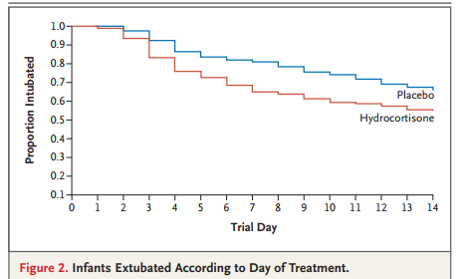
Commentaires
Onland et al STOP-BPD
  Mortality was very high, but was decreased by HC,
  Same proportion developed BPD.
Watterberg et al HEX
  Infants sicker with >50% O2 mean
  Not informative for survival or BPD because so many babies received Dexa, 40% in the 2 groups
Long term? Little difference between groupes in « NDI »
Petite tendance d’avantage avec HC, Onland
Petite tendance d’avantage avec contrôle, Watterberg

Slide 41
Our approach
Preterm infants still intubated at 7 to 10 days of age with a RSI > 3.5 for more than 6 hours
  RSI = FiO2 x MAP (e.g. MAP=10, FiO2 0.3, RSI=0.30)
Start hydrocortisone
5 mg/kg/jour divided in 4 doses for 7 days, then
3,75 mg/kg/jour divided in 3 doses for 5 days, then
2,5 mg/kg/jour divided in 2 doses for 5 days, then
1,25 mg/kg/jour in 1 dose per day for 5 days

Slide 42
References
Northway WH, Jr., et al. Pulmonary disease following respirator therapy of hyaline-membrane disease. Bronchopulmonary dysplasia. N Engl J Med. 1967;276(7):357-68.
Subramaniam P, et al. Prophylactic or very early initiation of continuous positive airway pressure (CPAP) for preterm infants. Cochrane Database Syst Rev. 2021;10(10):CD001243.
Dargaville PA, et al. Effect of Minimally Invasive Surfactant Therapy vs Sham Treatment on Death or Bronchopulmonary Dysplasia in Preterm Infants With Respiratory Distress Syndrome: The OPTIMIST-A Randomized Clinical Trial. JAMA. 2021;326(24):2478-87.
Dargaville PA, et al. Two-Year Outcomes After Minimally Invasive Surfactant Therapy in Preterm Infants: Follow-Up of the OPTIMIST-A Randomized Clinical Trial. JAMA. 2023.
Klingenberg C, et al. Volume-targeted versus pressure-limited ventilation in neonates. Cochrane Database Syst Rev. 2017;10(10):CD003666.
Kamlin CO, et al. Predicting successful extubation of very low birthweight infants. Arch Dis Child Fetal Neonatal Ed. 2006;91(3):F180-3.
Schmidt B, et al. Long-term effects of caffeine therapy for apnea of prematurity. N Engl J Med. 2007;357(19):1893-902.
Ramaswamy VV, et al. Assessment of Postnatal Corticosteroids for the Prevention of Bronchopulmonary Dysplasia in Preterm Neonates: A Systematic Review and Network Meta-analysis. JAMA Pediatr. 2021;175(6):e206826.
Onland W, et al. Effect of Hydrocortisone Therapy Initiated 7 to 14 Days After Birth on Mortality or Bronchopulmonary Dysplasia Among Very Preterm Infants Receiving Mechanical Ventilation: A Randomized Clinical Trial. JAMA. 2019;321(4):354-63.
Hennelly M, et al. An Update on the Prevention and Management of Bronchopulmonary Dysplasia. Pediatric Health Med Ther. 2021;12:405-19.

Slide 43
My email
Keith.barrington@umontreal.ca

