Slide 1
Blood Gas Interpretation

Slide 2
What do we measure?
Only 3 things are actually measured
pH, pCO2, pO2
All the other results are calculated
Bicarbonate (HCO3-)
Base Excess
Total CO2…

Slide 3
Oxygenation
How much oxygen is in the blood?
O2 is dissolved in plasma
In equilibrium with the O2 attached to haemoglobin
The PO2 is directly measuring only the dissolved part, but the saturation of the HgB depends on the PO2
Oxygen content of the blood much more dependent on the HgB and SaO2 than the PaO2

Slide 4
Hypoxia
A healthy adult, older child, or newborn after the first couple of days, living at sea level
PaO2 = 90-100
In Kigali, 1500 m, normal PaO2 is about 19 mmHg lower

Slide 5
pH
Normal pH is 7.35 -7.45
Frequently outside those limits in the newborn infant

Slide 6
Bicarbonate is calculated
[H⁺] = 24
PCO₂ HCO₃⁻
Normal PCO2 = 40
Normal pH = 7.40
HCO3 = 24

Slide 7
What is the « Base Excess »?

Slide 8
H⁺ +HCO₃⁻ = H₂CO₃ = CO₂+H₂O
If the CO2 increases, HCO3 increases also
EG if CO2 is 60, and there is no metabolic change, HCO3 will be more than 24
Base Excess is a concept developed to help you interpret the blood gas
For example, PCO2 60, pH 7.27, HCO3 = 27
Is there a metabolic alkalosis compensating for the increase in PCO2?

Slide 9
No
The Base Excess is 0
The increase in HCO3 is entirely due to the increase in PCO2
  Impossible to calculate that in your head!
That is why the Base Excess is on the BG result, to help you interpret the BG.
Doesn’t work perfectly in newborns, an acute increase in PCO2 will often have a negative base excess (base deficit), which disappears if you can correct the PCO2

Slide 11
Acidosis
If the pH <7.35 there is an acidosis
Adults will compensate by increasing ventilation, will not usually completely compensate
Newborn compensation is limited
Lower respiratory drive, especially in the preterm

Slide 12
Two kinds of acidosis
Loss of Bicarbonate
Accumulation of acids

Slide 13
Loss of Bicarbonate
In the newborn this is usually via the kidneys
GI losses in older children can happen
  Some very rare disorders in newborns
Urinary acidification is complicated
But we can think of it as being a threshold
« Renal bicarbonate threshold »
If the blood bicarbonate is above the threshold bicarbonate will be lost in the urine

Slide 14
Urine acidification
Renal bicarbonate threshold in adults 24 to 28 mM
In term newborn infants it is 19 to 21 mM
  Term infants lose a little HCO3 in the urine in the first few days
  If completely healthy and delivered by CS without labour, pH at birth similar to the mother
  Develop, normally a minor acidosis and on day 2 the HCO3 averages about 20-22
In preterm infants, threshold as low as 16 has been described.

Slide 15
Progressive metabolic acidosis
Preterm infants progressively lose some HCO3 in the urine over the first few days, until the serum bicarbonate is below their threshold
If you measure urine pH, you will find it is alkaline in the first 2 to 5 days
The becomes acidic

Slide 16
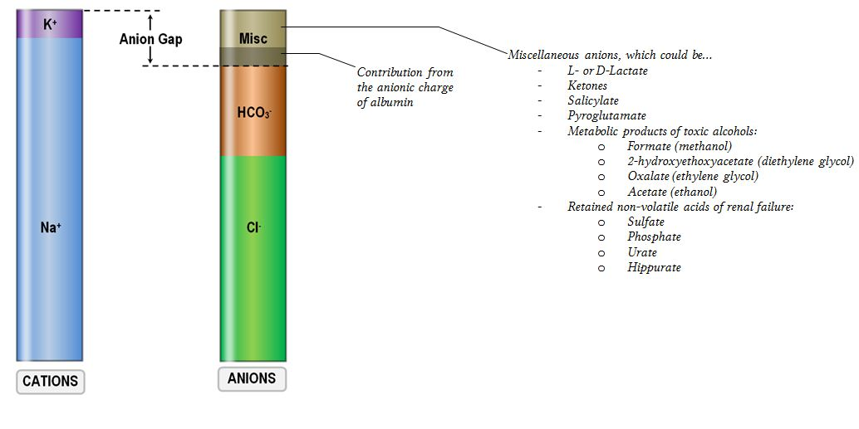
How to differentiate HCO3 loss from Acid accumulation?
Calculate the anion gap

Slide 17
Na (+K) – HCO3+Cl
Normal if K included = 20-22
Normal without K = 16-18
Because of frequent haemolysis in newborns, I usually calculate without the K.

Slide 18
HCO3 loss in urine
Normal anion gap (or low)
Some of the « missing » anions are albumin
If albumin is low then AG will be low

Slide 19
Normal anion gap acidosis in preterms
A normal phenomenon
Doesn’t need investigating or treating
But be wary

Slide 20
Accumulation of acid
MUDPILES
Not very helpful in babies!
  Methanol, diabetes, salicylates..
Doesn’t include Inborn Errors of Metabolism
Most frequent cause of increased anion gap acidosis in the newborn?
Which acid accumulates?
Lactic acid

Slide 21
Lactic acidosis
Accumulation of acid
Often little respiratory compensation
Perinatal asphyxia
Poor perfusion, as in sepsis or other causes of cardiac dysfunction

Slide 22
Anion gap in the newborn
If a newborn has very low albumin, and is healthy, the anion gap will be low
If they then develop a lactic acidosis, then the anion gap will increase
Back to normal at first, then increased.
There are ways of correcting the anion gap for hypo-albuminaemia
If you measure the serum albumin
Routine measurement of lactic acid is helpful

Slide 23
EG
Baby with birth asphyxia, lethargic, first blood gas, 1 h of age
PCO2 = 55
pH = 7.1
HCO3 = 16.5
BE = -12

Slide 24
Mixed acidosis, respiratory and metabolic
Na 147
Cl=108
Anion gap = 147-(106+12)=29
Lactate = 12
High anion gap acidosis, due to accumulation of acid

Slide 25
Baby with asphyxia
Stage 1 encephalopathy, 12 hours of age
PCO2 = 32
pH = 7.45
HCO3 = 22
BE = -2

Slide 26
Respiratory alkalosis
Without metabolic compensation
Occurs frequently in infants with milder asphyxia
Probably increases brain injury
Because hypocapnia causes cerebral vasoconstriction

Slide 27
Preterm infant with Resp distress
Day 1 of life, 18 hours of age
PCO2 = 58
pH = 7.22
HCO3 = 23
BE= -4

Slide 28
Respiratory acidosis
With mild metabolic acidosis
Na = 132, HCO3 = 23, Cl = 109
Anion gap = 16
Probably due to bicarbonate loss

Slide 29
3 day old term infant
Lethargic and mild tachypnoea
PCO2 32
pH 7.24
HCO3 = 13
BE = -12

Slide 30
Metabolic acidosis
Partial respiratory compensation
Na = 146, HCO3 = 13, Cl = 101
Anion Gap = 32
Lactate = 2.1
Accumulation of acid other than lactate
Methylmalonic acidemia

Slide 31
Preterm infant on ventilator, day 3
Pip= 18
PEEP = 6
RR = 60
sIMV rate = 40
FiO2 = 25%
PCO2 = 50
pH = 7.18
HCO3 = 18
BE = -9

Slide 32
Mixed acidosis
Increase ventilation?
Give Bicarbonate?

Slide 33
Preterm infant day 42 on HHFNC
PCO2 = 56
pH = 7.36
HCO3= 32
BE = 6.2

Slide 34
Hypercarbia with metabolic compensation
Causes?
Treatment?
Frusemide (Lasix) frequent cause of metabolic alkalosis

Slide 35
Metabolic alkalosis
Decreases respiratory drive
Leads to hypercarbia
Baby with BPD on lasix with high PCO2 and normal pH
Is it due to BPD or to lasix?

Slide 36
Preterm infant on ventilator, day 3
Pip= 18
PEEP = 6
RR = 60
sIMV rate = 40
FiO2 = 25%
PCO2 = 62
pH = 7.19
HCO3 = 23
BE = -4

Slide 37
Mostly respiratory acidosis
Pip= 18
PEEP = 6
RR = 60
sIMV rate = 40
Ti=0.4s
What changes could you make?

Slide 38
Increase Rate
Other options?
If there is also an oxygenation problem
Increase pip
If there is no oxygenation problem
Decrease PEEP

Slide 39
Preterm infant on ventilator, day 2
Pip= 18
PEEP = 6
RR = 60
sIMV rate = 40
FiO2 = 25%
PCO2 = 42
pH = 7.32
HCO3 = 21
BE = -4

Slide 40
Normal blood gas
Wean!
We can decrease the pulmonary trauma
Wean depending on average tidal volume
If 4 to 5 mL/kg, acceptable
Decrease rate
If > 5 mL/kg
Decrease pip

Slide 41
Full term infant with MAS
HFOV
10 Hz
Amplitude = 28
MAP = 14
FiO2 = 45%
PCO2 = 32
pH = 7.45
HCO3 = 22
BE = -2

Slide 42
Iatrogenic respiratory alkalosis
Changes?
Decrease amplitude
Don’t touch the frequency!

Slide 43
Full term infant with MAS
HFOV
10 Hz
Amplitude = 38
MAP = 14
FiO2 = 45%
PCO2 = 64
pH = 7.14
HCO3 = 21
BE = -7

Slide 44
Ventilator set to amplitude of 38, but actually delivering 30. Tidal volume 1.4 mL/kg
To increase the ventilation we need to increase the Vt (or increase the frequency without changing the Vt)
Every HFOV machine, tidal volume is affected by changing the frequency.. In the opposite direction
  Increasing frequency decreases Vt
Because DCO2 depends on Vt² x frequency
Increasing the frequency usually decreases ventilation and PCO2 increases

Slide 45
Babies over 2.5 kg
May be difficult to get adequate Vt on HFOV at 10 Hz
Decreasing fequency often improves ventilation and decreases PCO2.
Sophie ventilator calculates DCO2 for you, gives a guide as to what will happen to the PCO2 if you change the frequency

Slide 46
Decrease frequency to 8 Hz
Ventilator now able to deliver amplitude of 38
Vt increases to 2.4 mL/kg

Slide 47
5 day old 1.8 kg preterm infant on CPAP
6 cmH2O
21%
PCO2= 52
pH = 7.18
HCO3= 19
BE = -8

Slide 48
Response?
Intubate?
But mostly a metabolic acidosis
nIPPV?
Little direct ventilation with nIPPV
Probably won’t affect the PCO2

Slide 49
Preterm infant on ventilator, day 3
Pip= 18
PEEP = 6
RR = 60
sIMV rate = 40
FiO2 = 75% for SpO2 = 90%
PaO2 = 48
PCO2 = 62
pH = 7.19
HCO3 = 23
BE = -4

Slide 50
Response
Need to increase MAP and minute ventilation
Options?
Increase PEEP and rate
Increase pip
Increase pip and PEEP
  ? Effect on Vt

Slide 51
Preterm infant on ventilator, day 3
Pip= 23
PEEP = 8
RR = 60
sIMV rate = 60, Ti 0.33
FiO2 = 75% for SpO2 = 90%
PaO2 = 48
PCO2 = 52
pH = 7.29
HCO3 = 24
BE = -2

Slide 52
Response
Need to increase MAP, but ventilation is acceptable
Increase PEEP
Could increase Ti, but…
Consider HFOV
? Starting settings for HFOV
When switching for oxygenation, increase MAP by 2 (13 currently, put on 15)
Amplitude difficult to predict, start at 20 and adjust according to vibration, aim for initial Vt of 2 mL/kg
Take a blood gas within the hour, some babies become very hypocapnic

Slide 53
Preterm infant on ventilator, day 1
Pip= 25
PEEP = 6
RR = 60
sIMV rate = 60, Ti 0.33
FiO2 = 35% for SpO2 = 92%
PaO2 = 52
PCO2 = 59
pH = 7.19
HCO3 = 22
BE = -5

Slide 54
Response
Increase minute ventilation
Increase rate
Increase pip
Switch to HFOV
Starting settings for HFOV?
When switching for high CO2, keep same MAP, choose amplitude based on vibrations and volume, aiming for 2 mL/kg
Currently MAP is 12

