Slide 1
Apneas and monitoring
Keith J Barrington

Slide 2
Preterm infants <34 have apneas
All have breathing "pauses"
Apneas are defined as longer pauses with desaturation or bradycardia
The majority of apneas end spontaneously... if we wait!

Slide 3
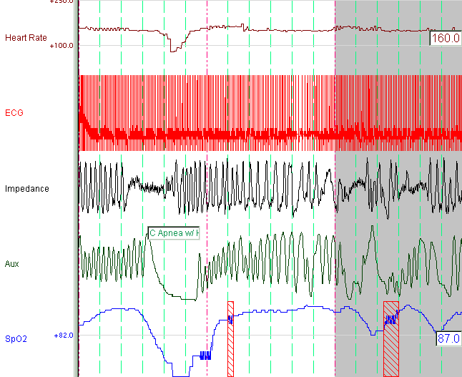
Central apnea with bradycardia et desaturation
The Aux channel is nasal CO2, and is delayed 7 seconds compared to the impedance channel.

Slide 4

Clinical Monitors
The Aux channel is nasal CO2, and is delayed 7 seconds compared to the impedance channel.
Alarme d’apnée sonne après 15 seconds (ou +)

Slide 5
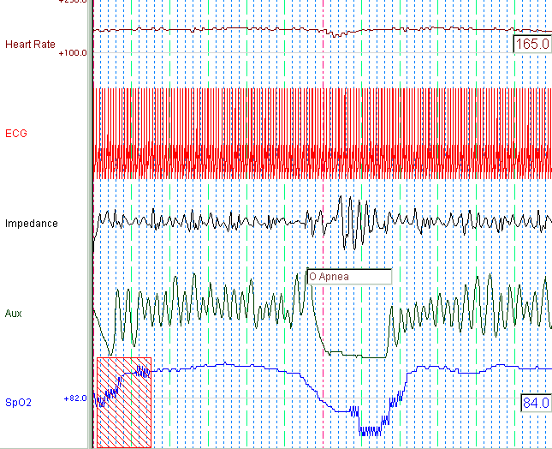
Obstructive apnea with desaturation
Signale d’impédance démontre une augmentation d’effort respiratoire durant l’obstruction

Slide 6
Clinical Monitor
Signale d’impédance démontre une augmentation d’effort respiratoire durant l’obstruction

Slide 7
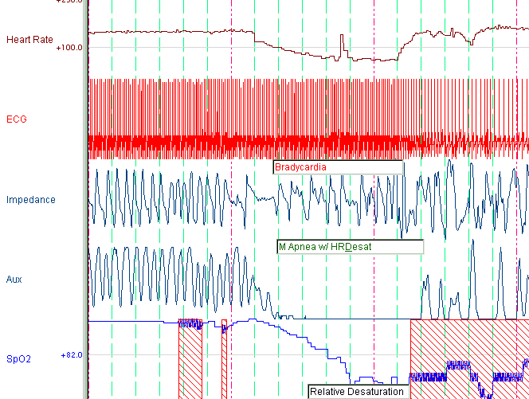
Prolonged Mixed Apnea
Desaturation down to 63%, heart rate down to 54, notice that heart rate falls simultaneously with the start of the apnea. Apnea duration 31 s.

Slide 8
Desaturation down to 63%, heart rate down to 54, notice that heart rate falls simultaneously with the start of the apnea. Apnea duration 31 s.
Pas d’alarme d’apnée

Slide 9
Proportions of different types of apnea
After the first few days, and for the majority of the hospital course, these are the usual proportions of apnea types.

Slide 10
Apnea of Prematurity:
Types of apnea
Mixed apnea: usually begins with a central event which may be short (2 - 8 seconds) and is accompanied by airway closure.
Mixed apnea are the commonest apnea in the premature infant - represents 44-60% of all Apnea
Also difficult to diagnose unless associated with significant bradycardia or desaturation
Neonates are prone to mixed apnea as their airway tends to close during central apnea

Slide 11
Aetiology
Prematurity
  80-90% of newborns < 34 weeks
  Starts 1-5 days of life
  Eventual resolution
Infection
Respiratory diseases
Airway obstruction; Atelectasis; Aspiration; MMH
Hypoxia

Slide 12
Aetiology
Less common
  Anaemia?
  Polycythemia
  Overheating
Pain
Metabolic problems
  Hypoglycaemia
  Hypocalcemia
  Hypermagnesemia
  Hypernatremia

Slide 13
Aetiology
CNS
  Intraventricular hemorrhage
  Post-hemorrhagic hydrocephalus
  Convulsions
  Meningitis
Medications
Maternal
  MgSO4
  Painkillers
Neonatal
  Anticonvulsants
  Prostaglandin E
  Analgesics/narcotics

Slide 14
Therapy for apnea
Caffeine
Possibly doxapram as a back up therapy in resistant cases
CPAP, and/or non-invasive ventilation

Slide 15

Caffeine
Adenosine A2 Receptor Blockage
Respiratory stimulation
Respiratory stabilization
Other effects
  Anti-inflammatory
  Decreased apoptosis
  Bronchodilation

Slide 16
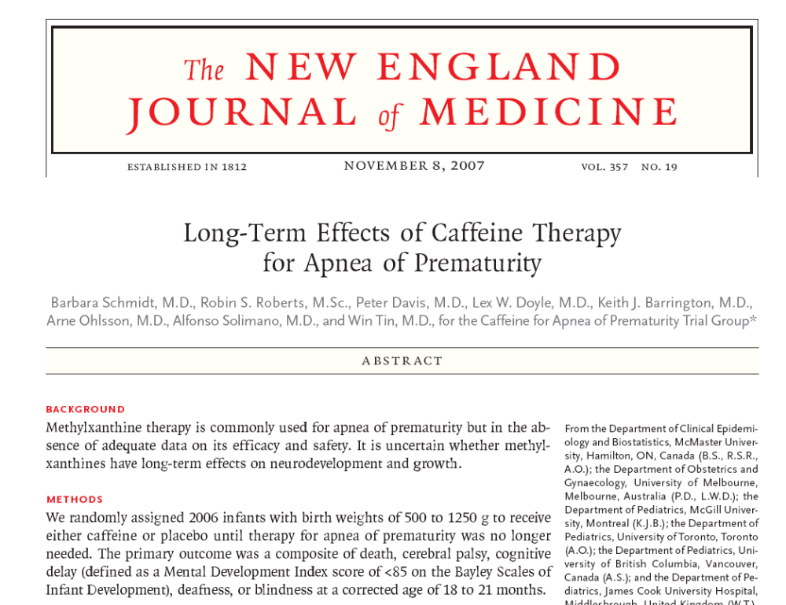

Slide 17
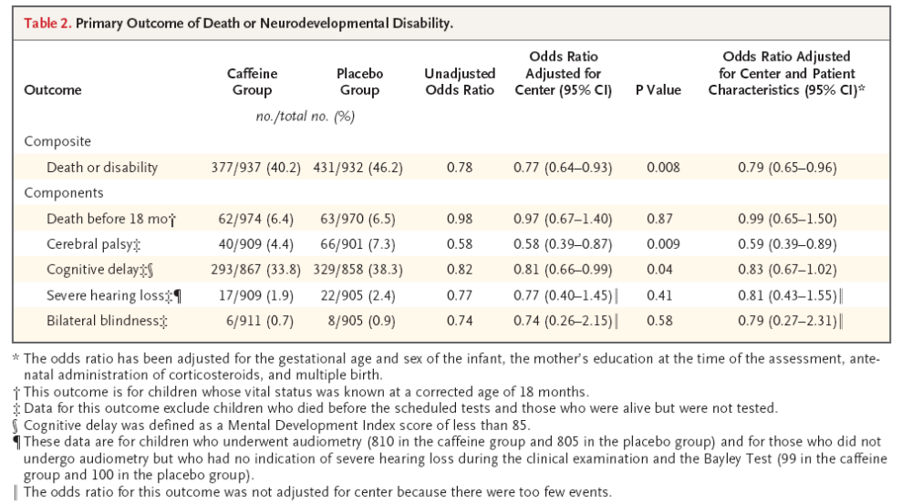

Slide 18
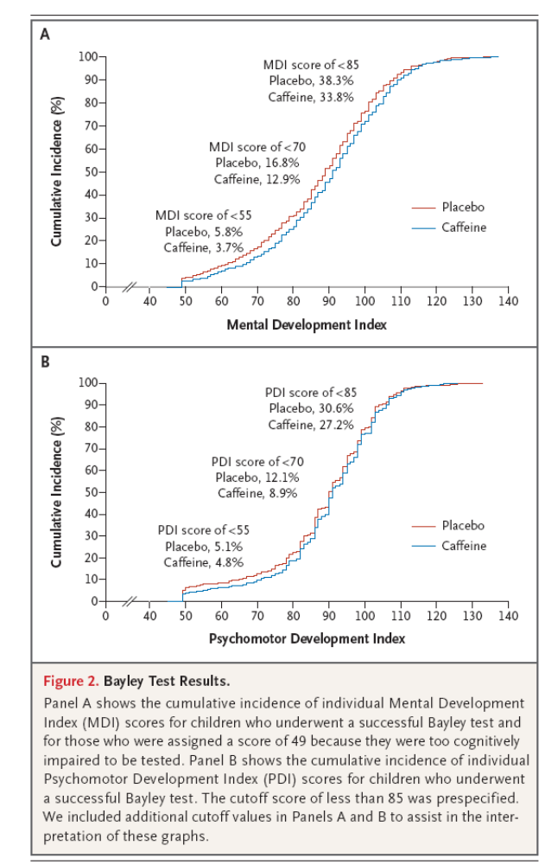

Slide 19
Caffeine
Very wide margin of safety
Few dosing indications
Dose may be increased in difficult cases
Reduces intermittent desaturation episodes
usually short mixed apneas

Slide 20
Doxapram
Respiratory stimulant which works on central respiratory drive and on the peripheral chemoreceptor
Also increases BP
Narrow margin of safety
No good evidence about long term effects: research currently being done

Slide 21
CPAP
Very effective for obstructive apneas

Slide 22
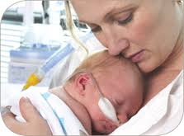
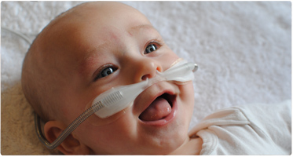
High-flow?
More comfortable and Less nasal trauma

Slide 23
High-flow for apnea?
No good studies
Could consider if it difficulty providing CPAP

Slide 24
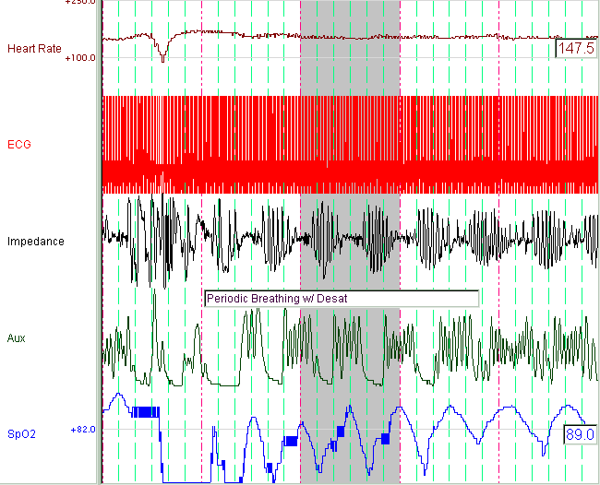
Periodic breathing
Note the cyclic desaturation,
The Aux (nasal CO2) is 7 seconds delayed compared to the impedance

Slide 25
Nasal ventilation for apnea?
Studies contradictory
Worth a trial if apnea is bad enough to consider intubation

Slide 26
Periodic Breathing
Usually no deceleration, brief desaturations
A phenomenon that is not pathological
Even when it's very prolonged
Responds to caffeine

Slide 27
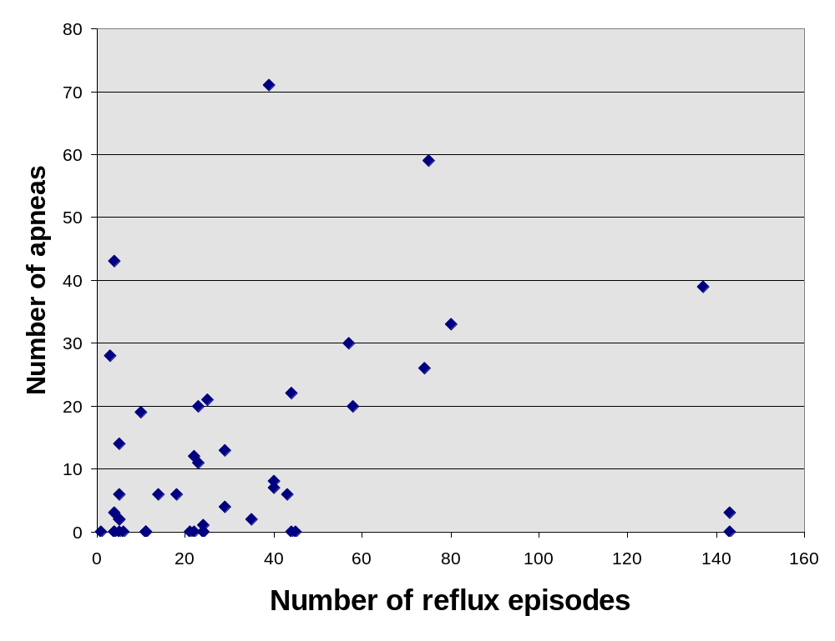
Prolonged apneas and episodes of reflux

Slide 28

Apneas and reflux?
All babies have reflux
The only reliable clinical sign of reflux is regurgitation
All other signs reported by nurses are not associated with reflux
No obvious link between apnea and reflux
Do not treat apnea with anti-reflux medication
Study Shows More Apneas with 'Anti-Reflux' Medications
No study shows less apnea

Slide 29
Even if the infant does have both reflux and apneas..
There is no medication therapy that reduces reflux
Pro-kinetics are not effective, and are toxic
(metoclopramide, domperidone, erythromycin)
Majority of reflux in newborns is not acidic
Acid blockage for apneas is not needed
Stomach acid is important, for protection against infections, absorption of iron and calcium

Slide 30
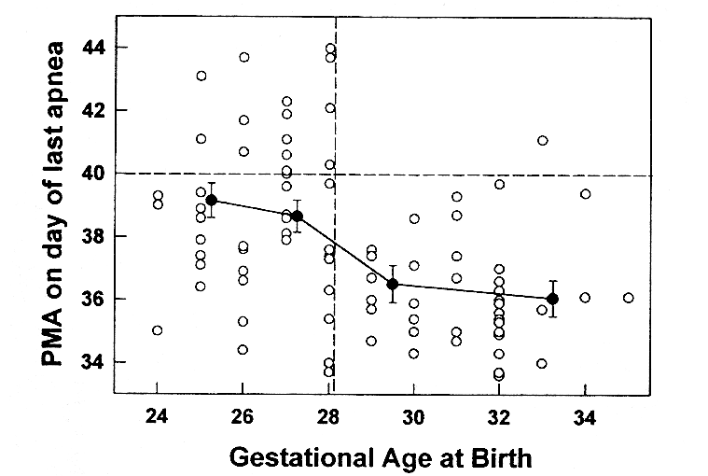
Darnall et al 1997

Slide 31
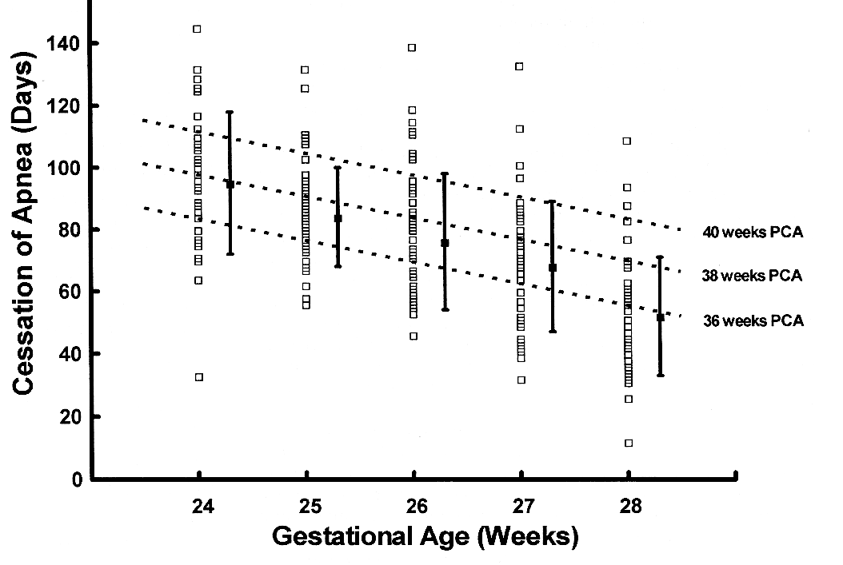
Eichenwald et al 1997

Slide 32
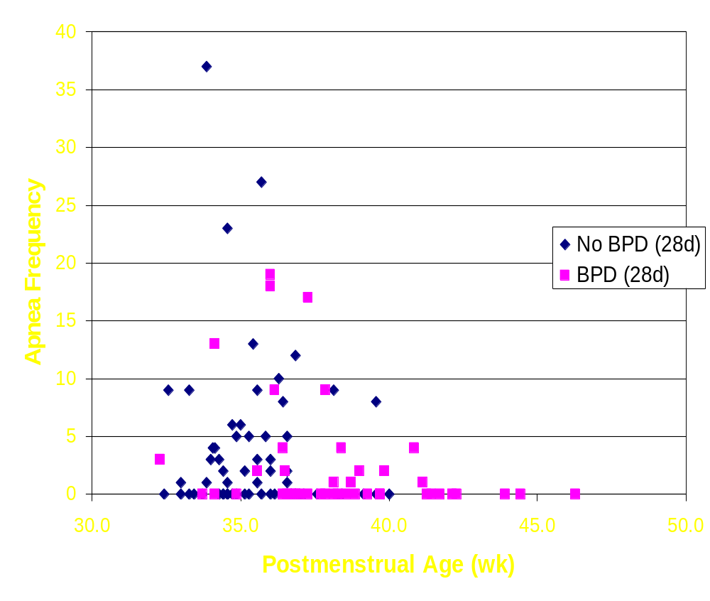
Postmenstrual Age
Notes:
BPD by 28 d definition is very frequent and not significantly correlated with persistent apnea

Slide 33
Resolution of apneas
After 5 days without an event, 95% without recurrence
After 7 days without an event, 98% without recurrence

