Slide 1
Antenatal steroids
What's new?

Slide 2
An appetizer to start
Physiology!
YEAH!
What do steroids do?
  Massive increase in surfactant production
  "up-regulation" of beta-adrenergic receptors
The effect of steroids was discovered by chance
the increase in steroid production towards the end of pregnancy prepares the lungs for extrauterine life
  Surfactant production to stabilize terminal sacs/alveoli
  Regulation of fluid in the air spaces

Slide 3
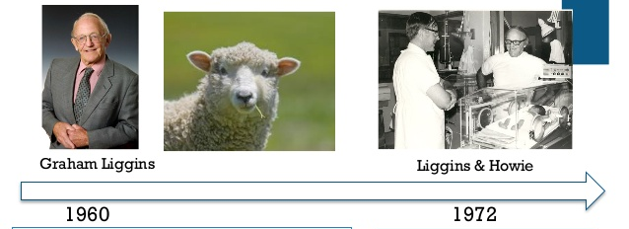
Antenatal steroids
Liggins investigated mechanisms triggering labor
Premature lambs survived
When ready for clinical study, 2 years for design, grant, enrollment and submission. 2 years for publication! (rejected by Lancet)
Liggins GC, Howie RN. A Controlled Trial of Antepartum Glucocorticoid Treatment for Prevention of the Respiratory Distress Syndrome in Premature Infants. Pediatrics. 1972;50(4):515-25.

Slide 4
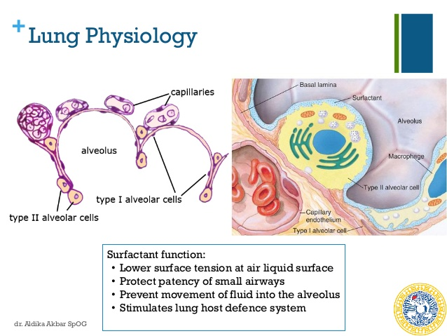

Slide 5
Transient tachypnea
Retention of fetal pulmonary fluid
  Before birth lungs produce pulmonary fluid (chloride pumps)
  After birth lungs absorb fluid (amiloride sensitive sodium pumps)
  Ultra-rapid change stimulated by catecholamines, beta-adrenergic receptors
Vaginal delivery- increase in catecholamines-increase in steroids
  Less TTNN
  And less MMH

Slide 6
Preterm delivery after 34 weeks
3 studies of the use of ANS for threatened preterm labor between 34 and 36 weeks
3 studies of ANS administration before planned cesarean section between 36 and 38 6/7 weeks

Slide 7
Characteristics | Stutchfield et al 2005 | Balci et al 2010 | Porto et al.2011 | Ahmed et al 2015 | Gyamfi-Bannerman et al 2016 | Nada et al 2016
Study location | United Kingdom | Turkey | Brazil | Egypt | United States | Egypt
Study design | Open label RCT | Open label RCT | Double blind RCT | Open label RCT | Double blind RCT | Double blind RCT
No of centers | 10 | 1 | 1 | 1 | 17 | 1
Duration of study (months) | 48 | 28 | 26 | 17 | 51 | 37
Lost to follow-up (%) | 2.9 | 0 | 12.5 | 0 | 0.1 | N/R
No of participants* | 819 (373 v 446) | 100 (50 v 50) | 273 (143 v 130) | 452 (228 v 224) | 2831 (1427 v 1400) | 1227 (616 v 611)
Inclusion criteria | Women undergoing planned cesarean delivery | Women at risk of imminent late premature delivery | Women at risk of imminent late premature delivery | Women undergoing planned cesarean delivery | Women at risk of imminent late premature delivery | Women undergoing planned cesarean delivery
Women with diabetes* | 10 (4 v 6) | Excluded | 5 (3 v 2) | N/R | Excluded | N/R
Corticosteroids used | Betamethasone | Betamethasone | Betamethasone | Dexamethasone | Betamethasone | Dexamethasone
Gestational age (weeksdays) | ≥370 | 340-366 | 340-366 | 370-396 | 340-366 | 380-386
Primary outcome | Admission to NICU | Incidence of RDS | Incidence of RDS | Incidence of RDS | Composite neonatal outcome† | NICU Admission for resp. morbidity

Slide 8
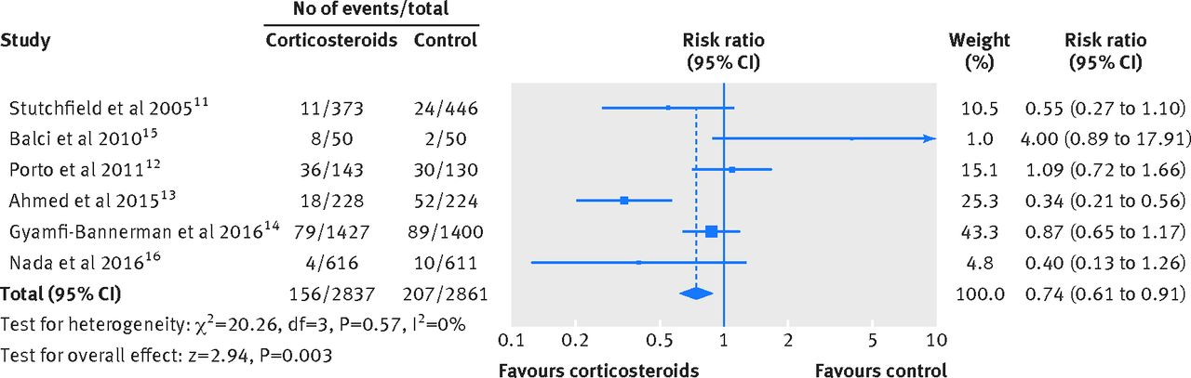
Risk of RDS

Slide 9
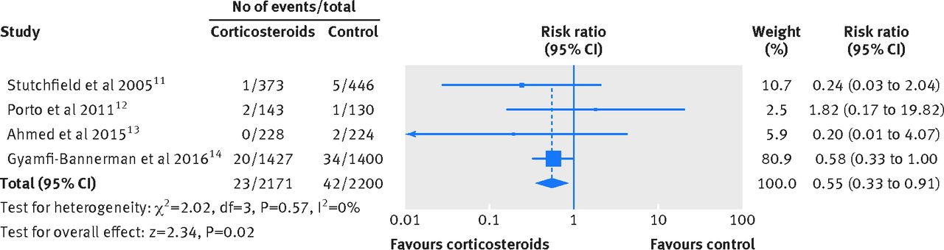
Risk of severe RDS

Slide 10
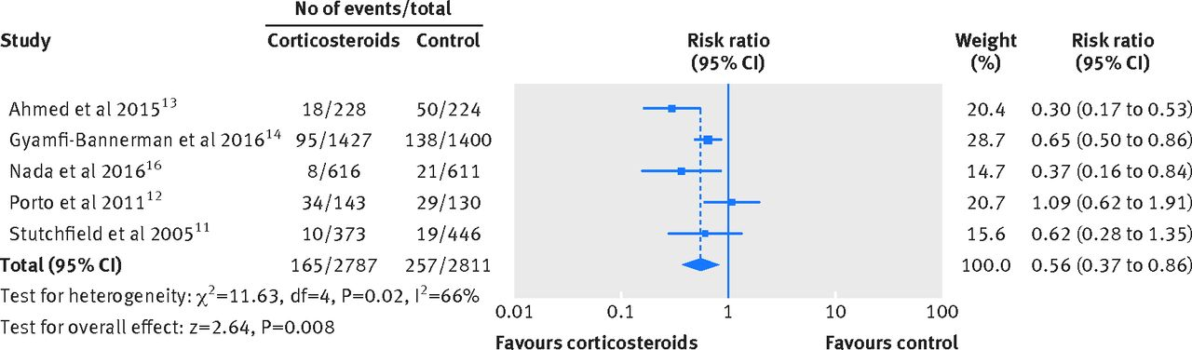
Risk of TTNN

Slide 11
ANS for threatened delivery 34 to 366
Outcomes | Summary measure (95% CI) DL
Severe RDS | 0.60 (0.33 to 0.94)
RDS | 0.98 (0.77 to 1.24)
Mild RDS | 1.09 (0.66 to 1.80)
Moderate RDS | -
Transient tachypnea of the newborn | 0.72 (0.56 to 0.92)
Use of surfactant | 0.61 (0.38 to 0.99)
Mask ventilation | 0.83 (0.67 to 1.02)
Mechanical ventilation | 0.80 (0.51 to 1.24)
Admission to NICU | 0.94 (0.87 to 1.02)
APGAR score at 1 min | −0.46* (−0.78 to 0.14)
APGAR score at 5 min | −0.62* (−0.91 to 0.33)
Neonatal hypoglycemia | 1.61 (1.38 to 1.87)
Neonatal death | 0.95 (0.20 to 4.58)

Slide 12
ANS for Term Cesarean Section
Outcomes | Summary measure (95% CI) DL
Severe RDS | 0.22 (0.04 to 1.29)
RDS | 0.40 (0.27 to 0.59)
Mild RDS | 0.43 (0.26 to 0.72)
Moderate RDS | 0.40 (0.18 to 0.88)
Transient tachypnea of the newborn | 0.38 (0.25 to 0.57)
Mechanical ventilation | 0.19 (0.08 to 0.43) (3.3% vs 0.7%)
Time on oxygen (hours) | −2.06* (−2.17 to −1.95)
Maximum inspired oxygen concentration (%) | −0.66* (−0.69 to -0.63)
Admission to NICU | 0.48 (0.19 to 1.20)
LOS in NICU (days) | −7.44* (−7.44 to −7.43)
APGAR score at 1 minutes | 0.06* (0.07 to 0.05)
APGAR score at 5 minutes | 0.06* (0.05 to 0.07)
Neonatal death | 0.50 (0.05 to 5.46)

Slide 13
Relative risk and absolute risk
Relative risk of NICU admission = 0.5
37 weeks 11.4% vs 5.2%
38 weeks 6.2% vs 2.8%
39 weeks 1.5% vs 0.6%,
“confirming a 50% reduction in respiratory morbidity up to 39 weeks gestation.” (Stutchfield et al)
Absolute risk reduction at 39 weeks =0.009, NNT=111
111 mothers must be treated before cesarean section at 39 weeks to avoid one admission to the NICU

Slide 14
Other drawbacks
Diabetic mothers excluded from most studies
Little long-term follow-up
Stutchfield et al followed, by mail, 407 of the 862 mothers/children
352 with school questionnaire

Slide 15
Stutchfield
Outcome measure: mean (SD) | Control | Betamethasone | Difference (95% CI) | Significance
 | N=190 | N=217
Hyperactivity scale | 3.06 (2.74) | 3.32 (2.85) | 0.26 (−0.29 to 0.81) | 0.19
Conduct problems scale | 1.34 (1.59) | 1.31 (1.72) | −0.03 (−0.36 to 0.29) | 0.80
Peer problems scale | 1.47 (1.88) | 1.36 (1.91) | −0.11 (−0.48 to 0.26) | 0.87
Total difficulties score | 7.85 (6.49) | 8.03 (6.83) | 0.18 (−1.12 to 1.48) | 0.19
Additional help n (%) | N=166 | N=189
 | 22 (13.3) | 34 (18.0) | χ2(1)=1.492 | 0.22
Child's quartile of ability | N=164 | N=186
Top quarter | 74 (45.1) | 70 (37.6)
Middle half | 76 (46.3) | 83 (44.6) | χ2(2)=6.74 | 0.03
Lower quarter | 14 (8.5) | 33 (17.7%)

Slide 16
Steroids near term
Effective for:
  Reduce the rate of
    MMH
    TTNN
    Admission to intensive care for respiratory distress
    Intubated children
But
    Neonatal hypoglycemia (15/143 v 9/130 et 343/1427 v 209/1400) RR=1.61 (1.38 to 1.87)
    Possibility of negative impacts on development

Slide 17
Long-term outcomes of late premature infants
Even if their pulmonary problems are improved by steroids
  More developmental and neurological problems compared to term
  Steroids should not be given to facilitate premature delivery
  The goal should always be:
  Delivery closest to term that is safe

Slide 18
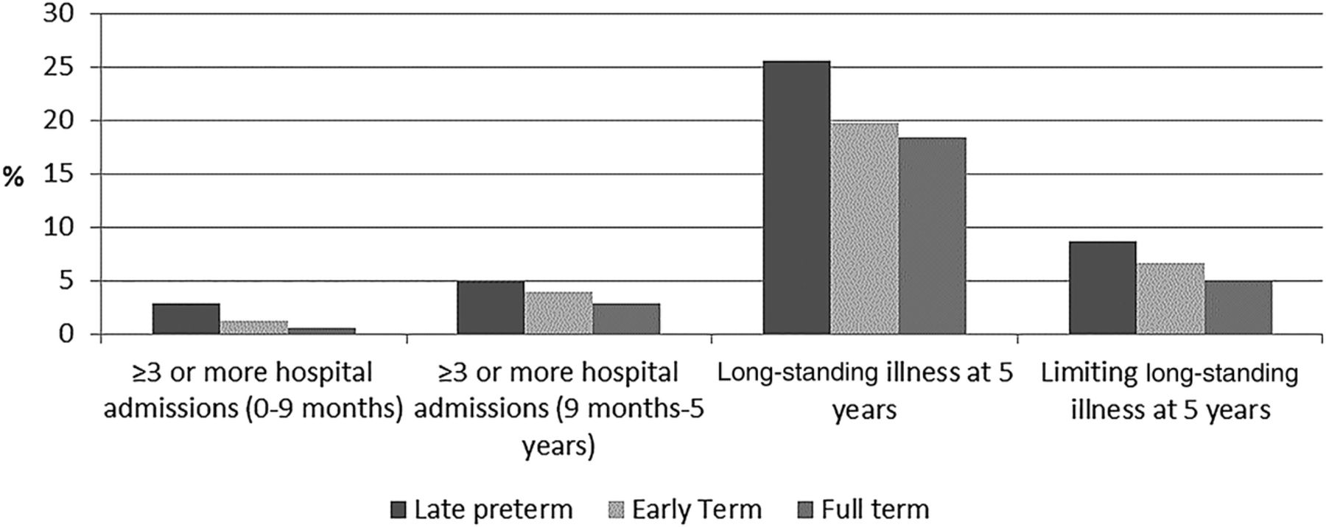
Long-term health of late preterm infants

Slide 19
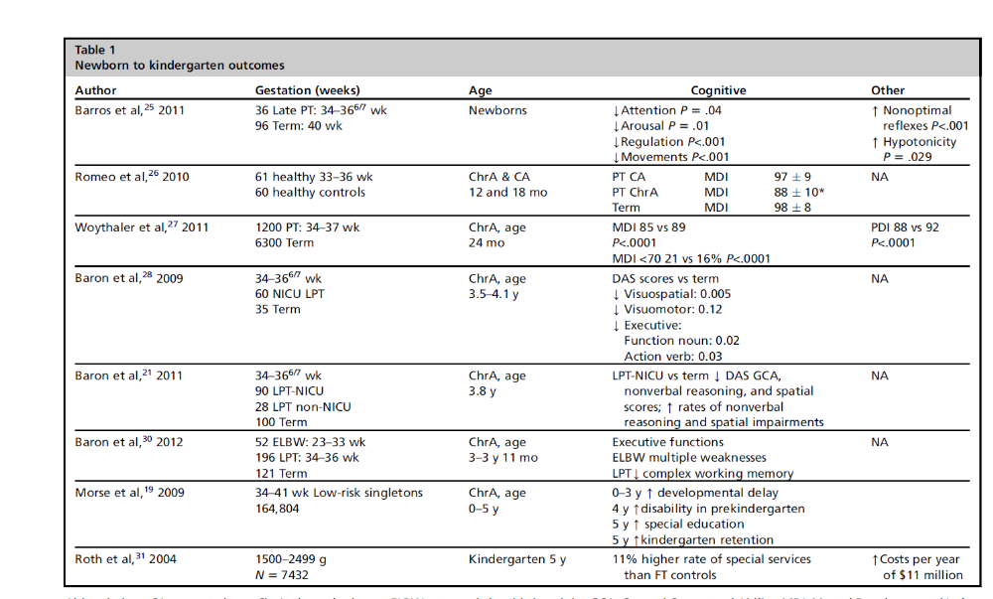

Slide 20
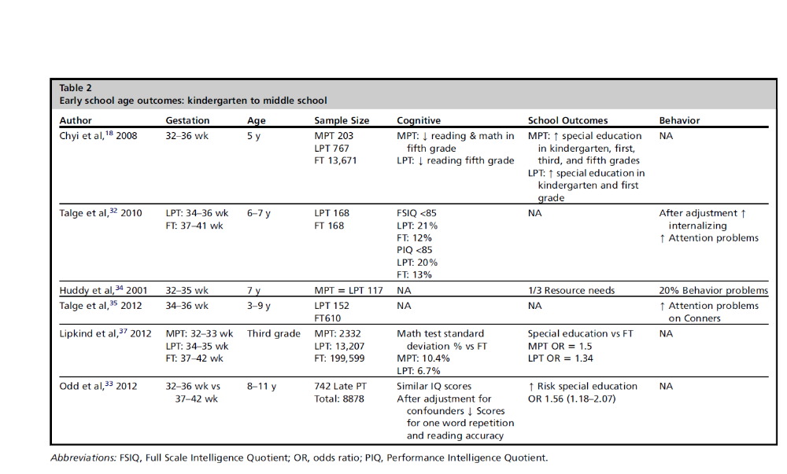

Slide 21
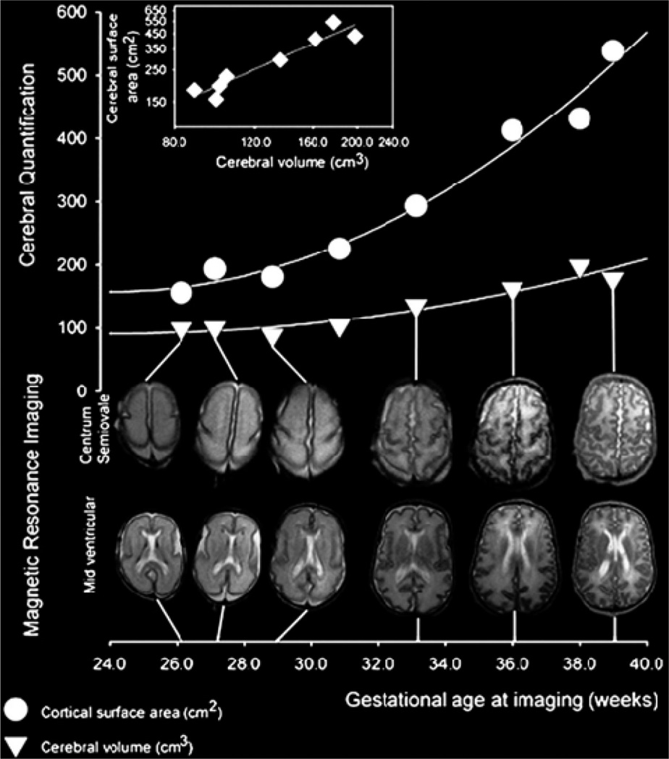

Slide 22
If there is a high risk of delivery before 366
Or there is a valid indication for delivery by elective cesarean section before 39 weeks
Steroids improve lung function,
  absolute short-term benefits are greater at 34 weeks than at 35 weeks or later
Increased risk of hypoglycemia
  Monitoring as for other risk factors
Unknown long-term risks

Slide 23
Most recent recommendations
RCOG England, 2010
.
“Who should receive antenatal corticosteroids?
Antenatal corticosteroids should be given to all women at risk of iatrogenic or spontaneous preterm birth up to 34 +6 weeks of gestation.
Antenatal corticosteroids should be given to all women for whom an elective caesarean section is planned prior to 38 +6 weeks of gestation.
There is evidence of benefit in all major subgroups of preterm babies, such as women with premature rupture of membranes and pregnancy-related hypertension syndromes as well as the subgroups discussed below.
This benefit is irrespective of race or gender. A single course of antenatal corticosteroids should be considered routine for preterm delivery with few exceptions”

Slide 24
Most recent recommendations
ACOG, 2016
“Routine Administration for Women at Risk of Imminent Preterm Birth
A single course of corticosteroids is recommended for pregnant women between 24 0/7 weeks and 33 6/7 weeks of gestation”
A single course of betamethasone is recommended for pregnant women between 34 0/7 weeks and 36 6/7 weeks of gestation at risk of preterm birth within 7 days, and who have not received a previous course of antenatal corticosteroids

Slide 25
Very premature steroids
ERC, little data before 25 weeks
Observational data

Slide 26
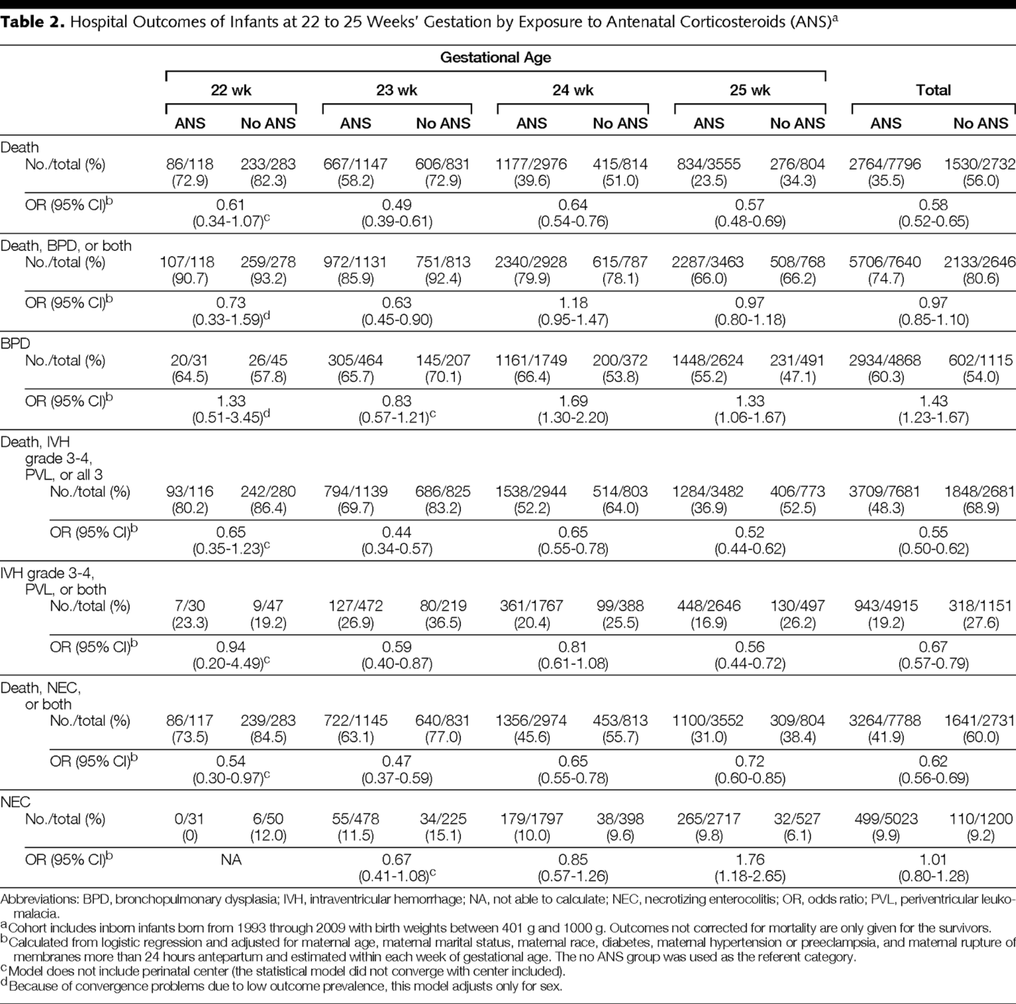
Carlo W et al: Association of Antenatal Corticosteroids With Mortality and Neurodevelopmental Outcomes Among Infants Born at 22 to 25 Weeks' Gestation
JAMA. 2011;306(21):2348-2358. doi:10.1001/jama.2011.1752

Slide 28
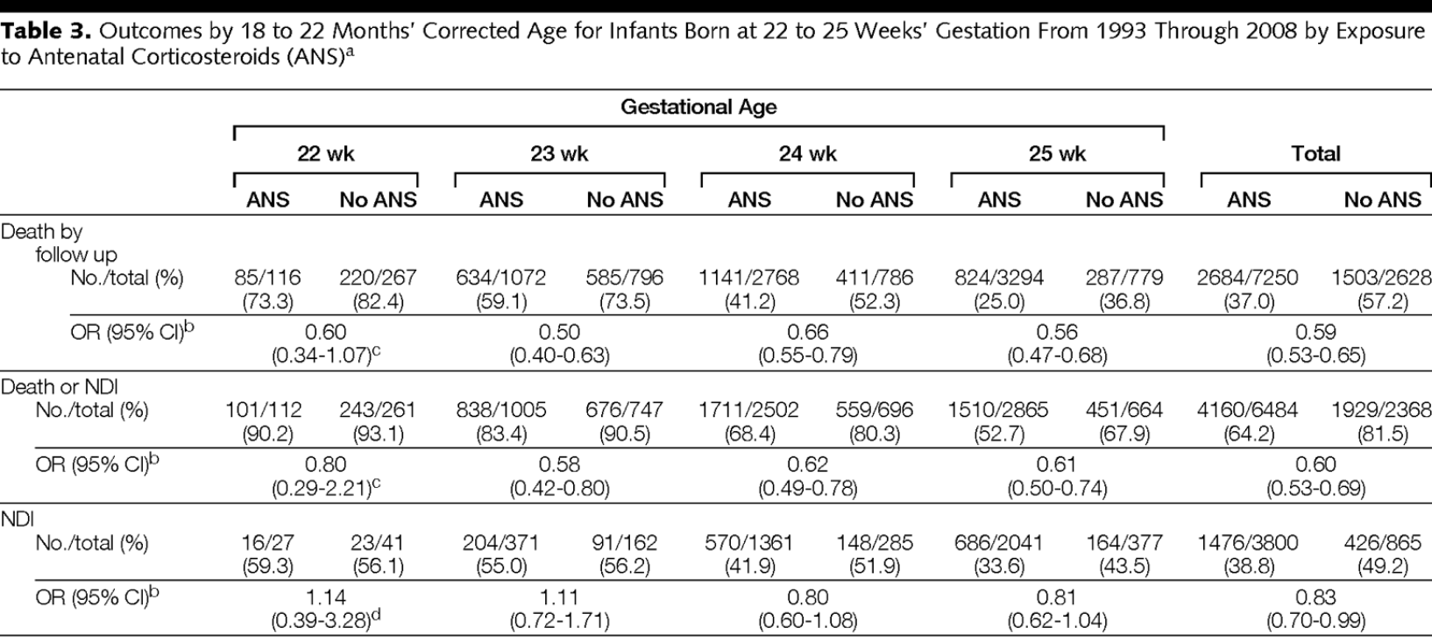
Also less hearing loss, blindness, cerebral palsy

Slide 29
Very premature steroids
No contraindication to giving steroids at 22, 23 weeks before transferring a mother to CHUSJ (or elsewhere)
Increases survival with fewer complications
We are not forced to intervene because steroids are given, this decision will be made with the parents after evaluation and review of all the facts and after discussion with our team.
Partial effects detectable after 2 to 4 hours, reduction in mortality after 12 hours,
If there is even a possibility of active intervention, give steroids as soon as the mother arrives at the hospital

Slide 30
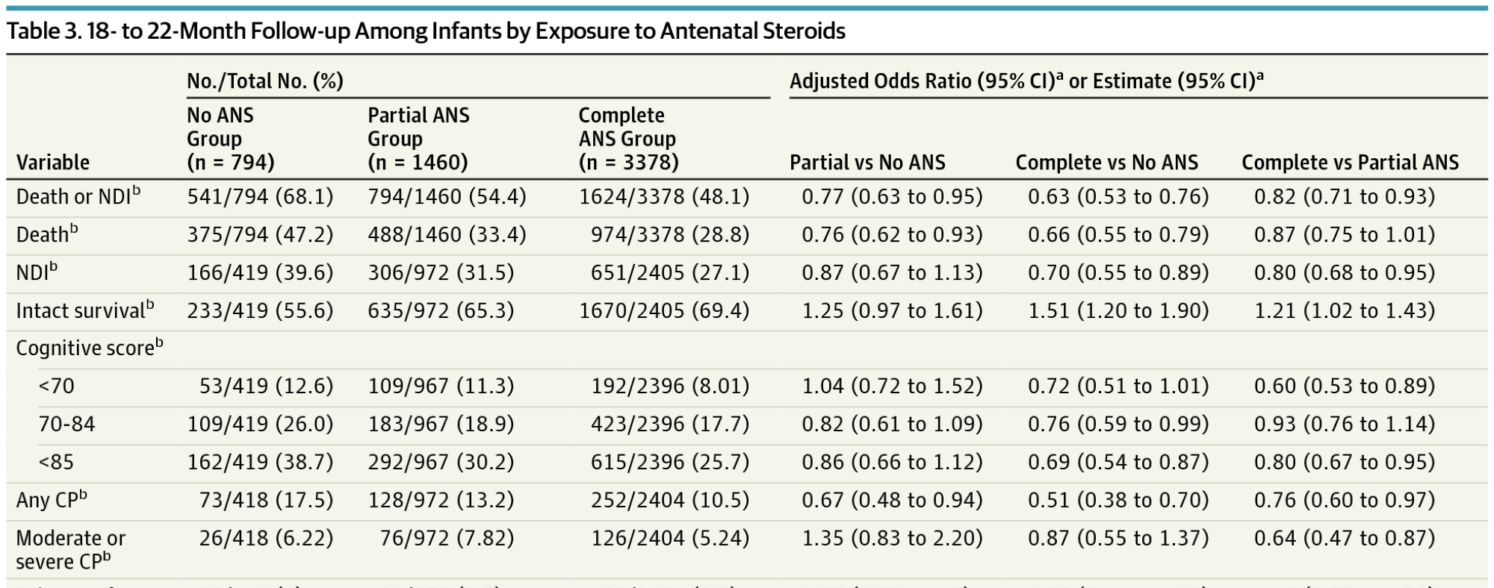
Association of Neurodevelopmental Outcomes and Neonatal Morbidities of Extremely Premature Infants With Differential Exposure to Antenatal Steroids
JAMA Pediatr. Published online October 10, 2016. doi:10.1001/jamapediatrics.2016.1936
Even a partial course improves survival and neurological/developmental outcomes

Slide 31
Multiple steroid courses?
Effects of steroids decrease after 7 to 10 days,
Can we give a second course?

Slide 32
Recommendations
RCOG : “Weekly repeat courses of antenatal corticosteroids reduce the occurrence and severity of neonatal respiratory disease, but the short-term benefits are associated with a reduction in weight and head circumference. Weekly repeat courses are not recommended.
A single rescue course may be considered with caution in pregnancies where the initial course was given at less than 26 weeks of gestation.”
ACOG : “a single repeat course of antenatal corticosteroids should be considered in women who are less than 34 0/7 weeks of gestation who have an imminent risk of preterm delivery within the next 7 days, and whose prior course of antenatal corticosteroids was administered more than 14 days previously »

