Slide 1

Early Caffeine treatment in the preterm and outcomes
Keith J Barrington

Slide 2
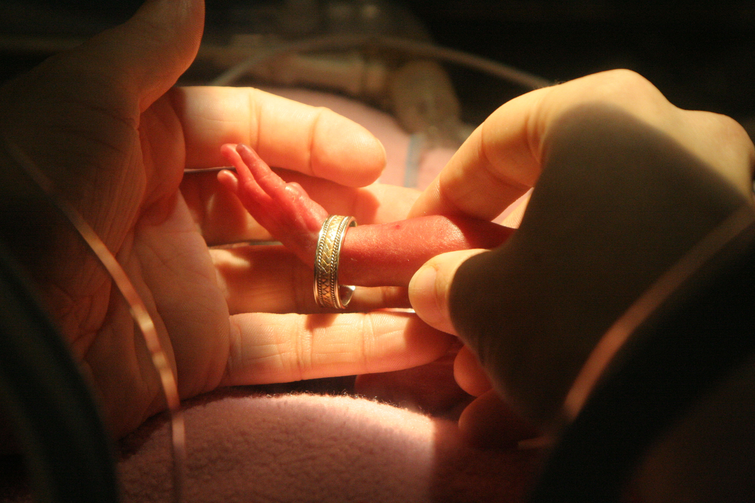

Slide 3


Slide 4
Caffeine
Adenosine receptor antagonist,
  non-selective A1 and A2a antagonist
Increases respiratory drive
  Probably also increases diaphragmatic contractility
Decreases apnea, central and mixed
Decreases intermittent hypoxia
Used since 1979 (in Montréal)

Slide 5
Caffeine actions
Apnea is related to polymorphisms of the A2a gene
  rs35320474–2592 C⁄ T and T⁄ T genotypes also associated with BPD development.
Individual caffeine response variability was found to be associated with A1 gene polymorphism

Slide 6
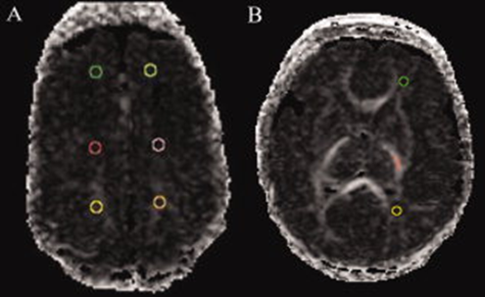
Caffeine impacts
Improves white matter development
  substantial effect on cerebral WM diffusion measures, with no effects on MR-defined cerebral injury or structure. Doyle et al 2010. Ann Neurol
Perhaps by decreasing apnea,
and the intermittent hypoxia and recurrent re-oxygenation (with hyperoxia)
but also….

Slide 7
Caffeine impacts
Decreases CNS inflammation
    Kang C-H, et al. Caffeine suppresses lipopolysaccharide-stimulated BV2 microglial cells by suppressing Akt-mediated NF-κB activation and ERK phosphorylation. Food and Chemical Toxicology. 2012;50(12):4270-6.
Protects against hypoxia induced apoptosis
    Kumral A, et al. Protective Effects of Methylxanthines on Hypoxia-Induced Apoptotic Neurodegeneration and Long-Term Cognitive Functions in the Developing Rat Brain. Neonatology 2010;98(2):128-36.
Protects lungs against hyperoxia
    Nagatomo T, et al. Caffeine Prevents Hyperoxia-Induced Functional and Structural Lung Damage in Preterm Rabbits. Neonatology. 2016;109(4):274-81.

Slide 8
Outline
Who should receive caffeine?
When should it be started?
When should it be stopped?
What dose should we give?

Slide 9
Who should receive caffeine?
Outcomes were all improved (or unaffected) in the CAP trial
No major adverse effects
Some slowing of growth velocity, which caught up after the caffeine ended
Criteria for trial entry
< 1250 g birth weight
<10 days of age
Considered for caffeine therapy by the attending
    treatment of apnea, prophylaxis of apnea, or to aid extubation
Outcomes improved BPD, PDA ligation, and severe retinopathy.

Slide 10
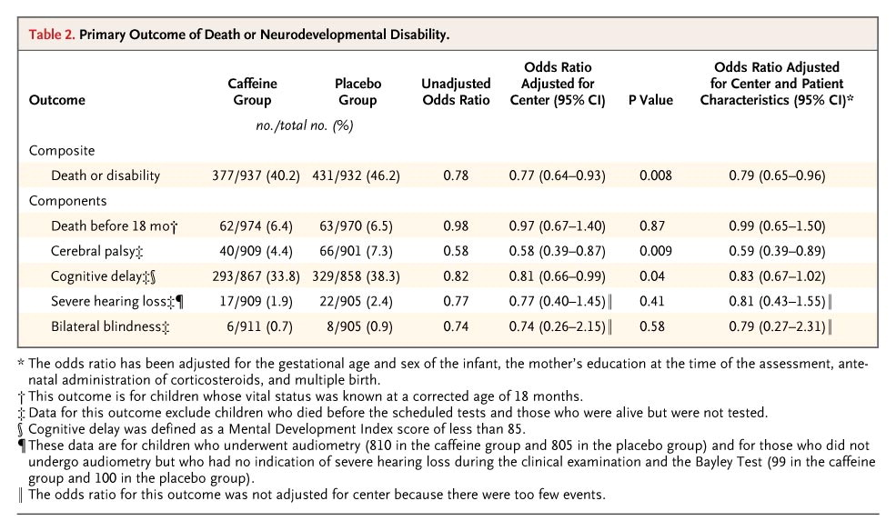

Slide 11
CAP Study
Incidence of Cerebral Palsy
8
7.3 %
7
6
5
4.4 %
%
P = 0.009
OR = 0.58 (0.39 – 0.87)
4
3
2
1
0
Placebo
Caffeine

Slide 12
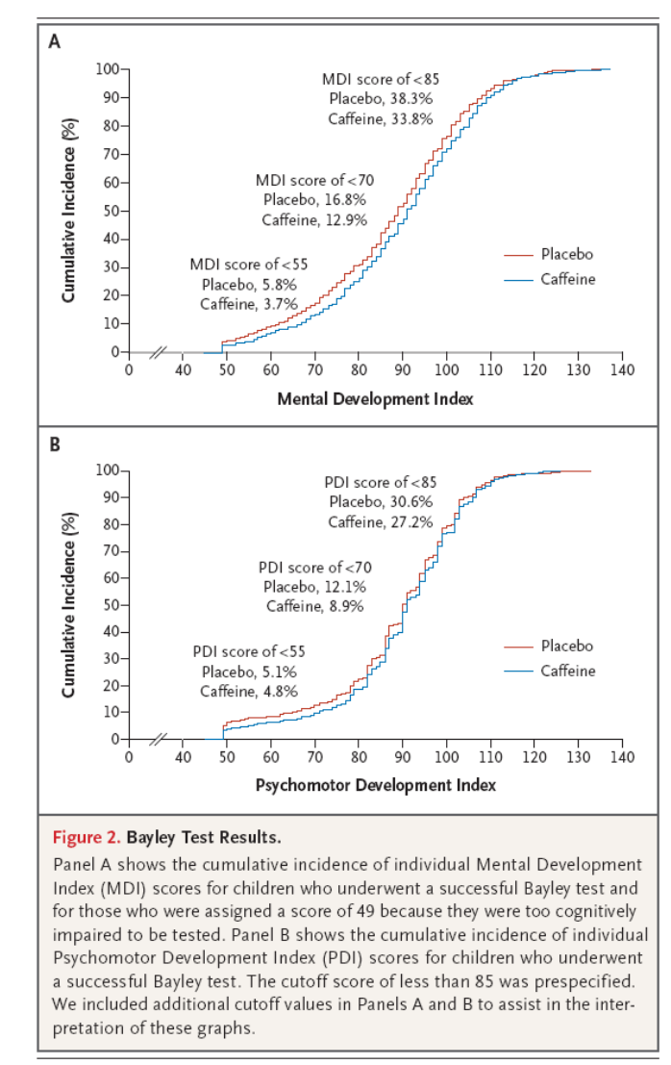

Slide 13
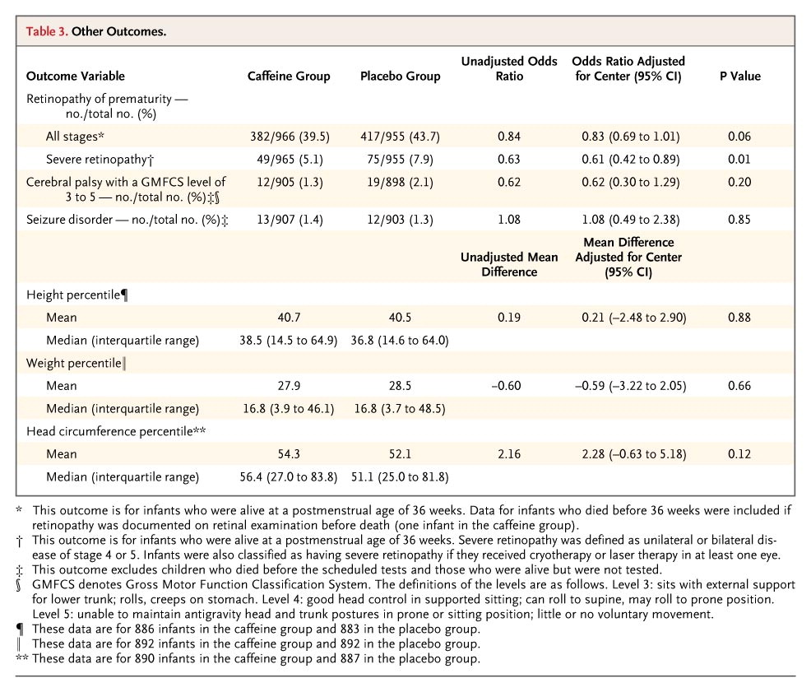

Slide 14
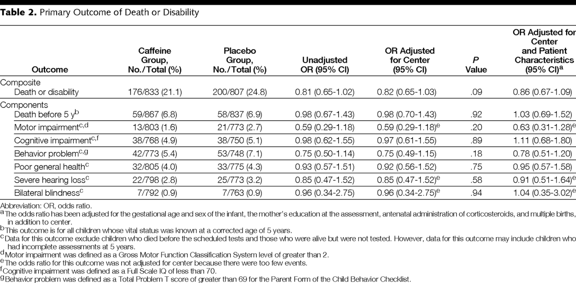
Outcome at 5 years

Slide 15
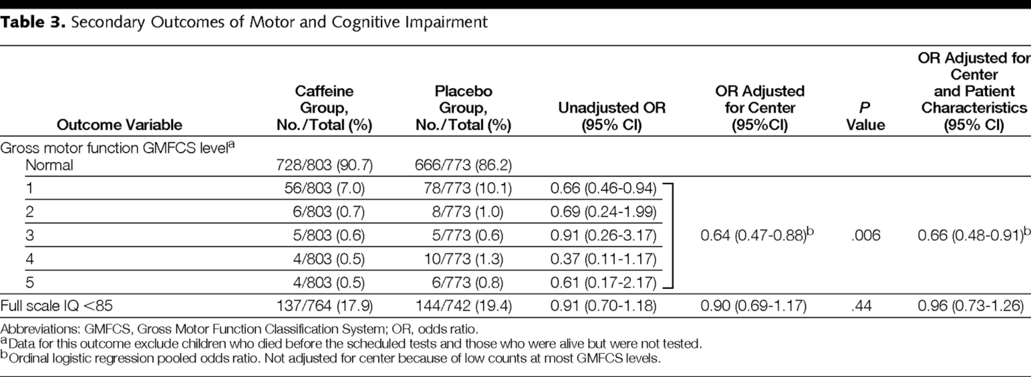
5 year outcomes

Slide 16
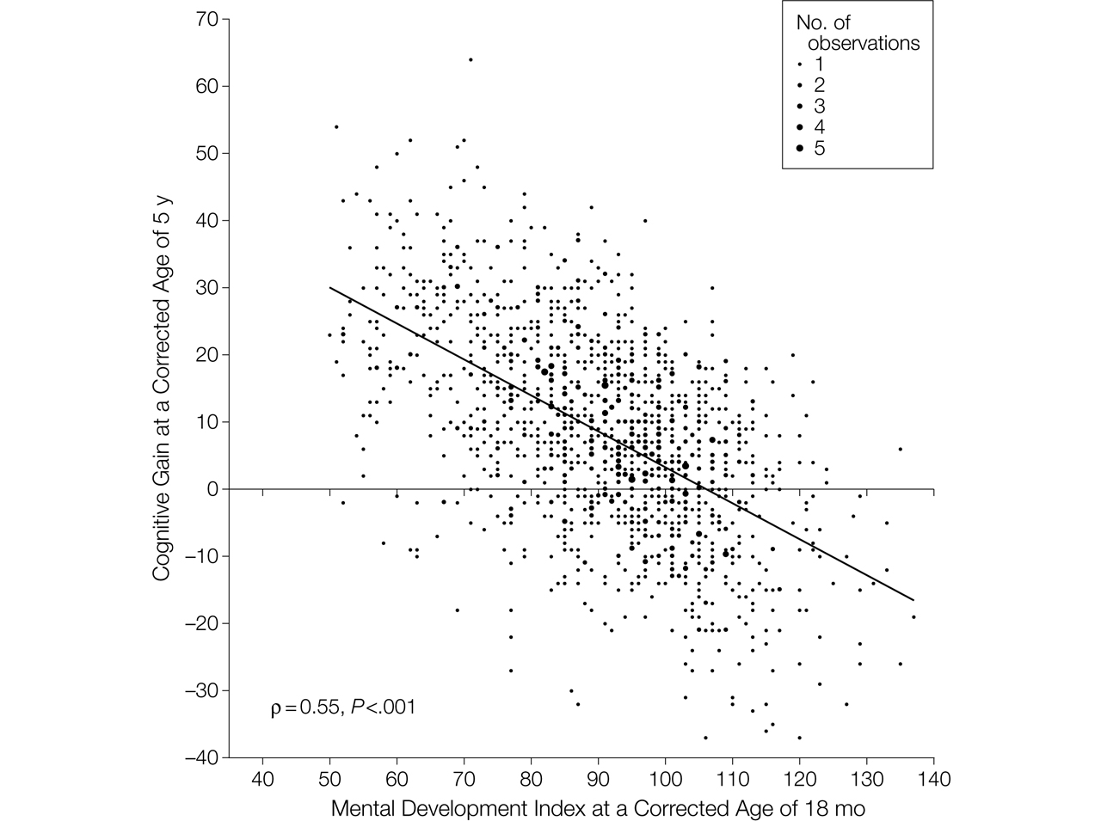

Figure 2. Relationship Between Mental Development Index Scores at 18 Months and Gain in Cognitive Scores Between 18 Months and 5 Years.
Schmidt, B. et al. JAMA 2012;307:275-282
Notes:
Cognitive gain was computed by subtracting the individual Mental Development Index scores at 18 months from the corresponding Wechsler Preschool and Primary Scale of Intelligence III (WPPSI-III) Full Scale IQ. Data are shown for the 1419 children who underwent a successful Bayley II test at 18 months and a successful WPPSI-III test at 5 years. For this analysis, we excluded children with Mental Development Index scores below 50 (the lowest score in the Bayley II) and with a Full Scale IQ below 40 (the lowest score in the WPPSI-III). The size of each data point is proportional to the number of coincident observations (range, 1 to 5). The solid diagonal line is the best-fitting regression line between the observed gain in cognitive scores at 5 years and the Mental Development Index scores at 18 months. ρ Is the correlation coefficient.

Slide 17
Developmental Co-ordination disorder at 5 y
Movement ABC < 5 %le despite IQ in the « normal » range
 | Caffeine | Placebo | Adjusted for center OR (95% CI) | Adjusted for center and covariates∗ OR (95% CI)
DCD† | 83/735 (11.3%) | 106/698 (15.2%) | 0.70 (0.51,0.95) P = .024 | 0.71 (0.52, 0.97) P = .032

Slide 18
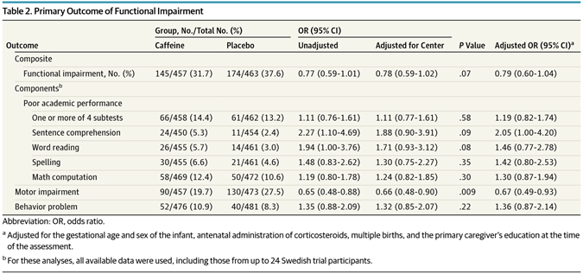
11 year outcomes, JAMA Pediatrics, april 2017

Slide 19
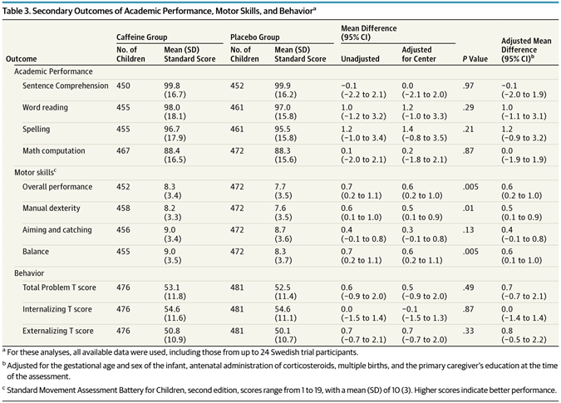
11 year outcomes

Slide 20
Who should receive caffeine?
How to apply the evidence base to an individual patient?
Patients who fit strictly in the entry criteria of the pivotal trial?
Patients who fit any of the entry criteria in any positive trial?
Only patients in subgroups of positive trials that showed benefit?
Patients in subgroups of negative trials that showed benefit?
Patients sufficiently similar to those in positive trials, and who are at risk of the adverse outcomes which were improved in those trials?

Slide 21
The patients in positive trials
Up to about 32 weeks gestation (CAP 27 + 2, weeks 10% were SGA)
Receiving respiratory support or not
Having apnea or at risk of apnea

Slide 22
When should caffeine be started?
Some of the advantages of caffeine in the CAP trial were more evident when started early <72 hours
No outcomes were better in the later use group
    Subgroup analysis, not preplanned

Slide 23
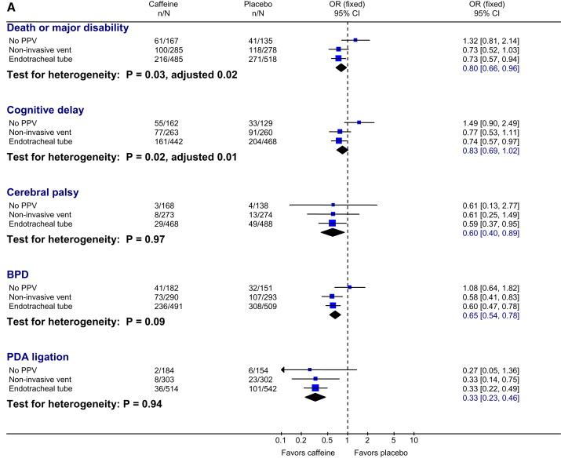
Davis PG, et al. Caffeine for Apnea of Prematurity Trial: Benefits May Vary in Subgroups. The Journal of Pediatrics 2010

Slide 24
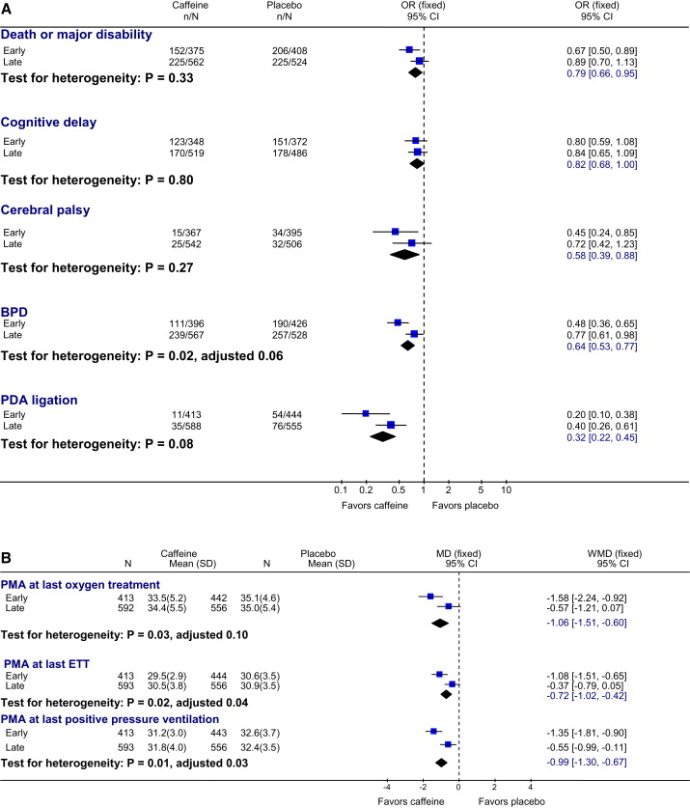

Slide 25
When should caffeine be started?
With very early treatment
Cardiac output appears to increase
  Four studies with measurement of right ventricular output by echo after early caffeine (one controlled and blinded)
  About a 25% increase in RVO after early caffeine
Improve rate of early extubation
Prevent intubation if on CPAP or non-invasive ventrilation

Slide 26
Lodha A, et al. Association of early caffeine administration and neonatal outcomes in very preterm neonates. JAMA Pediatr. 2015;169(1):33-8.
CNN analysis
<31 wk GA
Received caffeine
<48h vs >48h

Slide 27
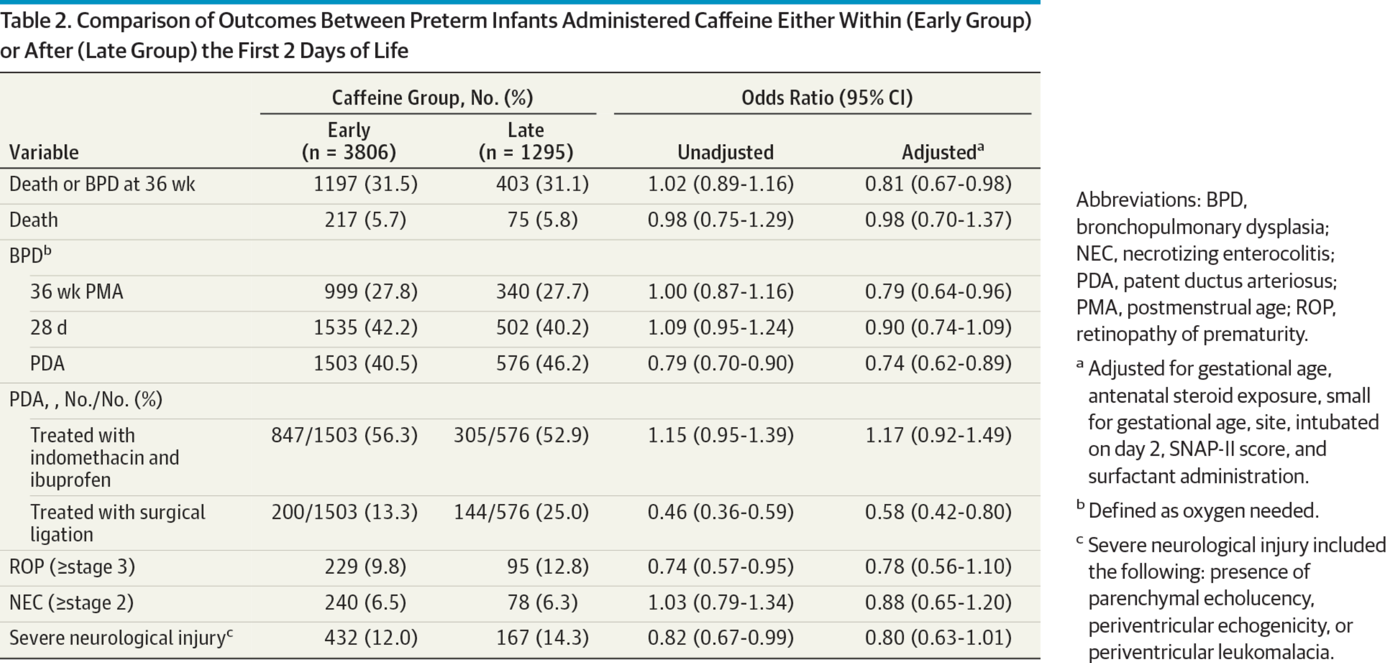
From: Association of Early Caffeine Administration and Neonatal Outcomes in Very Preterm Neonates, Lodha A et al
JAMA Pediatr. 2015;169(1):33-38. doi:10.1001/jamapediatrics.2014.2223
Comparison of Outcomes Between Preterm Infants Administered Caffeine Either Within (Early Group) or After (Late Group) the First 2 Days of Life

Slide 28
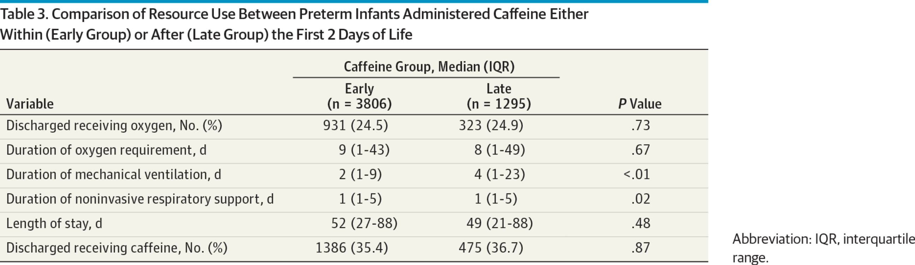
From: Association of Early Caffeine Administration and Neonatal Outcomes in Very Preterm Neonates
JAMA Pediatr. 2015;169(1):33-38. doi:10.1001/jamapediatrics.2014.2223

Slide 29
What dose to use?
CAP trial load of 20 mg/kg of caffeine citrate followed by 5 mg/kg/day, allowed increase up to 10 mg/kg if desired by the attending
Subgroup analysis showed no harm in those who had a dose increase

Slide 30
CAP study dose effects
In a secondary analysis
Babies who had an increase in the placebo dose had more cerebral palsy! 5.7% vs 8.5% (but the interaction was not Statistically significant)
The benefits of caffeine were also seen in babies who had increased dose, 4.5% had CP

Slide 31
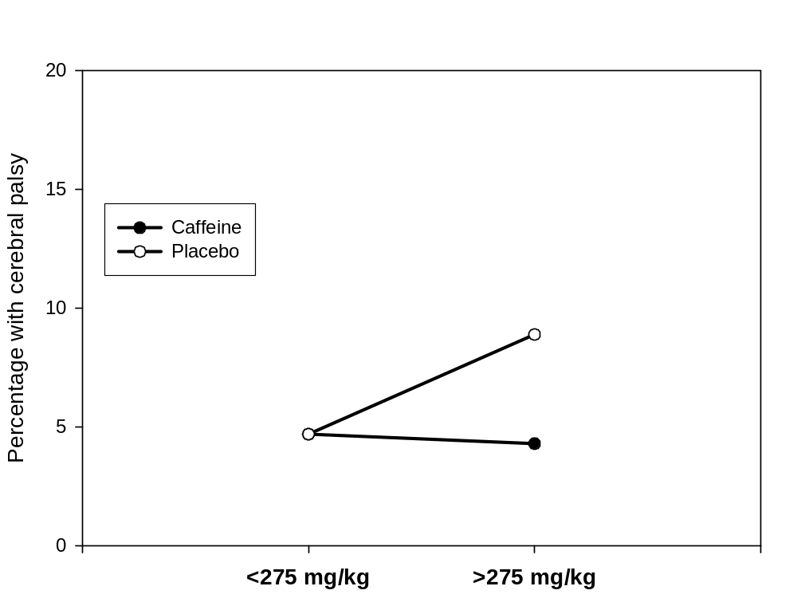
Total dose received
Interaction p=0.093
OR 1.00
(0.49, 2.03)
OR 0.46
(0.26, 0.81)

Slide 32
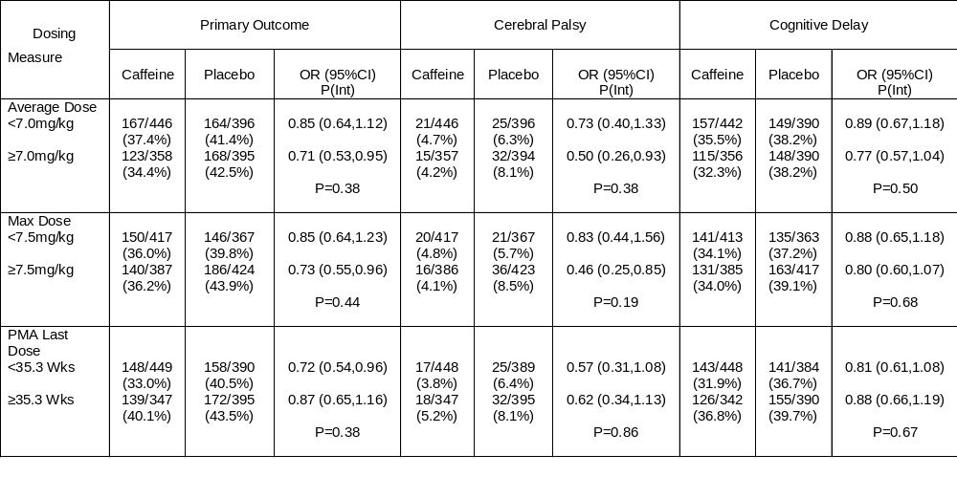
Results, other dosing metrics

Slide 33
Higher dose may be effective
Mohammed S, et al. High versus low-dose caffeine for apnea of prematurity: a randomized controlled trial. Eur J Pediatr. 2015;174(7):949-56.
  RCT 40 per group, less apnea with 40 mg/kg load and 20 mg/kg/d
Steer P, et al. High dose caffeine citrate for extubation of preterm infants: a randomised controlled trial. Arch Dis Child Fetal Neonatal Ed. 2004;89(6):F499-503.
  RCT, fewer extubation failures with 80 mg/kg load and 20 mg/kg/d cf 20 mg/kg load and 5 mg/kg/d

Slide 34
Higher dose may not be safe
McPherson C, et al. A pilot randomized trial of high-dose caffeine therapy in preterm infants. Pediatr Res. 2015;78(2):198-204.
  RCT in 72 infants, increased cerebellar hemorrhage with 80 mg/kg load over 36 h or 30 mg/kg over 36 h, followed by 10 mg/kg/d
Vesoulis ZA, et al. Early High-Dose Caffeine Increases Seizure Burden in Extremely Preterm Neonates: A Preliminary Study. Journal of Caffeine Research. 2016;6(3):101-7.
  Same trial showed increased seizure burden with higher dose
Hoecker C, et al. Caffeine Impairs Cerebral and Intestinal Blood Flow Velocity in Preterm Infants. Pediatrics. 2002;109(5):784-7.
  Observation of 50 mg/kg load, decrease in cerebral and intestinal blood flow velocity by doppler (n=16)

Slide 35
What dose to use?
The CAP dosing regime is safe and effective
Some higher dosing regimes may increase extubation success and decrease apnea further, but may not be safe.

Slide 36
When should it be stopped?
In the CAP trial there were no strict criteria
When the attending thought the infant no longer needed it, on average 34 weeks.
Many such infants are still having apnea, many are still having intermittent hypoxia (probably mostly related to apnea)
Caffeine reduces intermittent hypoxia close to term
Apnea at discharge associated with worse outcomes
Apnea after discharge associated with worse outcomes
Should we be continuing caffeine much longer than we now do?

Slide 37
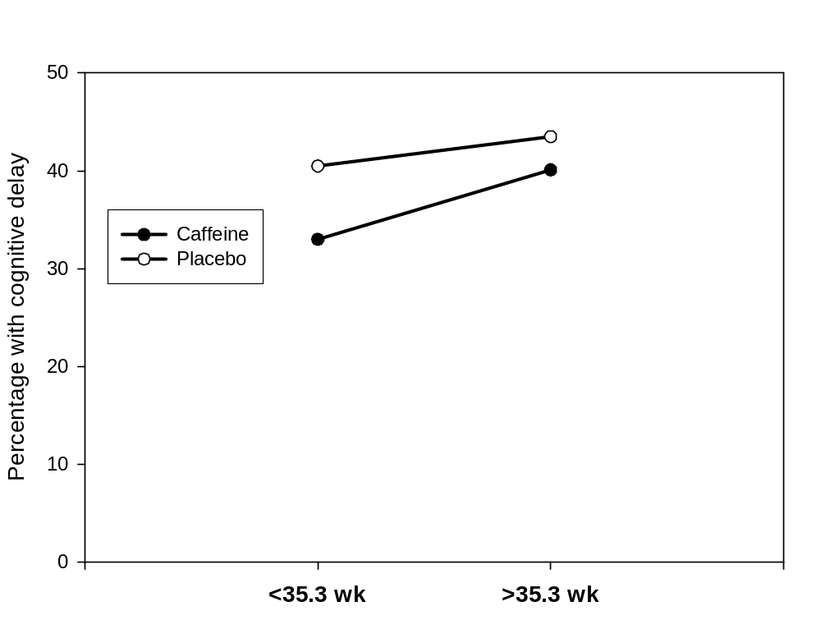
Caffeine dose response
0.72 (0.54,0.96)
Postmenstrual age of last caffeine dose
OR 0.87 (0.65, 1.16)
OR 0.72 (0.54, 0.96)
Interaction, p=0.38

Slide 38
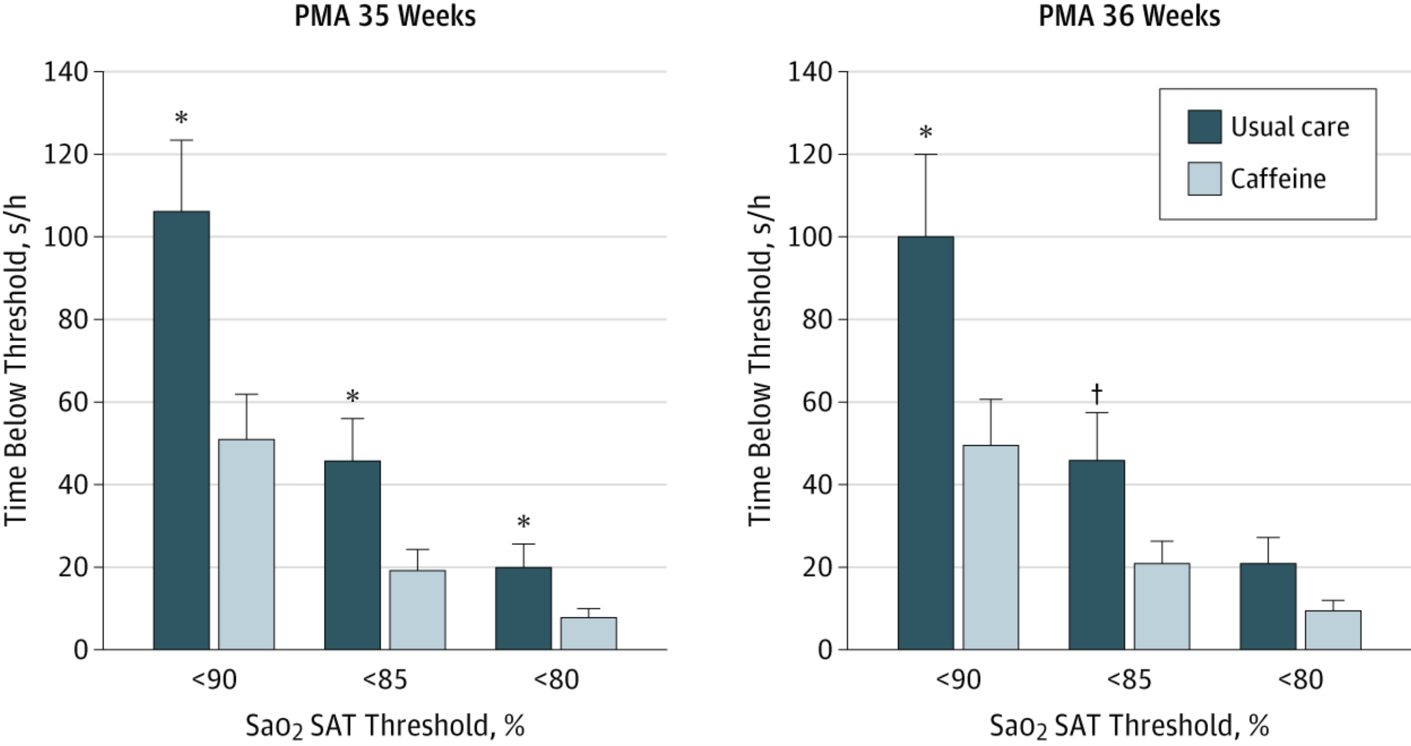
From: Effects of Caffeine on Intermittent Hypoxia in Infants Born PrematurelyA Randomized Clinical Trial
JAMA Pediatr. 2014;168(3):250-257. doi:10.1001/jamapediatrics.2013.4371
With extended caffeine treatment, intermittent hypoxia at the less-than-80% threshold was decreased by 64% at 35 weeks’ PMA (P = .002), but the 45% decrease at 36 weeks’ PMA was only borderline significant (P = .051).

Slide 39
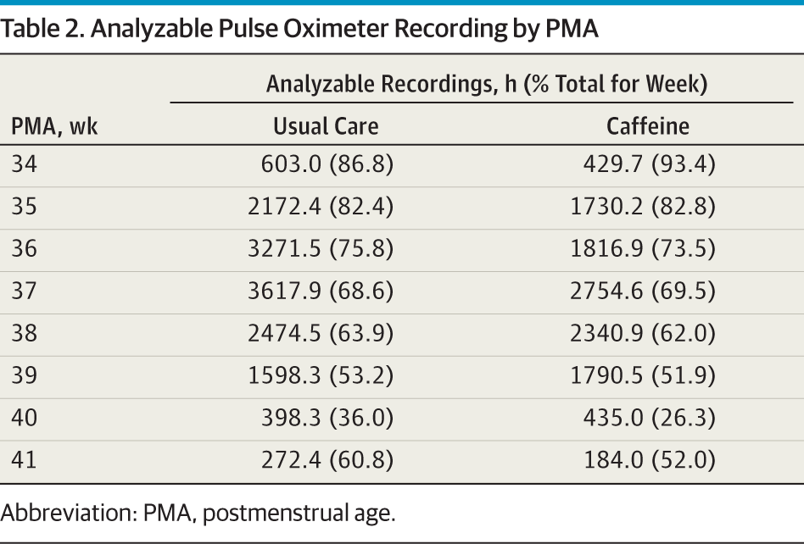

Slide 40
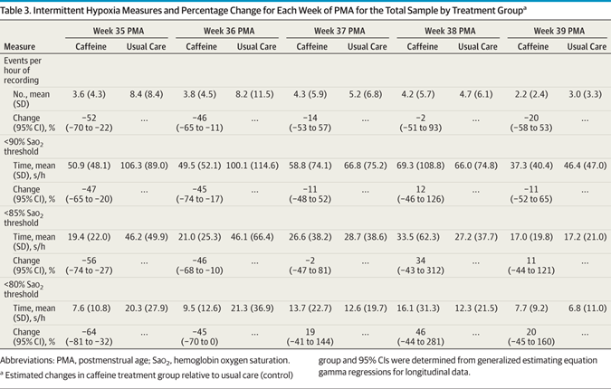

Slide 41
Duration of caffeine therapy
There is a need for trials of caffeine prolongation, that should probably continue to 42 to 44 weeks PMA
May decrease apnea/intermittent hypoxia
May further improve long term outcomes
Safe to discontinue caffeine at home?

Slide 42
