Slide 1

Treating Hypotension in the Preterm Newborn:
Keith J Barrington
CHU Ste Justine
Montréal

Slide 2


Slide 3
Hypotension in Preterm Infants
Common practice in the NICU, to treat preterm infants with a mean arterial blood pressure in mmHg < gestational age in weeks, regardless of clinical signs, regardless of any indication of poor perfusion
Many receive a fluid bolus (or 2 or 3 or 4) and then dopamine.
If the blood pressure remains « low » then dobutamine is added, and/or hydrocortisone.

Slide 4
Hypotension in Preterm Infants
What is hypotension?
Why do we worry about it?
Why are babies hypotensive?
Is there evidence that hypotension needs treating?
Do we know what to treat it with?
How are we going to answer these questions?

Slide 5
Laughon et al: the ELGAN study
 | Total n | No Treatment n=249 | Any Treatment n = 1138 | Vasopressor Treatment n = 470
Gestnl age, wk |  | Proportion of Infants, % | P = .001 | P .0005
23 | 85 | 7 | 93 | 52
24 | 246 | 10 | 90 | 47
25 | 289 | 16 | 84 | 34
26 | 338 | 18 | 82 | 32
27 | 429 | 27 | 73 | 25

Slide 6
Variability in « any » Rx
Center % Treated Lowest MAP d1 OR (95% CI) Adjusted OR (95% CI)
A | 29 | 28 | 1 |  | 1c
B | 46 | 27 | 2 | (1–4) | 3 | (1–6)
C | 61 | 20 | 4 | (2–7) | 5 | (2–10)
D | 69 | 24 | 5 | (3–9) | 9 | (5–18)
E | 80 | 25 | 9 | (5–20) | 33 | (14–80)
F | 85 | 24 | 13 | (6–27) | 25 | (11–56)
G | 91 | 23 | 24 | (11–50) | 44 | (19–102)
H | 92 | 23 | 26 | (13–52) | 54 | (25–118)
I | 93 | 23 | 32 | (7–145) | 84 | (17–404)
J | 93 | 25 | 34 | (15–78) | 80 | (32–203)
K | 94 | 22 | 37 | (16–82) | 58 | (24–140)
L | 94 | 23 | 39 | (14–106) | 92 | (31–275)
M | 96 | 26 | 65 | (19–225) | 105 | (29–385)
N | 98 | 23 | 116 | (27–504) | 299 | (65–1383)

Slide 7
Variability in inotrope Rx
Center % Treated Lowest MAP d1 OR (95% CI) Adjusted OR (95% CI)
A | 6 | 19 | 1 | 1c
N | 12 | 20 | 2 | (1–6) | 3 | (1–9)
F | 15 | 21 | 3 | (1–7) | 3 | (1–10)
M | 18 | 25 | 3 | (1–9) | 4 | (2–12)
D | 20 | 22 | 4 | (1–10) | 5 | (2–14)
B | 27 | 37 | 6 | (2–15) | 8 | (3–22)
H | 32 | 21 | 7 | (3–17) | 12 | (5–30)
K | 38 | 21 | 9 | (4–22) | 11 | (4–27)
C | 44 | 19 | 12 | (4–30) | 19 | (7–52)
J | 46 | 23 | 13 | (5–31) | 25 | (10–65)
I | 48 | 25 | 14 | (5–42) | 34 | (11–107)
E | 52 | 24 | 16 | (6–42) | 48 | (17–132)
G | 60 | 23 | 22 | (9–54) | 35 | (14–91)
L | 64 | 24 | 26 | (10–67) | 61 | (23–165)

Slide 8
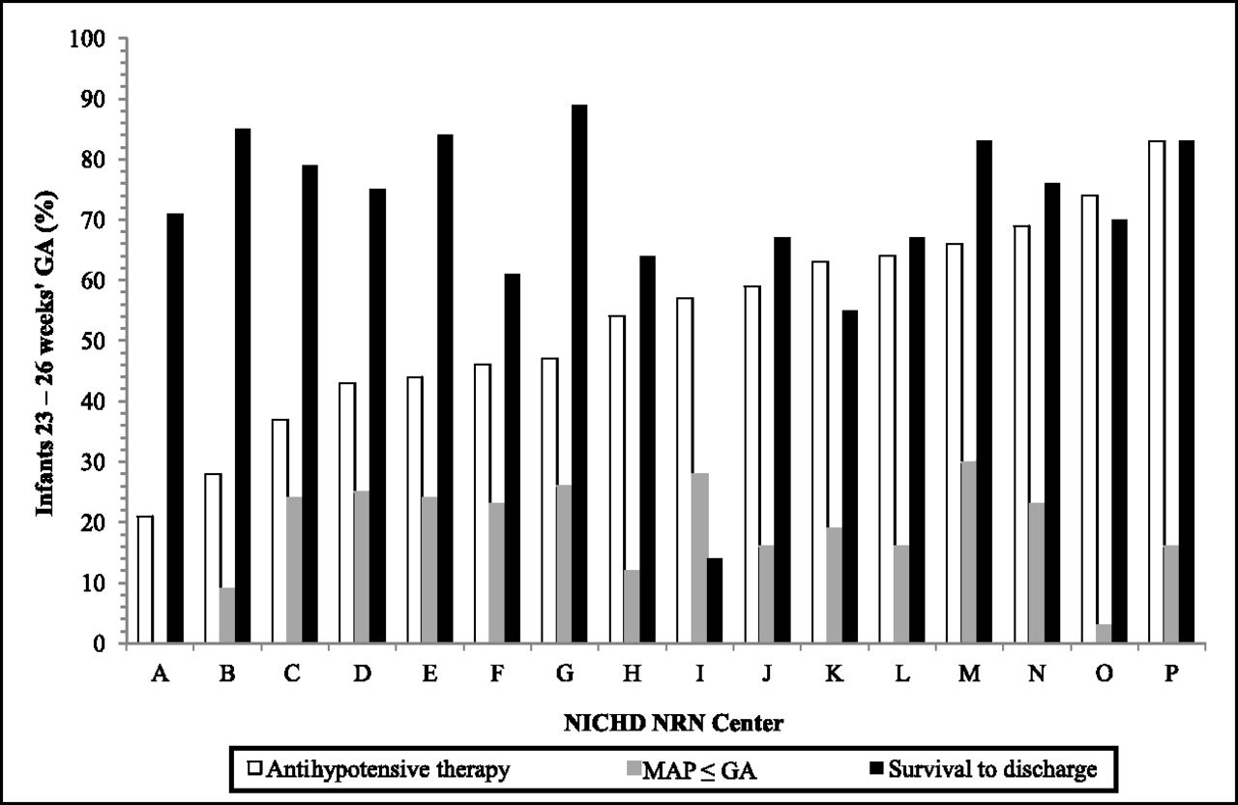

Center variation in the rate of antihypotensive therapy administration, frequency of low BP, and incidence of hospital survival.
Batton B et al. Pediatrics 2013;131:e1865-e1873
©2013 by American Academy of Pediatrics
Notes:
Center variation in the rate of antihypotensive therapy administration, frequency of low BP, and incidence of hospital survival.

Slide 9
In-hospital Outcomes for Infants Who Did or Did Not Receive Antihypotensive Therapy in the First 24 Hours
.
In-hospital Outcomes | No Therapy (n= 164) | Administered Therapy (n = 203) | P Value
Necrotizing enterocolitis requiring surgery, n (%) | 11 (7) | 16 (8) | .92
Bronchopulmonary dysplasia, n (%) | 75 (46) | 92 (45) | .26
Cystic periventricular leukomalacia,n (%) | 7 (4) | 11 (5) | .60
Intervention for ROP, n (%) | 13 (8) | 31 (15) | .03
(Any) IVH, n (%) | 43 (26) | 83 (41) | <.01
Grade 3/4 IVH, n (%) | 18 (11) | 44 (22) | <.01
Survived 24 h, n (%) | 156 (95) | 186 (92) | .19
Survived ≥1 week, n (%) | 146 (89) | 174 (86) | .20
Survived to hospital discharge, n(%) | 128 (78) | 137 (67) | .02
Morbidity-free survival,ª n (%) | 24 (15) | 11 (5) | <.01

Slide 10
What is hypotension?
Could define
  Statistically, according to a predefined percentile
  Physiologically, according to a limit shown to be associated with poorer outcomes
  Operationally, according to a limit below which treatment improves outcomes

Slide 11
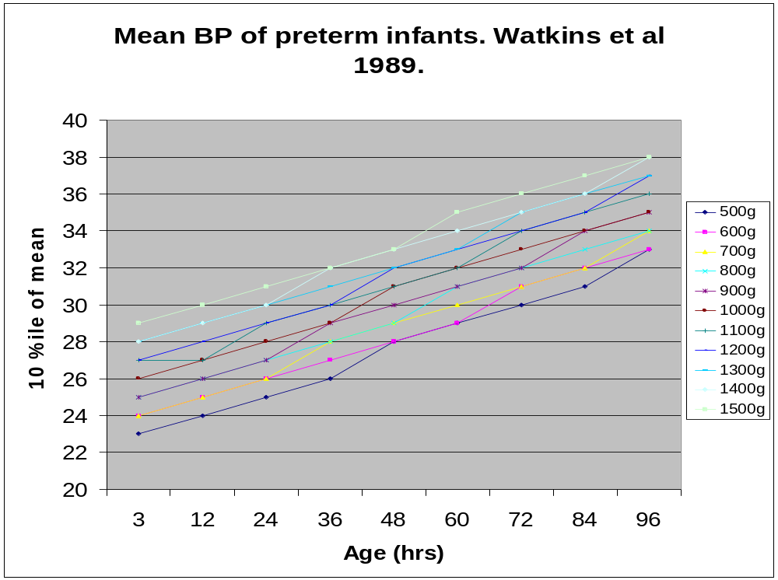
Notes:
Le Dr Watkins et al développaient les dixième pourcentiles de la TA moyenne pour chaque cent grammes tranche de poids à la naissance. Ils démontraient que les TA montent toutes les 12 heures, et que les enfants qui ont une TA moins que les dixième pourcentiles pour plus de 2 heures ont une fréquence élevée d’hémorragies cérébrales.

Slide 12
A physiologic definition: Is hypotension related to survival or long term outcomes?
Systematic review of the literature, found 16 studies that looked carefully at this issue
The answer…
Unclear!
The majority of studies have shown some correlation between lower BP and poor outcomes BUT
  Many excluded the treated infants from the cohort defining norms then included them when determining harm...
  Impossible to determine a threshold for treatment AND
  Systematic biases in many of them:
    For example: same BP used as threshold for all infants (Miall-Allen et al 30 mmHg)
    If you use the same threshold for everyone, the more immature babies will be more likely hypotensive, and they have the worse outcomes

Slide 13
Operational definition: Is there evidence that treating hypotension improves outcomes?
Fluid Boluses compared to no intervention
  Never studied in hypotensive preterm infants
Inotrope/Pressors compared to no intervention
  Never studied in hypotensive preterm infants
Steroids compared to no intervention
  Never studied in hypotensive preterm infants
No level 1 or 2 evidence of benefit, level 3 evidence of harm

Slide 14
Do we know what to treat it with?
Dopamine versus dobutamine, 5 trials
  Dopamine more likely to increase BP than dobutamine
Crystalloid versus colloid, 3 trials.
FFP versus albumin, 1 trial
Dopamine versus albumin, 2 trials
Dopamine versus hydrocortisone,1 trial
All were much too small to show a clinically important difference in survival or other complications
Commonly NO REPORT of clinically important outcomes.

Slide 15
Do we know what to treat it with?
Steroids in inotrope and fluid treated infants compared to no additional treatment
4 very small trials
Example:
  Preterm infants with mean BP < GA, all receiving ≥ 10 μg/kg/min of dopamine after ≥30 mL/kg of normal saline, randomized to 3 mg/kg/d of hydrocortisone for 5 days.
  Hydrocortisone infants had slightly faster decrease in dopamine dose, but no clinical differences in outcomes
Conclusion giving one toxin decreases the use of another toxin!

Slide 16
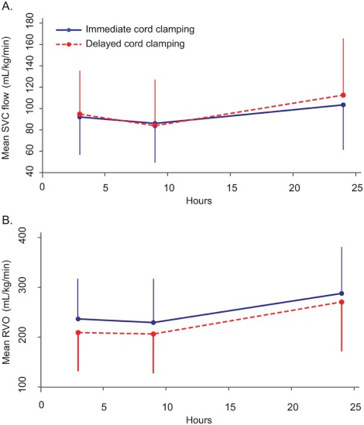
Why are preterm babies ‘hypotensive’?
No association with hypovolemia
  4 studies with measurements of circulating blood volume and blood pressure
260 babies randomized in the APTS trial

Slide 17
Popat H, et al. Effect of Delayed Cord Clamping on Systemic Blood Flow: A Randomized Controlled Trial. The Journal of pediatrics. 2016;178:81-6.e2.
Cardiorespiratory and blood gas data around time of echocardiography (n [%] unless otherwise specified)
 | 3 (3-6) h |  | 9 (6-12) h |  | 24 (20-28) h
Immediate cord clamping | Delayed cord clamping | Immediate cord clamping | Delayed cord clamping | Immediate cord clamping | Delayed cord clamping
n | 129 | 131 | 131 | 133 | 132 | 133
Heart rate | 147(15) | 149(14) | 146(12) | 146(13) | 146(15) | 148(13)
Blood pressure nearest to echocardiography, mean(SD) mm Hg
Systolic BP | 46(9) | 47(11) | 49(10) | 49(10) | 53(10) | 53(11)
Diastolic BP | 26(6) | 27(7) | 29(6) | 29(6) | 30(6) | 32(8)
Mean BP | 34(6) | 35(7) | 37(6) | 37(6) | 39(7) | 40(8)

Slide 18
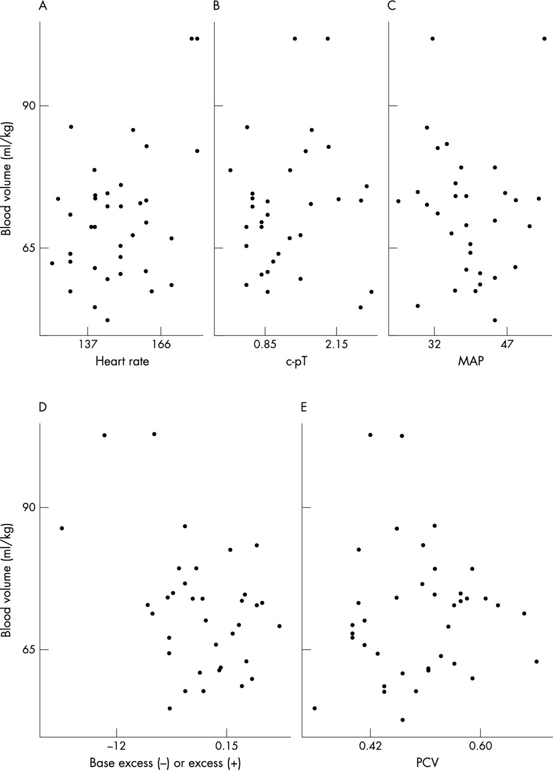

Plots of blood volume against each of the potential explanatory variables. c-pT, Core-peripheral temperature difference; MAP, mean arterial pressure; PCV, packed cell volume.
Aladangady N et al. Arch Dis Child Fetal Neonatal Ed 2004;89:F344-F347
Notes:
Plots of blood volume against each of the potential explanatory variables. c-pT, Core-peripheral temperature difference; MAP, mean arterial pressure; PCV, packed cell volume.

Slide 19
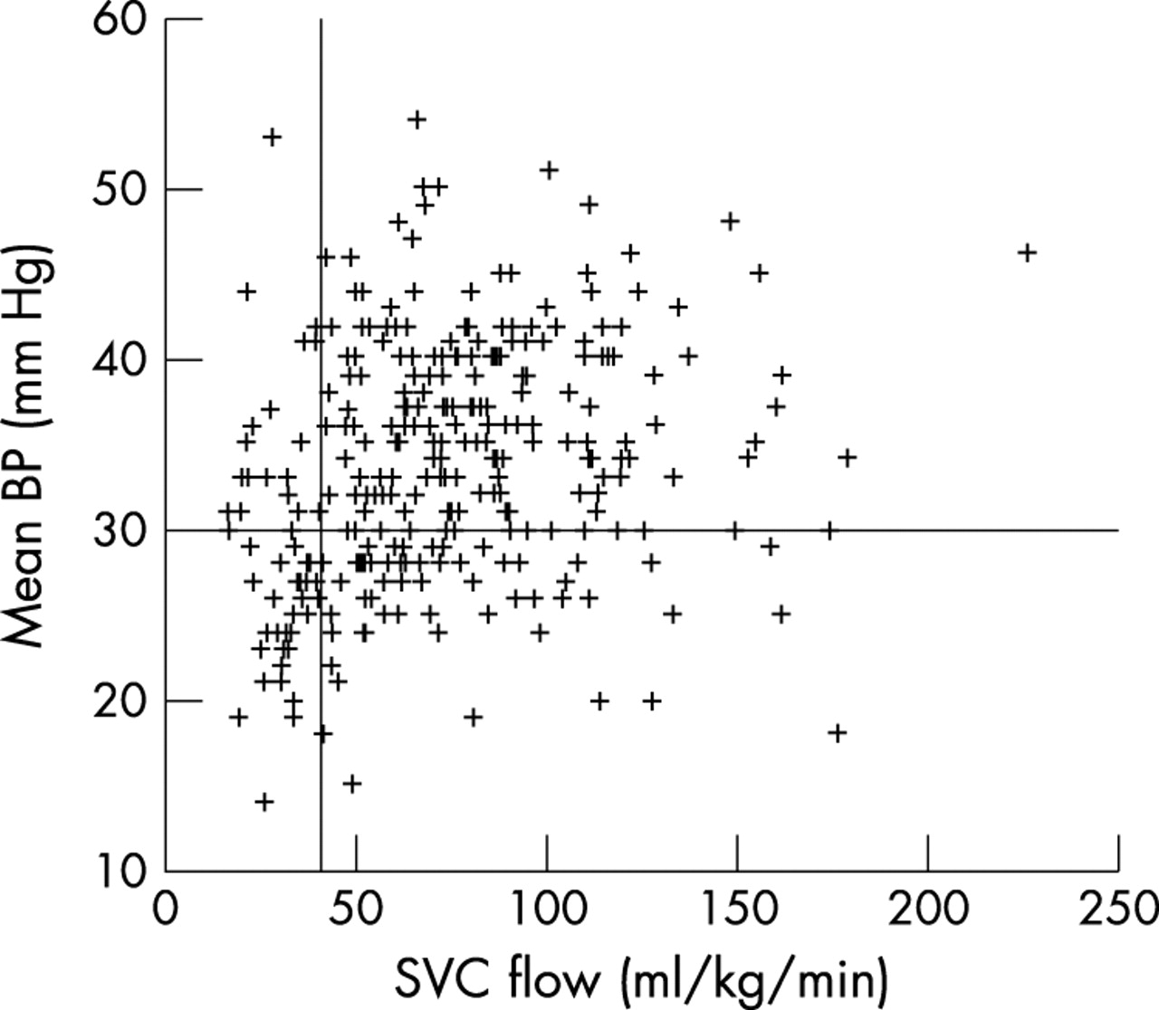

Figure 3 Scatter plot of mean blood pressure (BP) against superior vena cava (SVC) flow for all observations. Reference lines represent SVC flow of 41 ml/kg/min and mean BP of 30 mm Hg.
Osborn, D A et al. Arch. Dis. Child. Fetal Neonatal Ed. 2004;89:F168-F173
Copyright ©2004 BMJ Publishing Group Ltd.

Slide 20
Physiological responses to current common treatments?
Fluid boluses
  appear to increase left ventricular output but not RVO
  Increase ductal shunt: don’t improve systemic perfusion
  Small transient increase in blood pressure
Dopamine
  Increases BP, almost entirely by vasoconstriction, decreasing systemic flow
Steroids
  Increase pressure slowly, by what hemodynamic mechanism?

Slide 21
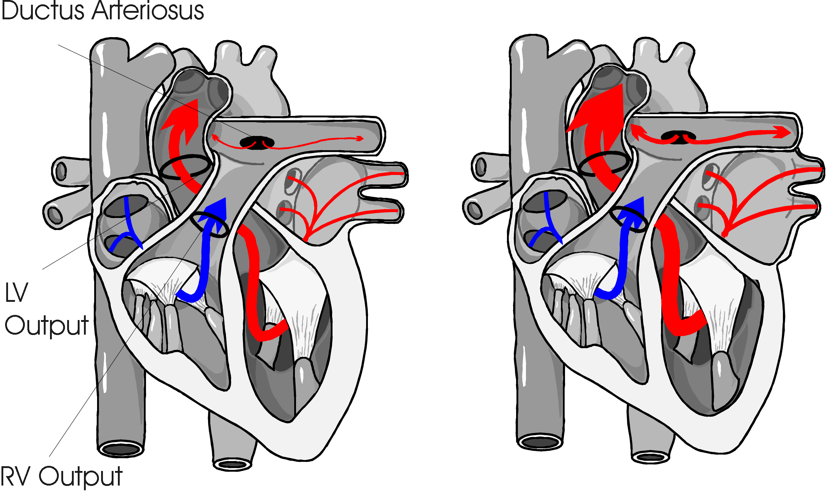
LVO & RVO

Slide 22
RCTs of dopamine
Osborn 2002
Dopamine at 20 decreased RVO from 146 to 120 mL/kg/min in preterm infants with low flows.
Roze 1993
Dopamine, enough to increase BP, LVO decreased from 245 to 206 mL/kg/min, hypotensive preterms
Phillipos 1996
Dopamine, enough to increase BP, LVO decreased from 200 to 194 mL/kg/min, hypotensive preterms

Slide 23
Milrinone clinical trial
Paradisis et al
 | Age (h) | Milrinone (n = 42) | Placebo (n = 48) | P value
SVC (mL/kg/min) | 3‡ | 78 (51, 107) | 86 (67, 107) | .2
 | 7 | 70 (48, 92) | 75 (51, 94) | .8
 | 10 | 67 (53, 87) | 81 (50, 100) | .5
 | 24 | 88 (73, 101) | 93 (72, 121) | .4
RVO (mL/kg/min) | 3‡ | 182 (140, 240) | 189 (133, 271) | .9
 | 7 | 177 (147, 258) | 187 (140, 240) | .9
 | 10 | 189 (146, 258) | 187 (133, 243) | .4
 | 24 | 242 (194, 301) | 250 (207, 306) | .7
BP (mm Hg) | 3‡ | 31 ± 6 | 30 ± 3 | .4
 | 7 | 28 ± 5 | 32 ± 6 | .001
 | 10 | 29 ± 4 | 32 ± 5 | .004
 | 24 | 34 ± 5 | 36 ± 6 | .2
HR (beats/min) | 3‡ | 149 ± 16 | 151 ± 17 | .6
 | 7 | 158 ± 15 | 145 ± 10 | .001
 | 10 | 157 ± 13 | 141 ± 12 | .001
 | 24 | 153 ± 13 | 144 ± 14 | .003
PDA diameter | 3‡ | 2 ± 0.9 | 1.9 ± 0.6 | .5
(mm) | 7 | 1.9 ± 0.7 | 1.5 ± 0.6 | .001
 | 10 | 1.9 ± 0.6 | 1.4 ± 0.6 | .001
 | 24 | 1.7 ± 0.8 | 0.9 ± 0.7 | .001

Slide 24
Low dose dopamine and the kidney
No evidence from neonatal animal models that low dose dopamine increases renal blood flow
One clinical trial also showed no effect
No evidence of beneficial renal effect of low dose dopamine in critically ill older children or adults either! (several systematic reviews)

Slide 25
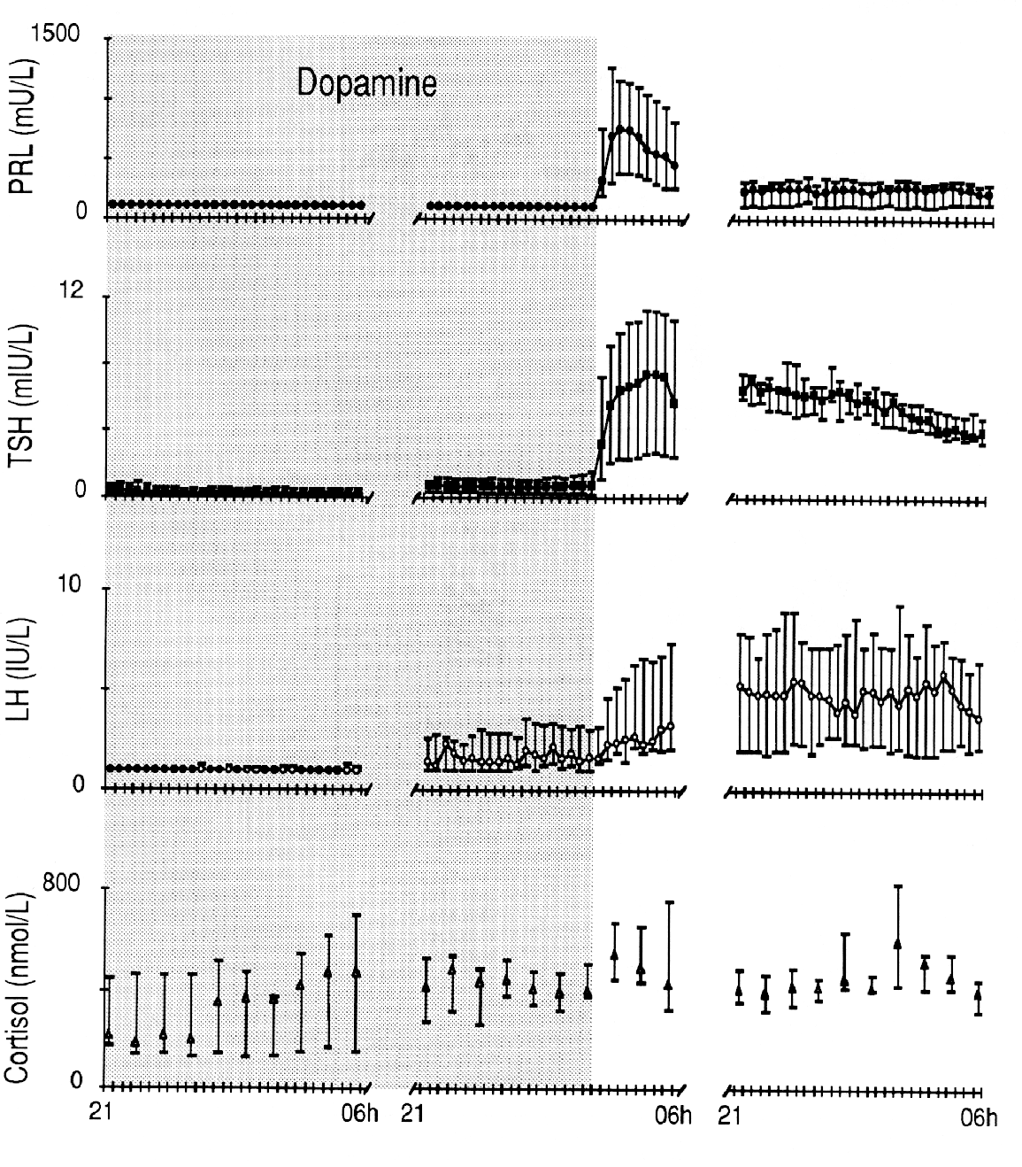
Pituitary effects of dopamine

Slide 26
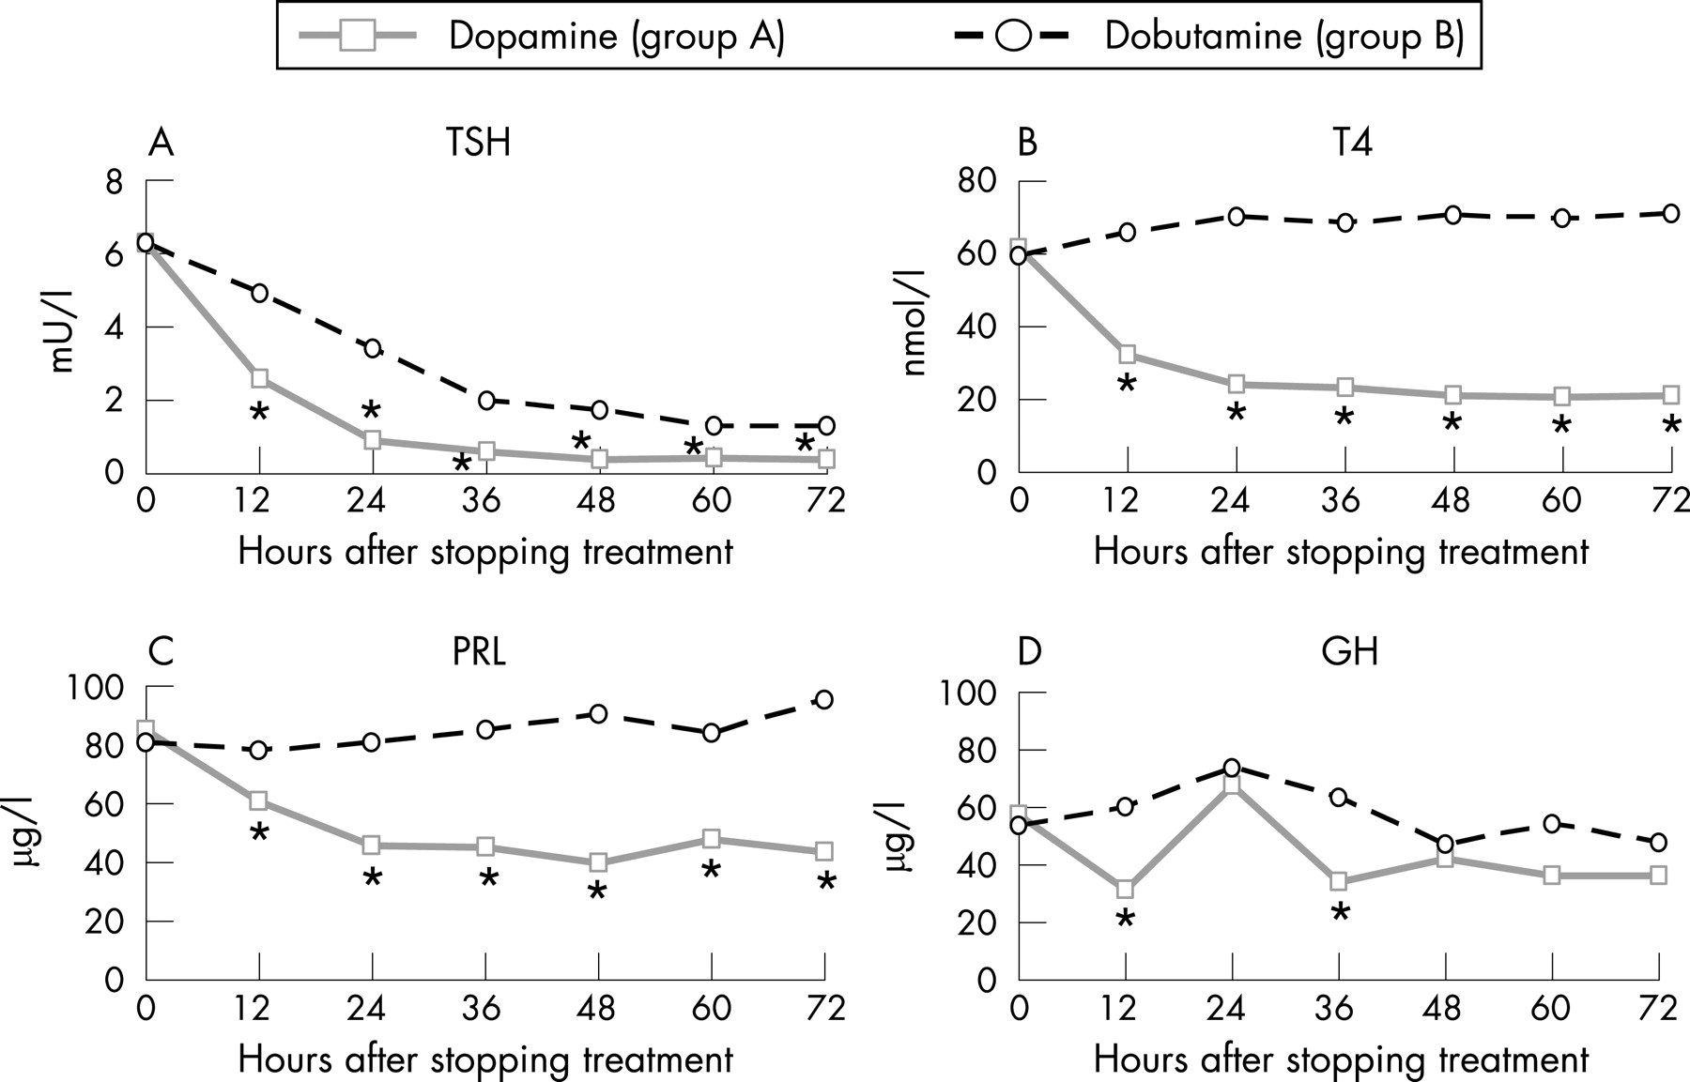
Three-day serum levels of (A) thyroid stimulating hormone (TSH), (B) total thyroxine (T4), (C) prolaction (PRL) and (D) growth hormone (GH) in the two study groups (dopamine group, n = 18; dobutamine group, n = 17). *p<0.01.
starting
starting
Filippi L et al. Arch Dis Child Fetal Neonatal Ed 2007;92:F367-F371
Copyright © BMJ Publishing Group Ltd & Royal College of Paediatrics and Child Health. All rights reserved.
Notes:
Three-day serum levels of (A) thyroid stimulating hormone (TSH), (B) total thyroxine (T4), (C) prolaction (PRL) and (D) growth hormone (GH) in the two study groups (dopamine group, n = 18; dobutamine group, n = 17). *p<0.01.

Slide 27
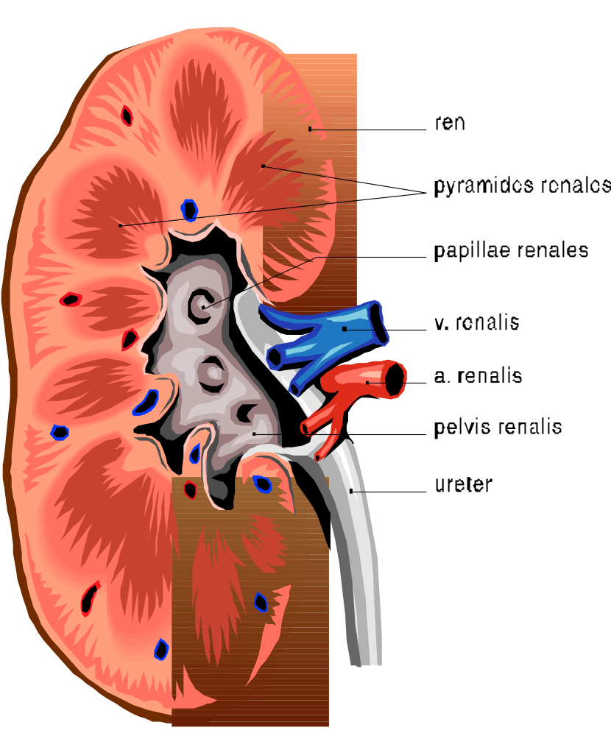

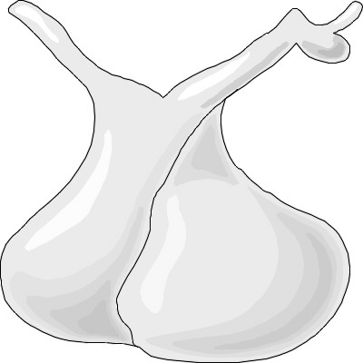
Low dose dopamine
= Pituitary dose dopamine

Slide 28
Treatment of Hypotension
So why do people treat?
« Hypotension impairs cerebral perfusion »
« CBF is pressure passive… »
Do common therapies improve CNS perfusion?
Safely?

Slide 29
Responses to Questionnaire: Canadian neonatologists
Criteria for diagnosing hypotension:
  74% use both BP<GA (or another criterion) and clinical signs to define hypotension.
  26% use BP alone, (most common, BP<GA)
Volume 1st-- 97%
Dopamine is 1st drug --92%
Three main patterns of treatment
  volume, dopamine, steroid (37%)
  volume, dopamine, dobutamine(28%)
  volume, dopamine, epinephrine (16%)

Slide 30
Treatments
Dopamine: starting dose range 2.5-10 μg/kg/min
  maximum dose 10-30
    The maximum dose for 7 respondents is the initial starting dose for 17 others.
Dobutamine: starting dose range 2-10 μg/kg/min
  maximum dose 10-20
Epinephrine: starting dose 0.01-0.1 μg/kg/min
  maximum dose 0.3-4.0
Usual corticosteroid = hydrocortisone (98%).
Initial doses varied 0.1–5 mg/kg/dose
Total daily doses range from 0.4-15 mg/kg/day.

Slide 31

Time to make a change

Slide 32
Retrospective cohort study
118 ELBW patients admitted 2000-2003. BP data were available on 107, 53% of patients had BP < GA.
18/118 ELBW infants received treatment for Hypotension:
  11 received only an epinephrine infusion,
  4 had only a single fluid bolus (saline 10 ml/kg), and
  3 had a fluid bolus followed by epinephrine infusion.
4 other Hypotensive infants received only a blood transfusion, over 2 hr, as therapy.

Slide 33
 | Normotensive | Permissive hypotension | Treated Hypotension
Number | 52 | 34 | 18
Necrotizing enterocolitis, n (%) | 4 (8%) | 3 (9%) | 2 (11%)
Surgical NEC, n | 1 | 1 | 1
Isolated GI perforation, n | 2 | 0 | 1
IVH 3 or 4, n | 2 | 4 | 5
Cystic PVL, n | 1 | 0 | 0
Mortality, n | 10 | 4 | 13*
Survival without severe IVH, cystic PVL, surgical NEC, or GI perforation, n (%) | 40 (77%) | 26 (76%) | 4* (22%)

Slide 34


Slide 35
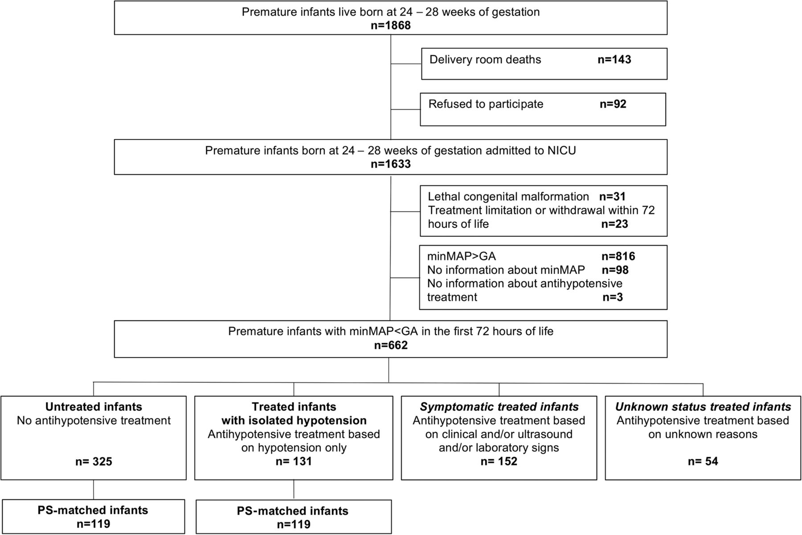
Epipage2 study
Durrmeyer X, et al. Abstention or intervention for isolated hypotension in the first 3 days of life in extremely preterm infants: association with short-term outcomes in the EPIPAGE 2 cohort study. Archives of Disease in Childhood - Fetal and Neonatal Edition. 2017.

Slide 36
Epipage 2
Treated symptomatic babies did much worse than asymptomatic babies
 | No. of events/total (%)
 | Treated (isolated hypotension) | Untreated | Treated symptomatic | p Trend test
Survival without severe morbidity at discharge* | 78/131 (61.3) | 170/325 (54.7) | 52/145 (36.9) | <0.001
Survival at discharge | 107/131 (82.2) | 262/325 (82.2) | 87/152 (58.2) | <0.001
Severe cerebral lesion | 15/131 (10.9) | 58/321 (16.9) | 39/147 (26.3) | <0.001
Grade III IVH or IPH | 14/131 (10.0) | 49/321 (14.1) | 34/147 (22.7) | 0.004
Necrotising enterocolitis | 4/130 (3.5) | 16/321 (4.8) | 8/150 (5.4) | 0.48

Slide 37
Epipage2
Comparing asymptomatic newborns, treated vs untreated
 | No. of events/total (%)
 | Overall cohort* |  |  | Matched cohort
 | Untreated | Treated | p Value† | Untreated | Treated | p Value‡
Survival without severe morbidity at discharge§ | 170/325 (54.7) | 78/131 (61.3) | 0.20 | 58/119 (48.7) | 73/119 (61.3) | 0.049
Survival at discharge | 262/325 (82.2) | 107/131 (82.2) | 0.99 | 92/119 (77.3) | 99/119 (83.2) | 0.29
Severe cerebral lesion | 58/321 (16.9) | 15/131 (10.9) | 0.10 | 31/117 (26.5) | 12/119 (10.1) | 0.002
Grade III IVH or IPH | 49/321 (14.1) | 14/131 (10.0) | 0.23 | 26/117 (22.2) | 12/119 (10.1) | 0.015
Necrotising enterocolitis | 16/321 (4.8) | 4/130 (3.5) | 0.58 | 6/118 (5.1) | 4/119 (3.4) | 0.52

Slide 38
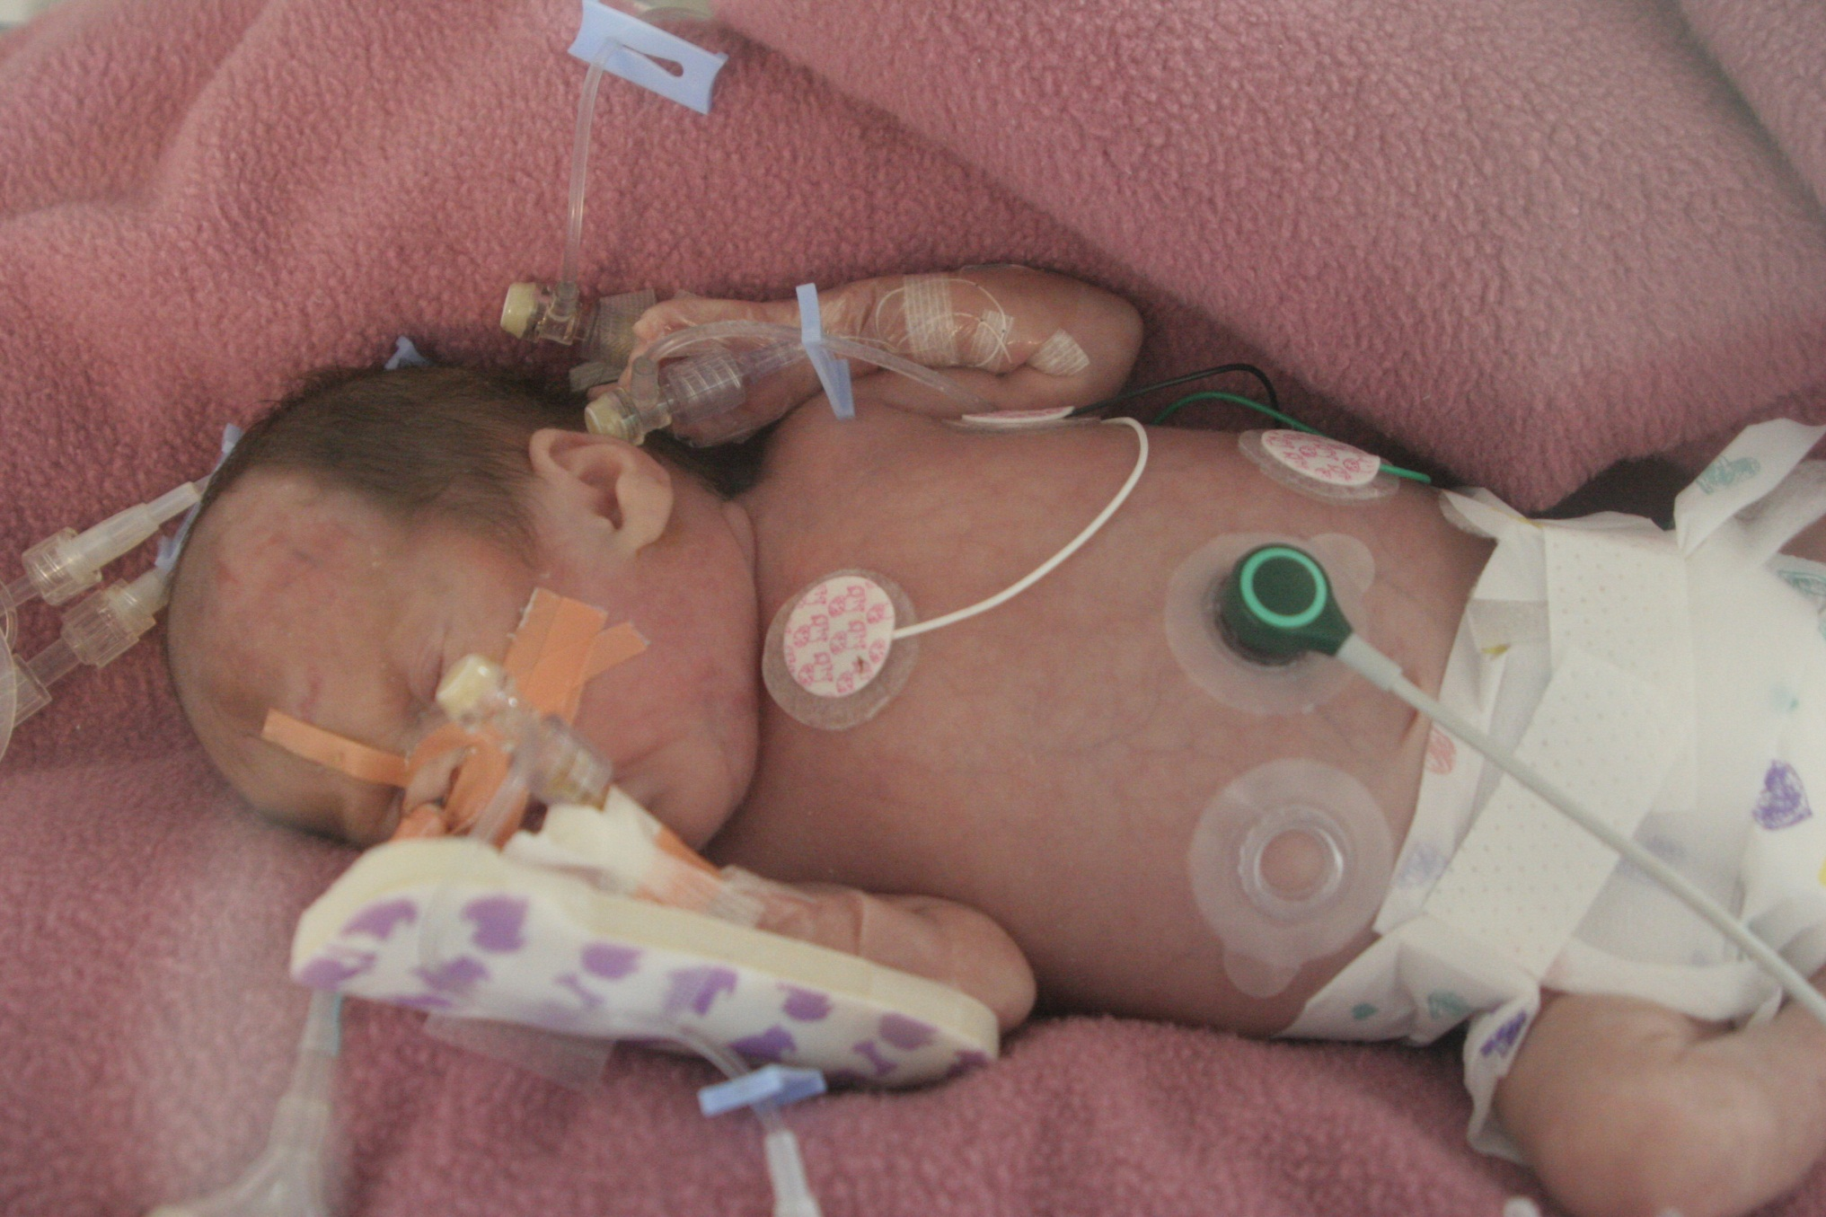

Slide 39
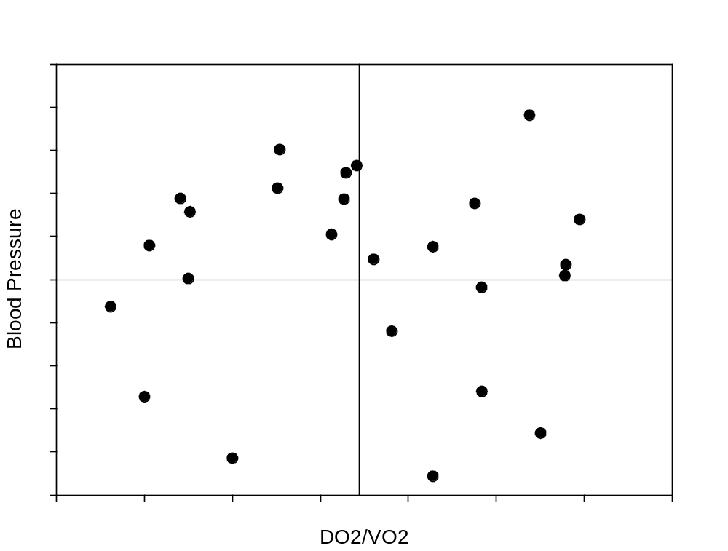

Hypotension or shock?

Slide 40

Where are we now?

Slide 41
Hypotension in Preterm Infants
What is hypotension?
  No clear definition
Why do we worry about it?
  Not clear that we should
Why are small preterm babies hypotensive in the first few days?
  In general because they have low vascular resistance
Is there evidence that hypotension needs treating?
  Not really
Do we know what to treat it with?
  No

Slide 42
Conclusion
Do we need to treat Hypotension, or should we be treating Shock?
Hypotensive babies who are clinically well perfused may not need any treatment, but that is uncertain
Babies with poor perfusion do badly, individualizing the interventions, by measurements of relevant physiologic endpoints such as blood flow, serum lactate, brain perfusion or activity etc. may help us to improve care, but this needs to be proven.

Slide 43

European

Slide 44
The HIP trial
Successful FP7 application, PI Gene Dempsey,
RCT of 800 infants less than 28 weeks
Masked trial, dopamine or placebo
If max study drug dose reached further treatment only if signs of poor perfusion
If signs of poor perfusion during treatment, rescue
Primary outcome survival without serious brain injury
Co-primary outcome: survival without neurodevelopmental impairment to 2 years CA.
  At least 2 other trials about to start, prospective meta-analysis planned
Enrolment very difficult! 56 infants randomized so far…

Slide 45
Can we define, or treat, inadequate perfusion?
When there is inadequate oxygen delivery to the tissues to support O2 needs
Increasing lactate? (Too Late?)
NIRS cerebral saturation low? (How low is too low?)
Pulse oximeter perfusion
Other indicators of perfusion
Capillary Filling Time
Urine Output

Slide 46
Detecting poor perfusion
Mostly concerned about cerebral perfusion, most critical in the short term
Can we determine clinically?
How well correlated with other measures?
Do we need a new monitor in the NICU?
How good is NIRS?

Slide 47
Evaluation of perfusion
Clinical exam
Lab/blood testing
Ancillary methods
  Accuracy in determining adequacy of O2 delivery
  Accuracy in predicting outcome
  Applicability in day-to-day
With thanks to de Boode Early Hum Develop 2010

Slide 48
Clinical examination
Capillary refill
Warmth of toes
Colour of skin
Urine output
Activity level

Slide 49
Capillary refill
Osborn
Dempsey
Others in term infants
  Significant inter-individual variation in the measurement, except when measured on the chest.

Slide 50
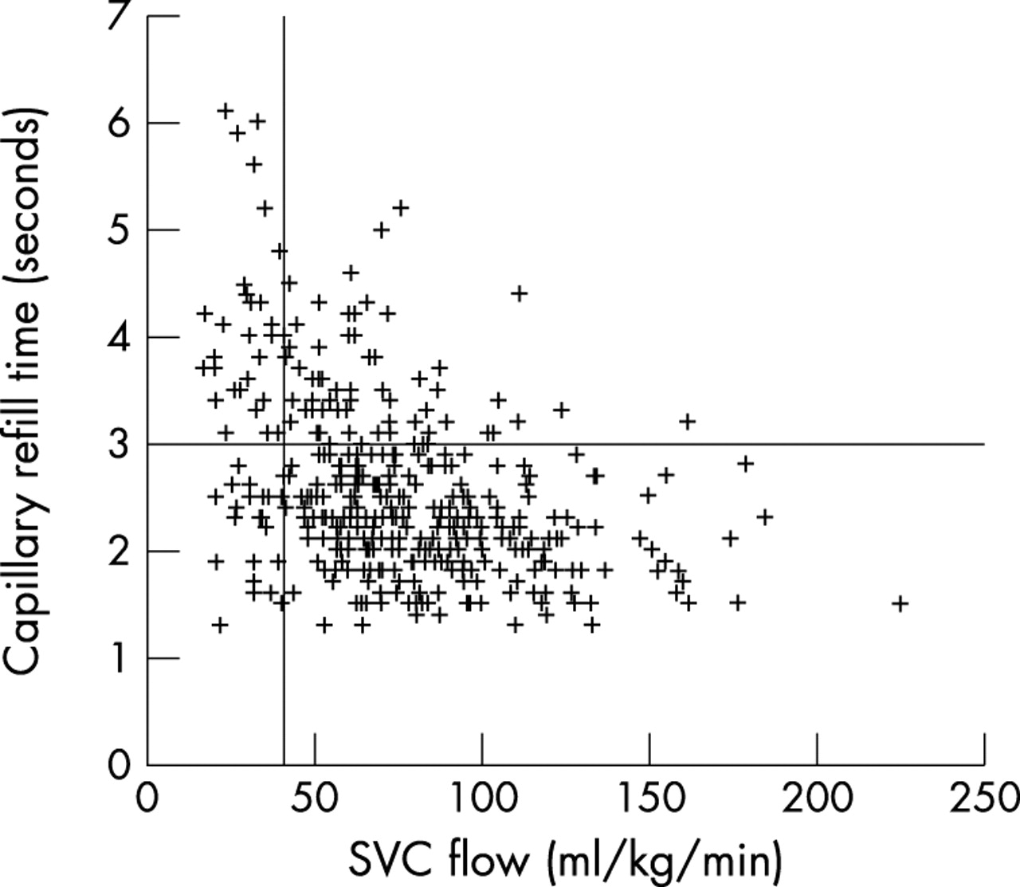
Scatter plot of capillary refill time against superior vena cava (SVC) flow for all observations.
Osborn D A et al. Arch Dis Child Fetal Neonatal Ed 2004;89:F168-F173
©2004 by BMJ Publishing Group Ltd and Royal College of Paediatrics and Child Health
Notes:
Scatter plot of capillary refill time against superior vena cava (SVC) flow for all observations. Reference lines represent SVC flow of 41 ml/kg/min and capillary refill time of three seconds.

Slide 51
Clinical examination
Capillary refill +/-
Warmth of toes
Colour of skin
Urine output ?
Activity level ?

Slide 52
Lab/blood tests
Base Excess
  Poor indicator of tissue O2 delivery
  Poorly correlated with lactate
Lactate
  Absolute values
  Direction of change

Slide 53
Serum Lactate
Several studies show that infants with high lactates in early life have an increased mortality, but the PPV is not high, e.g. 47%
  Groenendaal F, Lindemans C, Uiterwaal CSPM, de Vries LS: Early Arterial Lactate and Prediction of Outcome in Preterm Neonates Admitted to a Neonatal Intensive Care Unit. Neonatology 2003, 83(3):171-176.
Others have shown that the progression of lactates is more useful
  Deshpande SA, Platt MP: Association between blood lactate and acid-base status and mortality in ventilated babies. Arch Dis Child Fetal Neonatal Ed 1997, 76(1):F15-20.

Slide 54
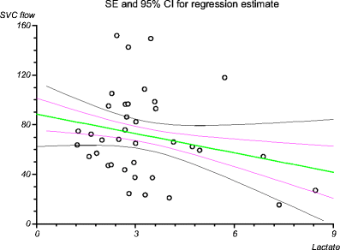
Miletin Pichova and Dempsey
A capillary refill time of >4 s combined with serum lactate concentrations >4 mmol/l had a sensitivity of 50%, a specificity of 97%, a PPV of 80% and an NPV of 88% for predicting low flow states.

Slide 55
Ancillary methods
Functional Echo
NIRS
Mixed venous O2
Indirect
  EEG
  aEEG
Masimo Perfusion Index

Slide 56
Functional Echocardiography
Threshold of 40 mL/kg/min well-supported but a bit simplistic
  Ignores HgB, SpO2, VO2
Not simple to measure SVC flow
Inter-observer variability
Intermittent

Slide 57
NIRS
Gold Standard?
Tissue oxygenation is what we are really concerned about
Some analyses suggest +/- 17% accuracy
Are low results correlated with long term outcomes?
How low is too low?

Slide 58
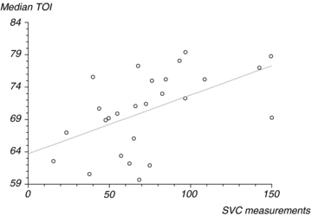
NIRS and Echo,
Moran, Miletin, Pichova and Dempsey 2009

Slide 59
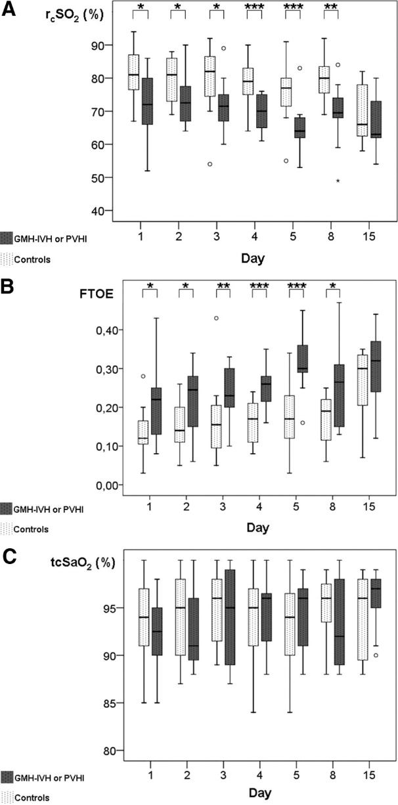

Figure 1. The course of rcSO2 (A), FTOE (B), and tcSaO2 (C) in preterm infants with GMH-IVH or PVHI versus a preterm control group.
Verhagen E A et al. Stroke 2010;41:2901-2907
Notes:
Figure 1. The course of rcSO2 (A), FTOE (B), and tcSaO2 (C) in preterm infants with GMH-IVH or PVHI versus a preterm control group. Data are shown in box and whisker plots. Dots and stars represent outliers. Significant differences between the 2 groups are marked in the top of the figure by asterisks (*≤0.05, **≤0.005, ***≤0.001, GMH-IVH or PVHI versus control subjects).

Slide 60
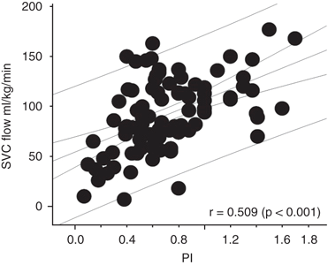
Takahashi et al, J Perinatol 2010
Perfusion Index, Masimo pulse oximeter

Slide 61
Perfusion Index
Reduced in infants who later show signs of sepsis
  (at 1 and 5 minutes of age)
Little other evidence that it is helpful

Slide 62
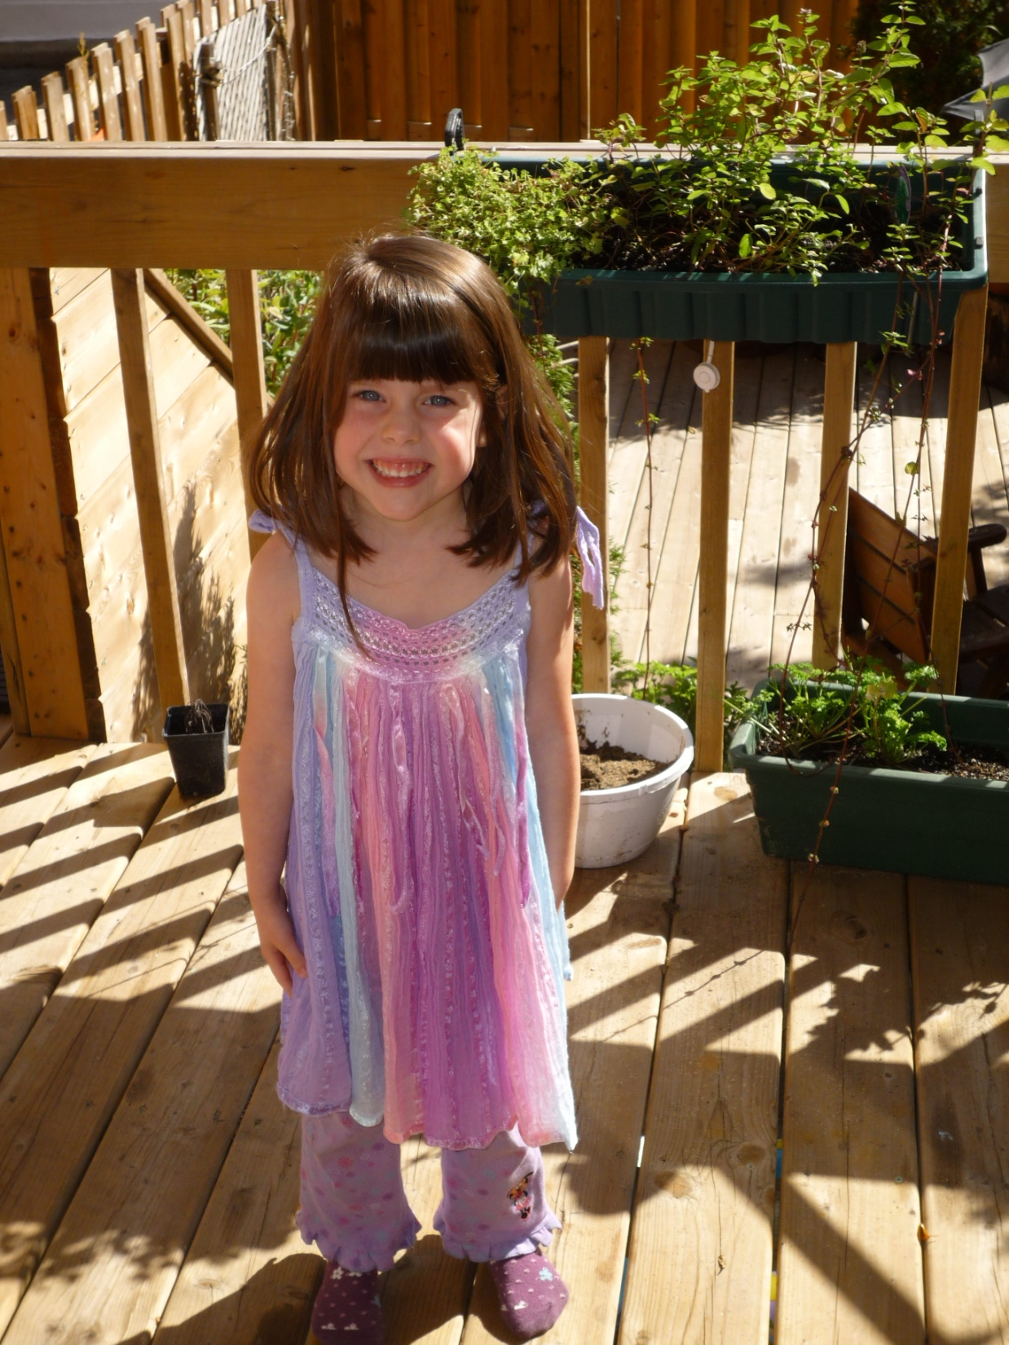
Merci

