Slide 1

What outcomes matter to parents?
“How do we incorporate the family’s values and the outcome data into decision-making?”
Keith J Barrington

Slide 2


Slide 3
What is a good outcome?
Which outcomes are important?
Which should be used in decision making?
Which are predictable?
Who decides?

Slide 4
What is a good outcome?
Withholding life sustaining interventions for other patients with outcomes as good as our « futile » patients is not considered acceptable
  American college of surgeons guide - patients in cardiac arrest after trauma - 3% survival. Many survivors have serious neurological/intellectual impairment
  Recommendation : Resuscitation should be tried anyway unless there is «decapitation, rigor mortis or decomposition »
    Janvier A, Leblanc I, Barrington KJ. Nobody likes premies: the relative value of patients' lives. J Perinatol. 2008;28(12):821-6.
    Janvier A, Leblanc I, Barrington KJ. The best-interest standard is not applied for neonatal resuscitation decisions. Pediatrics. 2008;121(5):963-9.
    Janvier A, Barrington KJ, Aziz K, Lantos J. Ethics ain't easy: do we need simple rules for complicated ethical decisions? Acta Paediatr. 2008;97(4):402-6.
    Bellieni C, Barrington KJ, Janvier A. Neonates are devalued compared to older patients. In: Ethical dilemmas for critically ill babies. Verhagen AEE Ed, Springer 2015.

Slide 5
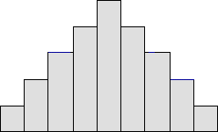
Why do we make life and death decisions based on uncertain information?
Gestational age is often decided by the first person to see the mother
They make mistakes
Even when they don’t, they are usually wrong.
Most babies who are labelled as « 23 weeks and 4 days » are not 23 weeks and 4 days.
95% of them (if they had good quality ultrasound around 10 wks of amenorrhea) are between 22 weeks and 6 days and 24 weeks and 2 days.

Slide 6
Should we have gestational age limits?
Director of Bliss, a premature baby charity in the UK
« deciding on active care for preterm infants based on the number of weeks gestation is like deciding to not resuscitate a victim of a car accident because they were travelling at over 40 miles an hour »
Actually its worse than that
It is like having a limit of 40 miles an hour, but never being able to be sure how fast the car was actually travelling
  Unless they were going through a radar check at the time (IVF).

Slide 7
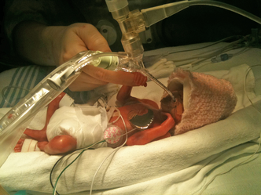
Our child is not just a gestational age. A first‐hand account of what parents want and need to know before premature birth
Domenica
22 wk 5/7….
(95% probability that she was between 22 weeks 0/7 and 23 3/7)
530g
Acta Paediatrica
Volume 103, Issue 10, pages 1035-1038, 18 JUL 2014 DOI: 10.1111/apa.12716
http://onlinelibrary.wiley.com/doi/10.1111/apa.12716/full#apa12716-fig-0003
Notes:
Domenica in the neonatal intensive care unit.
© IF THIS IMAGE HAS BEEN PROVIDED BY OR IS OWNED BY A THIRD PARTY, AS INDICATED IN THE CAPTION LINE, THEN FURTHER PERMISSION MAY BE NEEDED BEFORE ANY FURTHER USE. PLEASE CONTACT WILEY'S PERMISSIONS DEPARTMENT ON PERMISSIONS@WILEY.COM OR USE THE RIGHTSLINK SERVICE BY CLICKING ON THE 'REQUEST PERMISSION' LINK ACCOMPANYING THIS ARTICLE. WILEY OR AUTHOR OWNED IMAGES MAY BE USED FOR NON-COMMERCIAL PURPOSES, SUBJECT TO PROPER CITATION OF THE ARTICLE, AUTHOR, AND PUBLISHER.

Slide 8

Our child is not just a gestational age. A first‐hand account of what parents want and need to know before premature birth
Domenica
2 y 5 months
(exactly)
Acta Paediatrica
Volume 103, Issue 10, pages 1035-1038, 18 JUL 2014 DOI: 10.1111/apa.12716
http://onlinelibrary.wiley.com/doi/10.1111/apa.12716/full#apa12716-fig-0004
Notes:
Domenica at the age of 2 years and 4 months.
© IF THIS IMAGE HAS BEEN PROVIDED BY OR IS OWNED BY A THIRD PARTY, AS INDICATED IN THE CAPTION LINE, THEN FURTHER PERMISSION MAY BE NEEDED BEFORE ANY FURTHER USE. PLEASE CONTACT WILEY'S PERMISSIONS DEPARTMENT ON PERMISSIONS@WILEY.COM OR USE THE RIGHTSLINK SERVICE BY CLICKING ON THE 'REQUEST PERMISSION' LINK ACCOMPANYING THIS ARTICLE. WILEY OR AUTHOR OWNED IMAGES MAY BE USED FOR NON-COMMERCIAL PURPOSES, SUBJECT TO PROPER CITATION OF THE ARTICLE, AUTHOR, AND PUBLISHER.

Slide 9
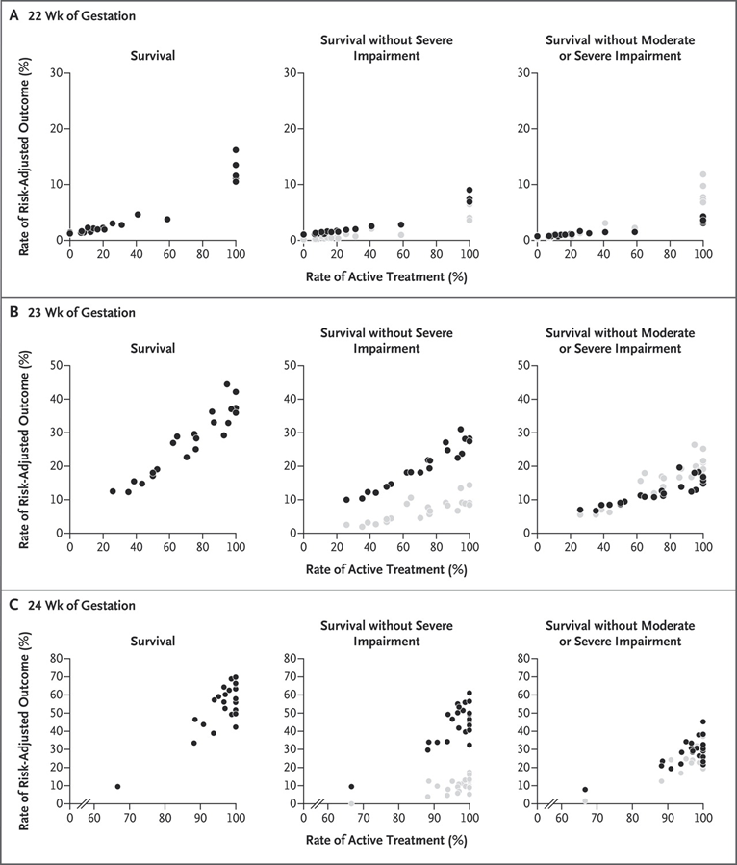
Rysavy M et al NEJM 2015

Slide 10
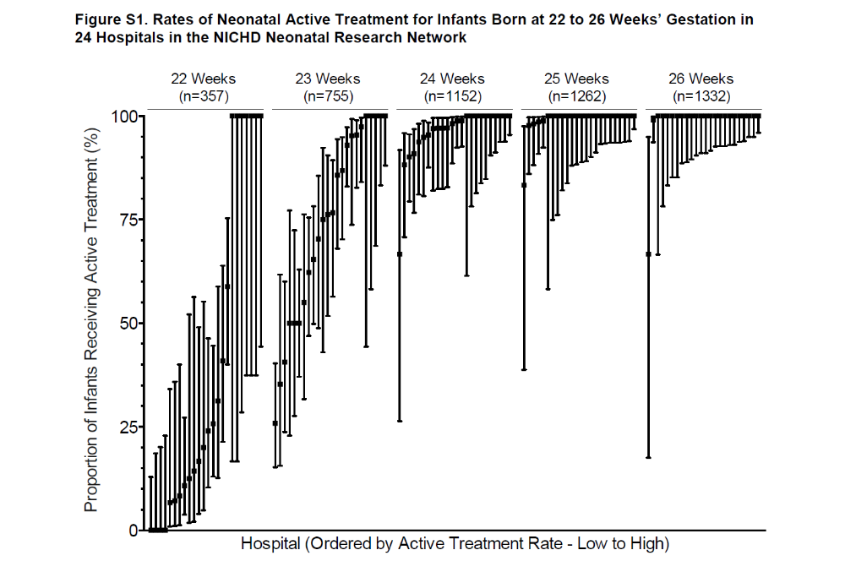

Slide 11
Shared decision-making
Centers with 0% intervention at 22 weeks and
Centers with 100% intervention at 22 weeks
All believe that they do “Shared-decision making”
WTF!
Does this happen anywhere else in medicine?
Anywhere?

Slide 12
Is the delivery room a good place to make a decision?
GA is uncertain
BW is unknown, until afterwards
Potential outcomes are extremely variable for any individual

Slide 13
Are the only decisions intervening or withholding?
How about a « trial of therapy »?
    Meadow W, Meadow X, Tanz RR, Lagatta J, Lantos J. The value of a trial of therapy – football as a ‘proof-of-concept’. Acta Paediatrica. 2011;100(2):167-9.
Many parents find value in a trial of therapy
Prognosis becomes much clearer as time goes on.

Slide 14
Which « impairments » are relevant to decision making?
Do children who are not « intact » contribute nothing to society?
Do they contribute nothing to their families?
What does “NDI” mean? What does it mean to families?

Slide 15
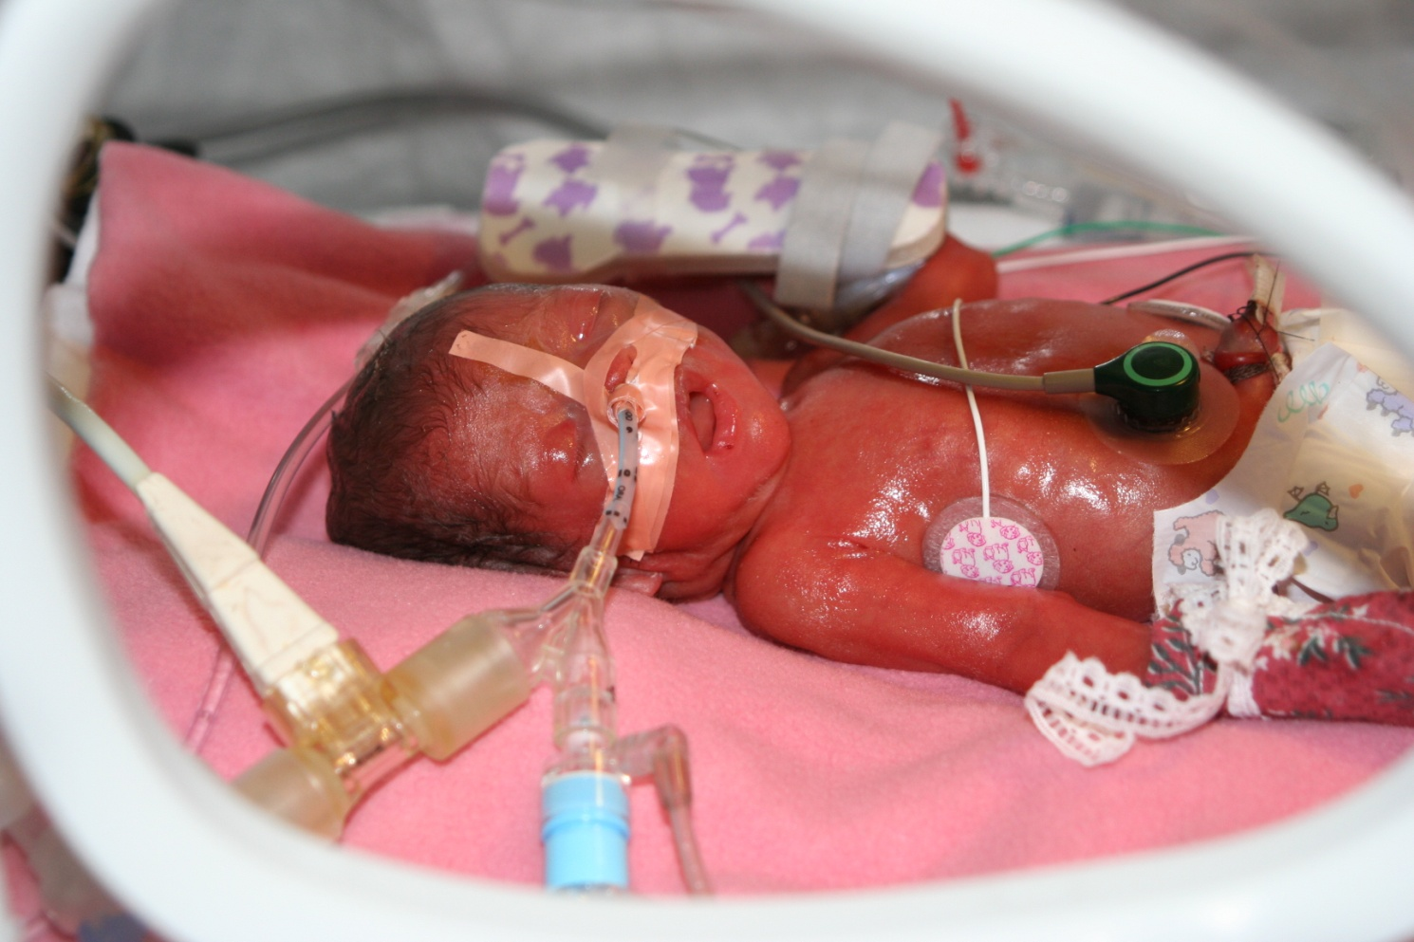
Newborn at 24 weeks GA:

Slide 16

Neurodevelopmental Impairment?
This little girl -ex 24 weeks- is neurodevelopmentally impaired
  According to 24 month Bayley 2
She now has executive function difficulties
She is not « intact »
I wouldn’t want her any other way

Slide 17
10 recommendations for Health Care Providers: from parents
Our child is not just a gestational age. A first‐hand account of what parents want and need to know before premature birth
Acta Paediatrica. Volume 103, Issue 10, pages 1035-1038, 18 JUL 2014 DOI: 10.1111/apa.12716
Tell women that there is nothing they could have done to prevent the premature birth from happening.
Our unborn children have a story and are part of our hopes and dreams. Do not use gestational age to categorise our child. Ask us if our unborn baby has a name.
Each baby is different. Have a personalised approach. You can tell us what generally happens to children about to be born at the same stage of gestation as our child, but please also describe to us the particularities of our child that will influence his or her outcome.
Each family is different. We disagree that every family needs to receive extensive information about everything negative that may happen. Some parents want statistics, others want the general picture. Some parents want to make important decisions on their own, while others want recommendations. Please listen to us individually.
We need to trust you. Do not tell us that babies at 22 or 23 weeks do not survive. Do not tell us that most preterm infants are disabled. We rely on you to know your data. Reflect on the difference between medical numbers and medical values. Do not tell parents that their child will have a negative impact on their family. You do not have data to support these claims. Many clinicians decide that giving babies a chance is not worth it for a 10%-20% survival rate. Our discussions should be about values and not so much about percentages.
Give us balanced information. Tell us about what our children may, or may not, be able to do. Also tell us about the quality of life of other preterm infants have when they get older
Words are important. Before our child's birth, do not ask us if we want to do ‘everything’ or ‘nothing’. Have you ever met parents who wanted ‘nothing’ for their child? Do not use the word resuscitation, as premature infants are not usually defibrillated. That is what we think resuscitation means when you use that language. Use the word stabilisation instead.
Do not take away the hope we have. There is always hope that we will deliver tomorrow. There is hope that we will be able to spend some time with our child. There is hope that we can survive the death of our child with positive memories. Do not abandon us. Instead, tell us that you will be there whatever happens.
Empower parents. When other family members are present, emphasise that strong families are important.
Be proud of the work you do. It is so important to us. You make it possible for us to share precious time with our babies. You are the heroes for so many families. You help babies survive and we are thankful for that

Slide 18
Recent guidelines of learned societies
refer to the following as important outcomes that should be considered in decision making:
Intact survival
Neurodevelopmental impairment
Severe or profound NDI
Survival without NDI

Slide 19
We all want intact survival…
But what is “intact”?
Who decides?
Can we really divide NICU graduates into those who are “intact” and those who are not?
Is an infant with a mild hemiplegia “intact”?
An infant with a low Bayley score?
An infant without NDI but who has oral aversion and is gastrostomy fed?

Slide 20
Dichotomizing continuous outcomes
Lung Injury is a continuum
BPD diagnosed by need for O2 at 36 weeks, 0 days.
What is the impact on the family of this diagnosis? Compared to:
  Home O2
  Readmissions during the first year of life
For decision-making, if an intervention decreases “BPD” but has no effect on perhaps more important outcomes?

Slide 21
Composite outcomes: death or NDI
Composite outcomes should be considered “when they are of similar value for patients and are affected in the same way by the intervention” (or risk factor)

Slide 22
Retinopathy and survival
SUPPORT trial
Survival and severe RoP affected in different directions by the intervention
The trial was negative: No difference in primary outcome
Even though more babies were alive in the high saturation group
No difference in severe visual difficulties/blindness

Slide 23
Parents and healthcare providers disagree
Disagree on the quality of life of children with serious disabilities
Disagree on the impact of disabled children on the lives of the family
And sometimes agree
Agree (mostly) on the importance of parental participation in decision making

Slide 24
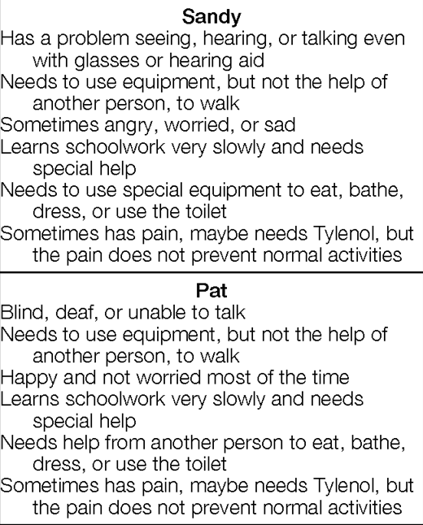
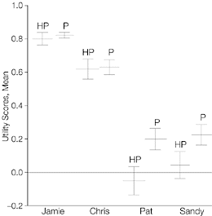
Quality of life of children with severe disabilities
Saigal S, et al. Differences in preferences for neonatal outcomes among health care professionals, parents, and adolescents. JAMA. 1999;281(21):1991-7.

Slide 25
Impacts on the family of a child with disability
Scorgie K, Sobsey D. Transformational outcomes associated with parenting children who have disabilities. Mental retardation. 2000;38(3):195-206.
Interviewed 80 families of children with disabilities (ranging from moderate to severe)
Compared the families’ own evaluation of their experiences to:
“Professional myths of family devastation, unending stress, near-universal divorce, and endless drudgery”

Slide 26
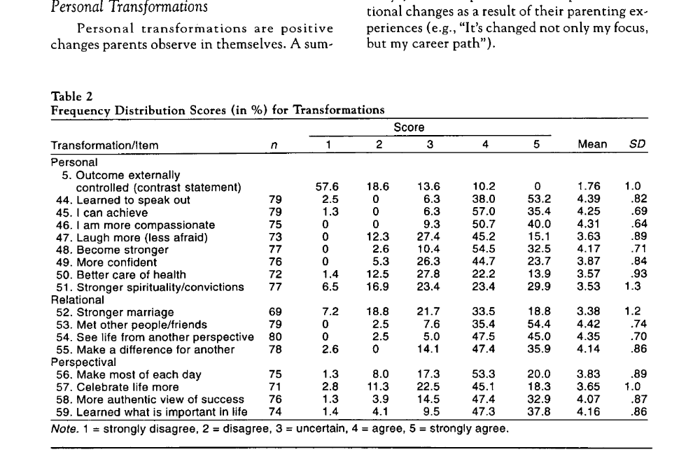
Impacts on the family; according to the family
Positive impacts

Slide 27
Impacts on families
Janvier A, et al. The experience of families with children with trisomy 13 and 18 in social networks. Pediatrics. 2012;130(2):293-8.
Parents who lived with a child with Trisomy 13 or 18
Healthcare Professionals overwhelmingly negative
Parents had many positive experiences with their children
  As well as huge challenges

Slide 28
Janvier, Farlow and Barrington 2016
150 T13/18 discharged home
Choice regarding levels of care frequently revised
  67 infants discharged with palliative care
  half of the parents changed to “full medical interventions as for any other child”.
  These 35 changed levels of care because their child did better than expected.
Decisional regret:
In regards to interventions their child received, 75% of parents report choosing “the right amount”, 24% “not enough” and only 1% “too much”.
The challenge of physicians is the same as described by parents
  the delicate balance between “giving the child a chance” vs “having the child go through too much”.
  It seems to us that neither a universal imposition of comfort-care nor a universal application of intensive care is appropriate.

Slide 29
Impacts on the family
Of course there are also negative impacts
Just because some impacts are positive doesn’t mean that you wouldn’t want it otherwise
Negative impacts can be addressed and minimized
  Bruns D, Foerster K. ‘We've been through it all together’: supports for parents with children with rare trisomy conditions. Journal of Intellectual Disability Research. 2011;55(4):361-9.
  Redquest BK, et al. Raising a child with special needs: the perspective of caregivers. Clin Nurse Spec. 2015;29(3):E8-15.
  McManus BM, et al. Modeling the social determinants of caregiver burden among families of children with developmental disabilities. American journal on intellectual and developmental disabilities. 2011;116(3):246-60.
But they can not be eliminated

Slide 30
Agreement that parents should be involved
But who has asked parents what outcomes are important for decision-making?
In the context of a choice of withholding or withdrawing Life-sustaining interventions? (LSI)
Or indeed in terms of choice of interventions to reduce lung injury, etc.

Slide 31
What do parents think are important outcomes for decision-making?
Einarsdottir J. Emotional experts: parents' views on end-of-life decisions for preterm infants in Iceland. Medical anthropology quarterly. 2009;23(1):34-50
For parents: quality of life turned out to be a “tricky” criterion for withdrawal of LSI
To know a severely disabled person influenced parents to refuse or accept quality of life as a valid argument.
Only a few of the parents were aware of the uncertainty of prognosis, and the disagreements among professionals.

Slide 32
Disability not the most important issue during the first days and weeks after birth. Survival was what mattered.
Concerns about disability emerged later
Parents began to wonder why physicians had not earlier discussed more about risk of disability, even before birth.
It would not have changed their attitude toward the survival of the child, but it would have been good to be better prepared.

Slide 33
Criteria for forgoing LSI? Parents’ views
“No life” was commonly stated to be a valid criterion for withdrawal of treatment.
“No life” could signify postponement of inevitable death for a short period by painful treatment,
Or living without crucial human qualities, such as an ability to take part in human communication and interaction.
Certainty of brain damage that would lead to inability to take part in human communication
  most frequently named as an acceptable criterion for termination of treatment.

Slide 34
Poor quality of life
Michelson KN, et al. Parental Views on Withdrawing Life-Sustaining Therapies in Critically Ill Children. Archives of pediatrics & adolescent medicine. 2009;163(11):986-92.
51% of parents (of PICU patients) agreed that a “poor quality of life” could be a reason for withdrawing LSI, (24% said no)
What did they mean by that?
Many described scenarios in which their child could not interact with his/her surroundings. For example, participants used phrases like, “[T]hey have no ability to communicate. They don't have any feelings. They are not thinking.”
  This is not “NDI”

Slide 35
Professional guidelines for withholding LSI
Usually based on survival without severe NDI
Which conflates 2 very different outcomes
Death
Survival with NDI
NDI is a composite of 4 different outcomes,
  With differing impacts and importance
CP, blindness, deafness, developmental “impairment”
A composite created by physicians

Slide 36
Important outcomes we don’t consider
Behavioural problems
Sleep disturbances
Feeding problems
  Can have major impacts on the family: may be more important than components of NDI
Happiness
Resilience and coping

Slide 37
Death or NDI
Are they of equal importance to families, to health care providers to society?
Are the components of NDI of equal importance?
Most infants with NDI are assigned that outcome based on a low developmental screening test score
  Which is not a reliable predictor of cognitive impairment

Slide 38
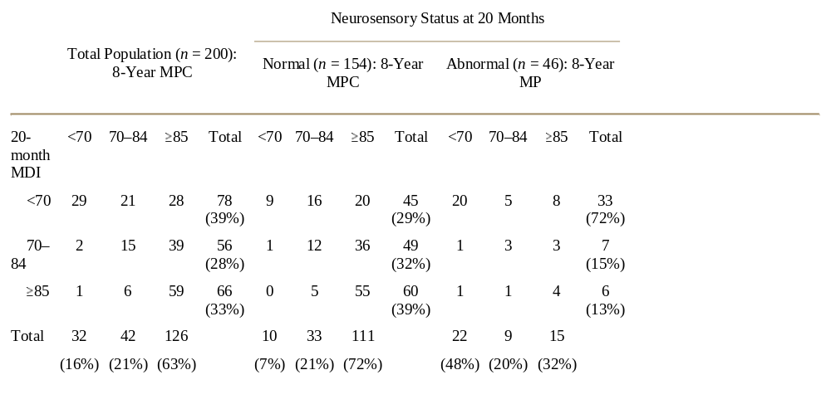
Does a low Bayley MDI mean that an infant has cognitive impairment? Hack et al

Slide 39
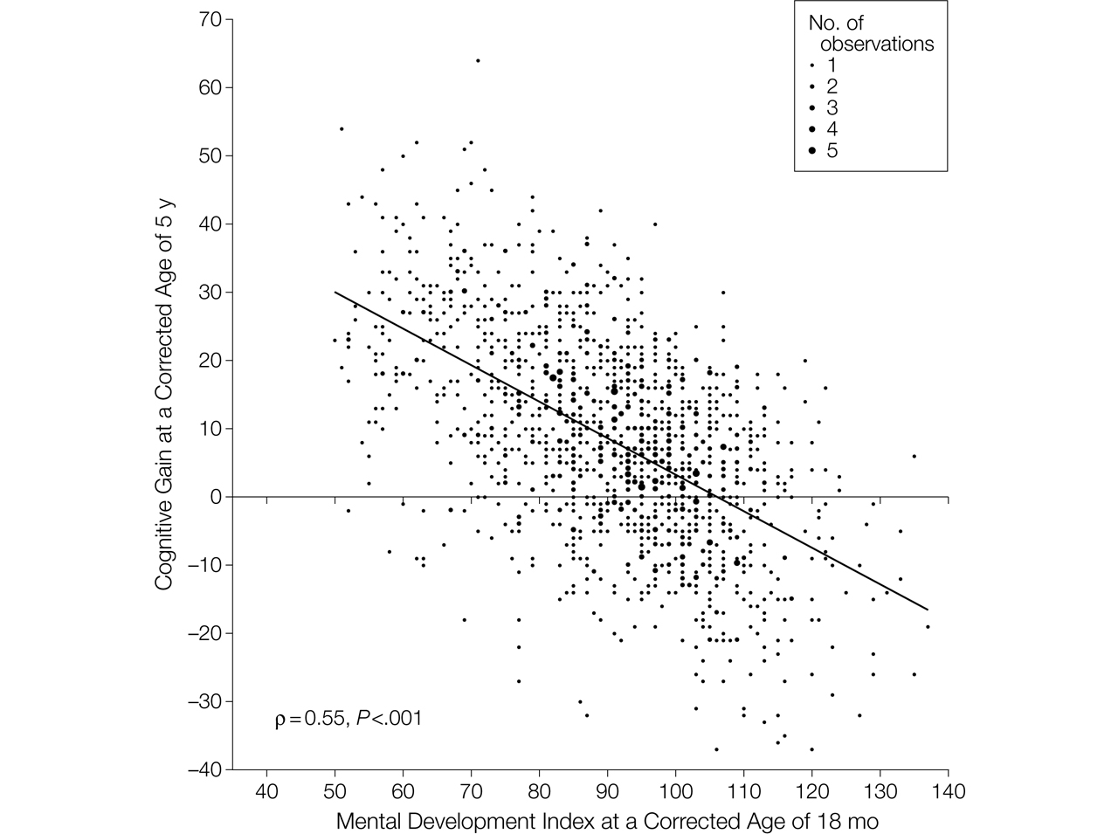

Figure 2. Relationship Between Mental Development Index Scores at 18 Months and Gain in Cognitive Scores Between 18 Months and 5 Years.
Schmidt, B. et al. JAMA 2012;307:275-282
Notes:
Cognitive gain was computed by subtracting the individual Mental Development Index scores at 18 months from the corresponding Wechsler Preschool and Primary Scale of Intelligence III (WPPSI-III) Full Scale IQ. Data are shown for the 1419 children who underwent a successful Bayley II test at 18 months and a successful WPPSI-III test at 5 years. For this analysis, we excluded children with Mental Development Index scores below 50 (the lowest score in the Bayley II) and with a Full Scale IQ below 40 (the lowest score in the WPPSI-III). The size of each data point is proportional to the number of coincident observations (range, 1 to 5). The solid diagonal line is the best-fitting regression line between the observed gain in cognitive scores at 5 years and the Mental Development Index scores at 18 months. ρ Is the correlation coefficient.

Slide 40
We are very poor at predicting outcomes
Survival
  Not predicted accurately by gestational age
  Incorporation of other information dramatically changes percentage survival predictions
  At 24 weeks predicted survival can be 10% or 90%
“NDI”
Components of NDI
  Predictions in individual babies?

Slide 41
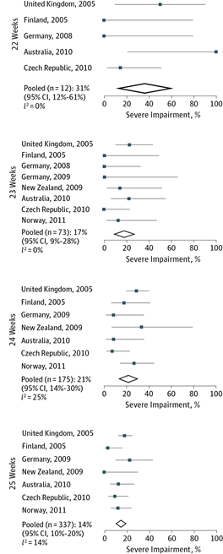
Among survivors at extremely low gestational age
Moore GP, et al. Neurodevelopmental outcomes at 4 to 8 years of children born at 22 to 25 weeks' gestational age: a meta-analysis. JAMA Pediatr. 2013;167(10):967-74.
Little evidence of effect of gestational age on important longer term neurological or intellectual outcomes
  Larger cohorts do show some trend
“Infants born at 22 weeks’ gestation have reported rates of moderate to severe neurodevelopmental impairment of 85% to 90%; for infants born at 23 weeks’ gestation, these rates are not significantly lower”
  AAP Clinical report, September 2015
Profoundly misleading

Slide 42
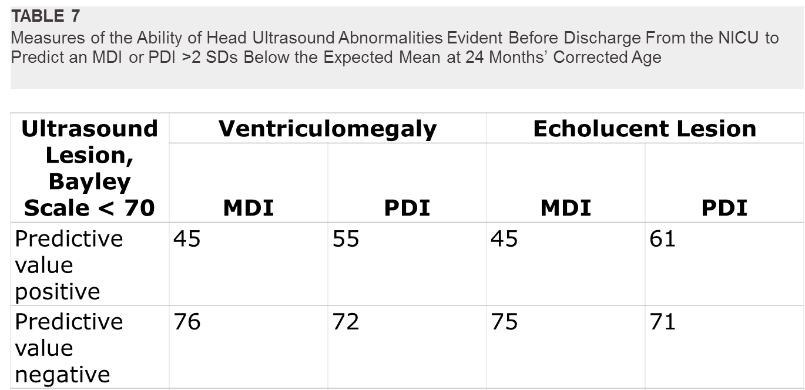
Among survivors who had a head ultrasound
O'Shea TM, et al. Neonatal cranial ultrasound lesions and developmental delays at 2 years of age among extremely low gestational age children. Pediatrics. 2008;122(3):e662-9.

Slide 43
Prediction of outcomes, which ones matter?
Development of guidelines regarding thresholds for LSI
Individual counseling of families about LSI
Designing research

Slide 44
Prediction of outcomes, which ones matter?
Development of guidelines regarding thresholds for LSI
  Based on community standards of criteria that are appropriate
  I think the thresholds should be fuzzy, they should be flexible enough to allow parental values to be included.
Individual counseling of families about LSI
  Based on values of the individual family (and the HCP)
Designing research
  Huge opportunity to develop outcomes which are truly Patient Centered
  Ask many parents not just the noisy ones!
  Develop patient outcomes which impact on the family

Slide 45

Pearce R, Baardsnes J: Term MRI for small preterm babies: do parents really want to know and why has nobody asked them? Acta Paediatrica 2012.
Parents of Lily and Maren
« We did not have a hundred babies. We had two but 50% had died. One was left. What did that mean for Maren? »
Jason Baardsnes and Rebecca Pearce, Acta Paediatr. 2012 Oct;101(10):1013-5

Slide 46
Pearce R, Baardsnes J: Term MRI for small preterm babies: do parents really want to know and why has nobody asked them? Acta Paediatrica 2012.
(The term MRI)…had identified moderate cerebellar damage
Our daughter had brain damage. Two of the most horrific words a parent can ever hear.
The doctor was compassionate but vague about the possible motor, cognitive and behavioural problems that Maren could face. He also said that it was hard to predict outcomes from MRIs, and it was not certain at all Maren would be disabled. In fact, many children with abnormal MRIs are not disabled.

Slide 47
When he left, I thought ‘okay, maybe this isn’t so bad after all’. …
I looked on PubMed for abstracts about cerebellar damage in preterm infants. One of the few articles that I found (Limperopoulos et al. 2007) was totally devastating… babies with cerebellar damage had a much greater chance of expressive and receptive language delays, severe motor disabilities, cognitive disabilities and autism symptoms.
This could be our child. We thought that we finally saw the light at the end of the tunnel, and then, we were handed this earth-shattering, crushing information.

Slide 48
For the first year, we were petrified and hypervigilant,
the MRI always in our minds. Was she making eye contact? Reaching for things? Showing any signs of ataxia? Babbling appropriately? Drooling too much? Acting ‘strange’?
She was our first child, so we did not really know what ‘strange’ was, but were watching for it! I would imagine Maren in a wheelchair or with leg braces, in a group home or with severe autism.
I started seeing a psychologist on a regular basis.
In our case, Maren’s MRI gave us no information about
what she is like today, it served only to completely terrify us.
Slowly, as she started meeting her milestones, our utter panic settled into something less acute.

Slide 49

Maren today
25 weeks, twin, early onset septic shock, fungal sepsis, prolonged HFOV and inhaled NO for marginal saturations, PDA ligation and postop hemodynamic compromise, severe BPD receiving steroids…
Cerebellar hemorrhage found on discharge MRI

Slide 50
To treat or not to treat?
(US 1984 amendment)
Treatment efficiency | Parents want Tx | Parents refuse Tx
Beneficial | Yes | Yes
Grey zone | Yes | No
Futile | yes? | No
But who decides where the grey zone starts and stops?
Notes:
50
Parenta are comnpetent and child`s surrogate

Slide 51
Newborn at 24 weeks GA: beneficial, “grey zone” or futile?

Slide 52
What are the outcomes at 23 weeks? France
“Parents should receive appropriate information of survival and risks”, “informed consent is given in the delivery room”
“In France, a do not resuscitate order is (generally made) for newborns weighing less than 600g and/or with a gestation of less than 24 weeks since the mortality is 100%”
  Desfrere, L; Tsatsaris, V.; Sanchez, L.; Cabrol, D., and Moriette, G. [Extremely preterm infants: resuscitation criteria in the delivery room and dialogue with parents before birth]. J Gynecol Obstet Biol Reprod. 2004 Feb; 33(1 Suppl):S84-7.

Slide 53
What is the survival at 23 weeks? Germany Herber-Jonas et al, Am J Obs Gyn, 2006Jul, 195(1): 16-22
In this study, 60% resuscitation at 22-24 weeks
When resuscitated:
Survival at 22 weeks: 37%
23 weeks: 75%

Slide 54
Grey Zones
One group have published their process for deciding that 24 weekers are futile, a consensus development process (which included no parents).
The same group now set their threshold at 23 weeks.
  I don’t know how they can be so sure that a baby is 23 weeks and 5 days and not 24+
  Life and death decision based on unreliable information
Doesn’t permit adjustment for other extremely important predictors of survival.
Predicted survival of some 23 week infants is substantially better than some 25 week infants.

Slide 55
Grey Zones
I do not have a threshold
But:
I have never resuscitated a baby we truly thought was less than 22 weeks gestation
I have resuscitated a tiny number of babies with a gestational thought to probably be less than 23 weeks (with some survival)

Slide 56
Conclusion
Mortality predictions are important for families, who are not aware of how poor we are at predicting death or survival
Before birth: incorporating other factors (rather than just GA), improves prediction, but does not eliminate uncertainty
After birth all bets are off.
The longer a baby survives the more likely they are to survive (!)
When everyone in the NICU thinks a baby will die, they often still survive.

Slide 57
Conclusion 2
Avoid “death or disability”
Evaluation of survival probability
  and then, separately:
Evaluation of the range of probable outcomes among survivors
Only put them together if you can explore and agree with parents which outcomes are equally bad (or worse) than being dead.
“65% chance of death or colostomy…”

Slide 58
Death or impotence
Many men of my age have diagnosis of prostate problems
Decision aids for therapy should not (and generally do not) conflate these 2 outcomes, even though both may be important to the individual
Presenting the risks separately can be understood by patients

Slide 59
Conclusion 3
Confident predictions of a child who will be unable to communicate are seen as a reasonable indication for withholding or withdrawing LSI by many parents
? Some patients with stage 3 HIE
? Some patients with brain malformations
? Is there any way to predict this for preterm infants?
Families differ, work with the family to find out what is important for them

Slide 60
Conclusion 4
In this era of “Patient-centered outcomes research”
We should be asking patients/parents what outcomes are important
To them
And their families
Both when we counsel regarding LSI
And when designing research
Measuring and communicating meaningful outcomes in neonatology:
A parental/family perspective
Annie Janvier, Barbara Farlow, Jason Baardsnes, Rebecca Pearce, Keith J. Barrington
In press, Seminars in Peirnatology

Slide 61
The antenatal consultation
Is about more than getting a yes/no decision for resuscitation
Is about more than assuring transfer of information to parents
Should be an exploration of parental values
An opportunity for education
  Of the medical team. About the family, their past experiences, their current situation, their needs their hopes their capacity for resilience
Janvier A, Lantos J, Aschner J, Barrington K, Batton B, Batton D, et al. Stronger and More Vulnerable: A Balanced View of the Impacts of the NICU Experience on Parents. Pediatrics. 2016.
Janvier A, Barrington KJ. CPS position statement for prenatal counselling before a premature birth: Simple rules for complicated decisions. Paediatrics & child health. 2014;19(1):22-4.

Slide 62
The antenatal consultation
More than 2 alternatives
  Do everything
  Do nothing
Sometimes “comfort care only” IS doing everything.
Doing nothing is NEVER an option
  Family support, emotional and other
  Comfort including potentially medications
  Follow up and advice for future pregnancies
  Etc
Trial of therapy, i.e. initiation of intensive care support with an assurance of early re-evaluation and redirection if appropriate

Slide 63
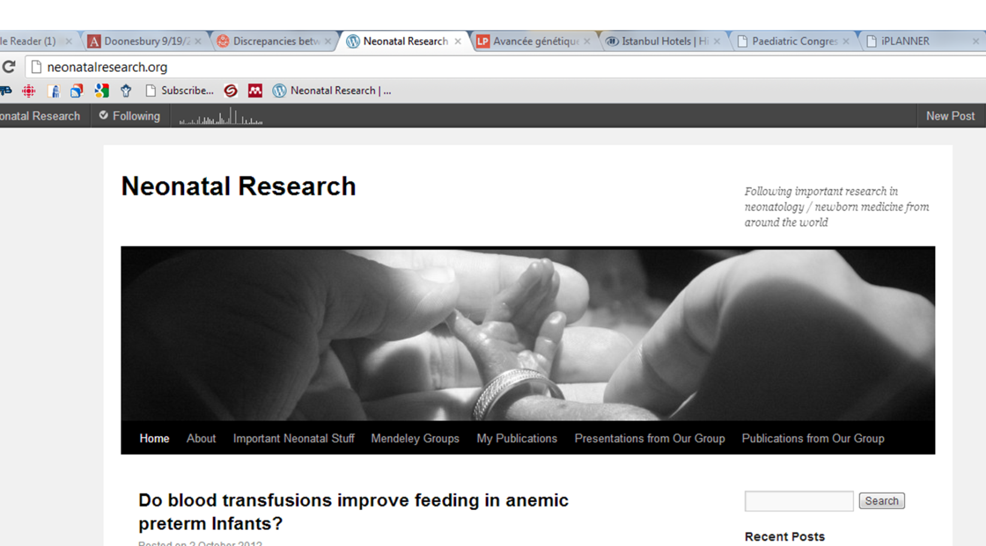
neonatalresearch.org
This presentation will soon be available on my blog, with a blog post and as a downloadable pptx file, with all the references.

