Slide 1

What is a good outcome?
Keith J Barrington

Slide 2
What is a good outcome?
Which outcomes are important?
Which should be used in decision making?
Which are predictable?
Who decides?

Slide 3
Recent guidelines of learned societies
refer to the following terms as important outcomes that should be considered in decision making:
Intact survival
Neurodevelopmental impairment
Severe or profound NDI
Survival without NDI

Slide 4
We all want intact survival…
But what is “intact”?
Who decides?
Can we really divide NICU graduates into those who are “intact” and those who are not?
Is an infant with a mild hemiplegia “intact”?
An infant with a low Bayley score?
An infant without NDI but who has oral aversion and is gastrostomy fed?

Slide 5
Dichotomizing continuous outcomes
Lung Injury is a continuum
BPD diagnosed by need for O2 at 36 weeks, 0 days.
What is the impact on the family of this diagnosis? Compared to:
  Home O2
  Readmissions during the first year of life
For decision-making, if an intervention decreases “BPD” but has no effect on perhaps more important outcomes?

Slide 6
Composite outcomes: death or NDI
Composite outcomes should be considered “when they are of similar value for patients and are affected in the same way by the intervention” (or risk factor)

Slide 7
Parents and healthcare providers disagree
Disagree on the quality of life of children with serious disabilities
Disagree on the impact of disabled children on the lives of the family
And sometimes agree
Agree (mostly) on the importance of parental participation in decision making

Slide 8
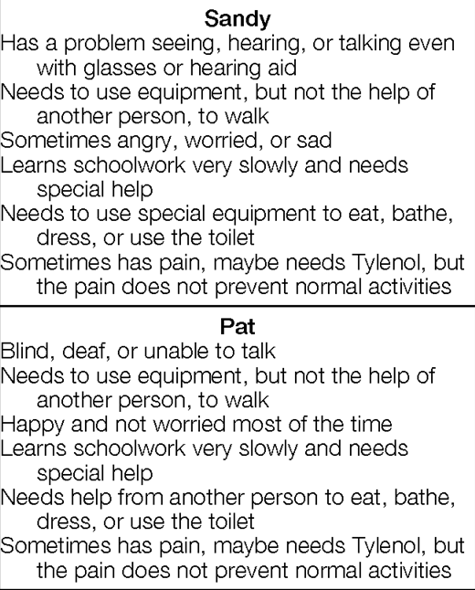
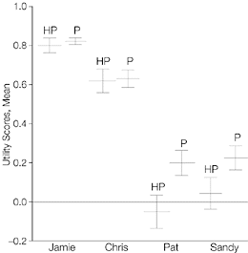
Quality of life of children with severe disabilities
Saigal S, et al. Differences in preferences for neonatal outcomes among health care professionals, parents, and adolescents. JAMA. 1999;281(21):1991-7.

Slide 9
Impacts on the family of a child with disability
Scorgie K, Sobsey D. Transformational outcomes associated with parenting children who have disabilities. Mental retardation. 2000;38(3):195-206.
Interviewed 80 families of children with disabilities (ranging from moderate to severe)
Compared the families’ own evaluation of their experiences to:
“Professional myths of family devastation, unending stress, near-universal divorce, and endless drudgery”

Slide 10
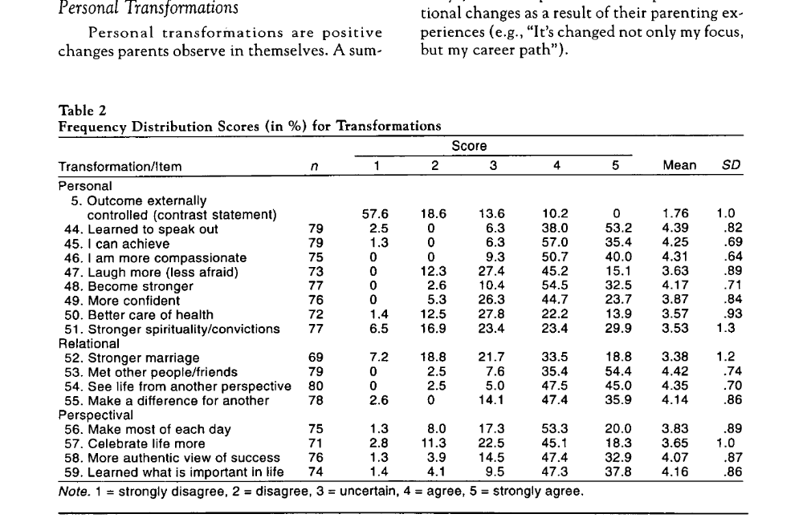
Impacts on the family; according to the family
Positive impacts

Slide 11
Impacts on families
Janvier A, et al. The experience of families with children with trisomy 13 and 18 in social networks. Pediatrics. 2012;130(2):293-8.
Parents who lived with a child with Trisomy 13 or 18
Healthcare Professionals overwhelmingly negative
Parents had many positive experiences with their children
  As well as huge challenges

Slide 12
Impacts on the family
Of course there are also negative impacts
Just because some impacts are positive doesn’t mean that you wouldn’t want it otherwise
Negative impacts can be addressed and minimized
  Bruns D, Foerster K. ‘We've been through it all together’: supports for parents with children with rare trisomy conditions. Journal of Intellectual Disability Research. 2011;55(4):361-9.
  Redquest BK, et al. Raising a child with special needs: the perspective of caregivers. Clin Nurse Spec. 2015;29(3):E8-15.
  McManus BM, et al. Modeling the social determinants of caregiver burden among families of children with developmental disabilities. American journal on intellectual and developmental disabilities. 2011;116(3):246-60.
But they can not be eliminated

Slide 13
Agreement that parents should be involved
But who has asked parents what outcomes are important for decision-making?
In the context of a choice of withholding or withdrawing Life-sustaining interventions? (LSI)
Or indeed in terms of choice of interventions to reduce lung injury, etc.

Slide 14
What do parents think are important outcomes for decision-making?
Einarsdottir J. Emotional experts: parents' views on end-of-life decisions for preterm infants in Iceland. Medical anthropology quarterly. 2009;23(1):34-50
For parents: quality of life turned out to be a “tricky” criterion for withdrawal of LSI
To know a severely disabled person influenced parents to refuse or accept quality of life as a valid argument.
Only a few of the parents were aware of the uncertainty of prognosis, and the disagreements among professionals.

Slide 15
Criteria for forgoing LSI? Parents’ views
“No life” was commonly stated to be a valid criterion for withdrawal of treatment.
“No life” could signify postponement of inevitable death for a short period by painful treatment,
Or living without crucial human qualities, such as an ability to take part in human communication and interaction.
Certainty of brain damage that would lead to inability to take part in human communication
  most frequently named as an acceptable criterion for termination of treatment.

Slide 16
Poor quality of life
Michelson KN, et al. Parental Views on Withdrawing Life-Sustaining Therapies in Critically Ill Children. Archives of pediatrics & adolescent medicine. 2009;163(11):986-92.
51% of parents (of PICU patients) agreed that a “poor quality of life” could be a reason for withdrawing LSI, (24% said no)
What did they mean by that?
Many described scenarios in which their child could not interact with his/her surroundings. For example, participants used phrases like, “[T]hey have no ability to communicate. They don't have any feelings. They are not thinking.”

Slide 17
Professional guidelines for withholding LSI
Usually based on survival without severe NDI
Which conflates 2 very different outcomes
Death
Survival with NDI
NDI is a composite of 4 different outcomes,
  With differing impacts and importance
CP, blindness, deafness, developmental “impairment”
A composite created by physicians

Slide 18
Important outcomes we don’t consider
Behavioural problems
Sleep disturbances
Feeding problems
  Can have major impacts on the family: may be more important than components of NDI
Happiness
Resilience and coping

Slide 19
Death or NDI
Are they of equal importance to families, to health care providers to society?
Are the components of NDI of equal importance?
Most infants with NDI are assigned that outcome based on a low developmental screening test score
  Which is not a reliable predictor of cognitive impairment

Slide 20
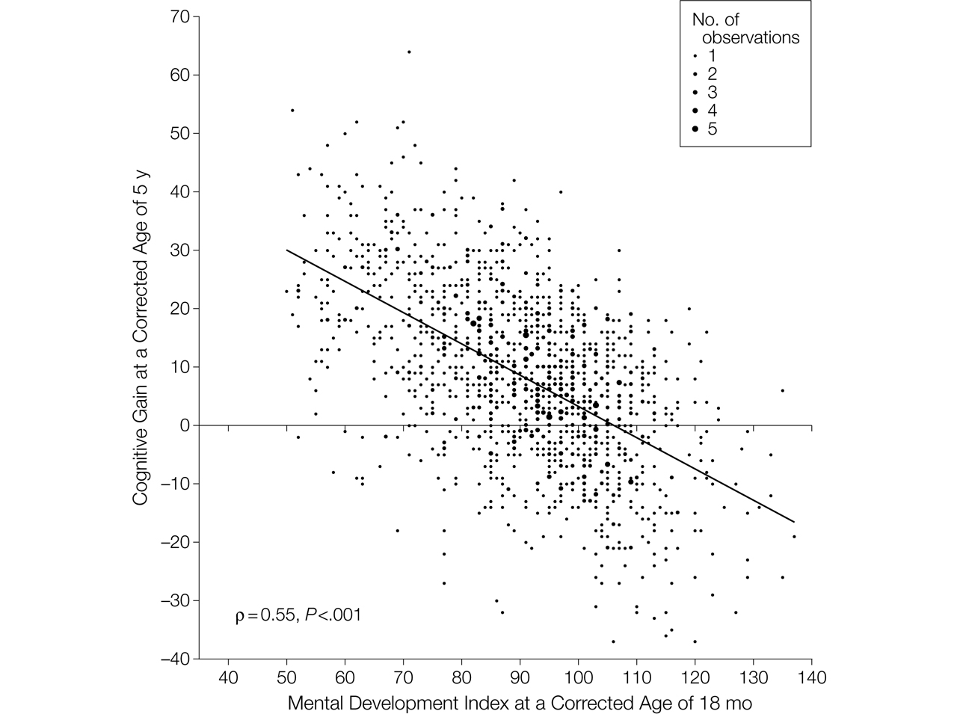

Figure 2. Relationship Between Mental Development Index Scores at 18 Months and Gain in Cognitive Scores Between 18 Months and 5 Years.
Schmidt, B. et al. JAMA 2012;307:275-282
Notes:
Cognitive gain was computed by subtracting the individual Mental Development Index scores at 18 months from the corresponding Wechsler Preschool and Primary Scale of Intelligence III (WPPSI-III) Full Scale IQ. Data are shown for the 1419 children who underwent a successful Bayley II test at 18 months and a successful WPPSI-III test at 5 years. For this analysis, we excluded children with Mental Development Index scores below 50 (the lowest score in the Bayley II) and with a Full Scale IQ below 40 (the lowest score in the WPPSI-III). The size of each data point is proportional to the number of coincident observations (range, 1 to 5). The solid diagonal line is the best-fitting regression line between the observed gain in cognitive scores at 5 years and the Mental Development Index scores at 18 months. ρ Is the correlation coefficient.

Slide 21
We are very poor at predicting outcomes
Survival
  Not predicted accurately by gestational age
  Incorporation of other information dramatically changes percentage survival predictions
  At 24 weeks survival can be 10% or 90%
“NDI”
Components of NDI
  Predictions in individual babies?

Slide 22
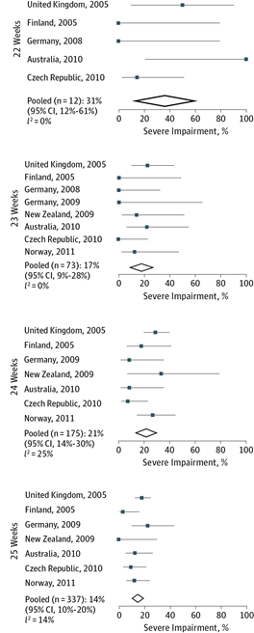
Among survivors at extremely low gestational age
Moore GP, et al. Neurodevelopmental outcomes at 4 to 8 years of children born at 22 to 25 weeks' gestational age: a meta-analysis. JAMA Pediatr. 2013;167(10):967-74.
Little evidence of effect of gestational age on important longer term neurological or intellectual outcomes
  Larger cohorts do show some trend
“Infants born at 22 weeks’ gestation have reported rates of moderate to severe neurodevelopmental impairment of 85% to 90%; for infants born at 23 weeks’ gestation, these rates are not significantly lower”
  AAP Clinical report, September 2015

Slide 23
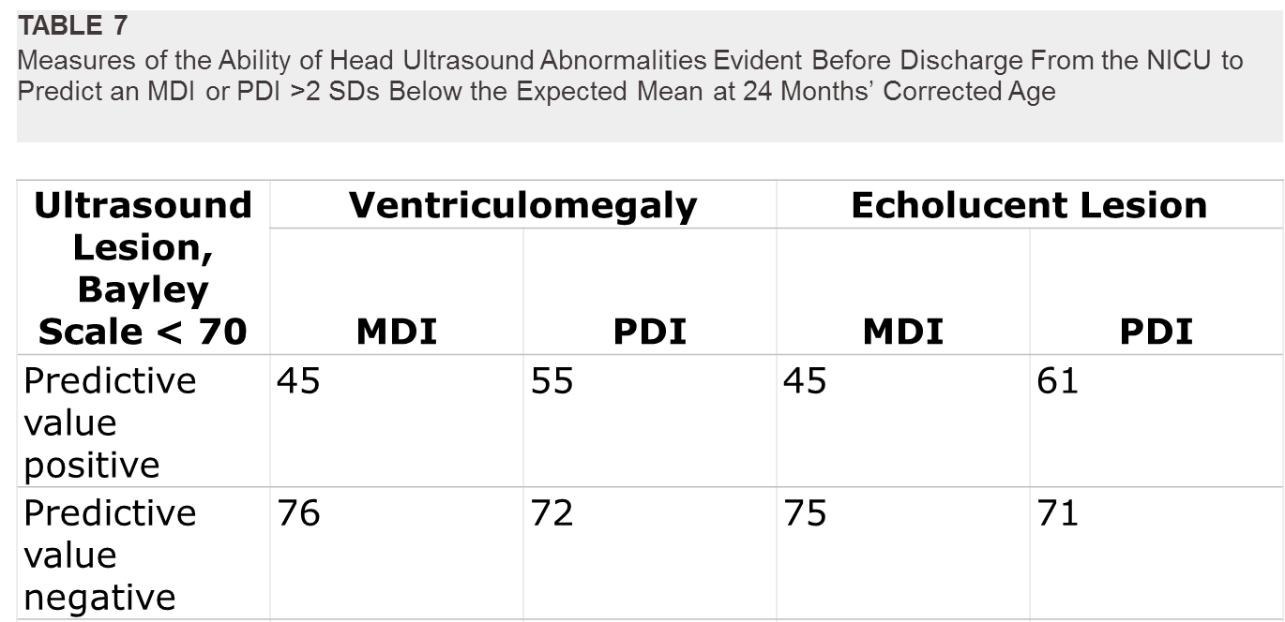
Among survivors who had a head ultrasound
O'Shea TM, et al. Neonatal cranial ultrasound lesions and developmental delays at 2 years of age among extremely low gestational age children. Pediatrics. 2008;122(3):e662-9.

Slide 24
Prediction of outcomes, which ones matter?
Development of guidelines regarding thresholds for LSI
Individual counseling of families about LSI
Designing research

Slide 25
Prediction of outcomes, which ones matter?
Development of guidelines regarding thresholds for LSI
  Based on community standards of criteria that are appropriate
Individual counseling of families about LSI
  Based on values of the individual family (and the HCP)
Designing research
  Huge opportunity to develop outcomes which are truly Patient Centered
  Ask many parents not just the noisy ones!
  Develop patient outcomes which impact on the family

Slide 26
Conclusion
Mortality predictions are important for families, who are not aware of how poor we are at predicting death or survival
Before birth: incorporating other factors (rather than just GA), improves prediction, but does not eliminate uncertainty
After birth all bets are off.
The longer a baby survives the more likely they are to survive (!)
When everyone in the NICU thinks a baby will die, they often still survive.

Slide 27
Conclusion 2
Avoid “death or disability”
Evaluation of survival probability
  and separately
Evaluation of probable outcomes among survivors
Only put them together if you can explore and agree with parents which outcomes are equally bad (or worse) than being dead.
“65% chance of death or colostomy…”

Slide 28
Conclusion 3
Confident predictions of a child who will be unable to communicate are seen as a reasonable indication for withholding or withdrawing LSI by many parents
? Some patients with stage 3 HIE
? Some patients with brain malformations
? Is there any way to predict this for preterm infants?
Families differ, work with the family to find out what is important for them

Slide 29
Conclusion 4
In this era of “Patient-centered outcomes research”
We should be asking patients/parents what outcomes are important
To them
And their families
Both when we counsel regarding LSI
And when designing research

