Slide 1

The Good, The Bad and The Ugly: probiotics, antibiotics, and necrotizing enterocolitis
Keith J Barrington
CHU Sainte Justine
Montreal

Slide 2


Slide 3
Disclosure
I have no relevant financial relationships with the manufacturer(s) of any commercial product(s) and/or provider(s) of commercial services discussed in this CME activity.
Probiotics are not approved for the prevention of NEC, but it is not clear what that means
The FDA don’t really know what to do about them.

Slide 4
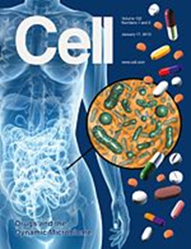


The intestinal microbiome

Slide 5
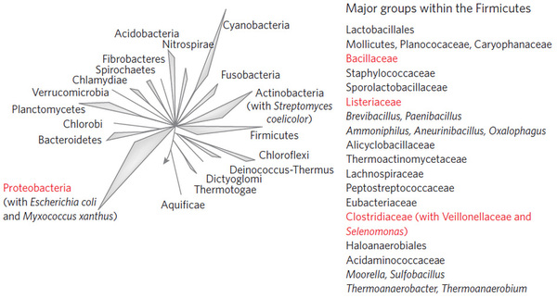

Slide 6
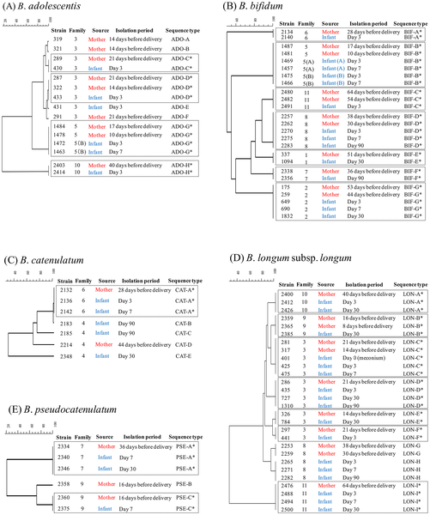

Figure 1. Comparison of MLST profiles of strains obtained from 12 vaginal delivered mother-infant pairs.
* Isolates from both members of a mother–infant pair and showing the same MLST profile within a given cluster.
Makino H, Kushiro A, Ishikawa E, Kubota H, et al. (2013) Mother-to-Infant Transmission of Intestinal Bifidobacterial Strains Has an Impact on the Early Development of Vaginally Delivered Infant's Microbiota. PLoS ONE 8(11): e78331. doi:10.1371/journal.pone.0078331
http://www.plosone.org/article/info:doi/10.1371/journal.pone.0078331

Slide 7
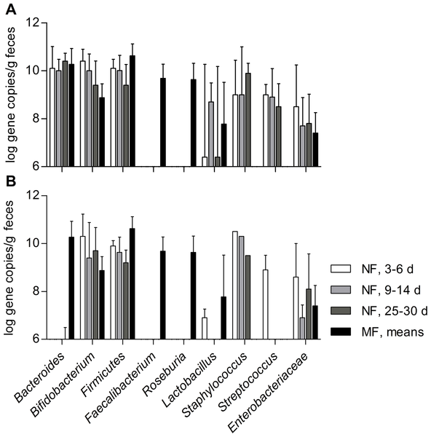
Figure 2. Gene copy numbers of the major gut-associated bacterial populations detected in neonatal feces (NF) using qPCR.
Jost T, Lacroix C, Braegger CP, Chassard C (2012) New Insights in Gut Microbiota Establishment in Healthy Breast Fed Neonates. PLoS ONE 7(8): e44595. doi:10.1371/journal.pone.0044595
http://www.plosone.org/article/info:doi/10.1371/journal.pone.0044595

Slide 8
Collado MC, Delgado S, Maldonado A, Rodríguez JM: Assessment of the bacterial diversity of breast milk of healthy women by quantitative real-time pcr. Letters in Applied Microbiology 2009, 48(5):523-528.
Table 2. Detection of bacterial DNA in the breast milk samples by quantitative real-time PCR technique (qRTi-PCR). Data are presented as log10 (genome equivalent ml−1)
Bacterial groups | Prevalence | Range | Mean ± SD
Total bacteria | 50/50 | 5·05–7·76 | 6·03 ± 0·75
Staphylococcus group | 50/50 | 1·30–5·56 | 3·55 ± 0·84
Bifidobacterium group | 50/50 | 2·45–4·75 | 3·56 ± 0·53
Lactobacillus group | 50/50 | 2·61–4·50 | 3·74 ± 0·47
Enterococcus group | 38/50 | 1·20–4·85 | 2·56 ± 0·71
Streptococcus group | 50/50 | 2·91–6·11 | 4·50 ± 0·81
Bacteroides group | 20/50 | 1·50–3·35 | 2·02 ± 0·55
Clostridium cluster XIVa–XIVb | 48/50 | 2·27–4·85 | 3·32 ± 0·60
Clostridium cluster IV | 2/50 | 1·07–2·12 | 1·60 ± 0·17

Slide 9
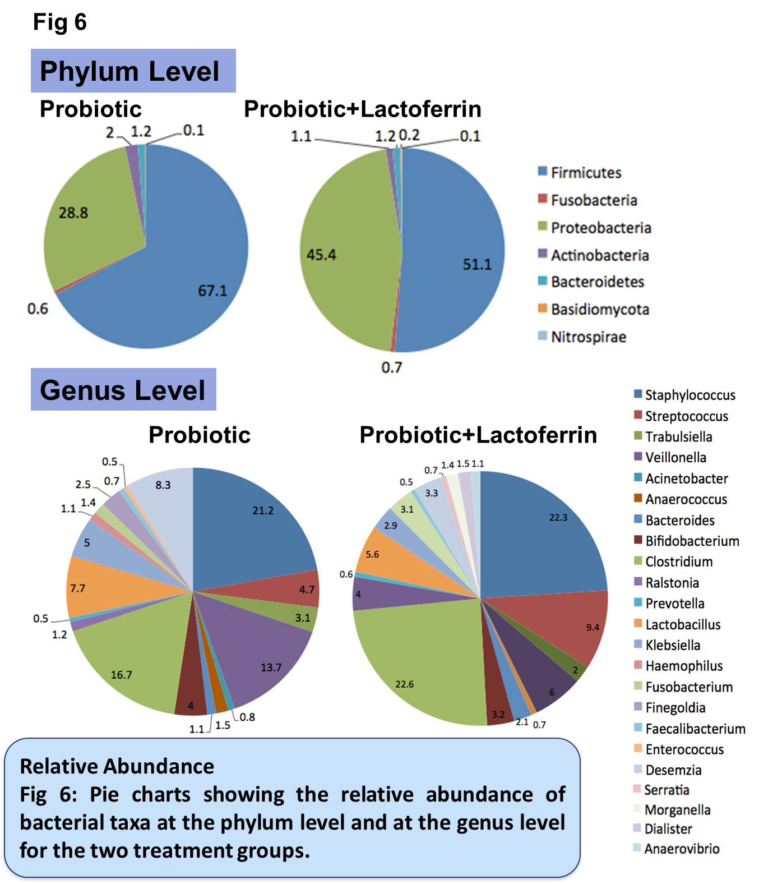

Slide 10
What is the source of the dysbiosis of the preterm infant?
Vaginal colonization with Bifido & Lacto as pregnancy advances
Often born by cesarian
Exposed to antibiotics pre and postnatally
Exposed to NICU flora
Multiple procedures
  Fed by tube
  Aspiration
  Intubation
Less breast milk received

Slide 11
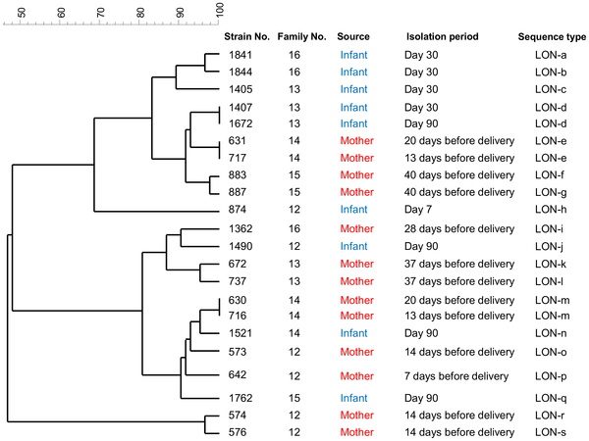
Figure 2. Dendrogram of 22 individual B. longum subsp. longum isolates from 5 cesarean delivered mother-infant pairs.
Among the 5 mother-infant pairs which gave delivery by C-section, none of the strains were identified as monophyletic between mothers and infants
Makino H, Kushiro A, Ishikawa E, Kubota H, et al. (2013) Mother-to-Infant Transmission of Intestinal Bifidobacterial Strains Has an Impact on the Early Development of Vaginally Delivered Infant's Microbiota. PLoS ONE 8(11): e78331. doi:10.1371/journal.pone.0078331
http://www.plosone.org/article/info:doi/10.1371/journal.pone.0078331

Slide 12
Newburg DS, Ruiz-Palacios GM, Morrow AL: Human milk glycans protect infants against enteric pathogens. Annu Rev Nutr 2005, 25(1):37-58.
Glycoconjugate | Pathogen | Reference | Typical concentrationª
GM1 | Labile toxin, cholera toxin | (44) | 180 μg/liter
GM3 | Enteropathogenic Escherichia coli | (20) | 13 mg/liter
Gb₃ | Shiga toxin | (36) | 100–150 μg/liter
Sulfatide | Human immunodeficiency virus | (59) | 100 μg/liter
Chondroitin sulfate | Human immunodeficiency virus | (39) | 6 mg/liter
Lactadherin | Rotavirus | (62) | 100 μg/liter
Mucin | S-fimbriated E. coli | (50) | 1 g/liter
Mannosylated glycopeptide | Enterohemorrhagic E. coli | (2) | 60 mg/liter
Oligosaccharides | Streptococcus pneumoniae | (1) | 0.2–10 g/liter
 | Enteropathogenic E. coli | (9) | 3 g/liter
 | Listeria monocytogenes | (6) | 3 g/liter
Fucosylated oligosaccharides | Campylobacter jejuni Vibrio cholerae Stable toxin | (46) (46) (41) | 1–25 mg/liter 1–25 mg/liter 40 μg/liter
Macromolecule-associated glycans | Noroviruses Pseudomonas aeruginosa | (23) (26) | 370 mg/liter 370 mg/liter
Sialyllactose | Cholera toxin | (21) | 200 mg/liter
 | E. coli | (53, 57) | 200 mg/liter
 | P. aeruginosa | (10) | 200 mg/liter
 | Aspergillus fumigatus conidia | (3) | 200 mg/liter
 | Influenza virus | (13, 29) | 200 mg/liter
 | Polyomavirus | (52) | 200 mg/liter
 | Helicobacter pylori | (33) | 200

Slide 13
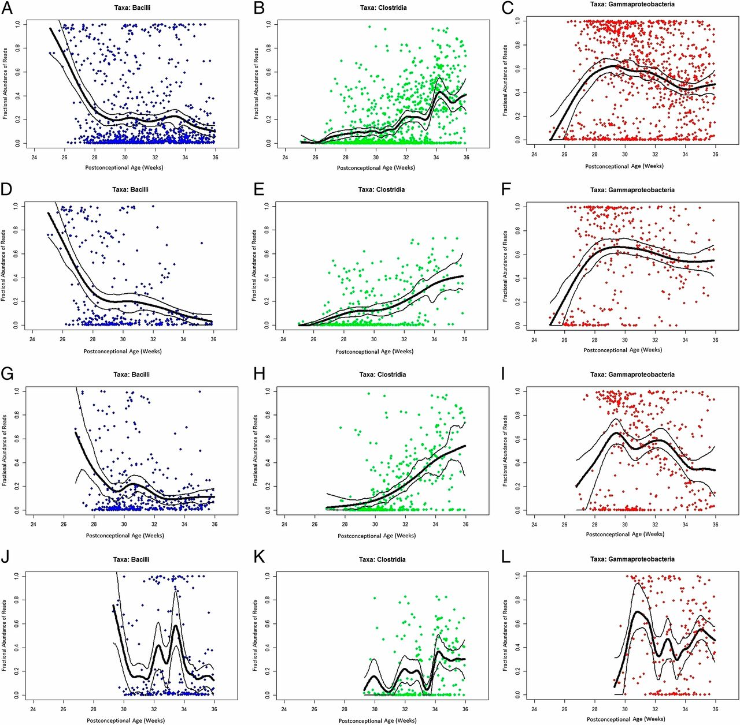
Percent bacterial class abundance.
La Rosa P S et al. PNAS 2014;111:12522-12527
©2014 by National Academy of Sciences
Notes:
Percent bacterial class abundance. Proportion of each bacterial class is represented in y axes in each graph. The x axes represent samples obtained at various postconceptional ages (weeks). The columns represent class proportions, as indicated. (A–C) All infants in cohort (n = 58 subjects). (D–F) Infants in <26 wk gestational age subcohort (n = 15 subjects). (G–I) Infants in 26–28 wk gestational age subcohort (n = 20 subjects). (J–L) Infants in >28 wk gestational age subcohort (n = 23 subjects). To reduce the effect of random fluctuations in the data (noise), the lines were produced by fitting a cubic smooth spline (thick black line) to the data with 95% confidence bands (thinner lines) generated using a nonparametric bootstrap method.

Slide 14
The gut microbiota of premature infants residing in a tightly controlled environment of a neonatal intensive care unit (NICU) progresses through a choreographed succession of bacterial classes from Bacilli to Gammaproteobacteria to Clostridia interrupted by abrupt population changes.
The rate of assembly is slowest for the most premature of these infants

Slide 15
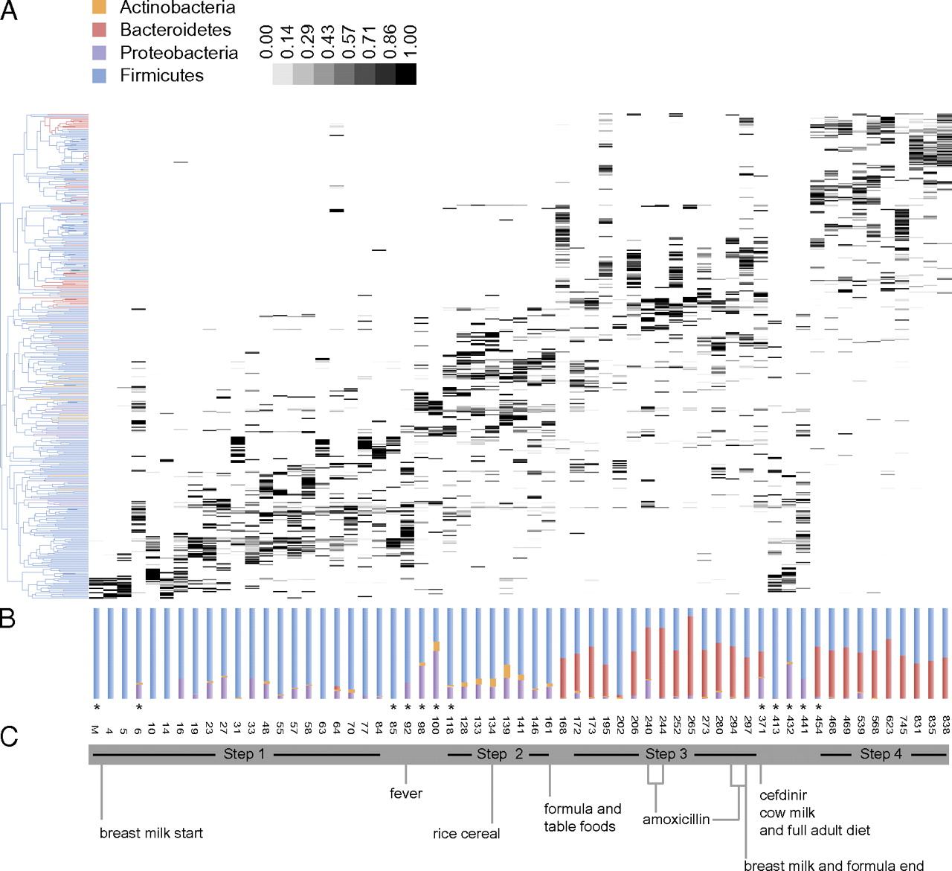
OTU-based community structure and composition in the gut microbiota.
Koenig J E et al. PNAS 2011;108:4578-4585
©2011 by National Academy of Sciences
Notes:
OTU-based community structure and composition in the gut microbiota. (A) Each vertical lane corresponds to a sample day, and the gray-scale shaded rectangles represent the abundance of the different OTUs. The dendogram on the left shows how the OTUs are clustered according to cooccurrence, and branches are colored to indicate the taxonomical assignment of the OTUs at the phylum level. Samples selected for metagenomic analyses are indicated with asterixes. (B) Relative abundances of the bacterial phyla in each samples. (C) Significant events pertaining to changes in the infant's diet are indicated. Steps characterized by specific bacterial consortia supported by linear discriminate analysis are shown.

Slide 16
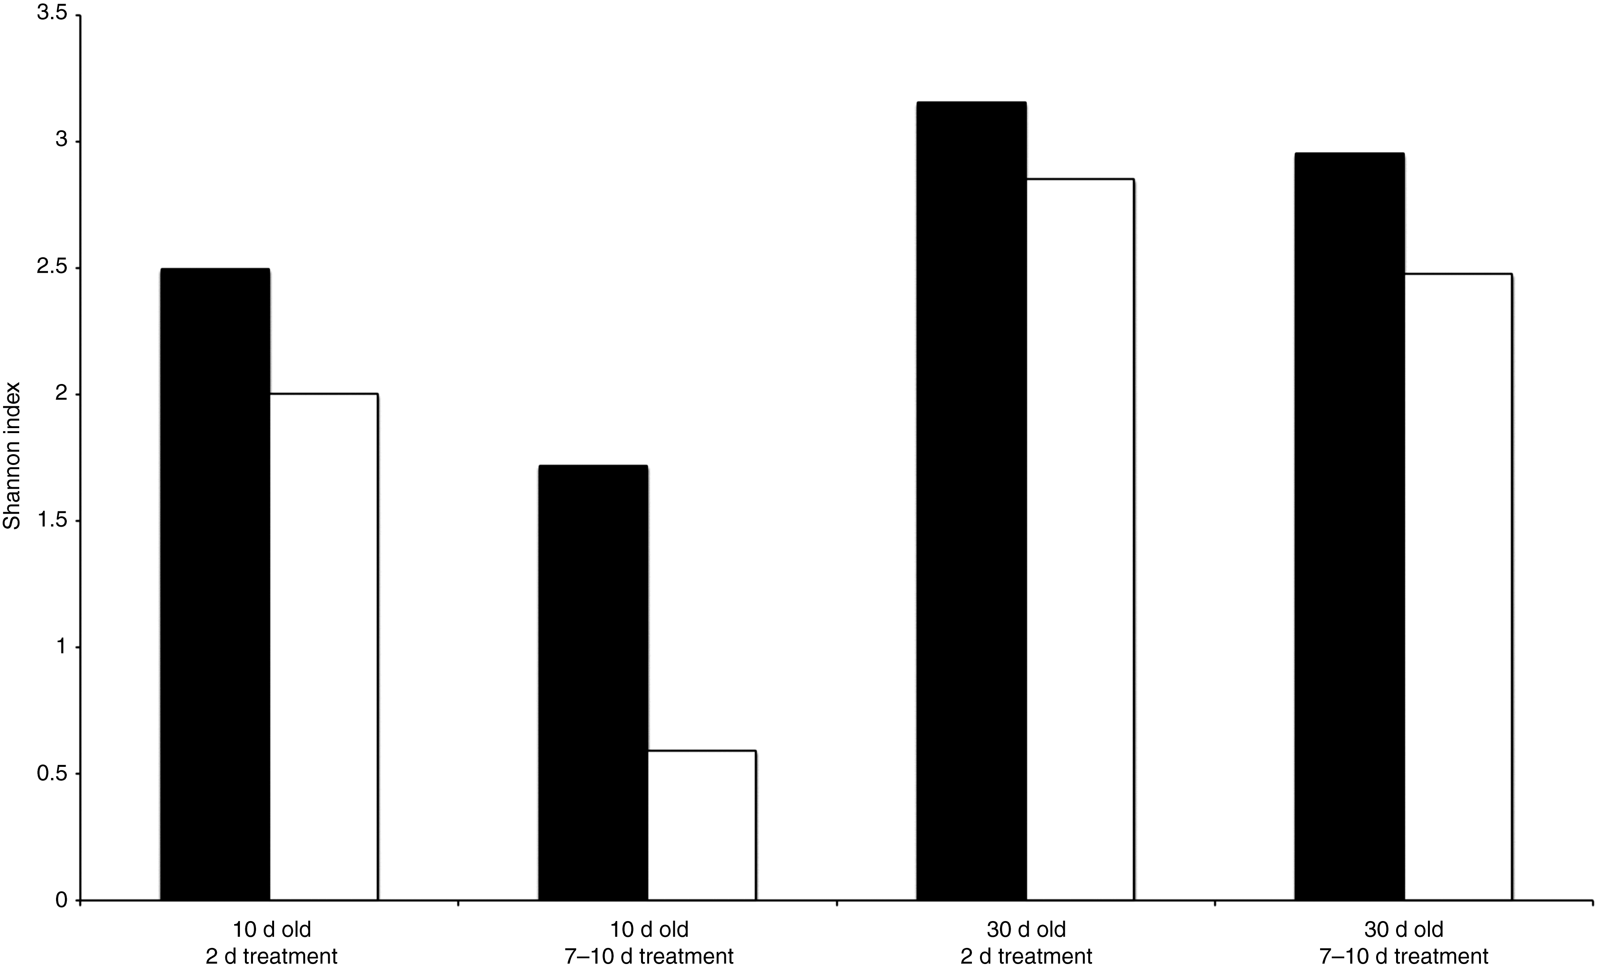
Figure 4
Majd Dardas The impact of postnatal antibiotics on the preterm intestinal microbiome
Pediatr Res (2014) 76, 150-158. doi:10.1038/pr.2014.69

Slide 17
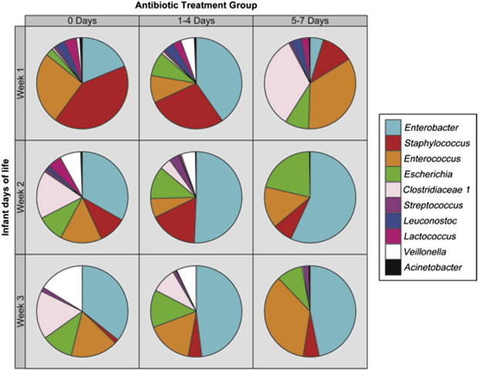
Figure 1 Pie graphs depicting relative abundance of bacterial genera detected in stool specimens from study infants as a function of antibiotic exposure over the first 3 weeks of life.
Corryn Greenwood , Ardythe L. Morrow , Anne J. Lagomarcino , Mekibib Altaye , Diana H. Taft , Zhuoteng Yu , David ...
Early Empiric Antibiotic Use in Preterm Infants Is Associated with Lower Bacterial Diversity and Higher Relative Abundance of Enterobacter
The Journal of Pediatrics, Volume 165, Issue 1, 2014, 23 - 29
http://dx.doi.org/10.1016/j.jpeds.2014.01.010

Slide 18
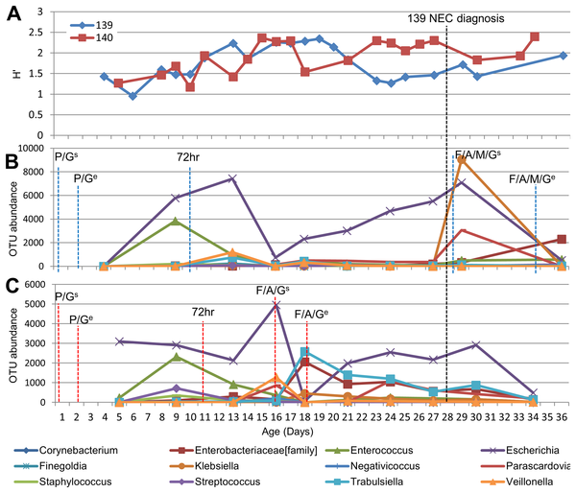
Figure 3. Development of gut microbiome in twin pair 139/140 mapped to life events.
Stewart CJ, Marrs ECL, Nelson A, Lanyon C, et al. (2013) Development of the Preterm Gut Microbiome in Twins at Risk of Necrotising Enterocolitis and Sepsis. PLoS ONE 8(8): e73465. doi:10.1371/journal.pone.0073465
http://www.plosone.org/article/info:doi/10.1371/journal.pone.0073465

Slide 19
Disrupting the developing microbiome
Prolonged use of antibiotics increases the incidence of NEC
    Kuppala VS, Meinzen-Derr J, Morrow AL, Schibler KR. Prolonged Initial Empirical Antibiotic Treatment is Associated with Adverse Outcomes in Premature Infants. The Journal of Pediatrics. 2011;159(5):720-5.
    Greenwood C, Morrow AL, Lagomarcino AJ, Altaye M, Taft DH, Yu Z, et al. Early Empiric Antibiotic Use in Preterm Infants Is Associated with Lower Bacterial Diversity and Higher Relative Abundance of Enterobacter. The Journal of pediatrics. 2014.
Use of acid-blocking medications increases NEC
    Terrin G, Passariello A, De Curtis M, Manguso F, Salvia G, Lega L, et al. Ranitidine is associated with infections, necrotizing enterocolitis, and fatal outcome in newborns. Pediatrics. 2012;129(1):e40-5.

Slide 20
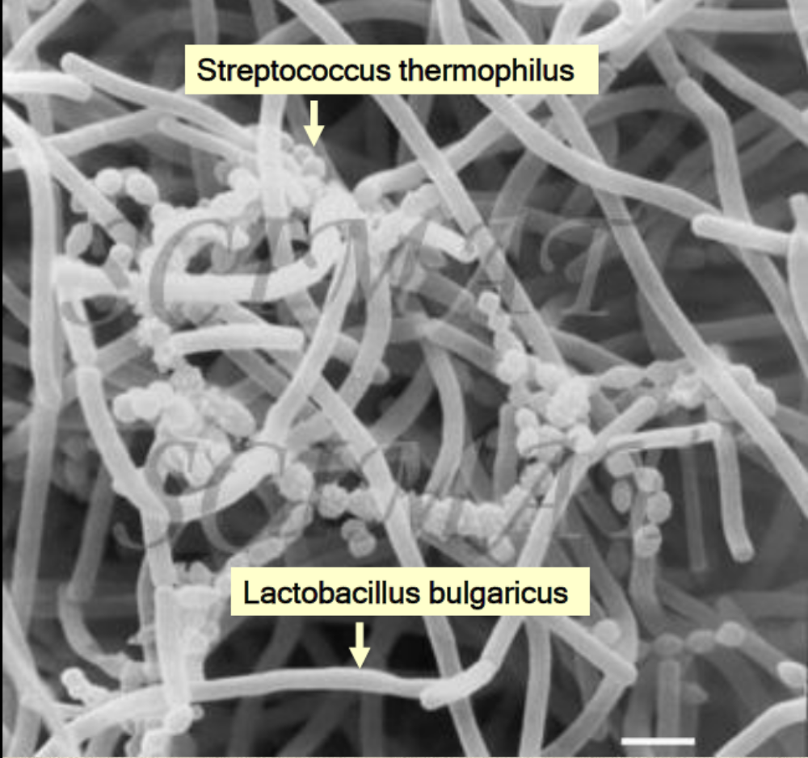
Probiotics

Slide 21
What are probiotics?
“Live micro-organisms which when administered in adequate amounts confer a health benefit on the host”
          FAO WHO 2001

Slide 22
Why not try and normalize the microbiome?
1st randomized trial in 1997
Do probiotics improve feeding tolerance?
(yes)
12% B breve colonization in controls
73% in supplemented
A series of small to moderately large trials, effects on NEC examined

Slide 23
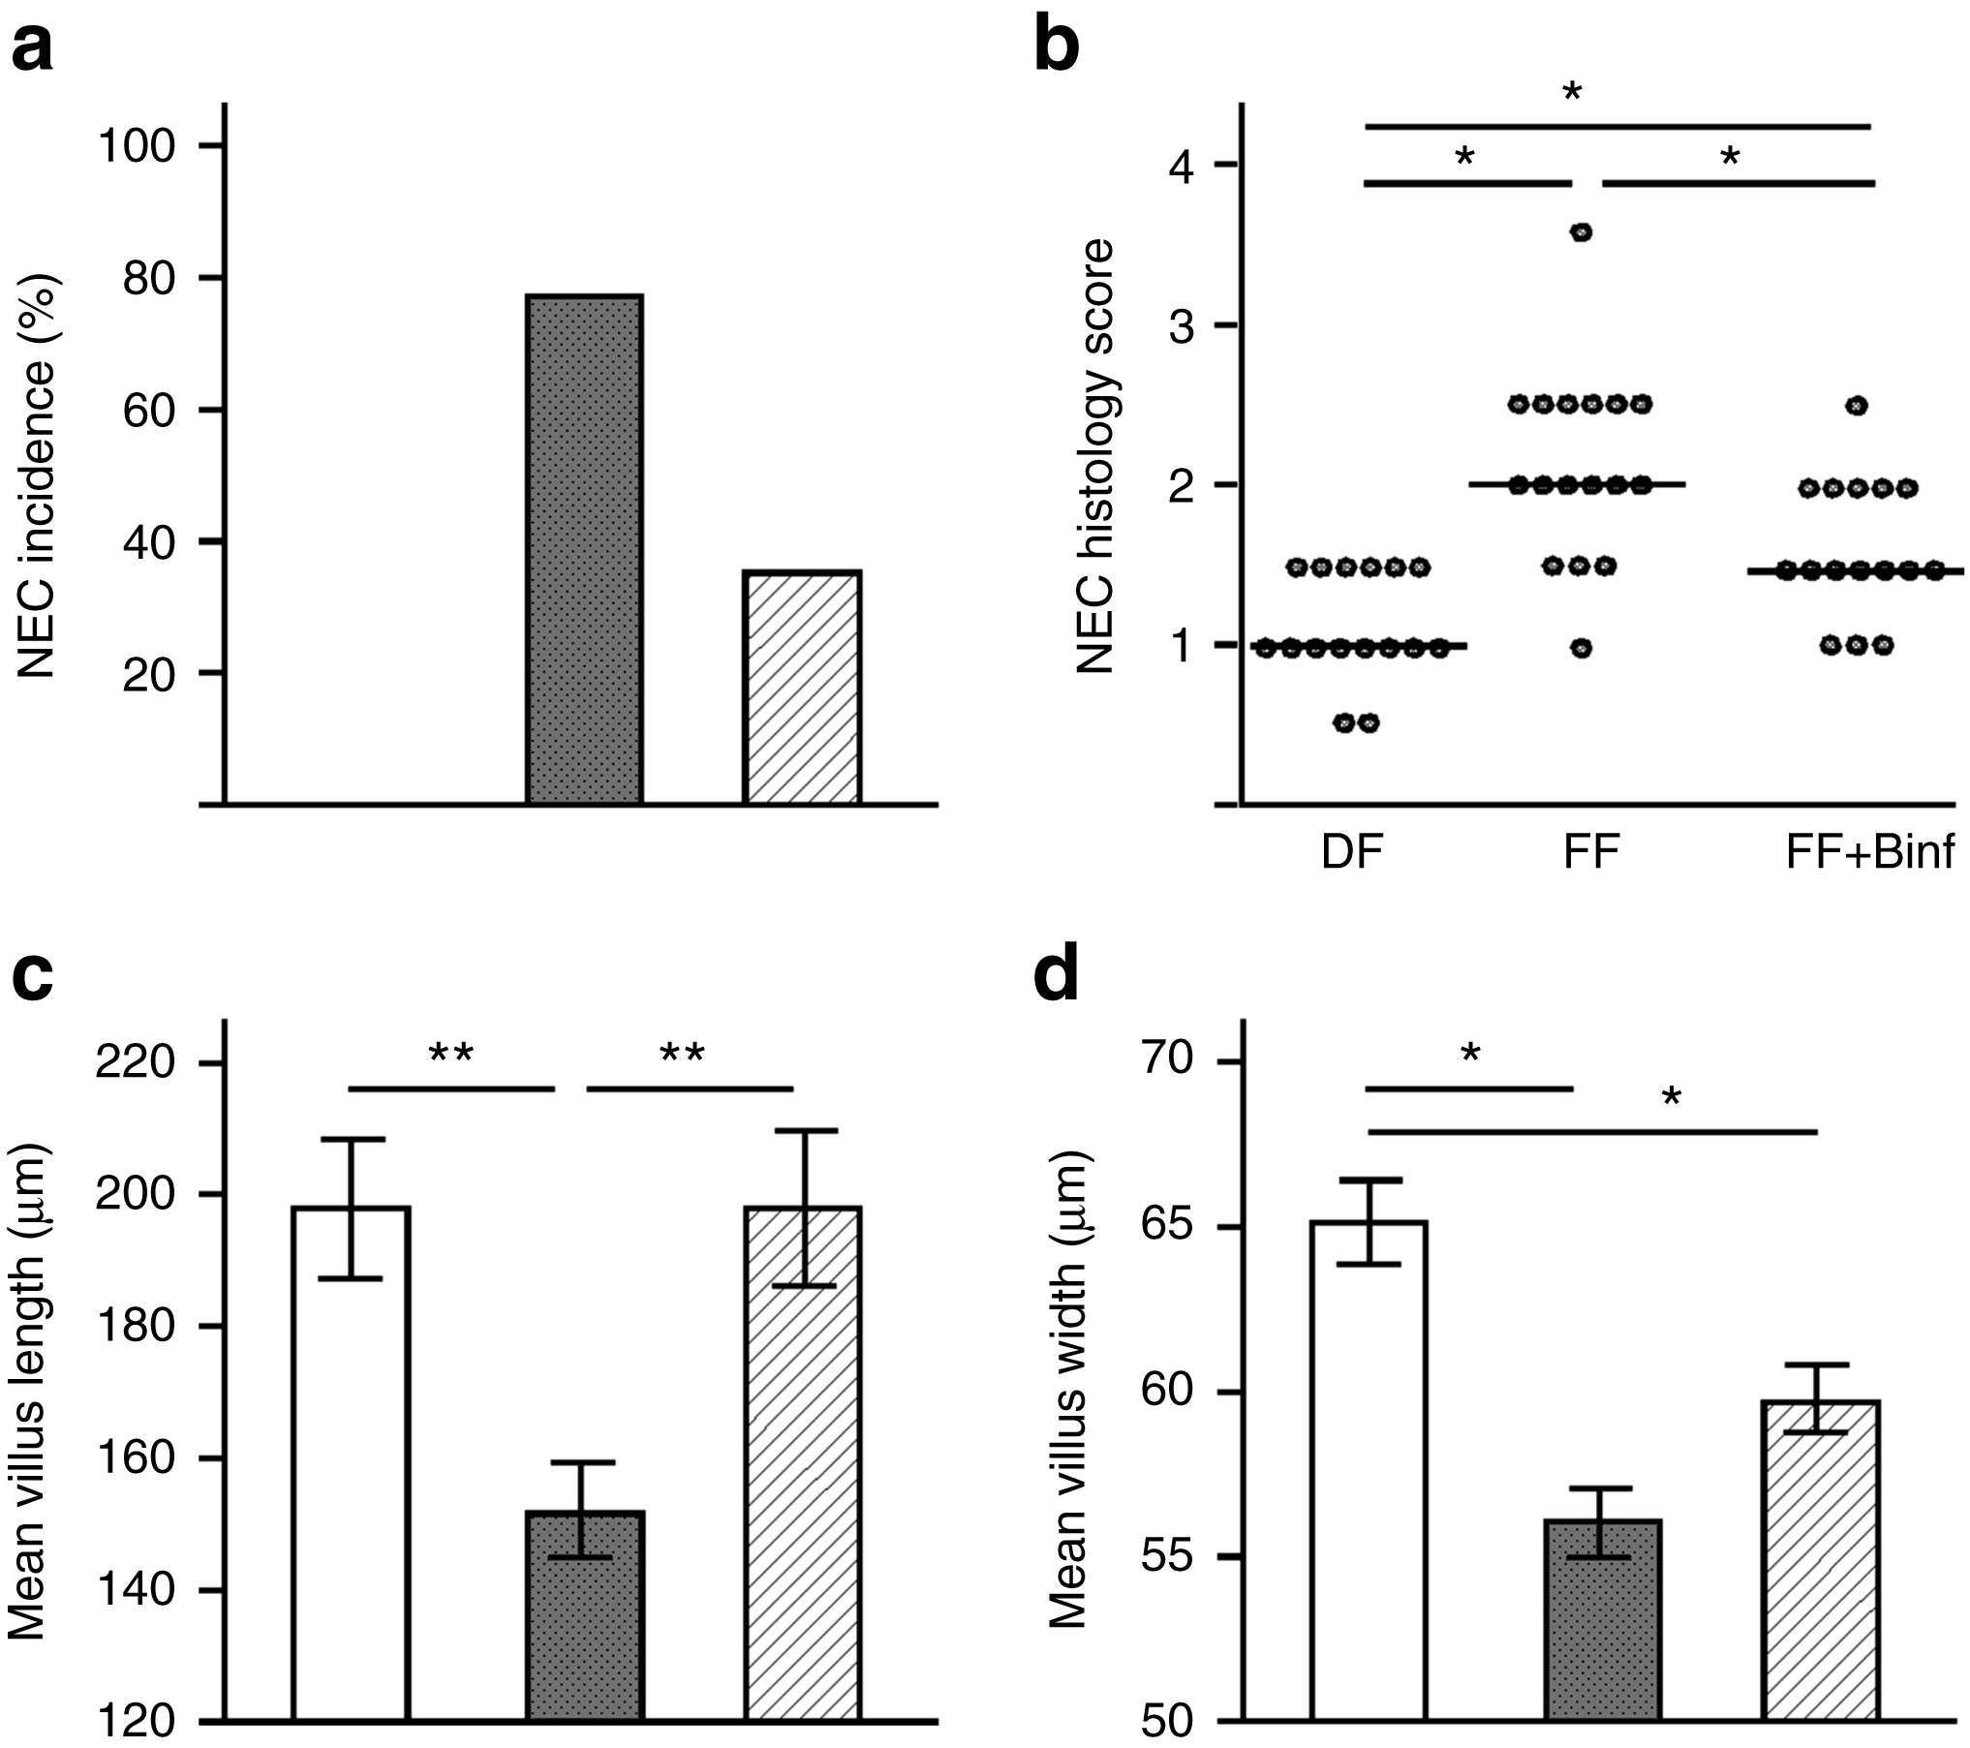
Figure 1
Mark A. Underwood, advance online publication Bifidobacterium longum subsp. infantis in experimental necrotizing enterocolitis: alterations in inflammation, innate immune response, and the microbiota
6 August 2014. doi:10.1038/pr.2014.102

Slide 24
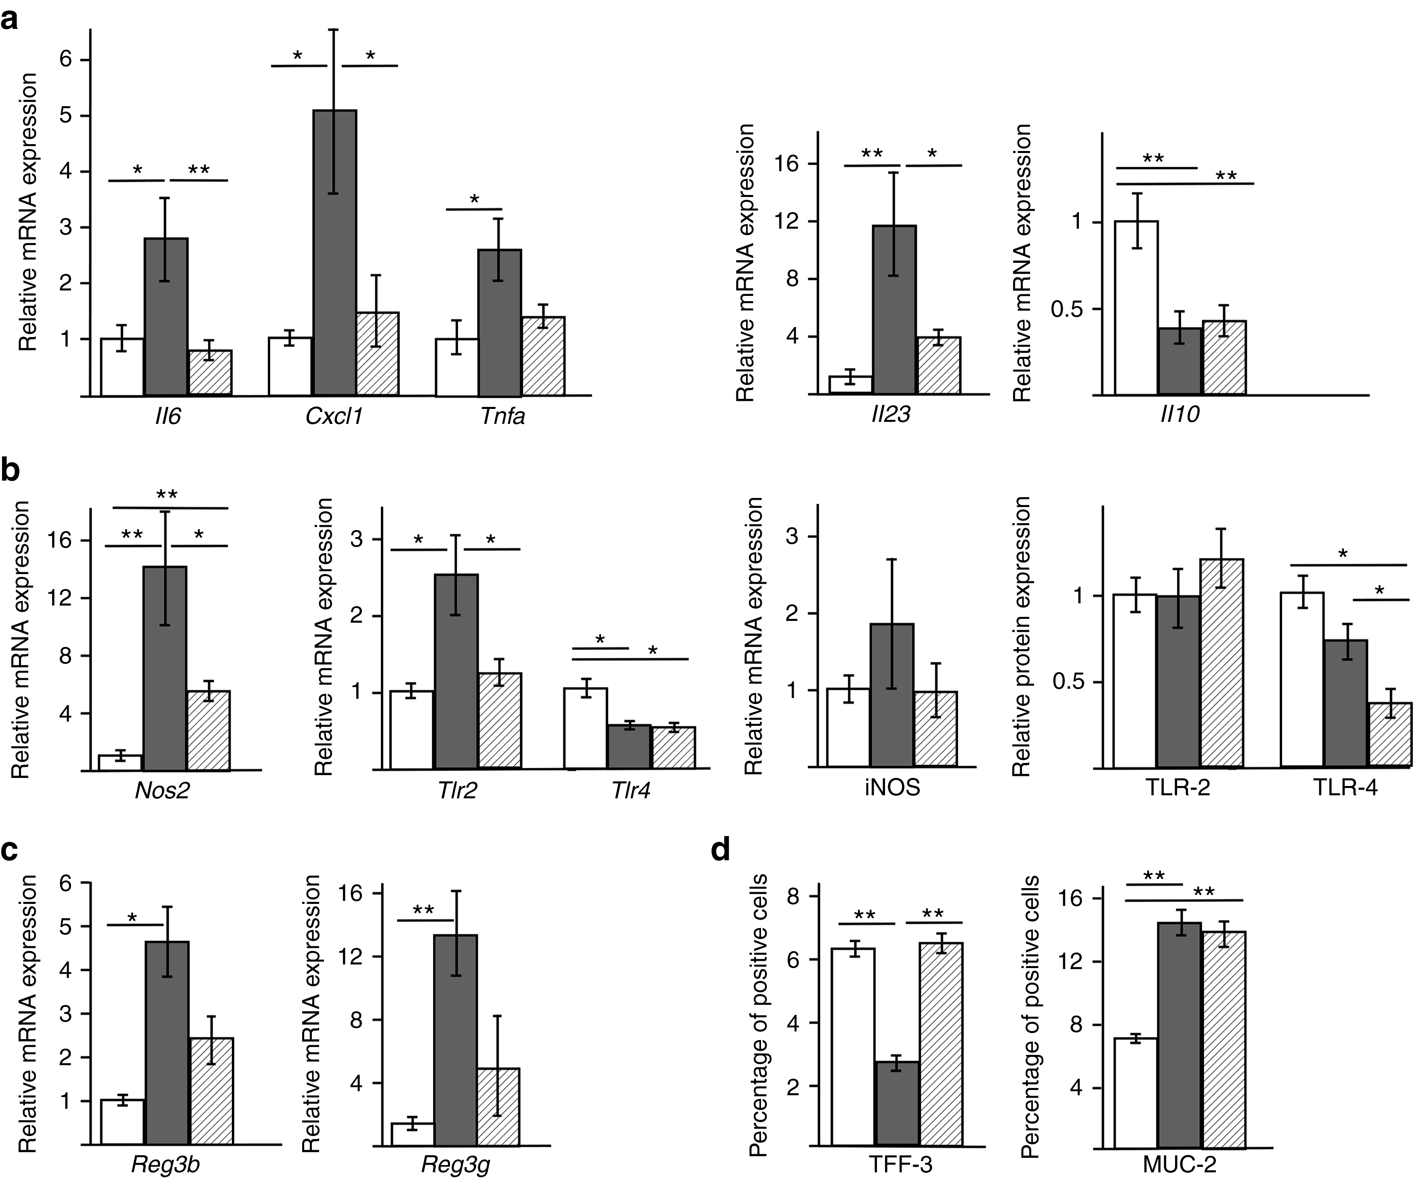
Figure 2
Mark A. Underwood, advance online publication
6 August 2014. doi:10.1038/pr.2014.102

Slide 25
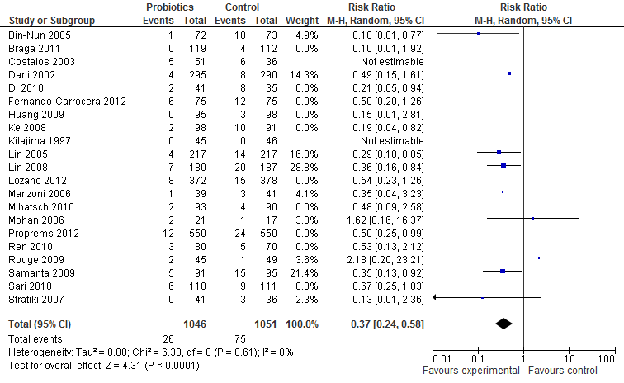

Slide 26
Application to Pharmacy Committee
Middle of 2010. Response was ‘we are not sure… let us think about it… we don’t have anything like that in the pharmacy… handling, quality control,
Is anyone else doing it?
How can we ensure that it is safe and effective here?
‘This above all to thine own self be true’
Hamlet

Slide 27
Madame S
Baby girl born at 24 weeks gestation, at the end of 2010
Receiving breast milk
At 2 weeks of age had a ‘NEC scare’ (or stage 1 NEC)
Mother then came to us and asked if her baby could have probiotics
We told her, they aren’t on the hospital formulary.
‘I’ll buy them myself then’
‘In that case go to the health food store and get flora-baby’.

Slide 28
Madame S
Started talking to other parents, some others wanted the probiotics also
Snowballed
I wrote an information letter to be given to all the parents with an at-risk baby in the NICU on admission
About half of the at-risk babies parents bought florababy, came to the hospital with it, and gave it to their babies, the nurses administered it when they weren’t there

Slide 29
Application #2 to Pharmacy Committee
Hospital administrator told me to stop giving out the letter, please.
Back at the pharmacy committee they agreed, as long as I objectively prospectively analyzed the results, which I was going to do anyway!
We now get Florababy directly from the supplier, at a cost of $12.79 for 60g.
Most babies only ever need 1 tub.

Slide 30
Janvier A 2014
Barrington K Janvier A
Design/Methods: Starting in July 2011 we have administered a preparation containing a mix of 4 bifidobacteria (b breve, bifidum, infantis and longum) and lactobacillus rhamnosus (Florababy (tm) holder of a Natural Product Number from Health Canada).
Data on complications has been collected, and compared with the admissions to the NICU during the previous 12 months. Infants surviving for less than 7 days were eliminated.
NEC stage 2 or greater was diagnosed by the presence of pneumatosis or other diagnostic findings on an abdominal radiograph, by an attending radiologist.

Slide 31
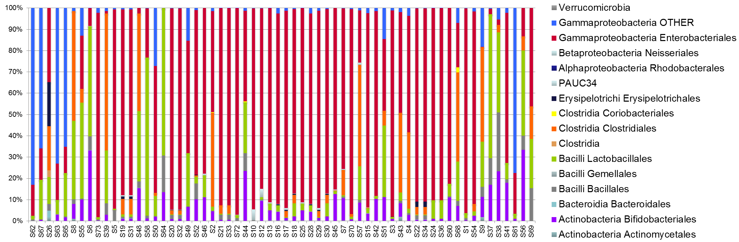
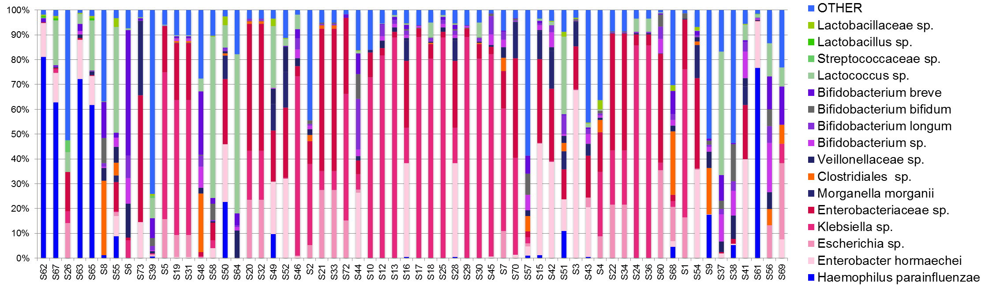

Slide 32
Characteristic | Pre-probiotic cohort (n=317) | Probiotic cohort (n=294)
Gestational Age, weeks. Mean (SD) | 28.9 (2.2) | 29.0 (2.1)
Birth weight, g. Mean (SD) | 1207 (376) | 1220 (334)
SGA (<10%le) | 11.4% | 16%
% female | 44% | 51%

Slide 33
Outcome | Pre-probiotic cohort (n=317) | Probiotic cohort (n=294) | Significance
NEC | 31 (10%) | 16 (5%) | p<0.05
Mortality | 31 (10%) | 20 (7%) | p=NS
NEC or Mortality | 54 (17%) | 31 (11%) | p<0.05
HCAI | 57 (18%) | 54 (17%) | p=NS
Day of life of diagnosis of NEC Mean (SD) | 22 (20) | 18 (11) | p=NS
NEC before 15 days of life (percentage of NEC cases) | 11 (35%) | 8 (50%) | p=NS
Infants receiving at least 1 day of TPN | 295 (94%) | 282 (96%) | p=NS
Age of 1st stopping TPN Mean (SD) | 16 (20) | 11 (10) | p=0.004
Age of finally stopping TPN | 22 (28) | 16 (18) | p=0.02

Slide 34
Babies under 1 kg
Outcome | Pre-probiotics (109) | Probiotics (98) | Significance
NEC | 18 (17%) | 10 (10%) | p=NS
Mortality | 27 (25%) | 14 (14%) | p=NS
NEC or mortality | 38 (35%) | 22 (22%) | p=NS
HCAI | 38 (35%) | 30 (30%) | p=NS

Slide 35
Outcome | Receipt of Probiotics | GA (per additional week) | Being SGA | Being Female
NEC | 0.51 (0.26, 0.98)* | 0.72 (0.62, 0.83)* | 2.6* (1.1, 5.8) | 0.44** (0.23, 0.87)
Mortality | 0.71 (0.38, 1.34) | 0.56 (0.48, 0.66) * | 3.5 (1.54, 7.84)* | 0.80 (0.43, 1.5)
NEC or mortality | 0.56 (0.33, 0.93)** | 0.62 (0.54, 0.69)* | 3.8 (1.95, 7.30)* | 0.72 (0.43, 1.19)
HCAI | 0.98 (0.81, 1.98) | 0.56 (0.50, 0.63)*** | 1.73 (0.90, 3.34) | 0.83 (0.52, 1.31)

Slide 36
Janvier et al J Pediatr 2014
Blood Culture positive sepsis was not affected by the introduction of probiotics, 22% of the infants had at least one episode prior to probiotics, 19% after the introduction of probiotics.
No cases of sepsis caused by the probiotic organisms has been noted.
Feeding tolerance, as measured by time to stopping TPN was shorter after the introduction of probiotics (11 d (SD10) vs 16 (SD 20), but this difference disappeared after correcting for gestational age and being SGA.
Conclusions: A product, commercially available in North America with good quality control, when used in routine daily administration, was associated with a substantial and significant decrease in definite NEC without apparent adverse effect. Further studies of probiotics should compare different strains

Slide 37
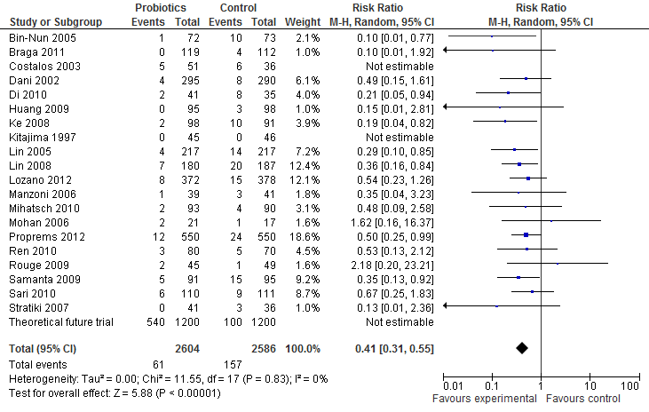
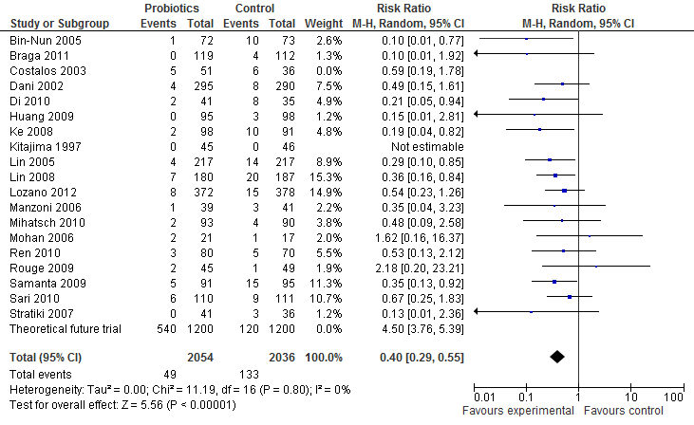
Meta-analysis
Sans Manzoni 2009, sans les études de Saccharomyces

Slide 38
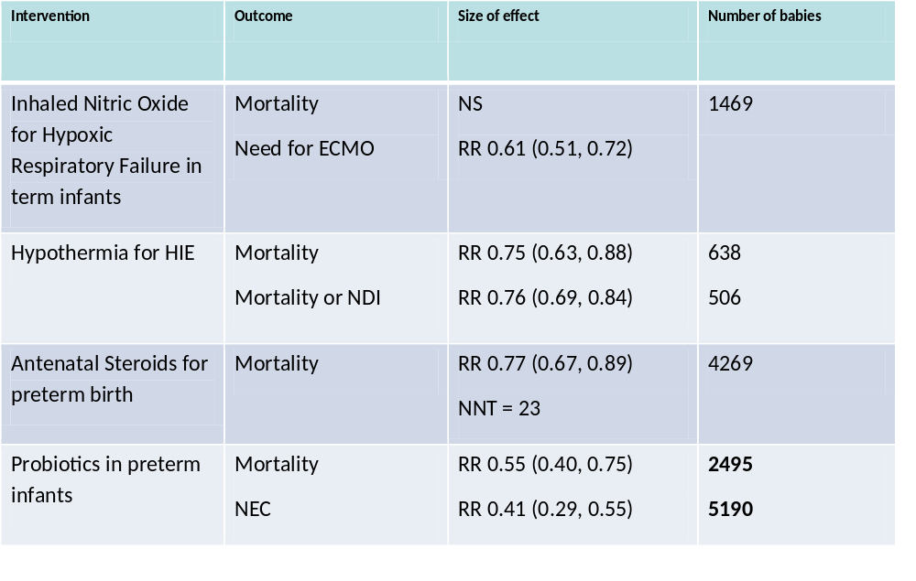

Slide 39
Probiotics
Probiotics are proven to reduce NEC and mortality.
The preparation chosen should contain a Bifidobacterium or Lactobacillus Rhamnosus, and probably a mix of the two
Good Quality Control of the preparation is essential
Parents deserve the right to know about probiotics
Further placebo controlled trials are unethical
  Other trials comparing preparations and timing are needed

Slide 40

Illegitimi non carborundum

Slide 41
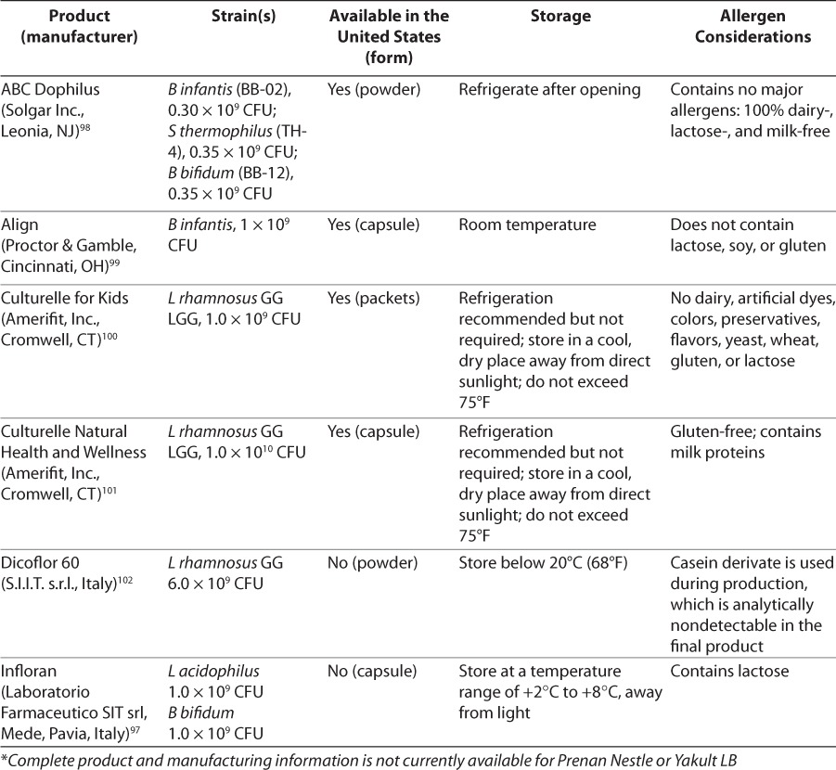
Luedtke SA, Yang JT, Wild HE: Probiotics and necrotizing enterocolitis: Finding the missing pieces of the probiotic puzzle. The journal of pediatric pharmacology and therapeutics : 2012, 17(4):308-328.

Slide 42
How to find a reliable source
A preparation identical to one used in an RCT which showed efficacy.
  ABCdophilus
  (infloran is not available in the US and has changed constituents)
A preparation with similar or identical strains and good quality control (a Health Canada NPN for example)
  Florababy

Slide 43
Probiotics
Babies < 32 weeks should be receiving probiotics
Appropriate preparations are available
The Balance of Benefits and risks is undeniable
If it was your baby….

Slide 44
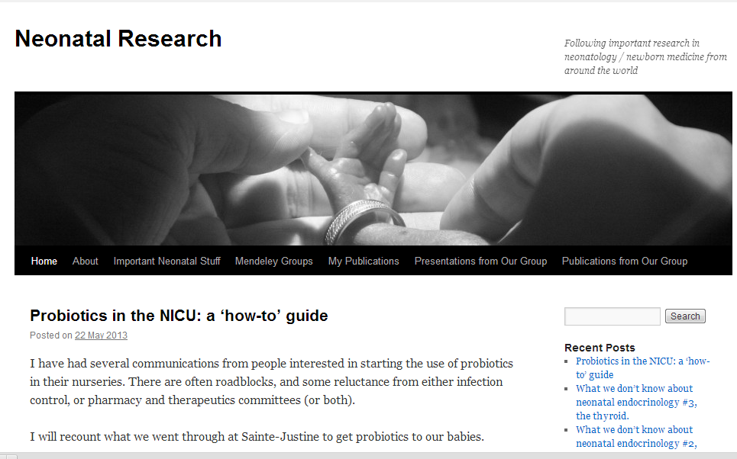
neonatalresearch.org

