Slide 1

Using Evidence: Innovating practice, improving care
Keith J Barrington
Sainte Justine Hospital
Montreal

Slide 2


Slide 3
Conflicts of Interest
I have no relevant financial relationships with the manufacturer(s) of any commercial product(s) and/or provider of commercial services discussed in this CME activity.
I will discuss off-label use of probiotics

Slide 4
Outline
How to integrate evidence into practice
What to do when evidence is inadequate
How to collaborate in improvements in care

Slide 5
Integrating Evidence into Practice
When is enough, enough?
Risk Benefit balance
A list of disasters in neonatology, and their common themes

Slide 6
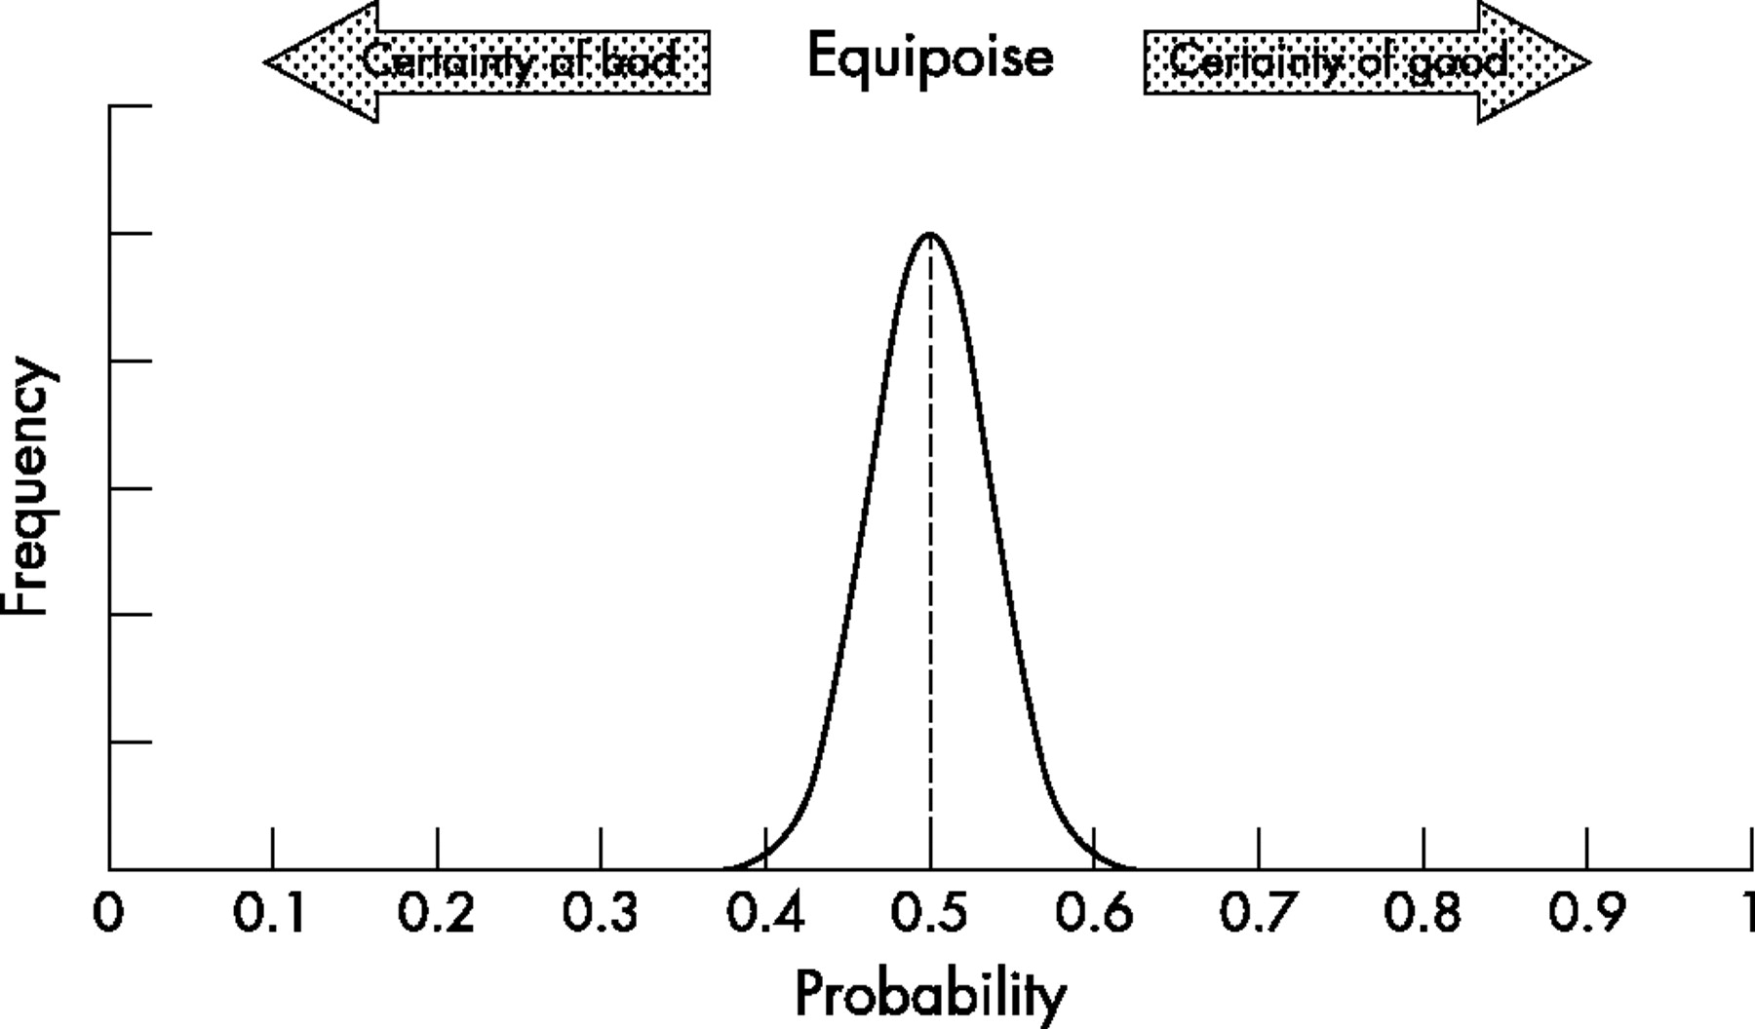

Figure 2 Predictive probability for a hypothetical ineffective treatment. The graph shows the probability distribution (modelled as a {beta} density) created by a hypothetical trial of 200 patients in which the numbers of successful outcomes were equal in both treatment and control groups. The mean of the distribution is 0.5 (shown by a dotted line), showing that the chance of treatment being successful is exactly 50%, or equivalent to a tossed coin being heads or tails.
Edwards, A D et al. Arch. Dis. Child. Fetal Neonatal Ed. 2006;91:F127-F131
Copyright ©2006 BMJ Publishing Group Ltd.

Slide 7
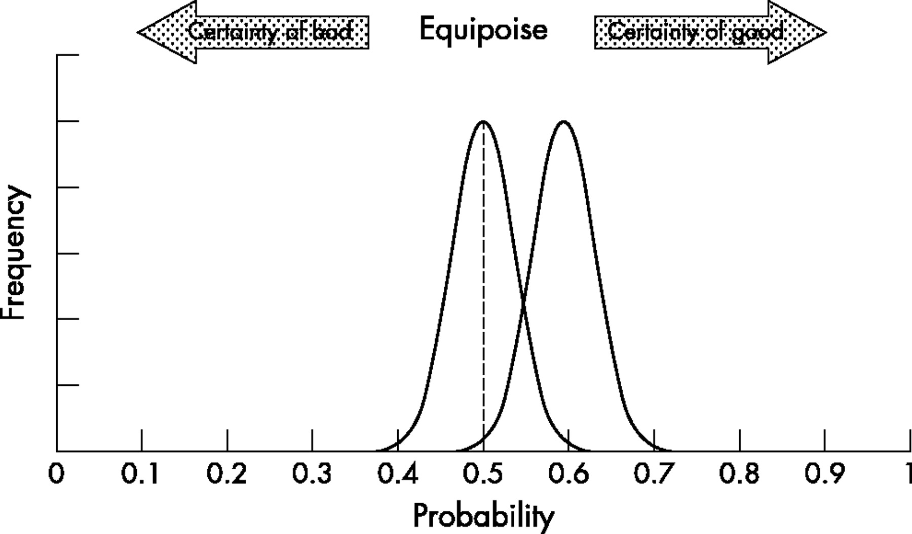
Figure 3 Predictive probability that head cooling improves outcome for infants with moderately severe neonatal encephalopathy as predicted by the CoolCap study. The chance that cooling will benefit the next patient treated is the mean of the distribution (0.59) and the lower 95% confidence limit is 0.52.
Edwards, A D et al. Arch. Dis. Child. Fetal Neonatal Ed. 2006;91:F127-F131
Copyright ©2006 BMJ Publishing Group Ltd.

Slide 8
Further studies…
Each positive study narrows the confidence interval, and increases the chance that a subsequent infant will benefit
A negative study has unpredictable effects on the confidence interval, and decreases the chance that a subsequent infant will benefit.

Slide 9
When is enough, enough?
When the likelihood of benefit is high
The likelihood of harm is low
How high?
  Depends on the importance of the benefits
How low?
  Depends on the severity of the harm, want harm to be less than the benefit
    But if the benefit is survival and the harm is a skin rash….
Risk of being too conservative, patients suffer from lack of new treatment,
  if risk-benefit balance positive
Risk of being too early to adopt, patients suffer from complications,
  if risk-benefit balance negative

Slide 10
Disasters in Neonatology
Oxygen and retinopathy
Sulfisoxazole and kernicterus
Chloramphenicol and grey babies
Hexachlorophene and vacuolar encephalopathy
Benzoic Acid and gasping syndrome
Dexamethasone and cerebral palsy

Slide 11
Disasters in Neonatology
Common theme
  Introduced without RCT evidence of benefit or safety
  (or only evidence of short term physiologic effect, without long term safety, or clinical efficacy data: dexamethasone)
No example of too early introduction of therapy which had RCT evidence of clinically important benefit and safety, which then turned out to be a disaster.
Common thread is the introduction of therapies based on ‘expert’ opinion, or on fashion, but without objective data

Slide 12
Avoiding the next disaster
Demand high quality RCT evidence with clinically meaningful outcomes, before any substantive change in treatment
We need all trials to be published, so support ‘All Trials’
We need all data to be available, so support Open Data Standards

Slide 13
Not all RCTs are equal!
Initial small single center trials tend to be much more positive
  Various biases, particularly publication bias
  Often not well masked
Clinically important outcomes are essential
  Just because your oxygen requirements go down, doesn’t mean you benefit
    Do you actually have less lung injury, more survival, better long term health?
  Just because the blood pressure goes up, doesn’t mean you should treat.
    Do you actually have better survival, less gut and brain injury, better long term health?

Slide 14
Immunoglobulins for Sepsis?
Cochrane review 2009
Mortality in infants with clinically suspected infection was reduced following IVIG treatment [7 studies (n = 378); typical RR 0.58 (95% CI; 0.38, 0.89)
Mortality in cases of subsequently proven infection was reduced [seven trials (n = 262); typical RR 0.55 (95% CI; 0.31, 0.98)
40-45% reduction in mortality!
No heterogeneity!
(average sample size 25 per group)

Slide 15
INIS
Large multicenter randomized trial of Immunoglobulin for treatment of neonatal sepsis.
  Brocklehurst P, et al. Treatment of neonatal sepsis with intravenous immune globulin. The New England journal of medicine. 2011;365:1201-11.
N=3500
No effect
  No subgroup with benefit
  Including those with confirmed culture positive sepsis
No evidence of harm in any of the early trials, nor INIS

Slide 16
INIS
Prior to INIS, I encouraged the use of IVIG in sick infants with sepsis, based on:
  Those few small RCTs, which seemed to show a benefit for survival
  No adverse effects, in those trials or in the larger trials of prophylaxis
  With little confidence, but analysis of risk-benefit that seemed positive
After INIS, comfortable that babies were not harmed, but no longer recommend IVIG

Slide 17
Therapeutic Hypothermia
After 2 large RCTs were positive, with reduced mortality and infrequent serious adverse events
  Which followed ‘hundreds’ of pre-clinical studies and small pilots
There was still a lot of reluctance to institute routine hypothermia
Was that appropriate?

Slide 18
Therapeutic Hypothermia
What were the benefits?
How certain could we be?
What were the risks?
How certain could we be?
  In my opinion, the neonatal community was too conservative, and waited too long. We have had our fingers burned by previous disasters, but they were different.

Slide 19
When Enough is Enough- what to do next
Consult Parents
Evaluate Risk-Benefit
Evaluate cost-effectiveness
Develop policy and protocols
Introduce the change
Evaluate the effects
  Does it work in our practice?

Slide 20
Probiotics: a relevant, recent, example
Enormous amount of positive data
No evidence of harm, in any of the trials
Poor uptake of a cheap effective therapy
  Why?

Slide 21
Questions to ask before instituting a new intervention
Is it biologically feasible?
Is there an appropriate animal model, which shows efficacy?
Are there preliminary studies without evidence of harm?
With some evidence of benefit?
Is there at least one good trial with masked allocation?
For studies of prophylaxis, much larger sample sizes are required.
  RCTs of treatment, 100% have the disease…
  RCTs of prophylaxis, if only 10% will get the disease, you need 10x more patients

Slide 22
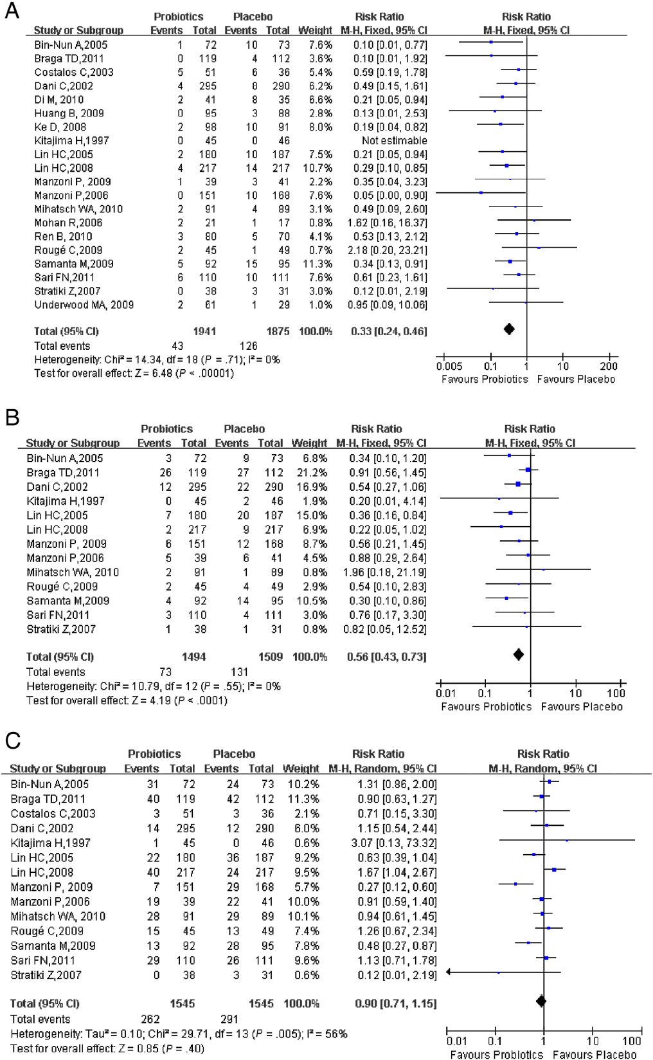
Forest plots of probiotics in preterm infants
(A, Effect of probiotics on NEC; B, Effect of probiotics on mortality; C, Effect of probiotics on sepsis).

Slide 23
Subgroup analyses | Studies (no. in probiotics group/no. in placebo group) | RR
 |  | RR (95%CI) | P_{RR} | I²_{Heterogeneity} | P_{Heterogeneity} | Model
Bifidobacteria
NEC | 8 (509/467) | 0.30 (0.16-0.58) | .0003 | 0 | .64 | Fixed
Mortality | 3 (174/166) | 0.74 (0.18-2.97) | .67 | 0 | .51 | Fixed
Sepsis | 3 (174/166) | 0.84 (0.29-2.41) | .74 | 0.21 | .28 | Fixed
Lactobacillus and Bifidobacteria
NEC | 6 (714/689) | 0.33 (0.19-0.58) | .0001 | 0 | .51 | Fixed
Mortality | 5 (653/660) | 0.47 (0.26-0.87) | .02 | 49 | .09 | Random
Sepsis | 5 (653/660) | 0.90 (0.60-1.36) | .62 | 71 | .007 | Random
Lactobacillus
NEC | 4 (595/610) | 0.37 (0.19-0.73) | .004 | 0 | .40 | Fixed
Mortality | 4 (595/610) | 0.61 (0.38-0.97) | .04 | 0 | .88 | Fixed
Sepsis | 4 (595/610) | 0.79 (0.46-1.36) | .40 | 71 | .01 | Random

Slide 24
Other recent meta-analyses
Deshpande G, Rao S, Patole S, Bulsara M: Updated Meta-analysis of Probiotics for Preventing Necrotizing Enterocolitis in Preterm Neonates. Pediatrics 2010, 125(5):921-930.
AlFaleh, Khalid; Anabrees, Jasim; Bassler, Dirk; AlKharfi, Turki: Probiotics for prevention of necrotizing enterocolitis in preterm infants Cochrane Database of Systematic Reviews. Issue 3, 2011.

Slide 25
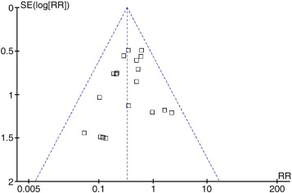
Funnel plot to assess publication bias
Analysis of effect of probiotic supplement on NEC risk including 20 studies; TEgger test = −1.12; 95% CI, −1.82 to 0.56; PEgger test = .278 > .05

Slide 26
Multiple small trials
Might inflate potential benefit
Need other methods to analyze
Trial Sequential Analysis

Slide 27
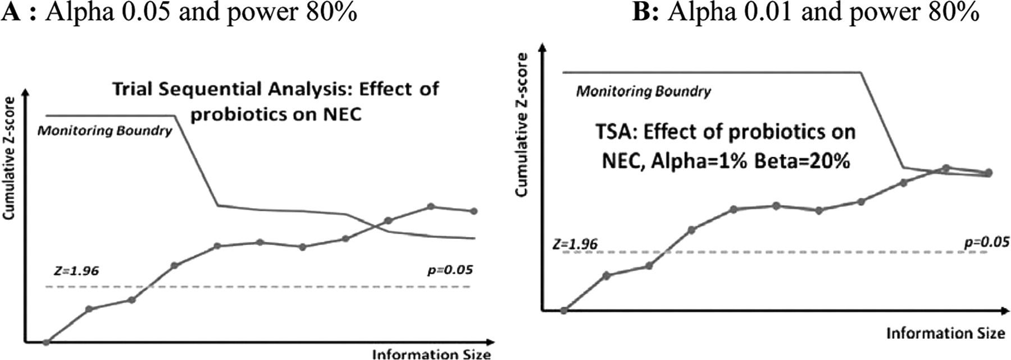

Trial sequential analysis.
Deshpande G et al. Pediatrics 2010;125:921-930
Notes:
Trial sequential analysis.

Slide 28
Other RCTs
2 other RCTS have been recently presented, both examined the effects of ‘Saccharomyces boulardii’ : no effect shown in either study.
Also:
Rojas MA, Lozano JM, Rojas MX, et al: Prophylactic probiotics to prevent death and nosocomial infection in preterm infants. Pediatrics 2012. Multicenter RCT infants <2kg; primary outcome was survival without nosocomial sepsis (Columbia). NEC 8/372 probiotics 15/378 controle (L reuteri)
2 others in progress, or just completed, with a total of 2,400 enfants,
  Costeloe angleterre, (PIP) primary outcome is sepsis, NEC or death (justification en partie ‘None of the studies has taken place in the UK’)
  Tobin Australie (PROPREMS) primary outcome sepsis.

Slide 29
ProPrems
Now Published
Australian RCT of probiotics; a mixture of 2 bifidobacteria (infantis and lactis) and streptococcus thermophilus (ABCDophilus)
1100 babies randomized <1500g and <32 wk
4.4% NEC grade 2 or more in controls
2.2% NEC (grade 2 or more) with probiotics
Slightly fewer serious infections

Slide 30
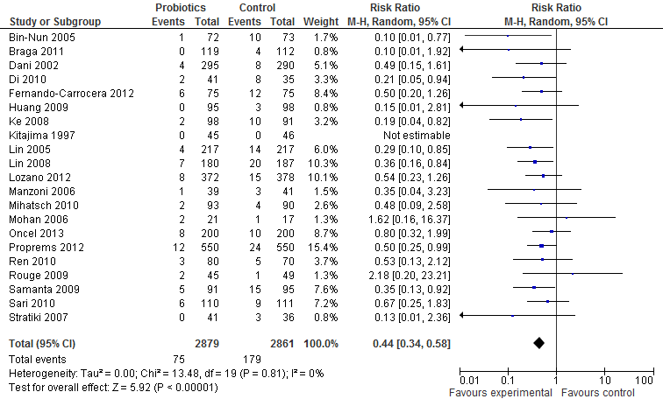
Meta-analysis
Without Manzoni 2009, without the studies of Saccharomyces

Slide 31
Involving Parents
Some of these decisions, I would say most, should be made in collaboration with parents
Parents should know about the data, and the uncertainties
  Requires education, not just information
They should be consulted, individually for their baby, and for policy changes

Slide 32
Involving Parents
Parents helped us to get Probiotics on the formulary at Ste Justine
Parents helped us to institute cooling, and raised funds for the first continuous EEG we use during cooling

Slide 33
Probiotics
We introduced the change, and evaluated the effects in practice

Slide 34
Characteristic | Pre-probiotic cohort (n=317) | Probiotic cohort (n=294)
Gestational Age, weeks. Mean (SD) | 28.9 (2.2) | 29.0 (2.1)
Birth weight, g. Mean (SD) | 1207 (376) | 1220 (334)
%ge < 26 weeks | 13.2 | 11.1
SGA (<10%le) | 11.4% | 16%
% female | 44% | 51%

Slide 35
Outcome | Pre-probiotic cohort (n=317) | Probiotic cohort (n=294) | Significance
NEC | 31 (10%) | 16 (5%) | p<0.05
Mortality | 31 (10%) | 20 (7%) | p=NS
NEC or Mortality | 54 (17%) | 31 (11%) | p<0.05
HCAI | 57 (18%) | 54 (17%) | p=NS

Slide 36
Outcome | Receipt of Probiotics | GA (per additional week) | Being SGA | Being Female
NEC | 0.51 (0.26, 0.98)* | 0.72 (0.62, 0.83)* | 2.6* (1.1, 5.8) | 0.44** (0.23, 0.87)
Mortality | 0.71 (0.38, 1.34) | 0.56 (0.48, 0.66) * | 3.5 (1.54, 7.84)* | 0.80 (0.43, 1.5)
NEC or mortality | 0.56 (0.33, 0.93)** | 0.62 (0.54, 0.69)* | 3.8 (1.95, 7.30)* | 0.72 (0.43, 1.19)
HCAI | 0.98 (0.81, 1.98) | 0.56 (0.50, 0.63)*** | 1.73 (0.90, 3.34) | 0.83 (0.52, 1.31)

Slide 37
Day of life of diagnosis of NEC Mean (SD) | 22 (20) | 18 (11) | p=NS
NEC before 15 days of life (percentage of NEC cases) | 11 (35%) | 8 (50%) | p=NS
Infants receiving at least 1 day of TPN | 295 (94%) | 282 (96%) | p=NS
Age of 1st stopping TPN Mean (SD) | 16 (20) | 11 (10) | p=0.004
Age of finally stopping TPN Mean (SD) | 22 (28) | 16 (18) | p=0.02

Slide 38
Parents
No longer consider parents to be passive consumers of health care for their infants
Partners in care, policy, innovation and research

Slide 39
When there is inadequate evidence
For so many questions (PDA!, hypotension!) we just don’t know what to do
1. Recognize the lack of evidence & be open about this with parents
2. Work with the current consensus, recognizing that this might be wrong
3. Use physiology based medicine, recognizing that this might be wrong
4. Collaborate in RCTs to find the answers

Slide 40
PDA
An example of how we are trying to innovate/improve practice at Sainte Justine, without definitive data
  Many PDA close spontaneously
  Large PDA less likely to do so
  Large PDA may lead to pulmonary hemorrhage
  Recent increase in pulmonary hemorrhage
Based on biologic plausibility, previous observational data, and a recent moderately large RCT (Kluckow et al), and a host of information about indomethacin safety.
New protocol,
  Re-introduction of prophylactic indomethacin for high risk infants
  Routine echocardiogram before 36 hours
  Indomethacin if large PDA (ibuprofen if oliguric)

Slide 41
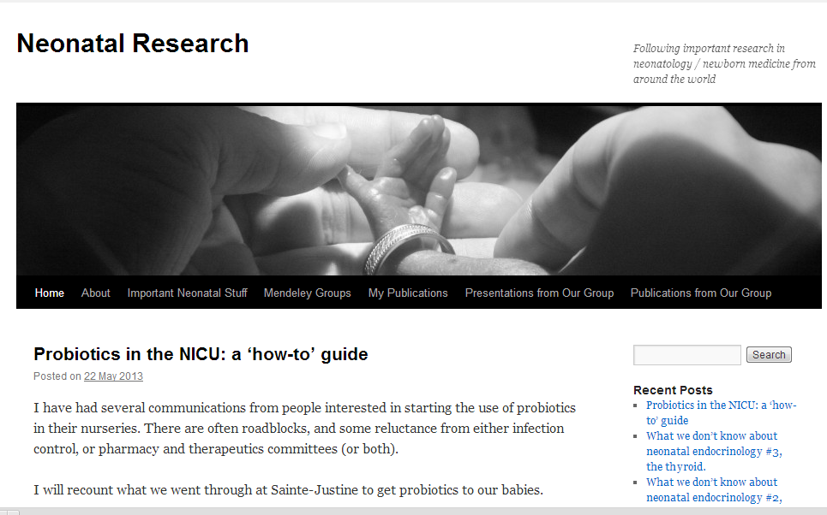
neonatalresearch.org

