Slide 1
Pulse oximetry screening for congenital heart disease.
Does it work?
Is it worth it?

Slide 2
Congenital Heart Disease
Most common group of congenital anomalies
About 1 in every 100 babies
  Depends on definition
  If you include all ASD, VSD found on screening ultrasounds, 1%
At least 8 per thousand have anomly with clinical impact

Slide 3
Congenital Heart Disease
Sometimes not detected before discharge home
Infants with CHD who present after a serious deterioration have higher mortality and higher morbidity
Often, patients who had duct dependent lesions, who present when the duct closes

Slide 4
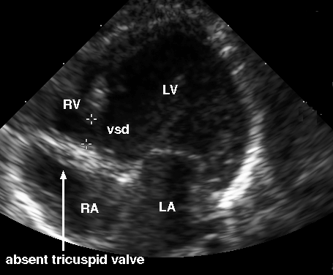

Slide 5
Congenital Heart Disease
Can we detect CHD before that happens
Antenatal screening
Postnatal screening

Slide 6
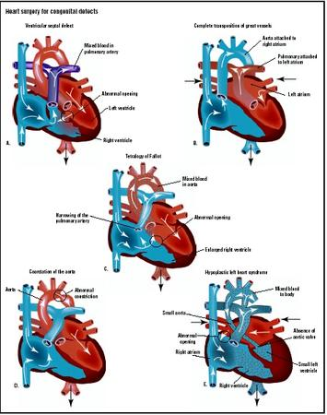

Slide 7
The target diagnosis
Critical congenital heart disease (CCHD)
CHD which is duct dependant and may cause sudden severe illness after PDA closure, and CHD which requires surgery in the 1st 28 days of life
Includes most cyanotic CHD, and left heart obstructive lesions

Slide 8
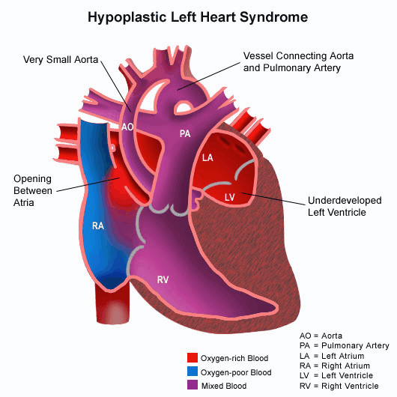

Slide 9
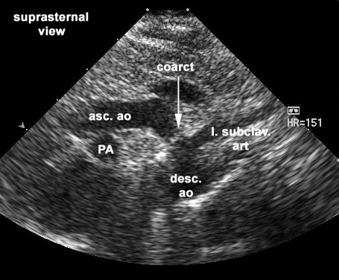

Slide 10
How many CCHD are missed?
Most pregnant women have a morphology scan around 20 weeks gestation
All babies born in hospital have a physical exam before hospital discharge
Nevertheless at least 20% of babies with CCHD are discharged without a diagnosis (data from UK)

Slide 11
CCHD in Canada
Are we missing CCHD in Canada?
No recent data
CCHD about 1 per 1000 births
If we are better than any other jurisdiction, then about 10% not diagnosed before discharge
1 baby in every 10,000 discharged from hospital with CCHD without diagnosis

Slide 12
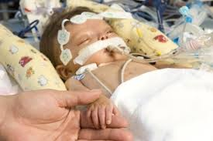

Slide 13
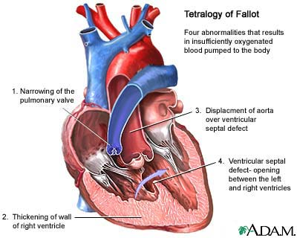

Slide 14
Does Oximetry Screening work?
Several very large studies
de Wahl-Granelli
  Only 2 antenatal diagnoses, 40,000 babies
Ewer
  23 antenatal diagnoses, 20,000 babies

Slide 15
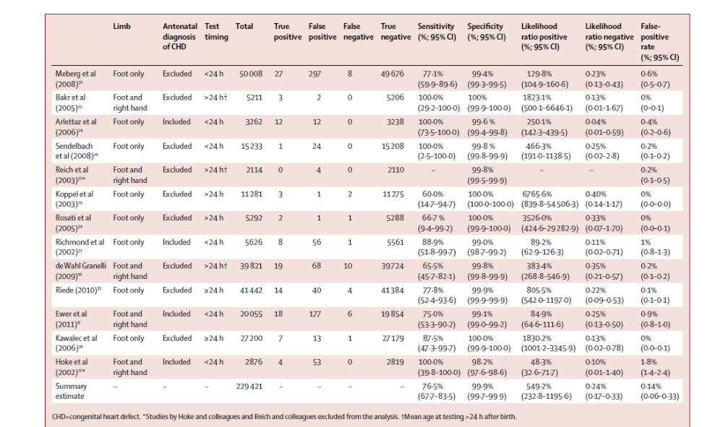

Slide 16
Is there a lot of extra work for the cardiologists?
False positive rate between 0.1% and 1%
Much lower if tested after 24 hours
False positive of physical examination 2%

Slide 17
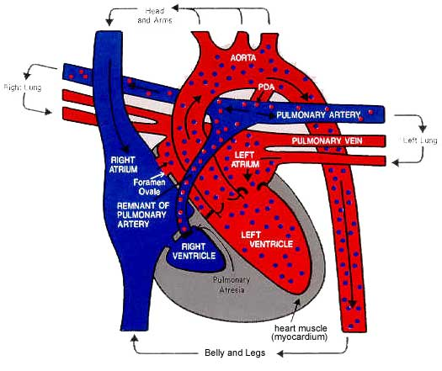

Slide 19
False positives
Many ‘false positives’ actually have diseases that need therapy, or follow up
Respiratory disease with desaturation
CHD which is not ‘critical`
Pulmonary hypertension

Slide 20
Do false positives worry parents?
UK study of 20000 babies
119 false positives
Asked the mothers
No increase in anxiety

Slide 21
Sensitivity is around 75%
Sensitivity of physical exam alone 66%
Combined sensitivity of oximetry with physical exam 83%

Slide 22
False negatives
17% of infants with CCHD which was not diagnosed antenatally will still be discharged without diagnosis
Mostly Coarctations, IAA occasionally others (TGA…)
Must be sure that parents know (just as with other screens) that a negative screen is not 100%, and babies still need normal health care

Slide 23
Is it worth it?
Neonatal Screening costs
How to calculate the benefit
CCHD screening by pulse oximetry in a society which has widespread morphology ultrasounds
About 25000$ per extra case of CCHD detected
A bit more expensive than hearing screening
Much cheaper than MassSpec
CCHD is treatable!

Slide 24
Evidence based recommendations
Screen before discharge
After 24 hours is preferable (same recommendations as hearing screen)
Motion resistant pulse oximeter
Foot saturation <95%
  +|- right hand to foot difference >3%
  Either simultaneous or do foot first, then right hand if foot is 95% or 96%
Immediate physical exam, if completely normal repeat oximetry
If repeat abnormal, or physical exam abnormal, echocardiography, the same day.

Slide 25
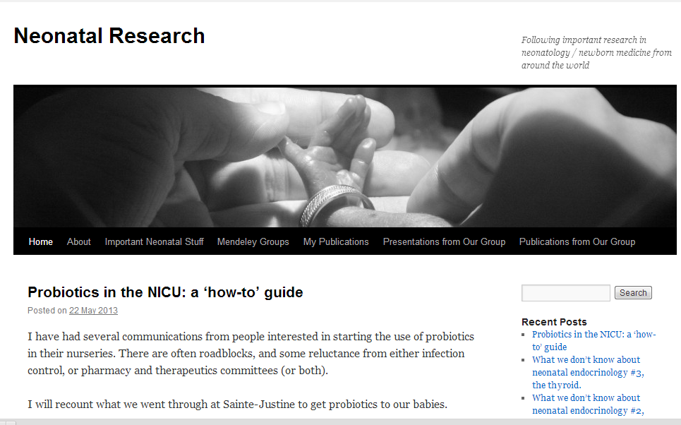
neonatalresearch.org

