Slide 1
Probiotics and Lactoferrin:
A review
Keith Barrington

Slide 2
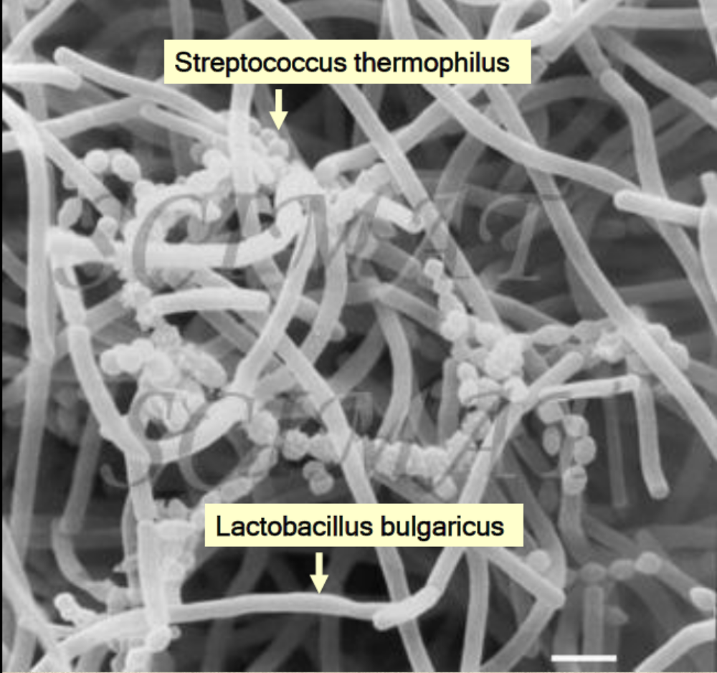
Probiotics

Slide 3
What are probiotics?
“Live micro-organisms which when administered in adequate amounts confer a health benefit on the host”
          FAO WHO 2001

Slide 4
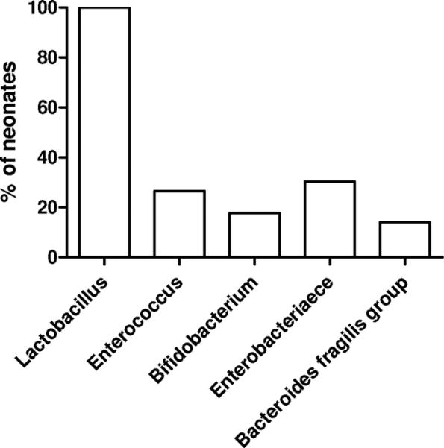

Figure 1.
The Pioneer Gut Microbiota in Human Neonates Vaginally Born at Term-A Pilot Study.
KARLSSON, CAROLINE; MOLIN, GORAN; CILIO, CORRADO; AHRNE, SIV
Pediatric Research. 70(3):282-286, September 2011.
DOI: 10.1203/PDR.0b013e318225f765
Figure 1. Bacterial incidence in healthy neonates vaginally born at term. Incidence of different bacterial groups in the fecal microbiota of neonates in their first 48 h of life, presented as percentage of total number of neonates (n = 79). Primers used for the qPCR analysis are indicated in Table 1.
© International Pediatrics Research Foundation, Inc. 2011. All Rights Reserved. Published by Lippincott Williams & Wilkins, Inc.
4

Slide 5
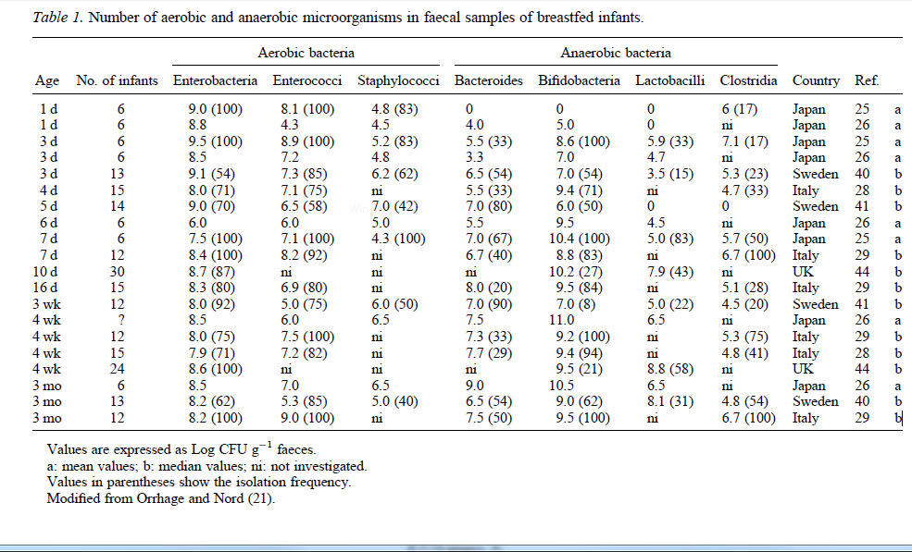

Slide 6
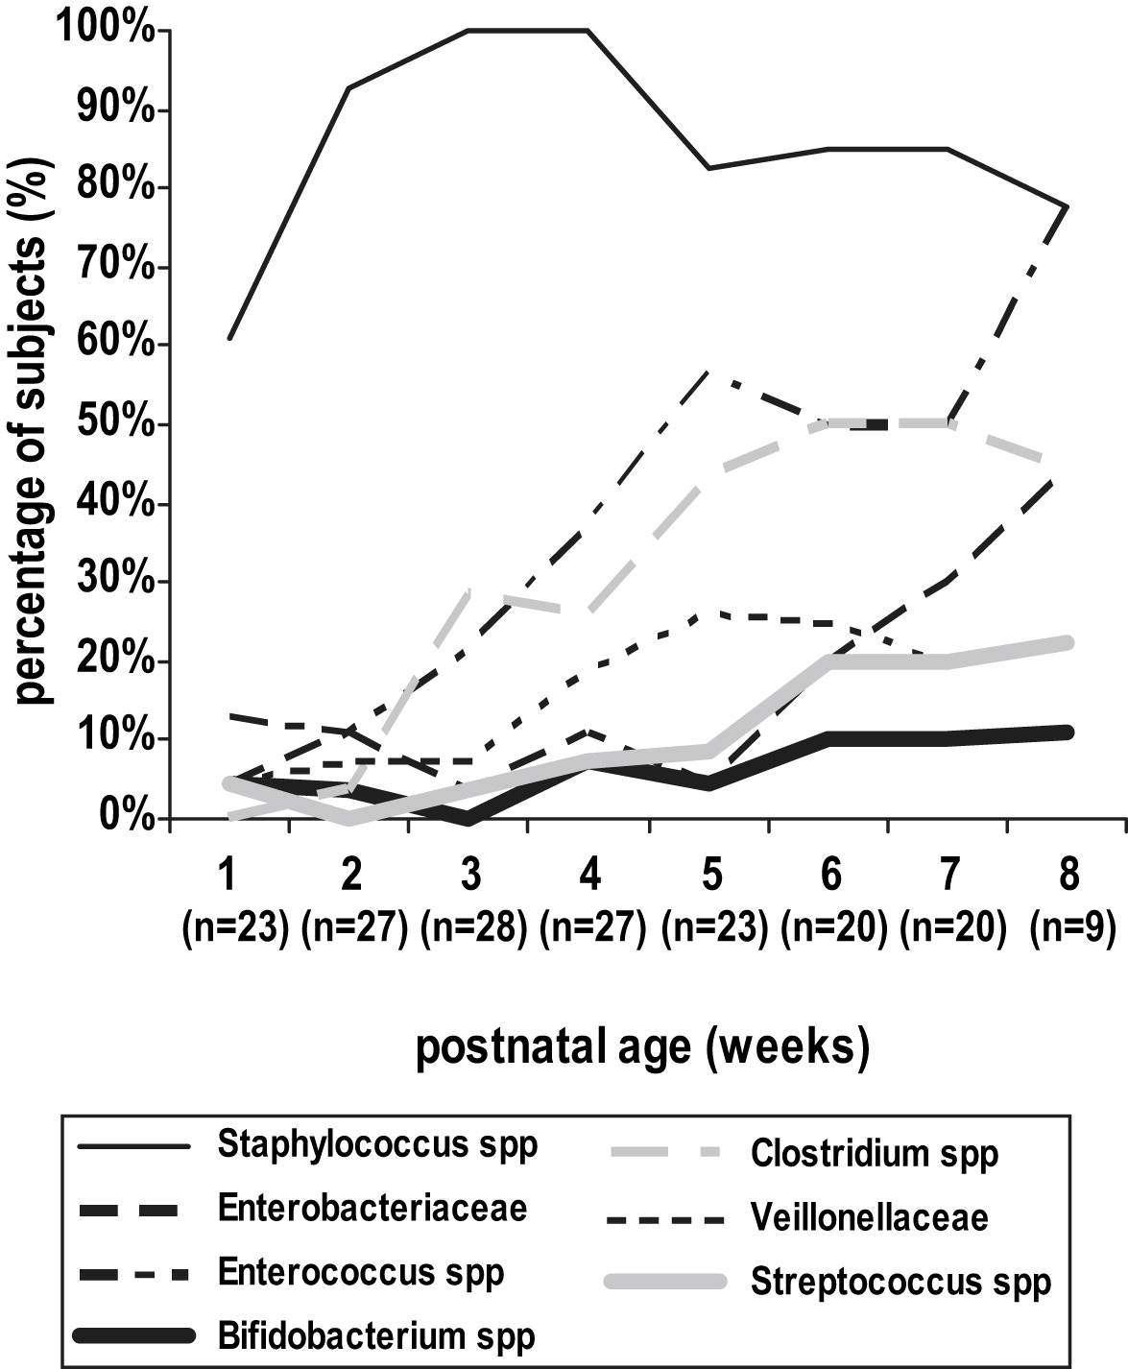
29 prématurés <30 wk

Slide 7
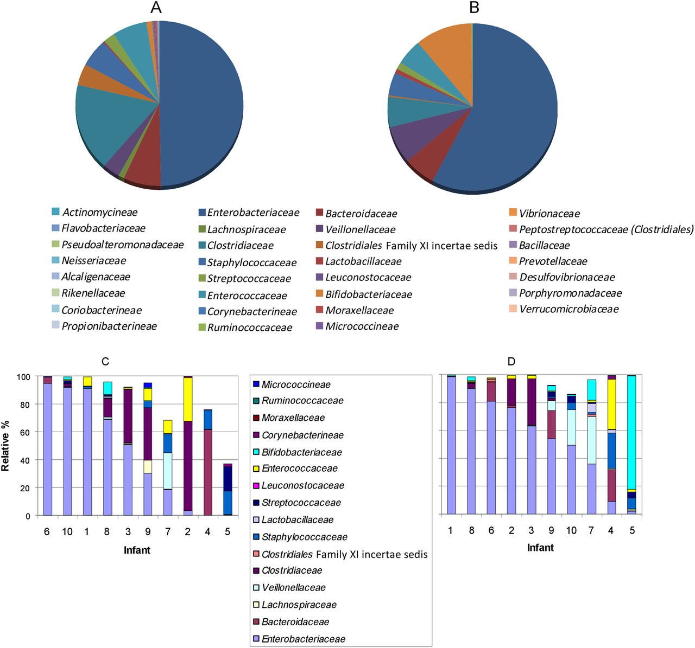

The aggregate relative proportion of family-level faecal microbiota in 10 preterm infants at weeks 2 (A) and 4 (B) of life.
Barrett E et al. Arch Dis Child Fetal Neonatal Ed doi:10.1136/archdischild-2012-303035
Copyright © BMJ Publishing Group Ltd & Royal College of Paediatrics and Child Health. All rights reserved.
Notes:
The aggregate relative proportion of family-level faecal microbiota in 10 preterm infants at weeks 2 (A) and 4 (B) of life. Interindividual variation in the proportion of the major families at weeks 2 (C) and 4 (D) of life. Samples are ordered from left according to Proteobacteria proportion.

Slide 8
What is the source of the dysbiosis of the preterm infant?
Vaginal colonization with Bifido & Lacto as pregnancy advances
Often born by cesarian
Exposed to antibiotics pre and postnatally
Exposed to NICU flora
Multiple procedures
  Fed by tube
  Aspiration
  Intubation
Less breast milk received

Slide 9
Why does breast milk decrease NEC?
‘Contaminated’ with bifidobacteria and Lactobacilli
Prebiotics
  fucosylated oligosaccahrides
  Other molecules

Slide 10
Collado MC, Delgado S, Maldonado A, Rodríguez JM: Assessment of the bacterial diversity of breast milk of healthy women by quantitative real-time pcr. Letters in Applied Microbiology 2009, 48(5):523-528.
Table 2. Detection of bacterial DNA in the breast milk samples by quantitative real-time PCR technique (qRTi-PCR). Data are presented as log10 (genome equivalent ml−1)
Bacterial groups | Prevalence | Range | Mean ± SD
Total bacteria | 50/50 | 5·05–7·76 | 6·03 ± 0·75
Staphylococcus group | 50/50 | 1·30–5·56 | 3·55 ± 0·84
Bifidobacterium group | 50/50 | 2·45–4·75 | 3·56 ± 0·53
Lactobacillus group | 50/50 | 2·61–4·50 | 3·74 ± 0·47
Enterococcus group | 38/50 | 1·20–4·85 | 2·56 ± 0·71
Streptococcus group | 50/50 | 2·91–6·11 | 4·50 ± 0·81
Bacteroides group | 20/50 | 1·50–3·35 | 2·02 ± 0·55
Clostridium cluster XIVa–XIVb | 48/50 | 2·27–4·85 | 3·32 ± 0·60
Clostridium cluster IV | 2/50 | 1·07–2·12 | 1·60 ± 0·17

Slide 11
Newburg DS, Ruiz-Palacios GM, Morrow AL: Human milk glycans protect infants against enteric pathogens. Annu Rev Nutr 2005, 25(1):37-58.
Glycoconjugate | Pathogen | Reference | Typical concentrationª
GM1 | Labile toxin, cholera toxin | (44) | 180 μg/liter
GM3 | Enteropathogenic Escherichia coli | (20) | 13 mg/liter
Gb₃ | Shiga toxin | (36) | 100–150 μg/liter
Sulfatide | Human immunodeficiency virus | (59) | 100 μg/liter
Chondroitin sulfate | Human immunodeficiency virus | (39) | 6 mg/liter
Lactadherin | Rotavirus | (62) | 100 μg/liter
Mucin | S-fimbriated E. coli | (50) | 1 g/liter
Mannosylated glycopeptide | Enterohemorrhagic E. coli | (2) | 60 mg/liter
Oligosaccharides | Streptococcus pneumoniae | (1) | 0.2–10 g/liter
 | Enteropathogenic E. coli | (9) | 3 g/liter
 | Listeria monocytogenes | (6) | 3 g/liter
Fucosylated oligosaccharides | Campylobacter jejuni Vibrio cholerae Stable toxin | (46) (46) (41) | 1–25 mg/liter 1–25 mg/liter 40 μg/liter
Macromolecule-associated glycans | Noroviruses Pseudomonas aeruginosa | (23) (26) | 370 mg/liter 370 mg/liter
Sialyllactose | Cholera toxin | (21) | 200 mg/liter
 | E. coli | (53, 57) | 200 mg/liter
 | P. aeruginosa | (10) | 200 mg/liter
 | Aspergillus fumigatus conidia | (3) | 200 mg/liter
 | Influenza virus | (13, 29) | 200 mg/liter
 | Polyomavirus | (52) | 200 mg/liter
 | Helicobacter pylori | (33) | 200

Slide 12
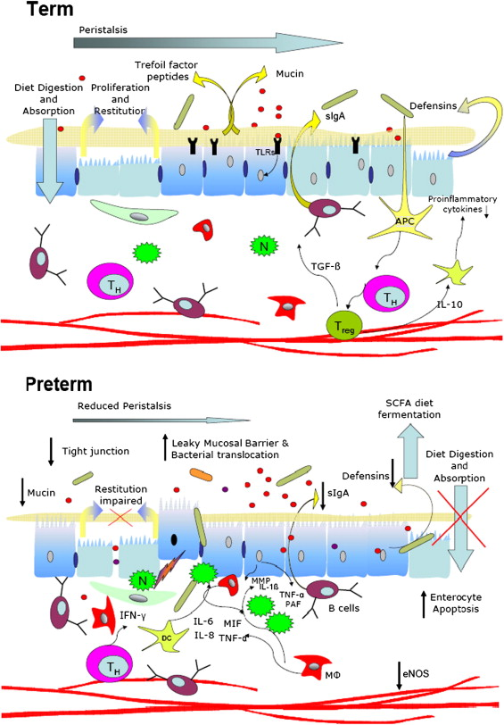
Siggers RH, Siggers J, Thymann T, Boye M, Sangild PT: Nutritional modulation of the gut microbiota and immune system in preterm neonates susceptible to necrotizing enterocolitis. The Journal of Nutritional Biochemistry 2011, 22(6):511-521.

Slide 13
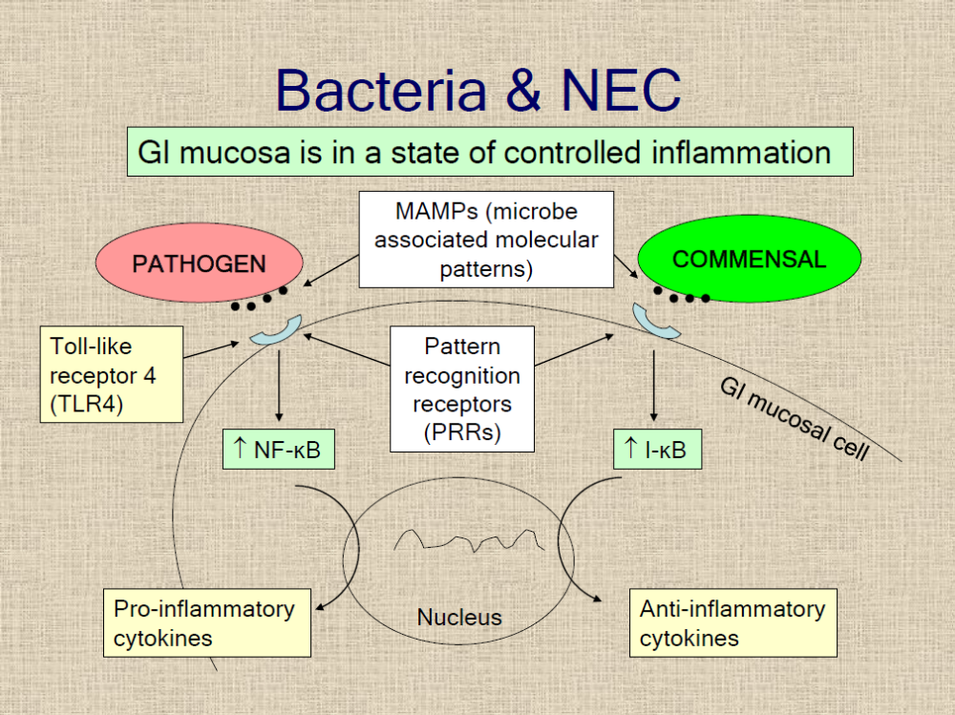

Slide 14
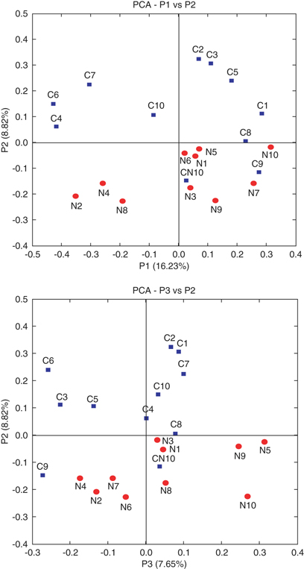
Principal coordinate analysis (PCA) of sequence libraries. Samples collected from infants without NEC (control) are represented by squares (blue); samples from infants with NEC are represented by circles (red).
Distribution of samples collected from infants with NEC was distinct from that collected from control infants. Samples C9 and CN10, which were collected from control patients who later developed NEC, notably clustered with the NEC group.

Slide 15
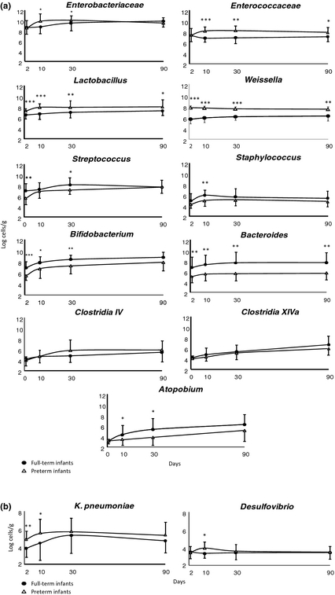
Establishment and development of intestinal microbiota in preterm neonates
FEMS Microbiology Ecology
Volume 79, Issue 3, pages 763-772, 15 DEC 2011 DOI: 10.1111/j.1574-6941.2011.01261.x
http://onlinelibrary.wiley.com/doi/10.1111/j.1574-6941.2011.01261.x/full#fem1261-fig-0001
Notes:
Fecal levels (mean ± SD) of the different microorganisms analyzed by qPCR. (a) Enterobacteriaceae,Enterococcaceae,Lactobacillus group, Weissella,Streptococcus,Staphylococcus,Bifidobacterium,Bacteroides group, Clostridium IV group, Clostridium XIVa group, and Atopobium group. (b) Klebsiella pneumoniae and Desulfovibrio. Asterisks indicate statistically significant differences at the corresponding sampling time. *P < 0.05; **P < 0.01; ***P < 0.001.
© This slide is made available for non-commercial use only. Please note that permission may be required for re-use of images in which the copyright is owned by a third party.

Slide 16
Latest meta-analysis
Wang Q, Dong J, Zhu Y: Probiotic supplement reduces risk of necrotizing enterocolitis and mortality in preterm very low-birth-weight infants: an updated meta-analysis of 20 randomized, controlled trials. J Pediatr Surg 2012, 47(1):241-248.

Slide 17
Study | Participants |  | Birth weight or gestation | Probiotic agents | Primary outcome | Jadad score
 | Probiotics | Placebo
Kitajima H, 1997[30] | 45 | 46 | <1500 g | Bifidobacteria | NEC; sepsis; mortality | 3
Dani C, 2002 [31] | 295 | 290 | <33 wk or <1500 g | Lactobacillus | NEC; sepsis; mortality | 4
Costalos C, 2003[32] | 51 | 36 | 28-32 wk | Saccharomyces | NEC; sepsis | 5
Bin-Nun A, 2005[33] | 72 | 73 | <1500 g | Mixtureª | NEC; sepsis; mortality | 3
Lin HC, 2005 [34] | 180 | 187 | <1500 g | Lactobacillus and bifidobacteria | NEC; sepsis; mortality | 4
Manzoni P, 2006[35] | 39 | 41 | <1500 g | Lactobacillus | NEC; sepsis; mortality | 4
Mohan R, 2006[36]^{b} | 21 | 17 | <34 wk and <1500 g | bifidobacteria | NEC | 4
Stratiki Z, 2007[37]^{b} | 38 | 31 | <34 wk and <1500 g | bifidobacteria | NEC; sepsis; mortality | 5
Ke D, 2008 [38] | 98 | 91 | <32 wk | bifidobacteria | NEC | 4
Lin HC, 2008 [39] | 217 | 217 | <34 wk and <1500 g | Lactobacillus and bifidobacteria | NEC; sepsis; mortality | 5
Huang B, 2009 [40] | 95 | 88 | <32 wk and <1500 g | Bifidobacteria | NEC | 3
Manzoni P, 2009[12] | 151 | 168 | <1500 g | Lactobacillus | NEC; sepsis; mortality | 5
Rougé C, 2009 [41] | 45 | 49 | <32 wk and <1500 g | Lactobacillus and bifidobacteria | NEC; sepsis; mortality | 5
Samanta M, 2009[42] | 92 | 95 | <34 wk and <1500 g | Lactobacillus and bifidobacteria | NEC; sepsis; mortality | 3
Underwood MA, 2009 [13] | 61 | 29 | <34 wk and 750-2000 g | Lactobacillus and bifidobacteria | NEC | 5
Di M, 2010 [43] | 41 | 35 | <32 wk | Bifidobacteria | NEC | 3
Mihatsch WA, 2010[14] | 91 | 89 | <30 wk and <1500 g | Bifidobacteria | NEC; sepsis; mortality | 5
Ren B, 2010 [44] | 80 | 70 | <33 wk and 1000-1800 g | Bifidobacteria | NEC | 3
Braga TD, 2011[15] | 119 | 112 | <1500 g | Lactobacillus and bifidobacteria | NEC; sepsis; mortality | 5
Sari FN, 2011 [16] | 110 | 111 | <33 wk or <1500 g | Lactobacillus | NEC; sepsis; mortality | 5

Slide 18
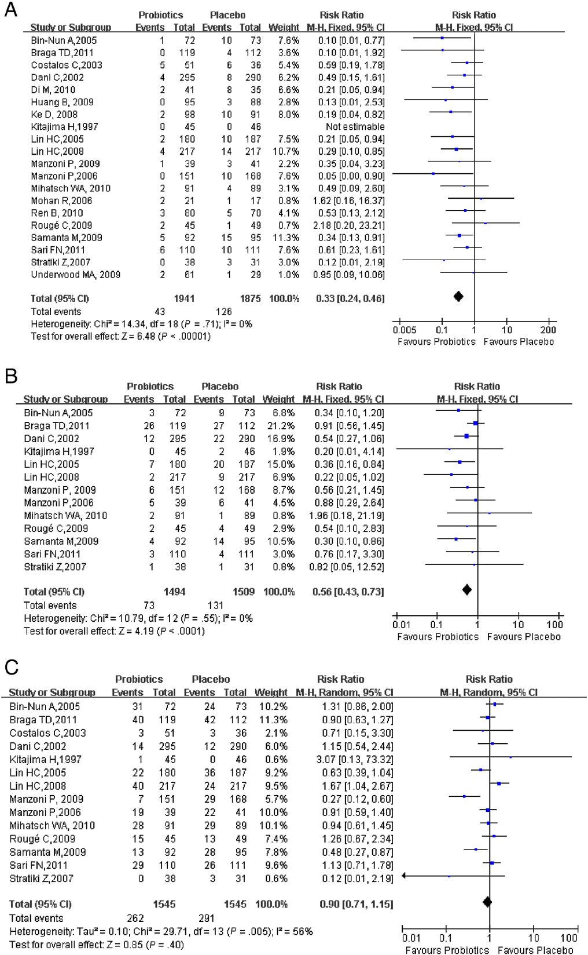
Forest plots of probiotics in preterm infants
(A, Effect of probiotics on NEC; B, Effect of probiotics on mortality; C, Effect of probiotics on sepsis).

Slide 19
Subgroup analyses | Studies (no. in probiotics group/no. in placebo group) | RR
 |  | RR (95%CI) | P_{RR} | I²_{Heterogeneity} | P_{Heterogeneity} | Model
Bifidobacteria
NEC | 8 (509/467) | 0.30 (0.16-0.58) | .0003 | 0 | .64 | Fixed
Mortality | 3 (174/166) | 0.74 (0.18-2.97) | .67 | 0 | .51 | Fixed
Sepsis | 3 (174/166) | 0.84 (0.29-2.41) | .74 | 0.21 | .28 | Fixed
Lactobacillus and Bifidobacteria
NEC | 6 (714/689) | 0.33 (0.19-0.58) | .0001 | 0 | .51 | Fixed
Mortality | 5 (653/660) | 0.47 (0.26-0.87) | .02 | 49 | .09 | Random
Sepsis | 5 (653/660) | 0.90 (0.60-1.36) | .62 | 71 | .007 | Random
Lactobacillus
NEC | 4 (595/610) | 0.37 (0.19-0.73) | .004 | 0 | .40 | Fixed
Mortality | 4 (595/610) | 0.61 (0.38-0.97) | .04 | 0 | .88 | Fixed
Sepsis | 4 (595/610) | 0.79 (0.46-1.36) | .40 | 71 | .01 | Random

Slide 20
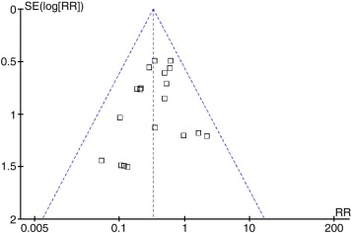
Funnel plot to assess publication bias
Analysis of effect of probiotic supplement on NEC risk including 20 studies; TEgger test = −1.12; 95% CI, −1.82 to 0.56; PEgger test = .278 > .05

Slide 21
Other recent meta-analyses
Deshpande G, Rao S, Patole S, Bulsara M: Updated Meta-analysis of Probiotics for Preventing Necrotizing Enterocolitis in Preterm Neonates. Pediatrics 2010, 125(5):921-930.
AlFaleh, Khalid; Anabrees, Jasim; Bassler, Dirk; AlKharfi, Turki: Probiotics for prevention of necrotizing enterocolitis in preterm infants Cochrane Database of Systematic Reviews. Issue 3, 2011.

Slide 22
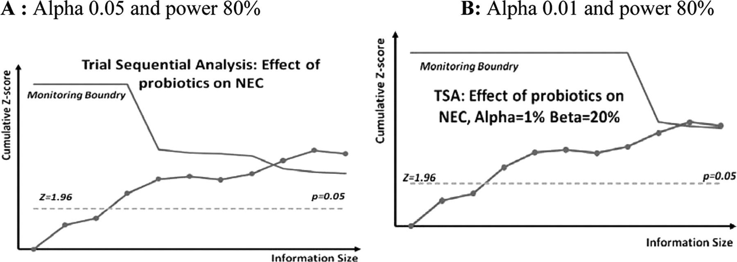

Trial sequential analysis.
Deshpande G et al. Pediatrics 2010;125:921-930
©2010 by American Academy of Pediatrics
Notes:
Trial sequential analysis.

Slide 23
Other RCTs
2 other RCTS have been recently presented, both examiend the effects of ‘Saccharomyces boulardii’ : no effect.
Rojas MA, Lozano JM, Rojas MX, Rodriguez VA, Rondon MA, Bastidas JA, Perez LA, Rojas C, Ovalle O, Garcia-Harker JE et al: Prophylactic probiotics to prevent death and nosocomial infection in preterm infants. Pediatrics 2012. Multicenter RCT infants <2kg; primary outcome was survival without nosocomial sepsis (Columbia). NEC 8/372 probiotiques 15/378 contrôle (L reuteri)
2 others in progress, or just completed, with a total of 2,400 enfants,
  Costeloe angleterre, (PIP) primary outcome is sepsis, NEC or death (justification en partie ‘None of the studies has taken place in the UK’)
  Tobin Australie (PROPREMS) primary outcome sepsis.

Slide 24
ProPrems
Just finished and presented
Australian RCT of probiotics; a mixture of 2 bifidobacteria (infantis and lactis) and streptococcus thermophilus
1100 babies randomized <1500g and <32 wk
4.4% NEC grade 2 or more in controls
2.0% NEC (grade 2 or more) with probiotics
Slightly fewer serious infections

Slide 25
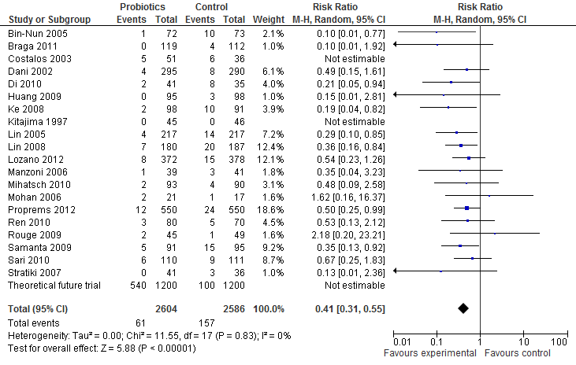
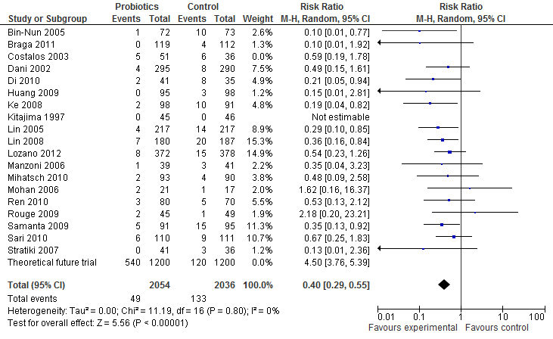
Meta-analysis
Sans Manzoni 2009, sans les études de Saccharomyces

Slide 26
Prospective cohort study CHUSJ
Design/Methods: Starting in July 2011 we have administered a preparation containing a mix of 4 bifidobacteria (b breve, bifidum, infantis and longum) and a lactobacillus rhamnosus (Florababy (tm) holder of a Natural Product Number from Health Canada).
Data on complications has been collected, and compared with the admissions to the NICU during the previous 18 months.
NEC stage 2 or greater was diagnosed by the presence of pneumatosis or other diagnostic findings on an abdominal radiograph, by an attending radiologist.

Slide 27
Prospective cohort study CHUSJ
Characteristic | Pre-probiotic cohort | Probiotic cohort
Gestational Age, weeks. Mean (SD) | 28.9 (2.2) | 29.0 (2.1)
Birth weight, g. Mean (SD) | 1207 (376) | 1220 (334)
SGA (<10%le) | 11.4% | 16%
% female | 44% | 51%

Slide 28
Outcome | Pre-probiotic cohort (n=317) | Probiotic cohort (n=294) | Significance
NEC | 31 (10%) | 16 (5%) | p<0.05
Mortality | 31 (10%) | 20 (7%) | p=NS
NEC or Mortality | 54 (17%) | 31 (11%) | p<0.05
HCAI | 57 (18%) | 54 (17%) | p=NS

Slide 29
Logistic Regression
Outcome | Receipt of Probiotics | GA (per additional week) | Being SGA | Being Female
NEC | 0.51 (0.26, 0.98)* | 0.72 (0.62, 0.83)* | 2.6* (1.1, 5.8) | 0.44** (0.23, 0.87)
Mortality | 0.71 (0.38, 1.34) | 0.56 (0.48, 0.66) * | 3.5 (1.54, 7.84)* | 0.80 (0.43, 1.5)
NEC or mortality | 0.56 (0.33, 0.93)** | 0.62 (0.54, 0.69)* | 3.8 (1.95, 7.30)* | 0.72 (0.43, 1.19)
HCAI | 0.98 (0.81, 1.98) | 0.56 (0.50, 0.63)*** | 1.73 (0.90, 3.34) | 0.83 (0.52, 1.31)

Slide 30
Lactoferrin
Protein in milk
Identified many decades ago
Involved in iron absorption (hence ‘ferrin’)
The reason why human milk iron is almost 100% bio-available
Very similar protein structure in cows milk and human milk
None in artificial formulae

Slide 31
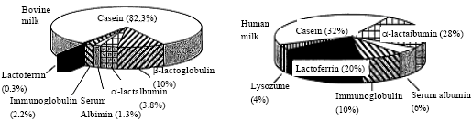
Protein composition of milk
Breast fed term infants receive about 100 mg of lactoferrin a day during the period of production colostrum, and rather less afterward.
Very little lactoferrin in cows milk, even less after modification.

Slide 32
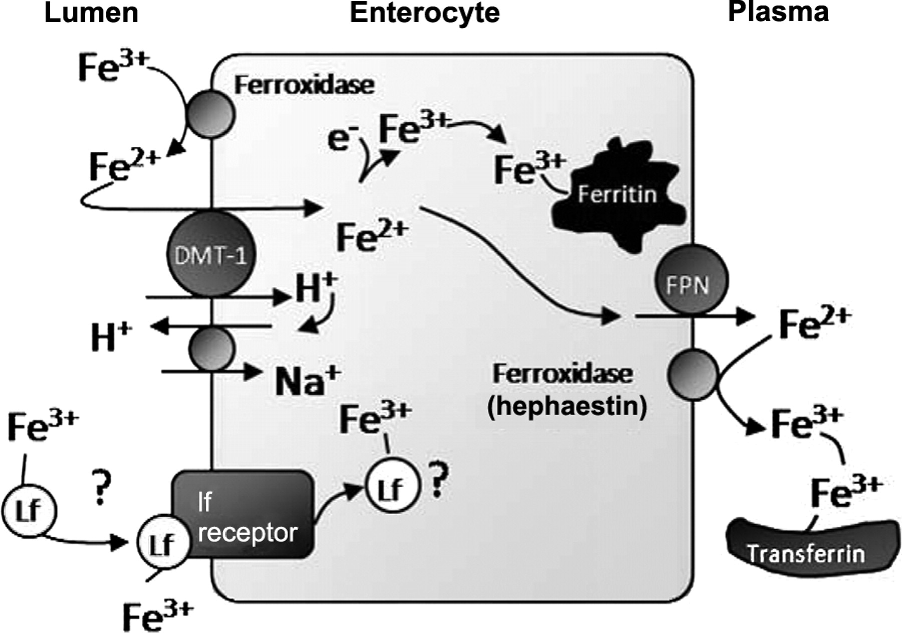
The known and postulated iron-transport processes believed to be operating in the neonatal duodenum.
Collard K J Pediatrics 2009;123:1208-1216
©2009 by American Academy of Pediatrics
Notes:
The known and postulated iron-transport processes believed to be operating in the neonatal duodenum. The well-accepted processes are shown in the upper part of the diagram. Dietary iron is converted to Fe2+ by ferroxidase enzymes to enable it to be transported into the enterocyte by DMT-1. Within the enterocyte the iron remains within the enterocyte (mostly bound to ferritin) or transported out by ferroportin (FPN). The transported iron is then converted to Fe3+ by hephaestin to allow it to bind to transferrin. The proposed, but currently unproven, transport system is shown in the lower part of the diagram. In this process, iron bound to lactoferrin (Lf) is transported into the enterocyte via the lactoferrin receptor. The question marks indicate the unproven nature of the process and the lack of knowledge concerning the fate of the iron entering the enterocyte by this route.

Slide 33
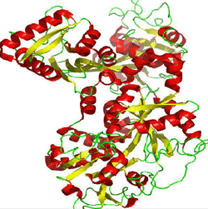

Lactoferrin
w h e y includes lactoferrin, beta-lactoglobulin, alpha lactalbumin glycomacropeptide, and immunoglobulins,

Slide 34
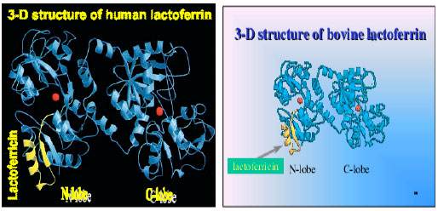
Three dimensional structures of diferric human LF (Farnaud and Evans, 2003) and bovine LF (Moore et al., 1997). The location of lactoferricin within the protein is shown in yellow and the two ferric ions are in red

Slide 35
Lactoferricin
Lactoferrin is partially hydrolysed in the stomach
Which creates lactoferricin, which has an increased antibacterial activity.
Lactoferrin also seems to promote the growth of probiotic organisms, Bifidobacteria

Slide 36
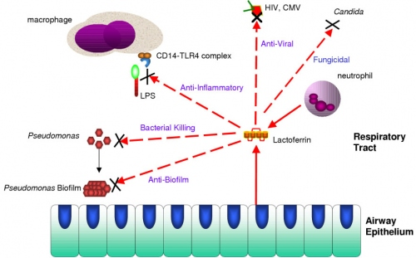
Lactoferrin
Rogan et al. Respiratory Research 2006 7:29 doi:10.1186/1465-9921-7-29

Slide 37
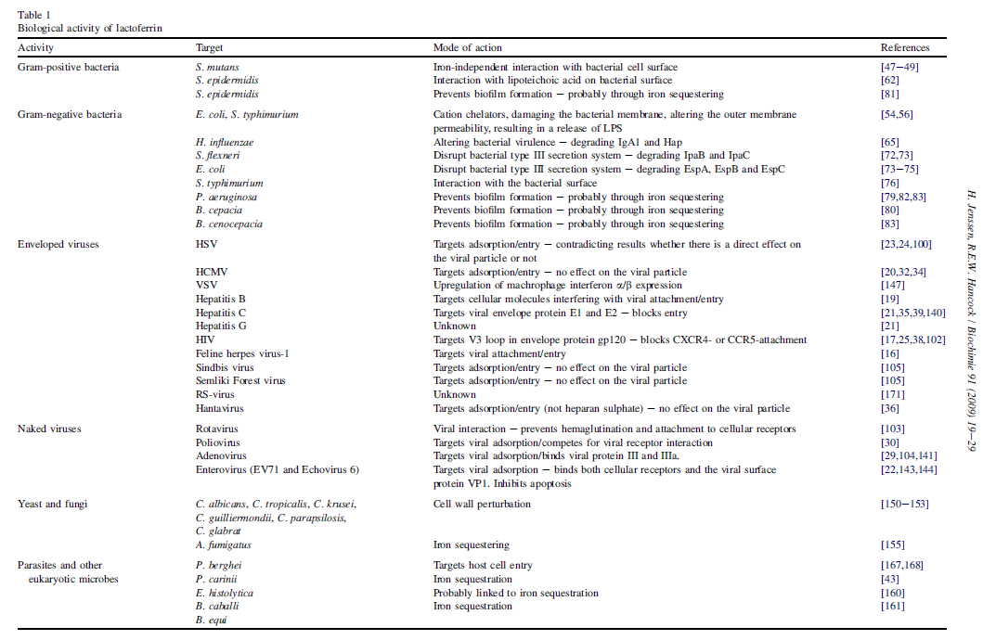
Jenssen H, Hancock REW: Antimicrobial properties of lactoferrin. Biochimie 2009, 91(1):19-29.

Slide 38
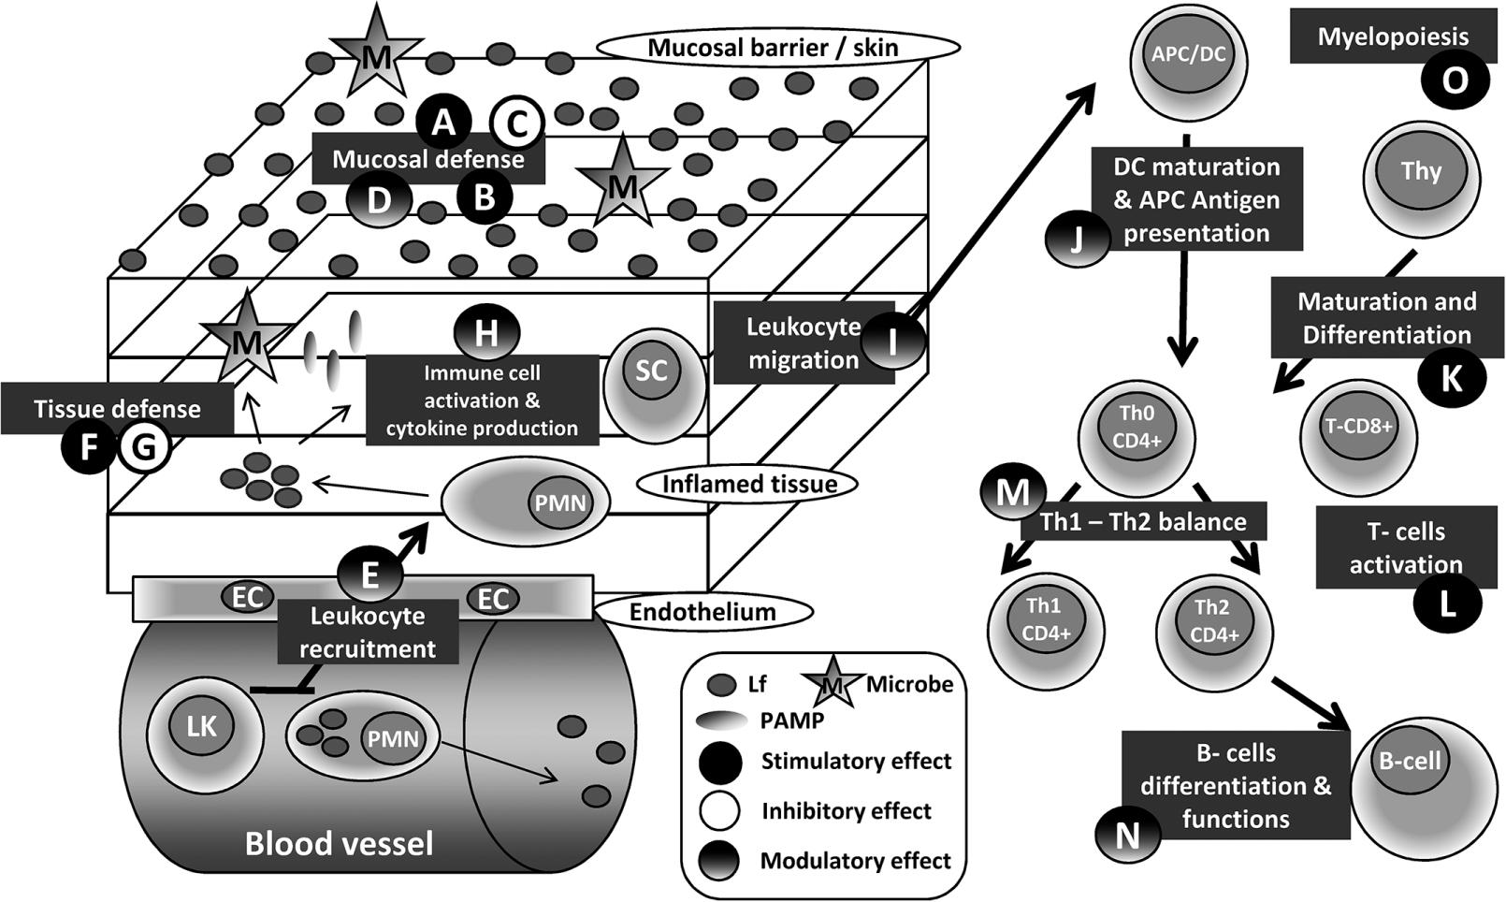
Legrand D: Lactoferrin, a key molecule in immune and inflammatory processes. Biochem Cell Biol 2012, 90(3):252-268

Slide 39
Manzoni P et al: Bovine Lactoferrin Supplementation for Prevention of Late-Onset Sepsis in Very Low-Birth-Weight Neonates: A Randomized Trial. JAMA 2009, 302(13):1421-1428.
472 VLBW infants were randomly assigned to receive orally administered BLF (100 mg/d) alone (n=153), BLF plus Lactobacillus GG (n=151), or placebo (n=168) from birth until day 30 of life (day 45 for neonates <1000 g at birth).

Slide 40
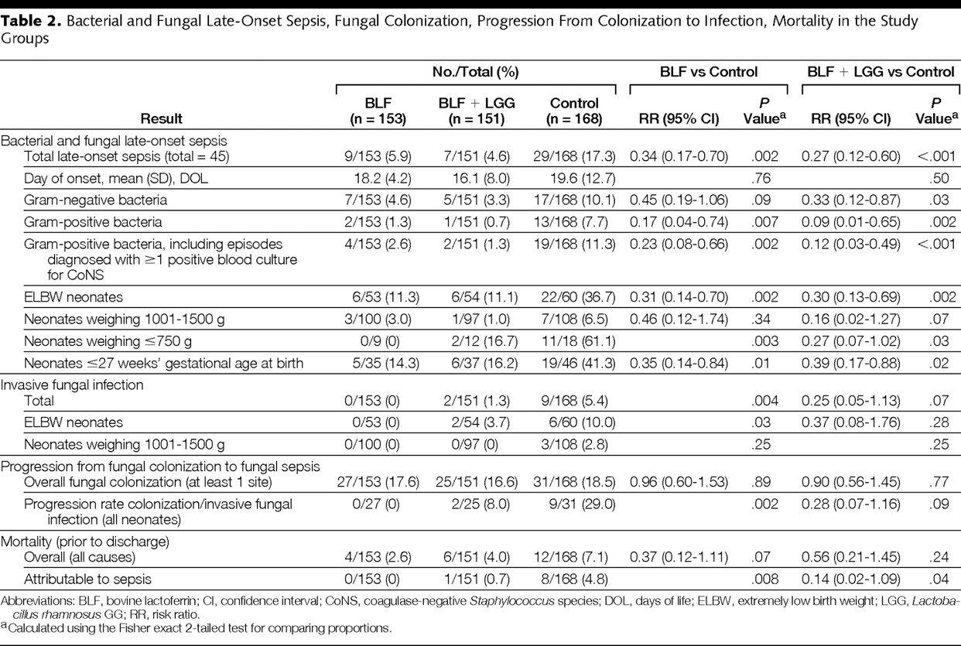

Table 2. Bacterial and Fungal Late-Onset Sepsis, Fungal Colonization, Progression From Colonization to Infection, Mortality in the Study Groups.
Manzoni, P. et al. JAMA 2009;302:1421-1428
Copyright restrictions may apply.
Notes:
Table 2. Bacterial and Fungal Late-Onset Sepsis, Fungal Colonization, Progression From Colonization to Infection, Mortality in the Study Groups

Slide 41
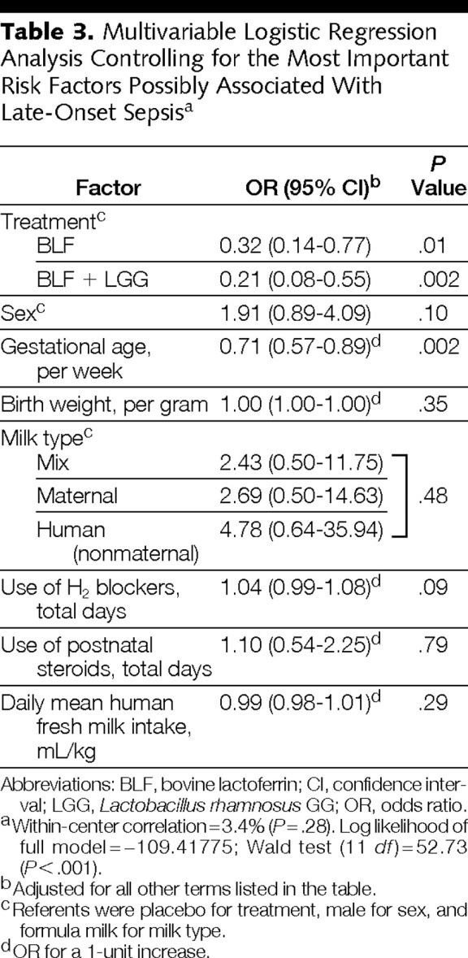
Table 3. Multivariable Logistic Regression Analysis Controlling for the Most Important Risk Factors Possibly Associated With Late-Onset Sepsisa.
Manzoni, P. et al. JAMA 2009;302:1421-1428
Copyright restrictions may apply.
Notes:
Table 3. Multivariable Logistic Regression Analysis Controlling for the Most Important Risk Factors Possibly Associated With Late-Onset Sepsisa

Slide 42
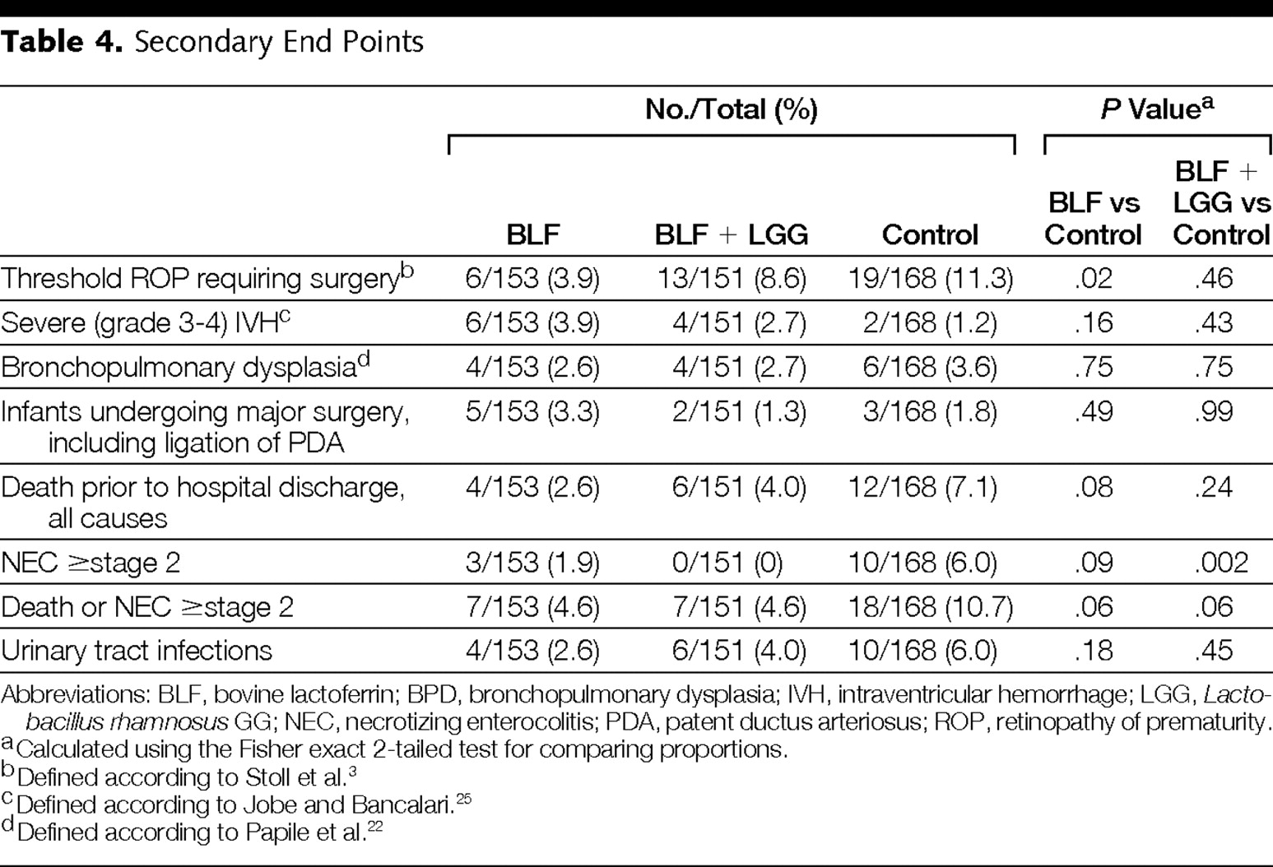
Table 4. Secondary End Points.
Manzoni, P. et al. JAMA 2009;302:1421-1428
Copyright restrictions may apply.
Notes:
Table 4. Secondary End Points

Slide 43
Outcome | Placebo (%) | bLF (%) | Risk Ratio (95% CI) | P
Death in hospital after day 3 | 12/168 (7.1) | 4/153 (2.6) | 0.37 (0.12 - 1.11) | 0. 07
Hospital death from late-onset sepsis | 8/168 (4.8) | 0/153 (0) | NA | 0.008
Late-onset sepsis (bacterial + fungal) | 29/168 (17.3) | 9/153 (5.9) | 0.34 (0.17 - 0.70) | 0. 002
Late-onset sepsis (bacterial only) | 23/168 (13.7) | 9/153 (5.9) | 0.43 (0.21 - 0.88) | 0.02
Late-onset sepsis in infants fed only breastmilk (not exposed to formula) | 7/37 (18.9) | 1/42 (4.2) | 0.13 (0.02 - 0.98) | 0.02
Necrotising enterocolitis (≥ stage 2)* | 14/259 (5.4) | 5/251 (2.0) | 0.35 (0.13 - 0.99) | 0.04**
Retinopathy of prematurity (treated) | 19/168 (11.3) | 6/153 (3.9) | 0.35 (0.12 - 0.82) | 0.02
Death > day 3 or major morbidity‡‡ | 47/168 (28.0) | 22/153 (14.4) | 0.51 (0.24 - 0.75) | 0.002

Slide 44
Manzoni P et al
Early Hum Develop 2011
 | LF | Placebo | R.R. | 95% | p
NEC>2nd stage | 5/251 2% | 14/259 5.4% | 0.35 | 0.13–0.99 | 0.04
 | LF+LGG | Placebo | R.R. | 95% | p
NEC>2nd stage | 1/242 0.4% | 14/259 5.4% | 0.07 | 0.01–0.55 | 0.001

Slide 45
Lacuna Study
The overall objective of this research program is to determine :
In infants who are born at gestational ages of 23 ^{0/7} to 30 ^{6/7} weeks,
does administration of bovine lactoferrin commencing within the first 48 hours of life, and continuing until 36 weeks post-menstrual age or to hospital discharge if sooner,
compared with control,
increase the probability of survival without a proven HCAI
to discharge from hospital?

Slide 46
LIFT Lactoferrin Infant Feeding Trial
A pragmatic, randomized clinical trial in 1,500 very low birth weight infants (VLBW: <1,500 g)
(I) aims to test the hypotheses that adding bovine lactoferrin (bLF) vs placebo to feeds improves the
Primary composite outcome of all-cause hospital mortality or any of 5 morbidities diagnosed or treated in hospital:
brain injury or chronic lung disease or retinopathy of prematurity (ROP) treated by local guidelines or late onset sepsis or necrotising enterocolitis (NEC);

Slide 47
LIFT
Funded by Australian MRC
About to start

Slide 48
Lactoferrin
A promising intervention for the future, more studies are needed.
2 large multi-center RCTs are in progress.

Slide 49
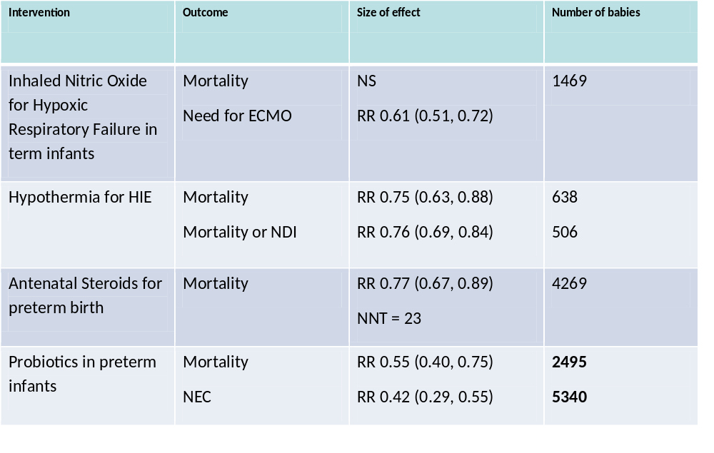

Slide 50
Probiotics
Probiotics are proven to reduce NEC and mortality.
The preparation chosen should contain a Bifidobacterium or Lactobacillus Rhamnosus, and probably a mix of the two
Good Quality Control of the preparation is essential
Parents deserve the right to know about probiotics
Further placebo controlled trials are unethical
  Other trials comparing preparations and timing are needed

Slide 51
Probiotics
Babies in Canada should be receiving probiotics
We have appropriate preparations
There is no further excuse!

Slide 52
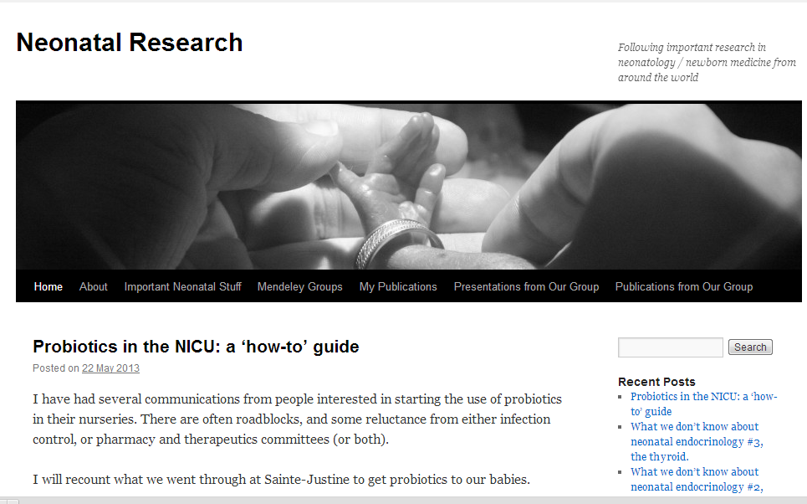
neonatalresearch.org

