Slide 1
Therapies to prevent Bronchopulmonary dysplasia:
An Evidence based approach.
Keith J Barrington
CHU Sainte Justine

Slide 2
Bronchopulmonary dysplasia
Problems of definition
A continuum of lung injury
Arbitrarily divided into BPD/non-BPD depending on duration of O2 therapy
Criteria for O2 therapy differ (hence the “physiologic definition”)
Long term effects rarely examined
  long term pulmonary outcomes
  neurodevelopmental impairment

Slide 3
Critical review
To provide evidence based guidelines for prevention of BPD
Review of the literature
Hierarchy of evidence

Slide 4
Antenatal therapies investigated
Steroids
TRH
Antibiotics

Slide 5
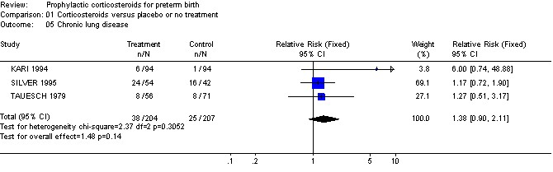
Antenatal steroids
No proven effect on BPD, reduce mortality, therefore probably improve survival without BPD

Slide 6
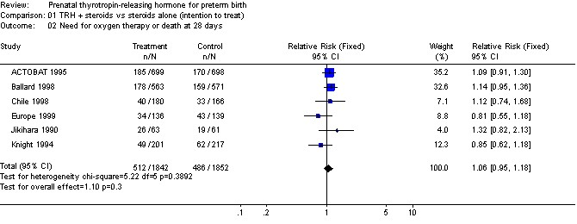
Antenatal TRH

Slide 7
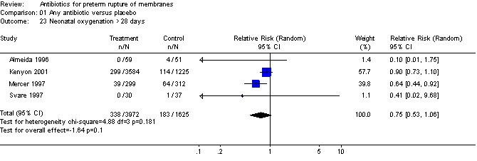
PROM antibiotic Rx

Slide 8
Postnatal therapies investigated
Surfactant therapy; preparation, dose, timing
Ventilatory management
  High frequency
  Early CPAP
  Permissive hypercapnia
  Synchronized ventilation
  early extubation
Oxygen therapy
Inhaled nitric oxide

Slide 9
Postnatal therapies investigated
Fluid management
Nutrition; calories, protein and fat.
PDA management
Vitamin A
Postnatal steroids
Ureaplasma and therapies for it
Diuretics
Antioxidants; SOD, vitamin E
Caffeine

Slide 10
Postnatal therapies

Slide 11
What to do in the delivery room?
Oxygen
Ventilation
Intubation /surfactant

Slide 12
Oxygen and Ventilation in the DR
No evidence of different starting FiO2 and BPD risk
No evidence of different target SpO2 and BPD risk
No evidence for PEEP during DR ventilation or for measuring and limiting tidal volume
    All likely to be important
    Can’t see any reason not to use PEEP
    Currently could use 30% to start, target progressively increasing saturations, PEEP of 4 to 6, avoid too much chest rise

Slide 13
Prophylactic surfactant
Preventing lung injury is essential, injury which may be initiated in the first few minutes of life.
There are a number of studies comparing rescue to prophylactic treatment.
One study compared early rescue with very early rescue (Osiris study) The difference in median administration times was 64 minutes. 11% less BPD with earlier rescue
  The Osiris collaborative group. Early versus delayed neonatal administration of synthetic surfactant - The judgement of OSIRIS. Lancet. 1992;340:1363-69

Slide 14
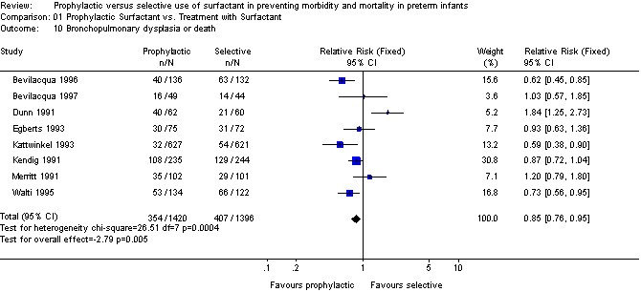
Surfactant prophylaxis

Slide 15
Surfactant prophylaxis vs rescue (natural sufactants)
Risk difference for BPD or death is 0.045, giving an NNT of 22.
To prevent one death the NNT is 17
Babies treated prophylactically are more likely to need only one dose
Overall mean number of doses received are 1.2 per prophylaxis baby and 1.5 per rescue baby.
    Controls were either all intubated or just given O2 as required, no routine use of CPAP in the controls
So if you have a ventilated preterm in the DR who needs oxygen, immediate surfactant should be given
Is prophylactic surfactant better than immediate CPAP with early rescue?

Slide 16
Surfactant vs CPAP
COIN
SUPPORT
VON (Dunn et al)
CURPAP

Slide 17
COIN trial
610 infants of 25+0 to 28+6 weeks.
If breathing at 5 min and needing respiratory support randomised to immediate nasal CPAP at 8 cm H2O, or intubation
Intubation rate first 5 days for the CPAP group 46% (55% for 25+26 w and 40% for 27+28 w).
Intubated group treated according to local practice (77% got surfactant)

Slide 18
COIN intubation criteria
Apnea unresponsive to stimulation and methlyxanthine treatment (>6 episodes requiring stimulation in 6 hours or requiring >1 episode of positive-pressure ventilation),
Arterial pH < 7.25 with a
PaCO2 > 60 mm Hg,
Metabolic acidosis not responsive to treatment,
Or > 60% FiO2

Slide 19
SUPPORT
1316 infants 24 weeks to 27 weeks
intubation and surfactant treatment (within 1 hour after birth) or
CPAP treatment initiated in the delivery room, with subsequent use of a protocol-driven limited ventilation strategy.
Intubated infants weaned to rate of 20 within 24 hous if possible and if PCO2 < 50, FiO2 <35%

Slide 20
SUPPORT intubation citeria
FIO2 ­­> 0.50 for SpO2 >= at or above 88%
PaCO2 > 65 mm Hg; or hemodynamic
instability, defined as a blood pressure that was low for gestational age, poor perfusion, or both, requiring volume or pressor support for a period of 4 hours or more.
Infants who were intubated within the first 48 hours after birth were to receive surfactant.

Slide 21
CURPAP
208 infants 25 to 28 wk GA
CPAP in the DR if stabilisable
Then randomized to INSURE at 30 minutes of age, extubated in less than an hour if possible
Comparison group remained on CPAP

Slide 22
CURPAP intubation criteria
1 of the following:
FIO2 > 0.4 for SpO2 85% to 92% for > 30 minutes unless rapid clinical deterioration
Apnea defined as 4 per hour or 2 per hour if bag and mask required,
Respiratory acidosis defined as PCO2 65 mm Hg (8.5 kPa), and pH 7.2 on arterial or capillary blood gas

Slide 23
Dunn et al
  640 infants 26 to 29 weeks GA, 3 groups:
Surf Prophylaxis
Prophylactic INSURE
CPAP
Intubation criteria
  ­­­>12 apneas needing stimulation or > 1 that required bagging in 6-h;
  PCO2 >65 mm Hg;
  FIO2 of >0.4 to maintain sat 86% - 94%.
  Intubation discretionary if FIO2 0.4 to 0.6 and mandatory if FIO2 > 0.6. After intubation, infants on O2 received surfactant.

Slide 24
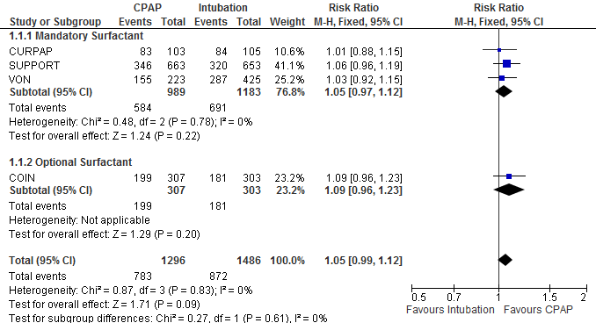
Meta-analysis, CPAP vs Intubation
Outcome survival without BPD

Slide 25
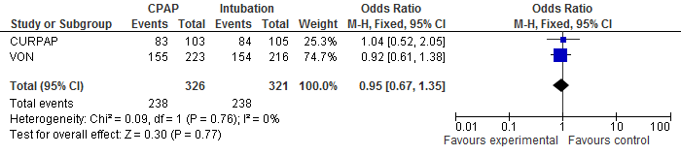
Meta-analysis, CPAP vs INSURE
Outcome survival without BPD

Slide 26
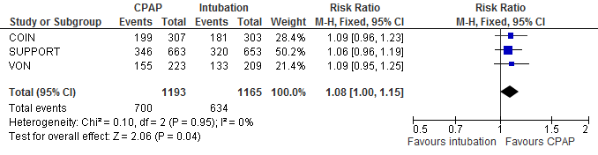
Meta-analysis, CPAP vs intubation: no INSURE

Slide 27
Initial respiratory management
If the baby can be stabilized without intubation:
CPAP installed in the delivery room
Uninterrupted CPAP during transfer to NICU
Administration of surfactant as soon as it becomes clear that the infant will need it
  How to decide this?

Slide 28
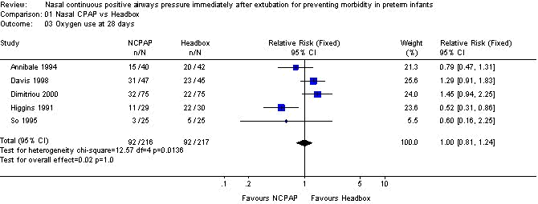
Postextubation CPAP

Slide 29
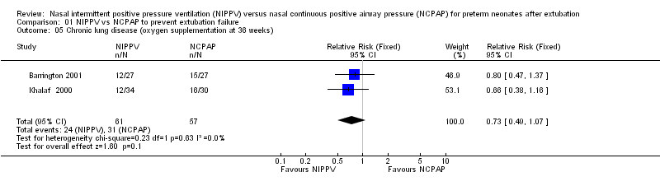
Postextubation nIMV

Slide 30
Permissive hypercapnia
Mariani G, Cifuentes J, Carlo WA: Randomized trial of permissive hypercapnia in preterm infants. Pediatrics 1999, 104:1082-8.
Pilot study 49 infants 601-1250 g, less than 24h of age
Randomized to hypercapnia (45-55 torr) or normocapnia (35-45 torr)
Shorter duration of ventilation, trend to less BPD, shorter O2 therapy, no change in ivh, pvl with permissive hypercapnia.

Slide 31
Permissive hypercapnia
Carlo et al 1999/2002 NICHD network study terminated early because of steroid complications
Therefore insufficient power
Compared goal PCO2 >52 to goal <48 mmHg
Duration of ventilation reduced

Slide 32
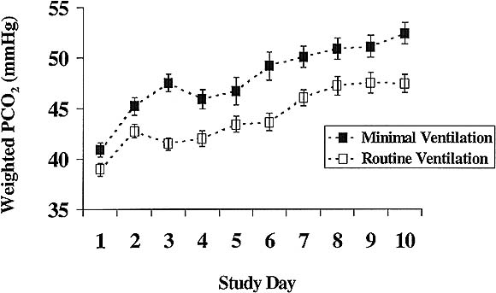
Minor CO2 differential between groups

Slide 33
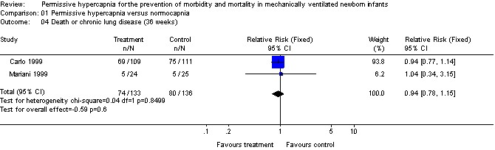
Permissive hypercapnia

Slide 34
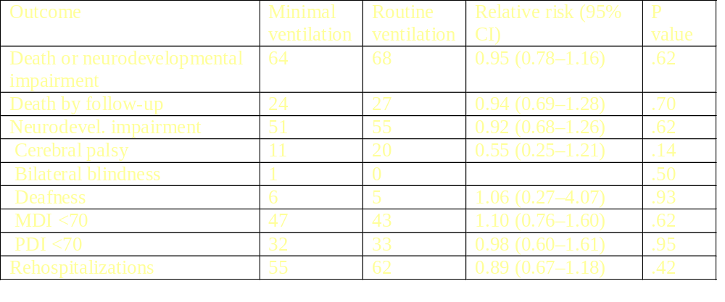
Permissive hypercapnia Carlo 2002
45% reduction in cerebral palsy!!!, p=NS

Slide 35
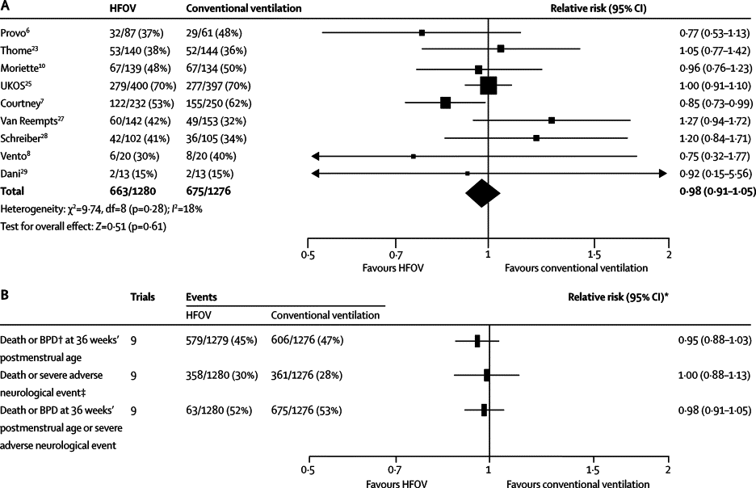
Offringa et al

Slide 36
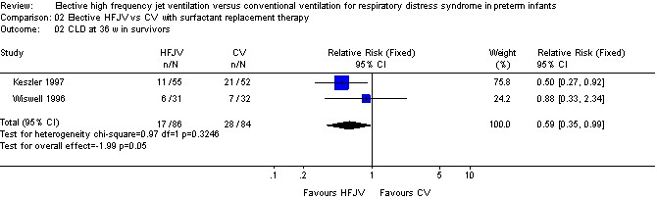
High frequency ventilation: jet

Slide 37
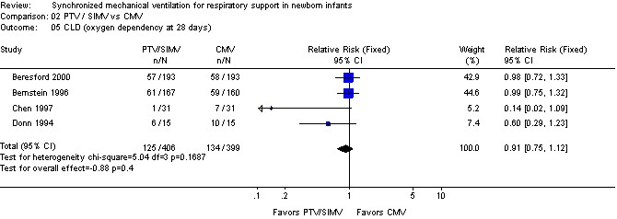
Synchronized ventilation

Slide 38
Oxygen therapy
O2 toxic yet essential
What oxygenation levels to aim for?
Usher 1973, reported much slower resolution of acute lung disease in preterm infants when PaO2 goal was 80-120 mmHg compared to goal of > 40
STOP-ROP showed that late O2 supplemental therapy goal 96-99% sat worsened pulmonary outcomes compared to 89-94% sat goal

Slide 39
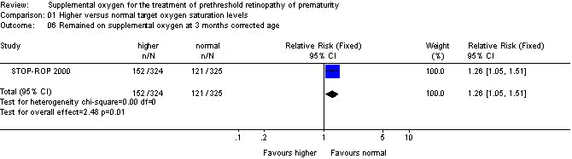
Oxygen therapy

Slide 40
Oxygen therapy
BOOST trial randomized infants with established BPD to high or low saturation groups
  High saturation no benefit, prolonged the need for oxygen
  Soft evidence of other adverse pulmonary outcomes
Reasonable goal: keep saturation around 90% to limit pulmonary O2 exposure
Turn down O2 when sats are high!

Slide 41
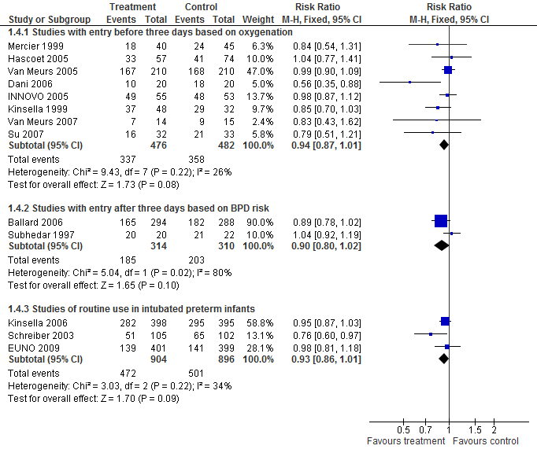
Inhaled NO
Death or BDP
Notes:
To answer Dr Soll’s question from yesterday, the Risk difference for these 3 groups of studies are 0.05, (-0.1, 0.01), 0.06 (-0.14, 0.01)and 0.04 (-0.08, 0.01).
Therefore the number needed to treat, is about 20, with a range from as few as 7 to as many as infinite!

Slide 42
IPD Meta-analysis
Death or CLD (Best available definition)
Trial
iNO
40 / 48 (83%)
6 / 16 (38%)
43 / 105 (41%)
42 / 61 (69%)
54 / 64 (84%)
170 / 224 (76%)
292 / 398 (73%)
4 / 20 (20%)
165 / 294 (56%)
134 / 399 (34%)
954 / 1629 (59%)
Placebo
27 / 32 (84%)
4 / 18 (22%)
56 / 102 (55%)
51 / 84 (61%)
56 / 62 (90%)
174 / 225 (77%)
294 / 395 (74%)
8 / 20 (40%)
184 / 288 (64%)
137 / 401 (34%)
992 / 1627 (61%)
RR (95% CI)
Kinsella 1999
0.99 (0.81, 1.21)
Srisuparp 2002
1.59 (0.55, 4.62)
Schreiber 2003
0.77 (0.57, 1.04)
Hascoet 2005
1.11 (0.85, 1.43)
INNOVO 2005
0.93 (0.82, 1.07)
Van Meurs 2005
0.98 (0.88, 1.09)
Kinsella 2006
0.99 (0.91, 1.08)
Dani 2006
0.53 (0.19, 1.46)
Ballard 2006
0.85 (0.74, 0.98)
EUNO 2008
1.01 (0.83, 1.23)
OVERALL*
0.96 (0.91, 1.01) p=0.095
0.2
0.5
1
2
5
Favours iNO
Favours placebo
† Subhedar removed from the analysis as zero cell counts caused model instability.
* χ² test for heterogeneity p > 0.05
Estimates derived from N=1000 iterations of log-binomial model using multiple outputation method.

Slide 43
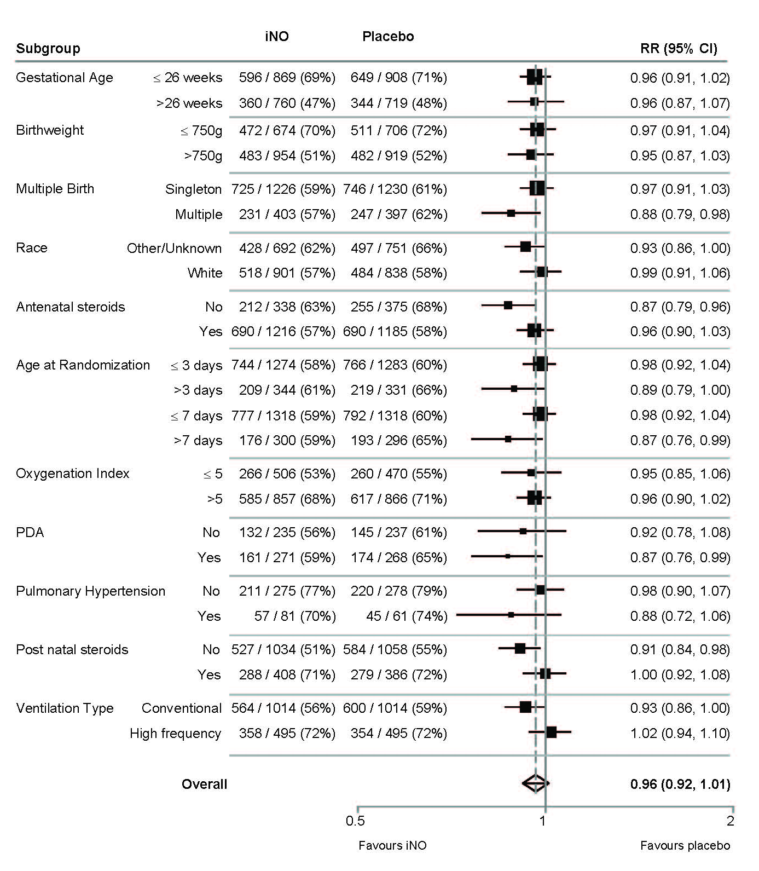
Subgroup Analyses
(death or CLD)

Slide 44
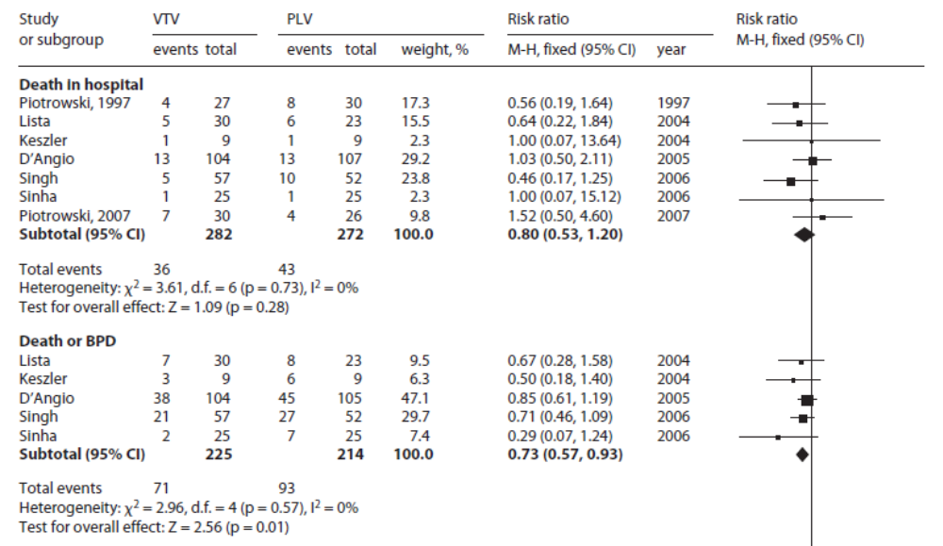
Volume Targeting Ventilation
Nine small RCTs, methods quite variable, total <600 infants

Slide 45
Volume targeting
Most harmful factor, probably end-inspiratory lung stretch.
Therefore just limiting the Vt is not enough
Therefore « optimize » PEEP as well as controlling tidal volume
  After surfactant PEEP of 3 adequate for infants who remain in 21% O2
  Vt of 4 mL/kg adequate

Slide 46
Early extubation
Unable to find reliable information about the effects of attempted aggressive weaning and early extubation on incidence of BPD
Extubation does not increase metabolic rate, or calorie consumption
Apnea usually increased
Less nosocomial sepsis
Less exposure to assisted ventilation by ETT, presumably less severe lung injury: BPD

Slide 47
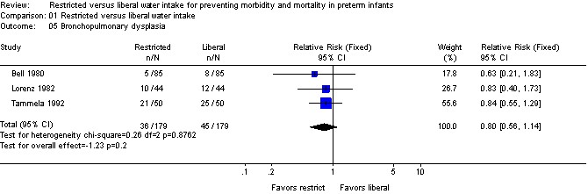
Restricted water intake

Slide 48
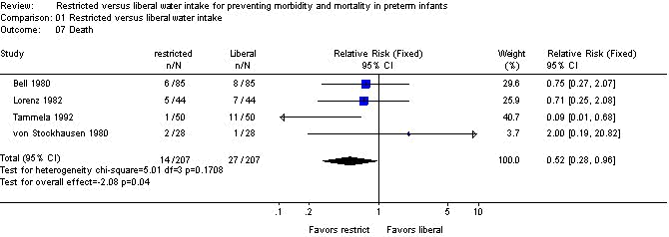
Restricted water intake

Slide 49
Restricted water intake
Kavvadia et al performed an RCT of varying fluid intakes in 168 VLBWs. 70,90,110, 120, 140, 150, 150 compared to restricted 40, 40-60, 70, 90, 110, 130, 150⁴. This study individualized Na intake after day1 (0 was given day 1, and there was no difference between the groups) and found no difference in any clinical outcomes.

Slide 50
Restricted Sodium intake
RCT compared 3-4 mmol/kg/d Na over first 5 days of life to ELBW infants, showed more hyperosmolarity and more BPD in the group receiving sodium. (n=17)
RCT compared 4 mmol/kg/d of Na on day 2 and after to a group who started Na only after losing at least 6% of their body weight (25-30wk n=46). Intervention group: more rapid resolution of lung disease².
Tammela’s RCT compared two fluid regimes in 100 newborns less than 1750g³, 50,60,70,80,90,120 ml/kg/d in restricted group, then 150 until 4 wk, and 80,100, 120, 150 ml/kg/d in controls followed by 200. In fact iv fluids contained a routine Na concentration of 3 mmol/100ml, so was also an RCT of Na intake .
Infants who received more fluid (and more Na) had increased BPD.

Slide 51
Restricted sodium intake
Lorenz randomized 88 VLBWs (>750g) to liberal or restricted fluid 70 to 80 mL/kg/d compared to 60 on day 1, increasing by a fairly complicated schedule⁵.
Modest differences in Na intake after day 2, 1 vs 2.5 mM/kg/d. There were no clinically significant differences found in outcomes, there was a minor trend to more PDAs and more BPD with liberal H2O and sodium intake.
Data could be summarized as : sodium restriction is associated with improved respiratory outcomes, whereas fluid restriction has no particular benefit.

Slide 52
Nutritional interventions

Slide 53
Nutrition
Repair of lung injury requires both energy and protein.
A retrospective case-control study of VLBW infants showed an association of BPD with poor energy and protein intake between weeks 2 and 4.
    deRegnier RA, Guilbert TW, Mills MM, Georgieff MK. Growth failure and altered body composition are established by one month of age in infants with bronchopulmonary dysplasia. J Nutr 1996 Jan;126(1):168-75.

Slide 54
Nutrition
Early intralipid may be associated with increased BPD rates
Very early intralipid doubled mortality in ELBW infants, 600-800g. Sosenko et al (1993)
Intralipid administration appears to increase PVR (Prasertsom et al 1996 Arch Dis Child)
Also worsens pulmonary vascular responses to hypoxia. (Piglet study. Barrington et al 1997)

Slide 55
Nutrition
An RCT comparing a 5 to a 14 day delay in introducing intralipid had no effect.
    Alwaidh MH, Bowden L, Shaw B, Ryan SW. Randomised trial of effect of delayed intravenous lipid administration on chronic lung disease in preterm neonates. J Pediatr Gastroenterol Nutr. 1996 Apr;22(3):303-6.
N=64, <1500 g

Slide 56
Nutrition
Deficits in protein and energy appear on day one in VLBW infants and progressively worsen until day 14.
    Cooke RJ et al.
The accumulated deficit is never recovered
Babies with the greatest deficit more likely to have BPD.
    Ehrenkrantz R. et al Longitudinal growth of hospitalized very low birth weight infants.
    Pediatrics. 1999 Aug;104(2 Pt 1):280-9.

Slide 57
Nutrition
This suggests that a more “aggressive” approach to nutrition should decrease pulmonary morbidity
Little good evidence from RCTs
    Randomised controlled trial of an aggressive nutritional regimen in sick very low birthweight infants. Wilson DC, Cairns P, Halliday HL, Reid M, McClure G, Dodge JA.

Slide 58
The patent Ductus Arteriosus
Benitz W, J Perinatol 2011
Extensive systematic review
No evidence of benefit of any approach to the PDA on BPD or survival.
Little evidence for or against screening echo and treatment in asymptomatic phase

Slide 59
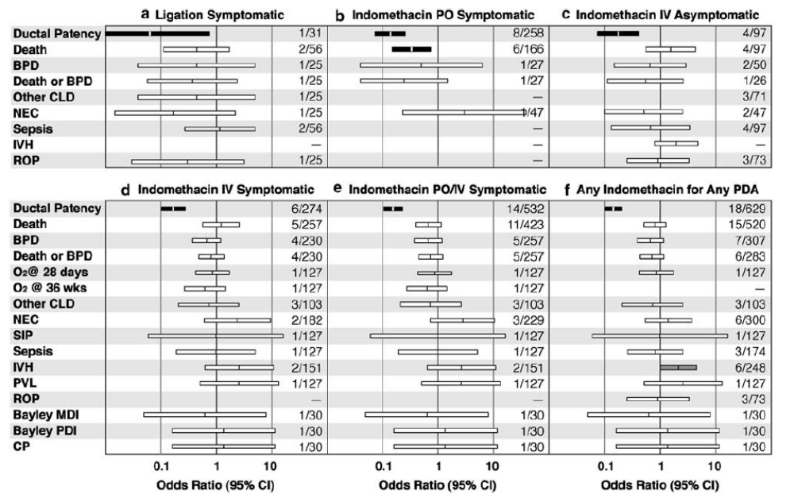
Benitz

Slide 60
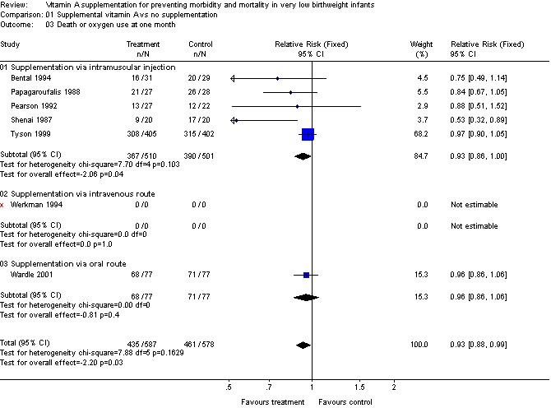

Slide 61
Vitamin E
Published systematic review: ineffective
    Specker B. L., deMarini S., Tsang R. C. Vitamin and mineral supplementation. Sinclair J. C. Bracken M. B. eds. Effective Care of the Newborn 1992:161-177 Oxford University Press New York, NY

Slide 62
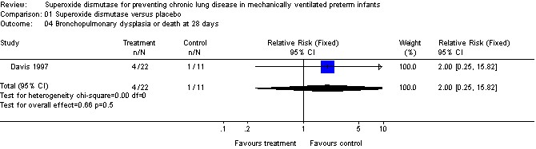
Superoxide dismutase

Slide 63
Erythromycin
Statistical association between presence of U. urealyticum and chronic lung disease.
Very large numbers of observational studies, inconsistent results
Biologically plausible
Randomized trials exist of erythromycin to determine if erythromycin eradicates Ureaplasma, and reduces BPD

Slide 64
Ureaplasma
Schelonka 2005, systematic review
23 studies; total 2216 infants reported BPD28, and 8 studies with 751 infants reported BPD36.
Association between Ureaplasma colonization and both BPD28 and BPD36, but substantial heterogeneity (Q test statistic, P < 0.01).
The greatest contribution to effect was from the studies enrolling fewer than 100 infants.,
Conclusion: Ureaplasma colonization associated with higher rates of BPD, greatest effect in small studies; reporting bias may be partially responsible.

Slide 65
Ureaplasma
Recent studies using PCR show strong association between Ureaplasma in the lung and BPD
Kotecha 2004, 17 patients 6 positive
Colaizy 2007, 139 patients 33 positive

Slide 66
Erythromycin
2 randomized trials
Lyon et al n = 75 (only 9 positive for U. u)
Jonsson et al n= 28
No effect seen on any clinically important outcome. U. u colonization was reduced (but not eliminated).

Slide 67
Treatment of Ureaplasma & BPD
Ballard HO, azithromycin
A total of 220 intubated infants <1250g (111 azithromycin, and 109 placebo).
Mortality was 18% with azithromycin group vs 22% for placebo (P¼0.45).
BPD was 76% azithromycin vs 84% placebo (P¼0.2).
The multiple logistic regression analysis demonstrated an odds ratio of 0.46 decrease in the chance of developing BPDor death for the azithromycin group, but was not statistically significant.
BPD was 73% in the Ureaplasma subgroup with azithromycin vs 94% placebo (P¼0.03).
Analysis of patients in the Ureaplasma subgroup only, using the exact logistic model demonstrated a decrease inBPDor death in the azithromycin group with an estimated odds ratio of 0.026 (0.001–0.618, 95% confidence interval).

Slide 68
224 infants between 750-1250g, cultures for Ureaplasma
74 (33%) infants had a positive culture for U urealyticum in the first 3 day cultures.
BPD was significantly higher with U urealyticum (15.9% vs 36.4%; P < .01). However, multivariate logistic regression analysis failed to reveal a significant association between the presence of U urealyticum and BPD development (odds ratio: 2.4 [95% confidence interval: 0.9-6.3]; P = .06).
Clarithromycin treatment resulted in eradication of U urealyticum in 68.5% of the patients.
BPD was significantly lower in the clarithromycin group than in the placebo group (2.9% vs 36.4%; P < .001). Multivariate logistic regression analysis confirmed the independent preventive effect of clarithromycin for the development of BPD (odds ratio: 27.2 [95% confidence interval: 2.5-296.1]; P = .007).

Slide 69
Erythromycin ineffective
Baier RJ, Loggins J, Kruger TE: Failure of erythromycin to eliminate airway colonization with ureaplasma urealyticum in very low birth weight infants. BMC Pediatr 2003, 3(1):10.

Slide 70
Further studies needed
Unbiased studies evaluating PCR detection of Ureaplasma in high risk infants, and RCTs of an effective anti-Ureaplasma agent (azithromycin or clarithromycin)

Slide 71
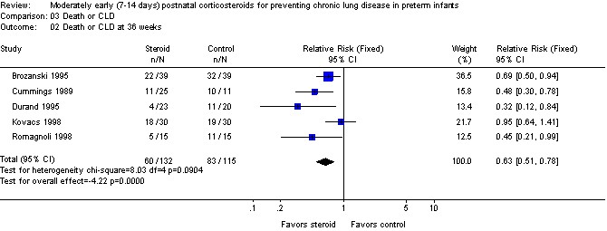
Early postnatal steroids

Slide 72
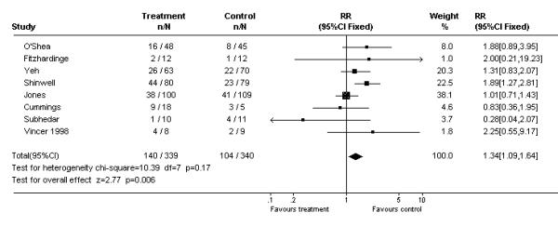
Postnatal steroids and long term impairment
BMC Pediatr. 2001; 1 (1): 1
Meta-analysis of the effects of postnatal steroids on neurodevelopmental impairment among surviving, followed up, infants.
Studies are displayed in order of the degree of known contamination of the randomization, Fitzhardinge and O'Shea known to have no contamination, Yeh, Shinwell, and Jones with progressively increasing degrees of contamination, and Cummings, Subhedar and Vincer unknown.

Slide 73
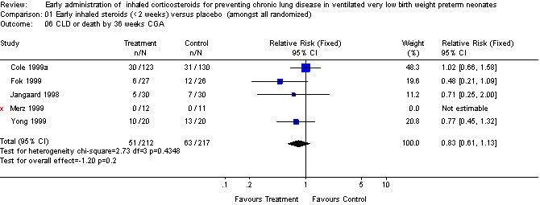
Inhaled steroids

Slide 74
Caffeine
CAP trial
Death or BPD 39% with caffeine, 49% in controls
Mortality not affected

Slide 75
Snapshot of the evidence

Slide 76
Proven therapies for improving survival without BPD, level 1 evidence
Antenatal steroids; possibly effective for BPD prevention, improve survival.
Prophylactic natural surfactant compared to no treatment
Prophylactic natural surfactant compared to rescue treatment
  Prophylactic natural surfactant compared to CPAP with early rescue; next slide.

Slide 77
Probably effective therapies, level 2 evidence or lower
Vitamin A; IM level 1, other routes?
Fluid restriction
Antibiotic treatment of PPROM
High frequency oscillation with early volume recruitment compared to standard approach IMV
Moderately early postnatal steroids; but adverse long term neurodevelopmental effects.

Slide 78
Possibly effective therapies, level 3 evidence or lower
Permissive hypercapnia
Delaying intralipid
Limit oxygen therapy
Inositol; probably effective if no surfactant

Slide 79
Probably ineffective therapies
Antenatal TRH
Vitamin E
Erythromycin
SOD
Sodium cromoglycate
Prophylactic bronchodilators?
Diuretics during acute RDS
Inhaled steroids

Slide 80
Unknown, should be investigated further
Inhaled nitric oxide, ? Now proven? Other studies in progress.
Early ibuprofen for asymptomatic PDA.
Azithromycin treatment of Ureaplasma colonized infants
New ventilation techniques
  Volume guarantee, pressure support, improved synchronization
Optimal fluid management

Slide 81
Paradigm for the prevention of BPD;1
Infants due to deliver before 34 weeks: antenatal steroids, single course. Antibiotics (including erythromycin) for at least 5 days if PPROM. (azith or clarith probably better)
Infants delivering before 28 weeks: CPAP in the delivery room, using a stable method that can be continued to the NICU.
Gentle ventilation in the delivery room, (using tidal volume limitation?)
Intubation for CO2 only if over 65mmHg
Intubation for FiO2 if over 40% (or perhaps earlier if progressive)

Slide 82
Paradigm for the prevention of BPD;1
If require intubation, and O2: surfactant as soon as possible, (then rapidly extubate to nIMV)
Low tidal volume ventilation (4 to 5 mL/kg) with permissive hypercapnia, allow PaCO2 up to 65. Or
Elective high frequency oscillation with volume recruitment

Slide 83
Paradigm for the prevention of BPD;2
Restrict sodium intake until day 3 or until 5% weight loss
Administer vitamin A, (not in TPN bag, unless whole system including tubing is protected from light!)
Early nutrition to achieve >80 calories as fast as possible
Insulin to allow adequate calories if required
Early feeds and early feed advancement at least 20 mL/kg/d.
? Delay introduction of intralipid (for ? 2 days)
Inhaled Nitric Oxide for infants still intubated at 7 to 21 days of age, continue for 24 days.

Slide 84
Paradigm for the prevention of BPD;3
Aim for O2 saturation 88- 92%
?Treat PDA as soon as diagnosed, before symptoms, routine echocardiography to detect asymptomatic PDA
Extubate early using caffeine/nIMV
Avoid postnatal steroids if possible

