Slide 1
Predicting Outcomes in Preterm Infants:
Which outcomes can we predict and why do we want to?
Keith J Barrington

Slide 2
Trying to Predict Handicap
'An impairment is any loss or abnormality of psychological, physiological or anatomical structure or function;
a disability is any restriction or lack (resulting from an impairment) of ability to perform an activity in the manner or within the range considered normal for a human being;
a handicap is a disadvantage for a given individual, resulting from an impairment or a disability, that prevents the fulfilment of a role that is considered normal (depending on age, sex and social and cultural factors) for that individual'.
  WHO 1976

Slide 3
‘I don’t want a handicapped baby’
Who does?
What most parents really mean (I believe) is that they don’t want a baby in a wheelchair with whom they can’t communicate.
For most parents, a baby with a limp, or who has problems at school, or who needs hearing aids… those are acceptable,
There is a big difference between ‘I don’t want this’ and ‘I will not accept this’
  and I think for most ethicists, the idea of interrupting treatment for such conditions would be outrageous.

Slide 4
Predicting Death
Surely this should be easy?
In the DR Wyckoff 2012
  ELBW neonates, Apgar score at 5 minutes of 0 or 1
  36% survival to discharge
    (among survivors 50% NDI, most of which (80%) is BSID MDI <70)

Slide 5
Predicting Death in the NICU
Meadow et al….repeatedly
Age at death has been changing
Causes of death: after the first few days, sepsis, NEC, progressive respiratory failure

Slide 6
Predicting Disability
Which disabilities do you want to talk about?
A low Bayley score is not a disability!
A low Bayley score is an indication of delayed development,
Many infants with low Bayley scores will not have ‘Cognitive Impairment’
Very few infants with low Bayley scores will be so badly impaired that there is substantial effect on their QoL

Slide 7
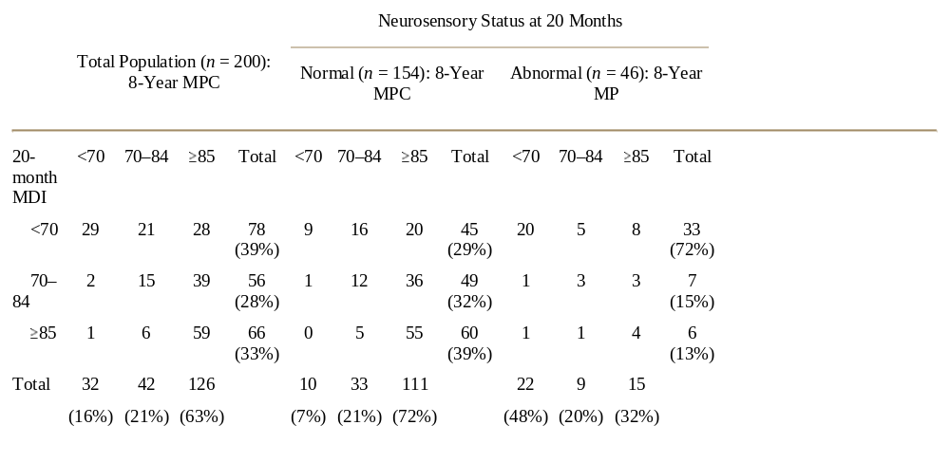
Does a low Bayley MDI mean that an infant has cognitive impairment? Hack et al

Slide 8
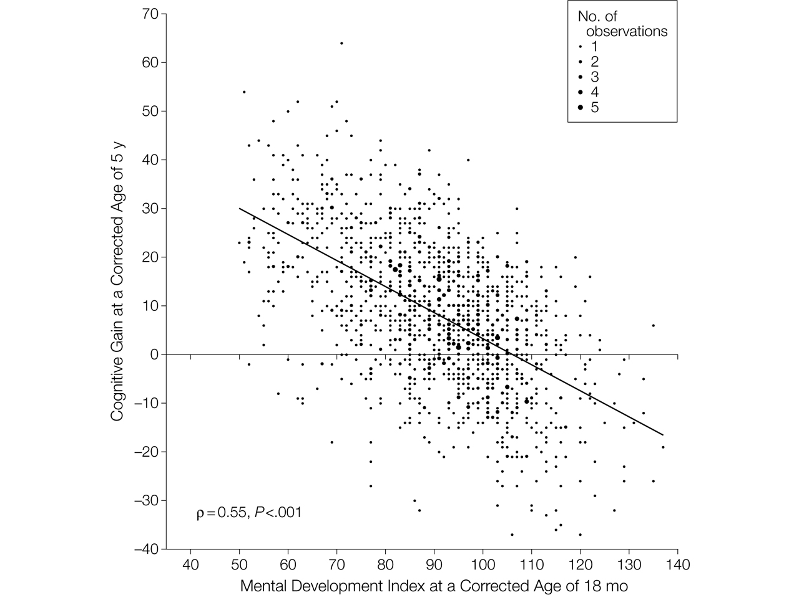

Figure 2. Relationship Between Mental Development Index Scores at 18 Months and Gain in Cognitive Scores Between 18 Months and 5 Years.
Schmidt, B. et al. JAMA 2012;307:275-282
Copyright restrictions may apply.
Notes:
Cognitive gain was computed by subtracting the individual Mental Development Index scores at 18 months from the corresponding Wechsler Preschool and Primary Scale of Intelligence III (WPPSI-III) Full Scale IQ. Data are shown for the 1419 children who underwent a successful Bayley II test at 18 months and a successful WPPSI-III test at 5 years. For this analysis, we excluded children with Mental Development Index scores below 50 (the lowest score in the Bayley II) and with a Full Scale IQ below 40 (the lowest score in the WPPSI-III). The size of each data point is proportional to the number of coincident observations (range, 1 to 5). The solid diagonal line is the best-fitting regression line between the observed gain in cognitive scores at 5 years and the Mental Development Index scores at 18 months. ρ Is the correlation coefficient.

Slide 9
Colombo and Carlson
Pediatrics: June 2012
The BSID is a global test designed to identify developmental delay. Its role and place within the ﬁeld of developmental science is relatively well established. The BSID is, to be charitable, only modestly related to school-age cognitive development (ie, the outcome that is most meaningful to investigators in this ﬁeld). The BSID is a global measure of developmental status in infancy that assesses and aggregates the timely attainment of relatively crude milestones in infancy and early childhood.
Simply, the BSID is not an adequate indicant of speciﬁc cognitive skills that may be differentially affected by interventions or exposures, nutritional or otherwise, and so its use to evaluate the construct of infant cognition is seriously deﬁcient in the context of recent advances in developmental science.

Slide 10
Reasons for trying to predict disability
To focus follow up programs
To initiate targeted early intervention
To prepare parents for their future
To understand the causes of disability
To perform research to reduce disability, or the impacts of disability
To redirect intensive care to comfort care, and eliminate disabled children

Slide 11
Very early predictions of outcome: why?
Often hear about the ‘Window of Opportunity’
Meaning that in the 1st few days, babies are often more dependent on intensive care support (ventilators in particular), and withdrawal of intensive care will quickly lead to the baby’s death.
If we wait too long the baby will be able to survive without intensive care support, and we will have missed the Window!
Do any other physicians talk about a window of opportunity to terminate their patients?

Slide 12
Head Ultrasounds
What is their sensitivity and specificity for predicting outcomes?
Systematic Review of findings on ultrasound and long term
Outcomes of babies with normal ultrasounds

Slide 13
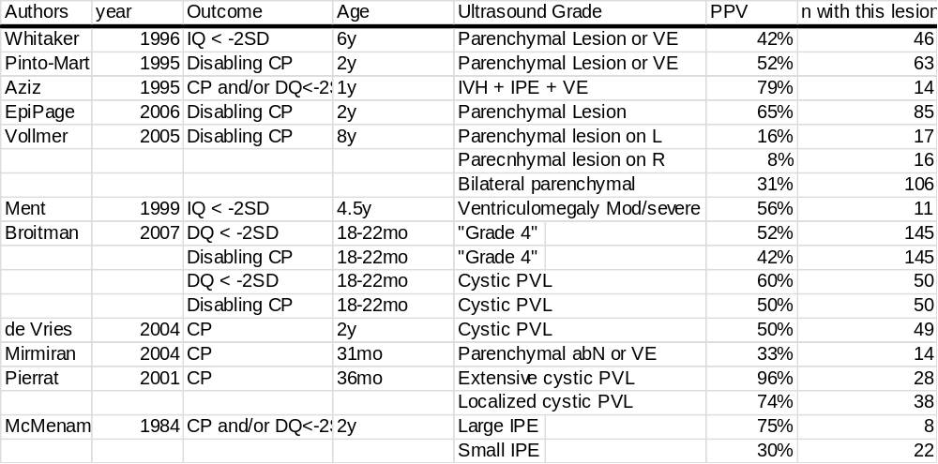
Results of review

Slide 14
ELGAN study
Infants less than 28 weeks gestation
Followed to 2 years
Of those with Normal Head ultrasound scans:
Bayley 2 MDI 23% <70
Bayley 2 PDI 26% <70

Slide 15
What about the 3 day ultrasound?
If we focus specifically on the ultrasound done at 72 hours.. The Holy Grail of neonatology.
What is the PPV of ANYTHING that you can see on the ultrasound at 72 hours.

Slide 16
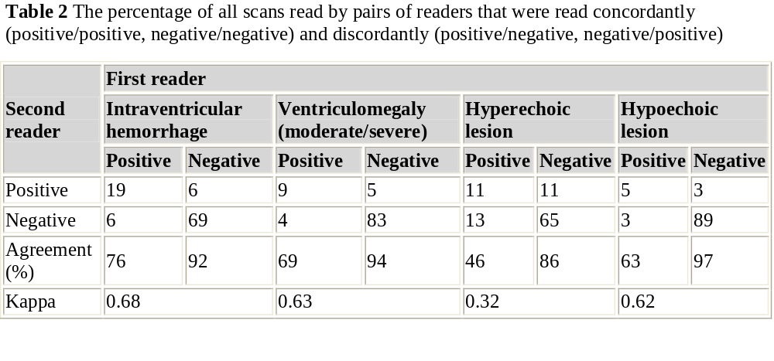
Kuban et al ELGAN study 2007
N=1450

Slide 17
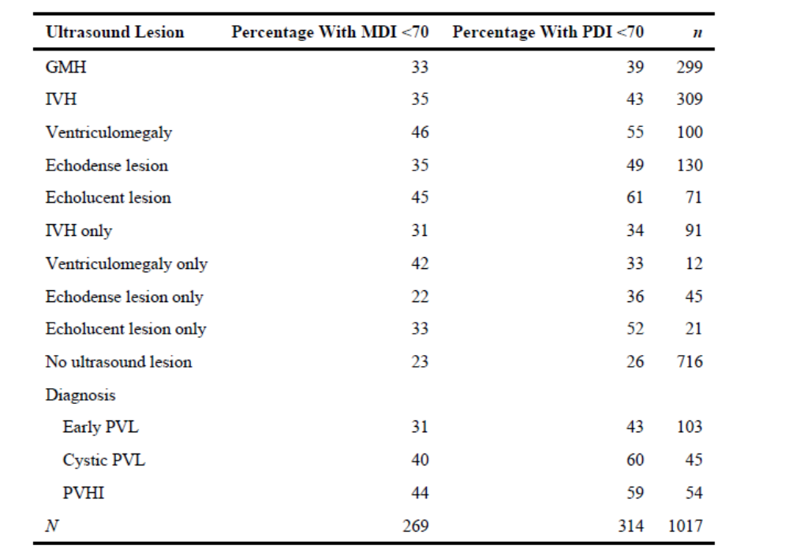
O’Shea TM et al, Pediatrics 2008

Slide 18
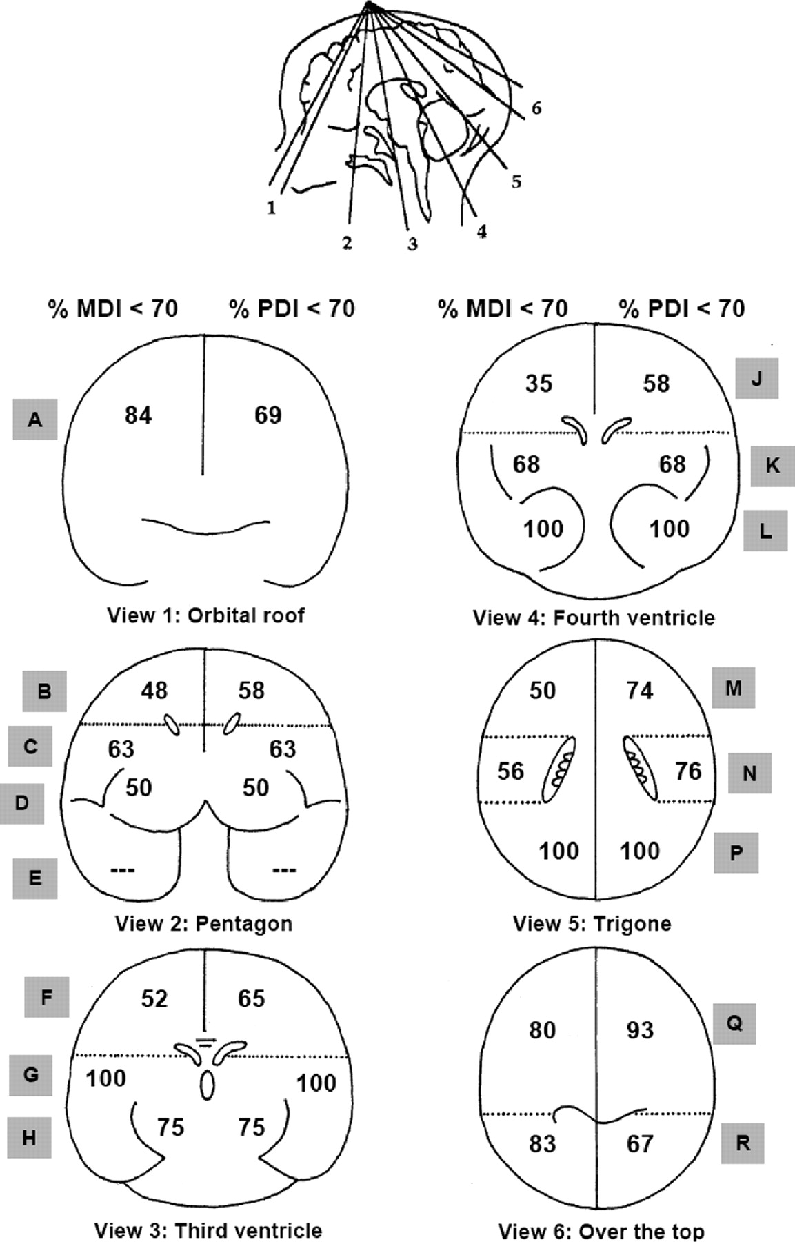

Percentage of children whose scan had an echolucency in a particular location and who had an MDI of <70 (black numbers on the left side of the brain) or a PDI of <70 (black numbers on the right side of the brain) on the BSID-II.
O'Shea T M et al. Pediatrics 2008;122:e662-e669
©2008 by American Academy of Pediatrics
Notes:
Percentage of children whose scan had an echolucency in a particular location and who had an MDI of <70 (black numbers on the left side of the brain) or a PDI of <70 (black numbers on the right side of the brain) on the BSID-II. The letters inside the shaded boxes indicate the zones as listed in Table 5.

Slide 19
TABLE 7
Measures of the Ability of Head Ultrasound Abnormalities Evident Before Discharge From the NICU to Predict an MDI or PDI >2 SDs Below the Expected Mean at 24 Months’ Corrected Age
Ultrasound Lesion, Bayley Scale < 70 | Ventriculomegaly |  | Echolucent Lesion
 | MDI | PDI | MDI | PDI
Predictive value positive | 45 | 55 | 45 | 61
Predictive value negative | 76 | 72 | 75 | 71
Sensitivity | 17 | 17 | 12 | 14
Specificity | 93 | 94 | 95 | 96

Slide 20
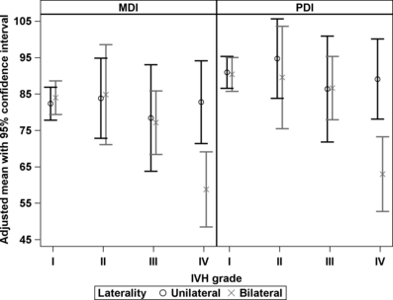
Grade and laterality of intraventricular haemorrhage to predict 18–22 month neurodevelopmental outcomes in extremely low birthweight infants
Acta Paediatrica
Volume 101, Issue 4, pages 414-418, 16 JAN 2012 DOI: 10.1111/j.1651-2227.2011.02584.x
http://onlinelibrary.wiley.com/doi/10.1111/j.1651-2227.2011.02584.x/full#f3
Notes:
Mean MDI and PDI by grade and laterality of IVH.
© This slide is made available for non-commercial use only. Please note that permission may be required for re-use of images in which the copyright is owned by a third party.

Slide 21
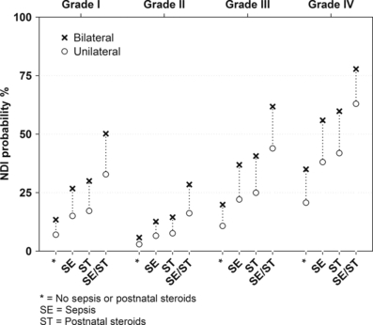
Grade and laterality of intraventricular haemorrhage to predict 18–22 month neurodevelopmental outcomes in extremely low birthweight infants
Acta Paediatrica
Volume 101, Issue 4, pages 414-418, 16 JAN 2012 DOI: 10.1111/j.1651-2227.2011.02584.x
http://onlinelibrary.wiley.com/doi/10.1111/j.1651-2227.2011.02584.x/full#f2
Notes:
Probability of NDI by laterality of IVH, grade of IVH, sepsis, and postnatal steroids.
© This slide is made available for non-commercial use only. Please note that permission may be required for re-use of images in which the copyright is owned by a third party.

Slide 22
Let’s get more High Tech
MRI at discharge

Slide 23
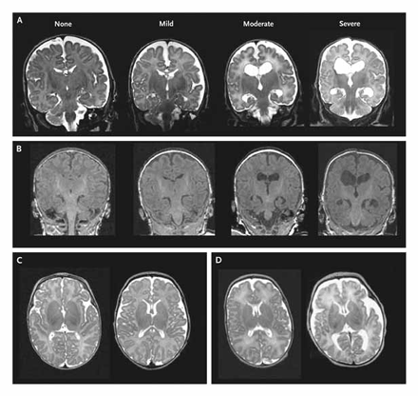
MRI
Woodward et al, NEJM 2006
167 infants <30 wk, MRI at term and 2 yr exam.

Slide 24
Woodward et al
What really matters to a parent: with this finding on MRI what is the likelihood that my baby will be severely impaired?
  I.E. what is the PPV
Now that the MRI is normal what is likelihood that my baby will be “normal”?
  What is the NPV
PPV from Woodward et al of Moderate to Severe AbN on MRI for severe impairment (incl. MDI or PDI < 70) 30%
NPV 95%

Slide 25
Miller et al
Moderate or severe White matter injury on preterm MRI
  PPV = 29% for a DQ <70 or disabling CP at 2 y
Moderate or severe White matter injury on MRI at term
  PPV = 42% for a DQ <70 or disabling CP at 2 y
In other words when we see moderate or severe WMI on an MRI most of the babies will have a good outcome!

Slide 26
Other MRI prediction studies
Shah DK 2006,
  PPV 50%, NPV 97%
Mirmiran M 2004
  PPV for CP 50%
Valkamaran AM 2000
  PPV of parenchymal lesions for CP, 58%
Arzoumanian 2003
  PPV 10%
Leijser LM 2008
  PPV 43% for severe abN outcome

Slide 27
MRI near term for predicting outcome
An important research tool, which might help us to understand the long term difficulties of preterm infants
This is not the same as saying that everyone should have one!

Slide 28
Positive Rolandic Sharp Waves
Marret et al
Prospective cohort, 417 infants <33 wk, 351 survived to be seen at 1 year
Abnormal = mild distal hypertonia or diplegia or tetraplegia at 12 mo
108 infants abnormal
i.e. 31% !!

Slide 29
PRSW
PPV for “abnormality” = 68% (n=145)
If PRSW > 2/min, PPV for abnormality = 27/28
Of the original cohort, 187/417 had PRSW
Background abnormalities without PRSW– no predictive ability.

Slide 30
Neonatalresearch.org
Series of ‘posts’ examining other attempts to predict outcomes
Last issue of Acta Pediatr
  NAPI at dicharge
  aEEG in the 1st 72 hours
The outcome they are trying to predict?
18 to 24 month Bayley MDI less than 70.

Slide 31
EEG? aEEG? Clinical Course? A Mixture?
EEG: Rolandic sharp waves little value
aEEG: too preliminary to say, but almost certainly the same situation
Clinical Features are more predictive of long term outcome than any finding on head ultrasound
  NEC, Postnatal Dexamethasone, Sepsis, poor nutrition, surgery (any)

Slide 32
Criteria for a Screening Test
Highly Sensitive
Very Specific
Identify treatable conditions
http://www.screening.nhs.uk/criteria
  6. The distribution of test values in the target population should be known and a suitable cut-off level defined and agreed.
  8. There should be an agreed policy on the further diagnostic investigation of individuals with a positive test result and on the choices available to those individuals
  10. There should be an effective treatment or intervention for patients identified through early detection, with evidence of early treatment leading to better outcomes than late treatment
  13. There should be evidence from high quality Randomised Controlled Trials that the screening programme is effective in reducing mortality or morbidity. Where screening is aimed solely at providing information to allow the person being screened to make an “informed choice” (eg. Down’s syndrome, cystic fibrosis carrier screening), there must be evidence from high quality trials that the test accurately measures risk. The information that is provided about the test and its outcome must be of value and readily understood by the individual being screened.

Slide 33
Do ultrasounds/MRI/EEG/aEEG etc qualify?
None of the ‘screening tests’ adequately discriminate between babies with impairment and without
None of them qualify as routine screening tests according to published criteria

Slide 34
Valid reasons for trying to predict disability in order to limit therapy
Handicap that is so profound that an individual could be considered ‘better off dead’ is a valid reason for trying to predict long term outcomes.
I am unaware of ANY way of doing this in the preterm.
Even one of the most clear cut examples in neonatology (term HIE with persistent stage 3 up to 72 hours of age) is no longer quite so predictive with cooling

Slide 35
Valid reasons for performing screening ultrasounds
To detect treatable lesions
  Posthemorrhagic ventricular dilatation
To detect reliably predictive lesions
  Devastating bilateral periventricular hemorrhagic infarction?
  Extensive bilateral cystic PVL
    Good for detection of disabling CP, not for cognition

Slide 36
A thought experiment
Twin babies are born at 32 weeks gestation requiring initial resuscitation
One baby has no known antenatal problems
The other has an antenatally diagnosed condition which gives a 100% chance of intellectual impairment, mean IQ of 50.
Is it ethically acceptable to resuscitate #1 and not #2?

Slide 37
Baby 2 has Down’s syndrome
Is it still acceptable to not resuscitate?

Slide 38
Experiment #2
Twin babies are born at 32 weeks gestation requiring initial resuscitation
One baby has no known antenatal problems
The other has an antenatally diagnosed condition which gives a 50% chance of intellectual impairment
Is it ethically acceptable to resuscitate #1 and not #2?

Slide 39
Experiment #3
Twin babies are born at 23 weeks gestation requiring initial resuscitation
One baby has a normal head ultrasound
The other has a unilateral grade 4 hemorrhage, a condition which gives a 10% chance of cerebral palsy and a 50% chance of delay in development, and is associated with, (on average in a large group), an IQ score 15 points lower at 8 years
Is it ethically acceptable to continue actively treating #1 and not #2?

Slide 40
Reliably predicting Outcomes
If we want to predict Quality of Life:
According to published data among preterm infants
We can predict acceptable to excellent quality of life at discharge with one test….
Is the baby alive?
If yes 98% PPV
If no 100% NPV

Slide 41
Is there hope to have better predictions?
Again we have to ask what do we want to predict?
Profound permanent impairment leading reliably to serious handicap, with a high likelihood.

Slide 42
Possibilities
Tests of discriminating abilities
Visual memory
  Both applied at TEA
  May be better predictors
I think that, realistically, it is unlikely that we will find predictors which can be applied within the ‘window of opportunity’ except for a tiny minority of devastating injuries

Slide 43
Implications
Does this mean we never talk to parents about the long term?
We never consider limiting therapy?
We should reconsider why we do our prognostic testing, and what impairments we want to predict.

Slide 44
Pearce R, Baardsnes J: Term MRI for small preterm babies: do parents really want to know and why has nobody asked them? Acta Paediatrica 2012.
(The term MRI)…had identified moderate cerebellar damage from an unrecognized bleed, a bleed that could have happened soon after birth or after one of her infections. At that point, it did not really matter.
Our daughter had brain damage. Two of the most horrific words a parent can ever hear.
The doctor was compassionate but vague about the possible motor, cognitive and behavioural problems that Maren could face. He also said that it was hard to predict outcomes from MRIs, and it was not certain at all Maren would be disabled. In fact, many children with abnormal MRIs are not disabled.

Slide 45
When he left, I thought ‘okay, maybe this isn’t so bad after all’. …
I looked on PubMed for abstracts about cerebellar damage in preterm infants. One of the few articles that I found (Limperopoulos et al. 2007) was totally devastating… babies with cerebellar damage had a much greater chance of expressive and receptive language delays, severe motor disabilities, cognitive disabilities and autism symptoms.
This could be our child. We thought that we finally saw the light at the end of the tunnel, and then, we were handed this earth-shattering, crushing information.

Slide 46
Looking back on our experience, parents should be given an informed choice as to whether they want an MRI done on their baby.
If doctors really feel that an MRI is absolutely necessary or that the information is invaluable to them (and is this really the case?), then parents should have the choice as to whether they want the results or not.

Slide 47
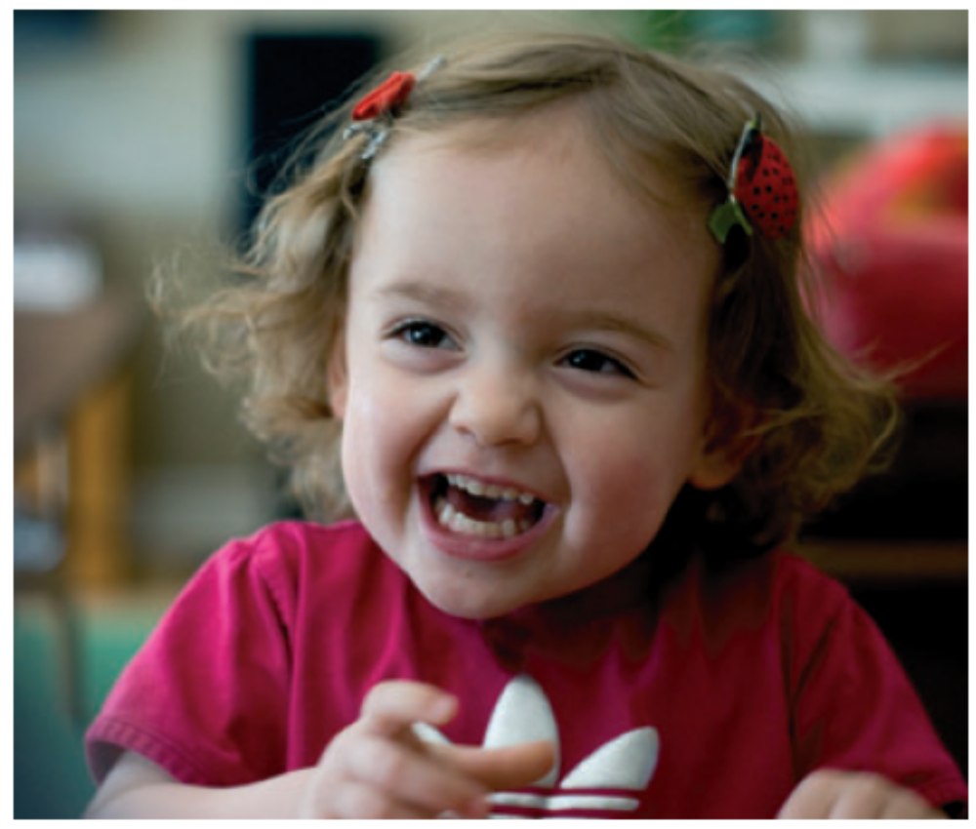
25 weeks, twin, early onset septic shock, fungal sepsis, prolonged HFOV and inhaled NO for marginal saturations, PDA ligation and postop hemodynamic compromise, severe BPD receiving steroids…
Cerebellar hemorrhage found on discharge MRI

