Slide 1
Which Inotrope for Which Baby?
Keith J Barrington
Université de Montréal

Slide 2
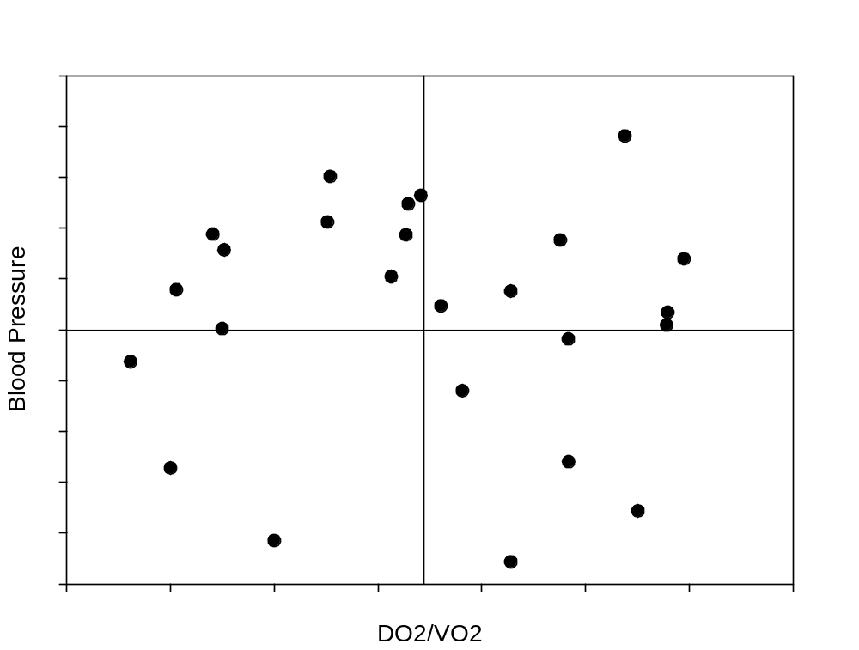
Hypotension or shock?

Slide 3
What questions to ask
When deciding about cardiovascular support there are 4 questions to ask
  1. Does the infant need treatment?
  2. What is the current hemodynamic situation?
  3. Which agent has a profile of effects that respond to the current situation?
  4. Is there any evidence that this agent will improve outcomes?

Slide 4
How to find the answers
1. Does the infant need treatment?
Closely tied to the answer to question 4.
For example a numerically low blood pressure probably does not need any intervention unless there are signs of poor perfusion
But an infant with progressive acidosis and anuria might well

Slide 5
2. What is the current hemodynamic situation?
History, Clinical examination, special tests
  History might be useful for diagnosing Hypovolemic shock and Septic shock
    But we have very little information about the hemodynamics of septic shock in babies.
  Clinical examination including toe temperature, capillary filling, urine output,
  Special tests, lactate, Functional Echocardiography

Slide 6
What does your hemodynamic evaluation need to tell you?
Blood pressure
Heart rate
­­­’Cardiac Output’
Pulmonary Hypertension?
Renal perfusion
CNS perfusion
Cardiac function
  Preload
  Afterload
  Contractility

Slide 7
When you have this information: want next?
What agents improve contractility?
What agents affect afterload?
What agents affect preload?

Slide 8
Functional
Neonatal hearts are functionally immature and are operating at such a relatively high performance that:
  There is little contractile reserve.
  Frank Starling curve is flatter in newborns.
  Newborns normally operate near flat portion of the curve.
  Neonatal hearts are intolerant of afterload.
  The right ventricle is more markedly affected by increased afterload, but the left doesn’t do very well either.

Slide 9
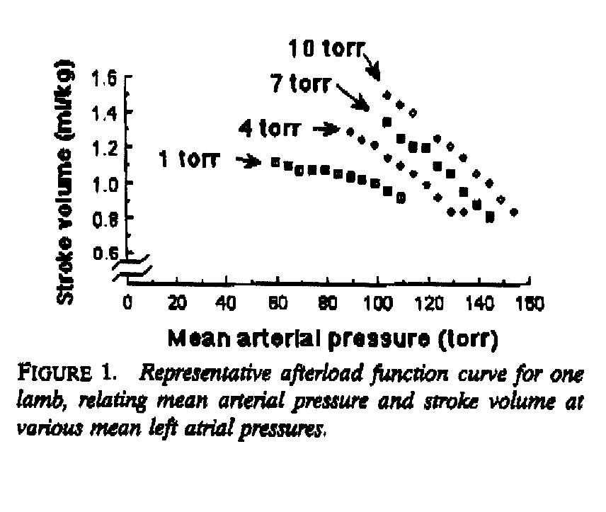
Effects of afterload

Slide 10
Catecholamine receptors
The catecholamines stimulate a variety of receptors which are usually categorized as α₁, α₂ , β₁ , β₂ , DA₁ and DA₂.
Traditionally, dopamine is said to stimulate DA receptors at low concentrations, β receptors at moderate concentrations, and α receptors at high concentrations.
In reality:
Dopamine has virtually no effect at the β₂ receptor, and very little at the β₁ receptor
Enormous variation in serum concentrations are obtained by the same administered dose of drug, as much as 100 fold variations may be seen.

Slide 11
Sympathetic innervation
Cardiac sympathetic innervation is incomplete at birth.
The various adrenoceptors appear at differing periods of ontogenesis.
The pattern of their appearance is not well defined.
β receptors increase in density in late gestation.
High cardiac output at birth may partly be mediated by the presence of many functional β receptors.
Further stimulation of these receptors in early life, e.g. with isoproterenol, does not much increase cardiac function.
α₁ receptors may appear prior to the β receptor.

Slide 12
Myocardial adrenoceptors
Dopamine receptors are present in the mature coronary circulation but not in myocardium.
Frequently stated that dopamine’s inotropic effects are due to release of endogenous norepinephrine from sympathetic nerve endings (tyramine-like effect).
Dopamine therefore may have indirect α and β effects on the myocardium.
  Rapid tachyphylaxis
The incomplete innervation of the neonatal heart means that this effect is of little importance in the newborn.

Slide 13

Newborn hearts are not small adult Hearts!

Slide 14
Vascular catecholamine receptors
There is much less information regarding the rates of appearance and maturation of vascular adrenoceptors.
α₁ receptors are present in neonatal peripheral circulation and respond to α₁ stimulants such as phenylephrine.
α₁ receptors appear to be relatively lacking in the pulmonary circulation of the lamb.
Vascular β receptors are next to appear.
DA receptors probably largely become active during postnatal life.

Slide 15
3. Which agent has a profile of effects that respond to the current situation?
I will restrict myself initially to the catecholamines, as they are most commonly used

Slide 16
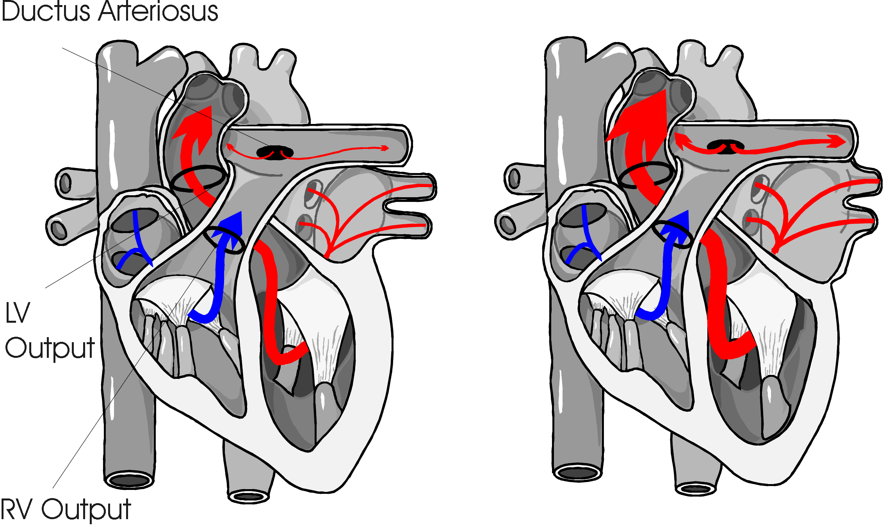
LVO & RVO

Slide 17
Dobutamine
Decreases afterload
Increases contractility
Increases systemic perfusion
Unpredictable effects on blood pressure
Causes tachycardia, which will usually resolve
  Effects on Pulmonary artery pressures uncertain

Slide 18
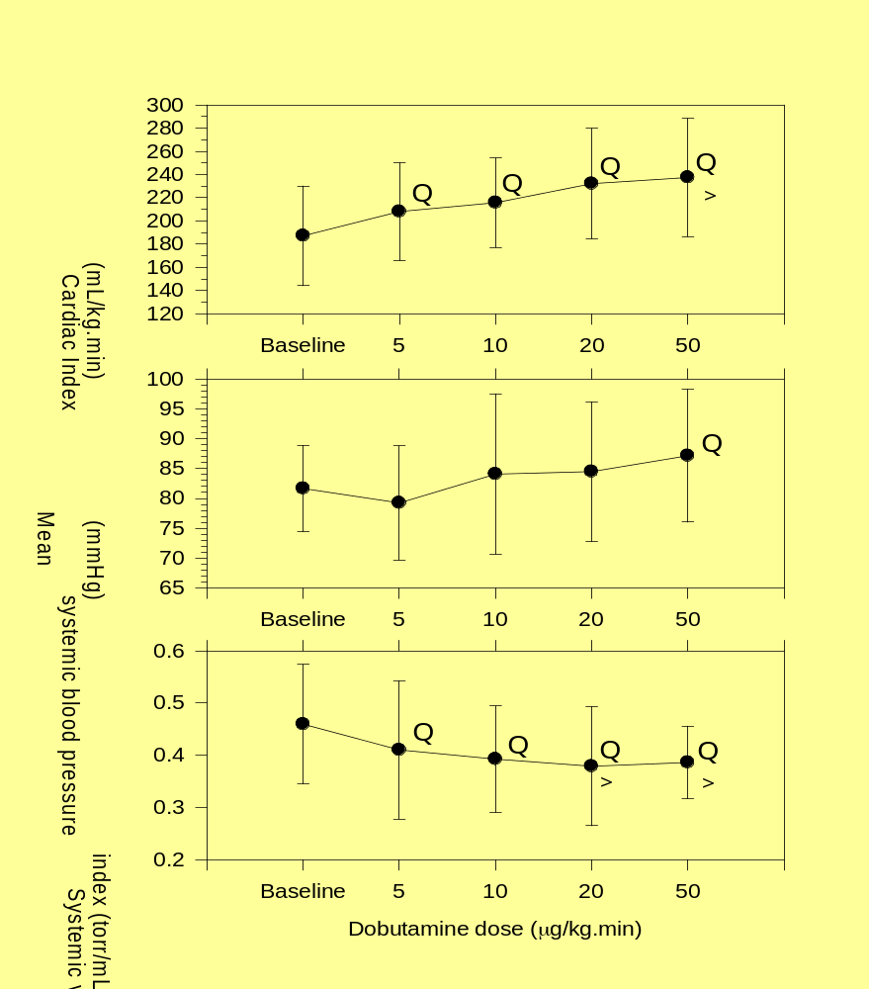
Dobutamine réponse
La TA a augmenté seulement à 50 μg/kg.min chez les porcelets (Cheung and Barrington 1998)
Le débit cardiaque a monté même à 5 μg/kg.min.
Vasodilatation à 5 μg/kg.min et plus.

Slide 19
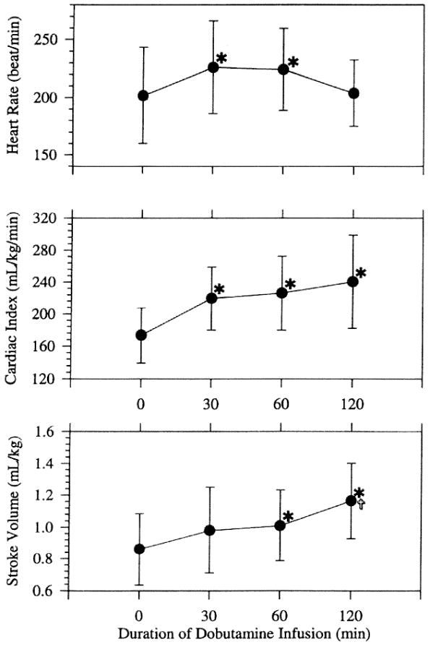

Figure 3
The hemodynamic effects of dobutamine infusion in the chronically instrumented newborn piglet.
Cheung, Po-Yin; MBBS, MRCP; Barrington, Keith; MBChB, FRCP; Bigam, David; MD, FRCS
Critical Care Medicine. 27(3):558-564, March 1999.
Figure 3 . Effects of dobutamine infusion at 10 [micro sign]g/kg.min on heart rate (top panel), cardiac index (middle panel), and stroke volume (bottom panel) over 120 mins. Means and SD are shown. *, p < .05 compared with 0 min;
© 1999 Lippincott Williams & Wilkins, Inc. Published by Lippincott Williams & Wilkins, Inc.
2

Slide 20
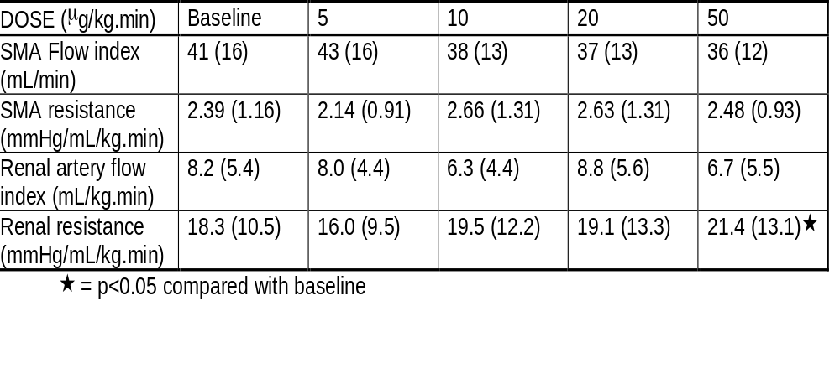
Dobutamine: renal and intestinal perfusion
(Cheung and Barrington, Cardiovasc Res 1996;31:2)

Slide 21
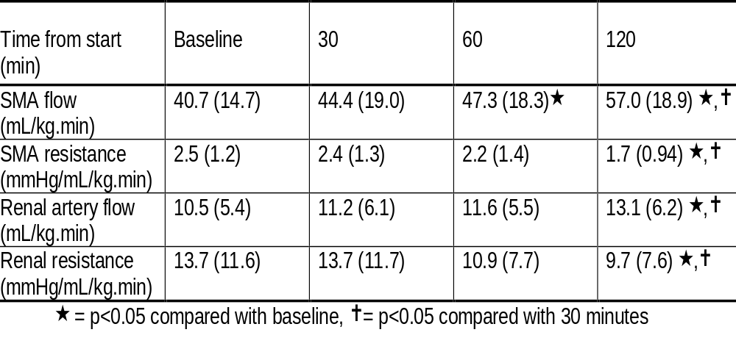
Prolonged dobutamine infusion

Slide 22
Dopamine
Increases afterload
Increases blood pressure
Increases pulmonary artery pressure
Often associated with a decrease in systemic perfusion
Dopaminergic effects?
  Pituitary suppression
  No increase in renal perfusion
  Possible increase in Gut perfusion

Slide 23
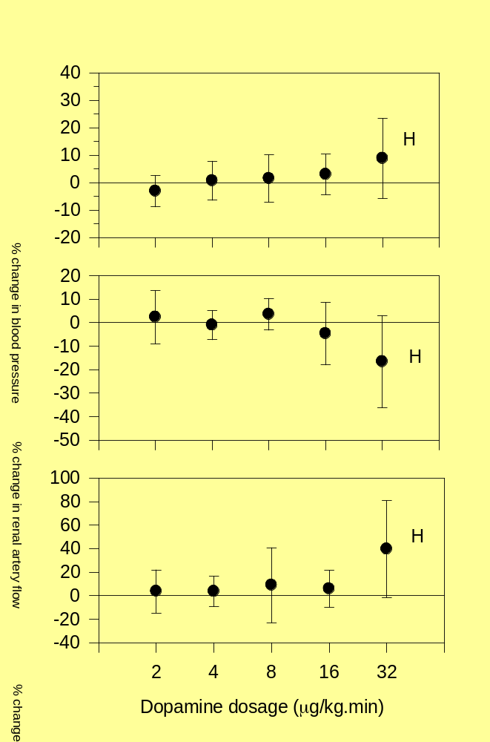
dopamine and renal perfusion:
Pearson RJ, Barrington KJ, Jirsch DW, Cheung PY. Dopaminergic receptor-mediated effects in the mesenteric vasculature and renal vasculature of the chronically instrumented newborn piglet. Crit Care Med 1996 Oct;24(10):1706-12.
Notes:
Voilà les résultats d’une étude utilisant les porcelets obtenus le premier jour de vie, et étudié le troisième jour. J’ai infusé la dopamine en ordre randomisé, il n’est pas une vasodilatation à petit dose. À haut dose la TA était élevée, mais le débit rénale était réduit, puis la seule effet de la dopamine sur la résistance artérielle rénale chez le nouveau-né est une vasoconstriction. Toutes les études des effets de la dopamine sur la résistance artérielle rénale chez le nouveau-né ont démontré la même chose.

Slide 24
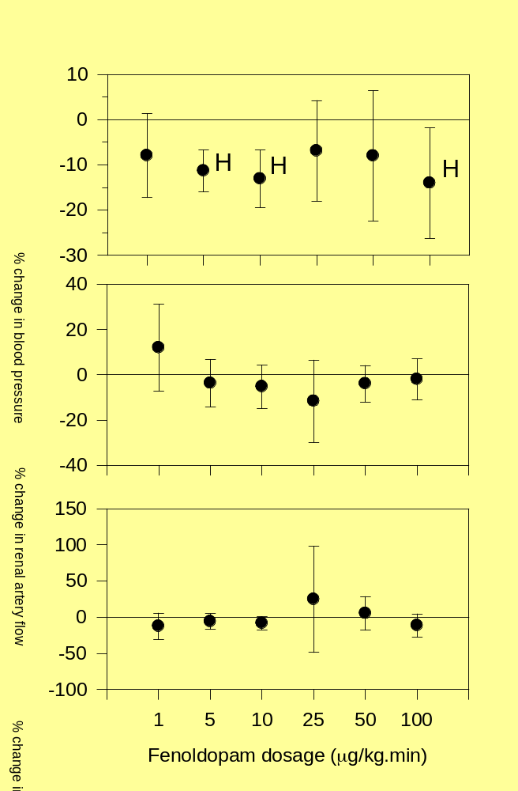
Effets d₁ agoniste sélectif
Fenoldopam est un agoniste sélectif au récepteur d₁.
Chez le nouveau-né il n’y a pas de dilatation rénale. La résistance vasculaire rénale n’est pas affectée peu importe la dose.
Notes:
Même lorsque j’ai utilisé un agoniste sélectif, ce qui devrait montrer les effets vasodilatateur si ils existent, il n y avait aucune évidence d’une vasodilatation rénale.

Slide 25
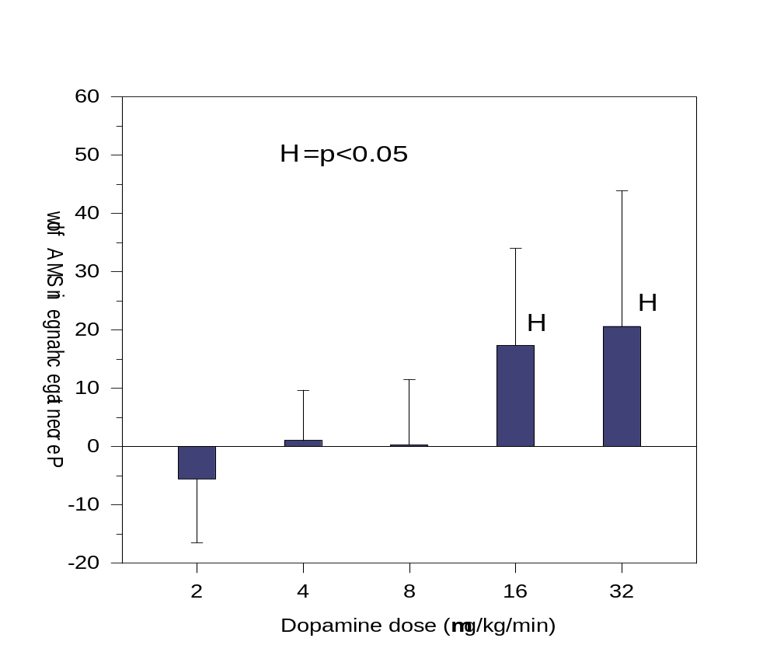
dopamine and intestinal perfusion

Slide 26
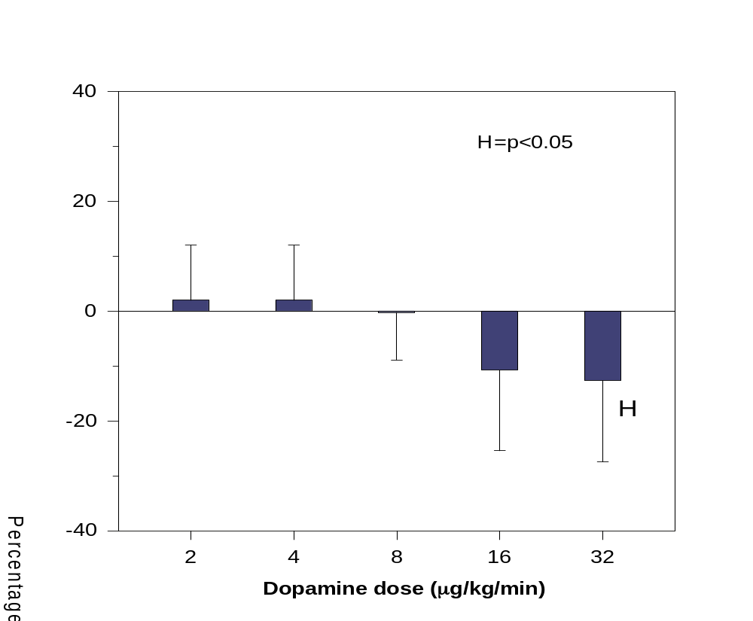
dopamine and intestinal vascular resistance

Slide 27
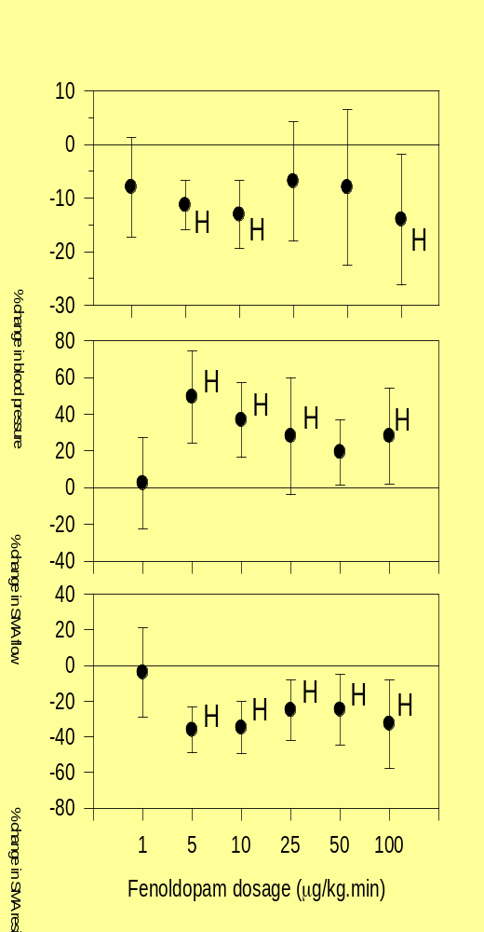
Effets de d₁ agoniste sélectif
Le fenoldopam a provoqué une dilatation de la circulation mésentérique à des concentrations élevées seulement.
Donc, le récepteur d₁ semble être actif dans la circulation intestinale du porcelet nouveau-né, mais son activité est réduite.
Notes:
Une dose de 1 à 2 micrograms est efficace chez les animaux et les humains adultes.

Slide 28
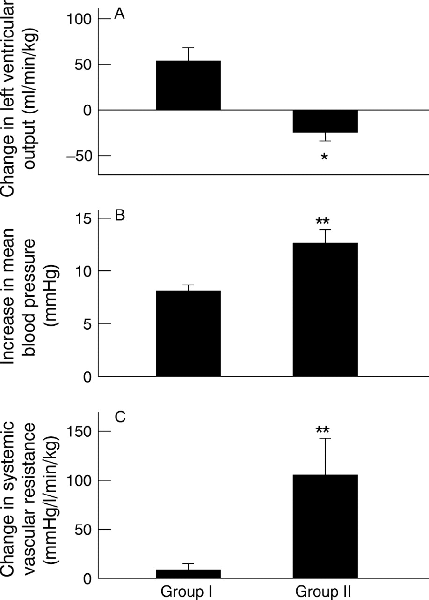

Change in left ventricular output (A), mean blood pressure (B), and systemic vascular resistance (C) after dopamine treatment in groups 1 and 2 neonates.
Zhang J et al. Arch Dis Child Fetal Neonatal Ed 1999;81:F99-F104
Copyright © BMJ Publishing Group Ltd & Royal College of Paediatrics and Child Health. All rights reserved.
Notes:
Change in left ventricular output (A), mean blood pressure (B), and systemic vascular resistance (C) after dopamine treatment in groups 1 and 2 neonates. Values are expressed as mean (SE): * p < 0.05; ** p < 0.01, group 1 vs group 2

Slide 29
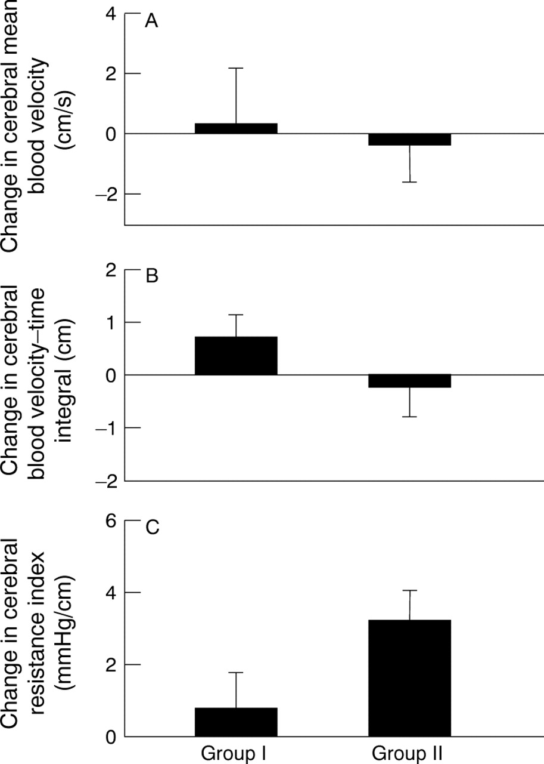
Changes in anterior cerebral artery mean blood velocity (A) and blood velocity–time integral (B), and cerebral vascular resistance index (C) after dopamine treatment in both groups.
Zhang J et al. Arch Dis Child Fetal Neonatal Ed 1999;81:F99-F104
Copyright © BMJ Publishing Group Ltd & Royal College of Paediatrics and Child Health. All rights reserved.
Notes:
Changes in anterior cerebral artery mean blood velocity (A) and blood velocity–time integral (B), and cerebral vascular resistance index (C) after dopamine treatment in both groups.

Slide 30
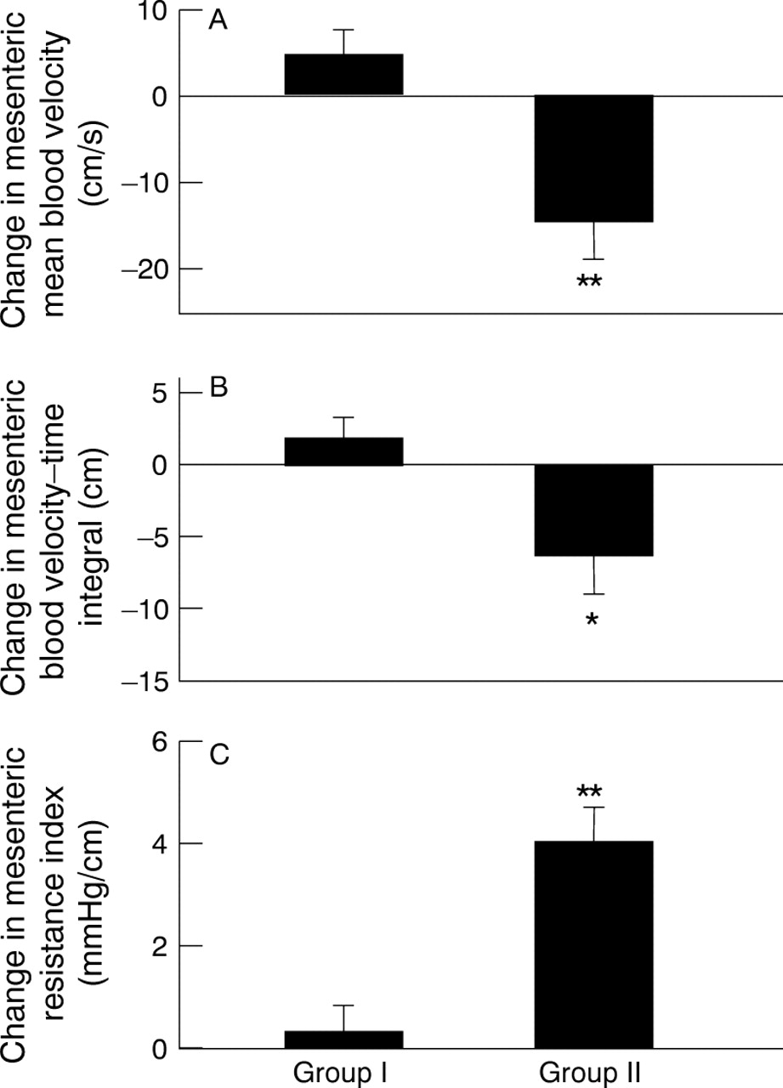
Change in mesenteric artery mean blood velocity (A) and blood velocity–time integral (B) and mesenteric resistance index (C) after dopamine treatment in both groups: *p <0.05; ** p < 0.01, group 1 vs group 2.
Zhang J et al. Arch Dis Child Fetal Neonatal Ed 1999;81:F99-F104
Copyright © BMJ Publishing Group Ltd & Royal College of Paediatrics and Child Health. All rights reserved.
Notes:
Change in mesenteric artery mean blood velocity (A) and blood velocity–time integral (B) and mesenteric resistance index (C) after dopamine treatment in both groups: *p <0.05; ** p < 0.01, group 1 vs group 2.

Slide 31
Epinephrine
Decreases afterload
Increases systemic perfusion
Increases blood pressure
Probably increases PA pressure less than systemic pressure

Slide 32
Norepinephrine
Increases afterload
Increases blood pressure
Effects on systemic perfusion uncertain
Effects on regional perfusion uncertain
Effects on pulmonary artery pressure uncertain in the human newborn,
  but experimental evidence of pulmonary vasodilatation in the fetus and in the presence of vasoconstriction

Slide 33
Other agents
Milrinone
Vasopressin
Levosimendan

Slide 34
Milrinone
Phosphodiesterase III inhibitors increase intracellular cAMP: inotropic effects and vasodilatation.
In neonatal models PDE III inhibitors have minimal effects, no effect, or even negative inotropic effects.
  developmental imbalance between class III and class IV Phosphodiesterase in neonatal sarcoplasmic reticulum.
Negative inotropic effects in neonatal puppies become positive in 1st few days after birth.
The effects on preterm human myocardium are unknown

Slide 35
Milrinone clinical trial
 | Age (h) | Milrinone (n = 42) | Placebo (n = 48) | P value
SVC (mL/kg/min) | 3‡ | 78 (51, 107) | 86 (67, 107) | .2
 | 7 | 70 (48, 92) | 75 (51, 94) | .8
 | 10 | 67 (53, 87) | 81 (50, 100) | .5
 | 24 | 88 (73, 101) | 93 (72, 121) | .4
RVO (mL/kg/min) | 3‡ | 182 (140, 240) | 189 (133, 271) | .9
 | 7 | 177 (147, 258) | 187 (140, 240) | .9
 | 10 | 189 (146, 258) | 187 (133, 243) | .4
 | 24 | 242 (194, 301) | 250 (207, 306) | .7
BP (mm Hg) | 3‡ | 31 ± 6 | 30 ± 3 | .4
 | 7 | 28 ± 5 | 32 ± 6 | .001
 | 10 | 29 ± 4 | 32 ± 5 | .004
 | 24 | 34 ± 5 | 36 ± 6 | .2
HR (beats/min) | 3‡ | 149 ± 16 | 151 ± 17 | .6
 | 7 | 158 ± 15 | 145 ± 10 | .001
 | 10 | 157 ± 13 | 141 ± 12 | .001
 | 24 | 153 ± 13 | 144 ± 14 | .003
PDA diameter | 3‡ | 2 ± 0.9 | 1.9 ± 0.6 | .5
(mm) | 7 | 1.9 ± 0.7 | 1.5 ± 0.6 | .001
 | 10 | 1.9 ± 0.6 | 1.4 ± 0.6 | .001
 | 24 | 1.7 ± 0.8 | 0.9 ± 0.7 | .001

Slide 36
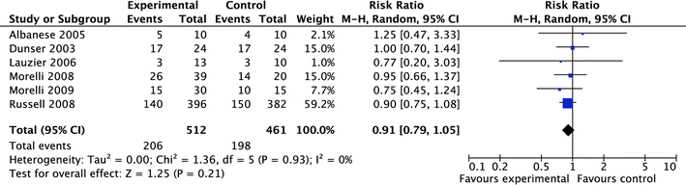
Vasopressin effects in adults

Slide 37
Vasopressin in experimental septic shock
Powerful vasoconstrictor, no inotrope effects
Decreases systemic perfusion
Decreases renal and hepatic blood flow
May increase urine output, by a pressure diuresis
Great caution!!

Slide 38
Levosimendan
Calcium sensitizing agent
Theoretical reasons for thinking that it might have benefit in the newborn
Animal studies and 2 case reports.
Possibly for the future

Slide 39
Based on these physiologic considerations
Low BP and low systemic perfusion (with or without pulmonary hypertension)
Epinephrine
Low BP and maintained perfusion, but signs of end-organ dysfunction
Norepinephrine or dopamine (probably norepinephrine if pulmonary hypertension)
Adequate BP but poor cardiac function
Dobutamine

Slide 40
4. Evidence that one agent or another improves clinically important outcomes
Septic Shock
  No evidence
Pulmonary hypertension
  No evidence
Cardiomyopathy and other conditions….
  Same answer
Full careful evaluation, including evaluation of systemic flows, followed by application of physiologic and pharmacologic principles is currently the best we can do.

