Slide 1
Gentle Ventilation
Keith J Barrington
Université de Montréal

Slide 2
Gentle Ventilation
We all want to do it… but what is it?
Outline:
Avoiding ventilator induced lung injury
Permissive Hypercapnia
Early extubation and non-invasive ventilation

Slide 3
Lung Injury
What is it that damages the lungs during assisted ventilation?
Over-Distension
Atelectasis
Intubation
Infection

Slide 4
Avoiding Lung Injury
Reducing over-distension
  Optimal PEEP
  Optimal tidal volume
Preventing atelectasis
Intubation only when required
Preventing Lung infection

Slide 5
Over-distension
Over-distension much more important than too much pressure
Very high pressures have little adverse effect if overdistension is prevented.
  Several animal studies showing that vey high pressures cause little damage if the chest wall is restricted, and tidal volumes remain acceptable
How to determine over-distension?

Slide 6
Reducing over-distension
Are ventilator graphics useful?
I am not aware of any reliable data that shows that they are useful in reducing lung injury
Why not?
  Leaks
  Dynamic not Static
  Change from breath to breath

Slide 7
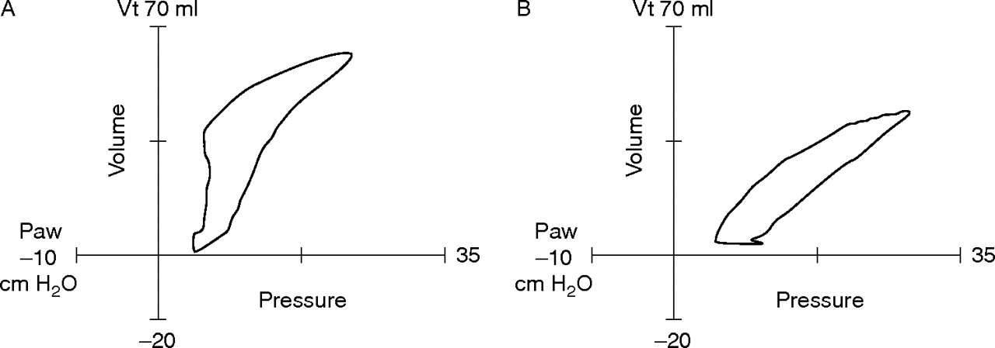

Pressure-volume loops.
Donn S M , Sinha S K Arch Dis Child Fetal Neonatal Ed 2006;91:F226-F230
Pressure-volume loops. (A) The loop shows hyperinflation, with an upper inflection point on the inspiratory limb. (B) The loop has been normalised by reducing the peak inspiratory pressure. Vt, Tidal volume; Paw, peak airways pressure.
Copyright © BMJ Publishing Group Ltd & Royal College of Paediatrics and Child Health. All rights reserved.
Notes:
Pressure-volume loops. (A) The loop shows hyperinflation, with an upper inflection point on the inspiratory limb. (B) The loop has been normalised by reducing the peak inspiratory pressure. Vt, Tidal volume; Paw, peak airways pressure.

Slide 8
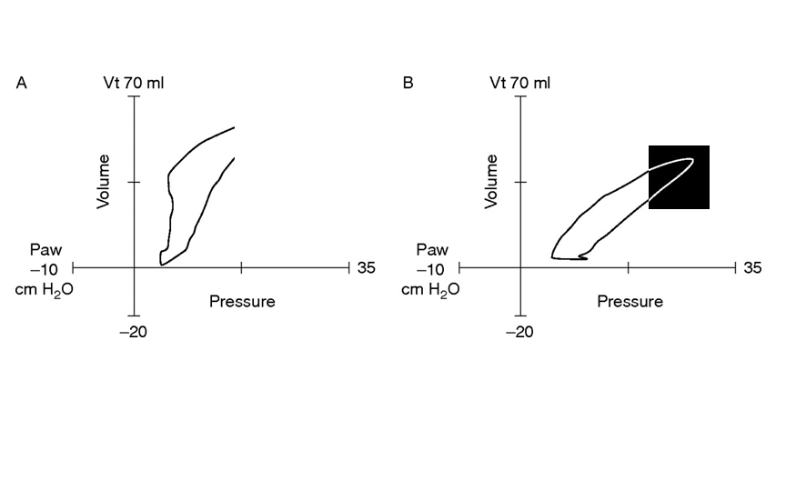

Slide 9
Overdistension
Because of leaks and variable baselines, ventilator graphics reset to zero at end-expiration.
The shape of the loops changes with every breath (unless the baby is paralyzed)
Therefore there is no way to determine what the end-expiratory lung volume is, or even whether it has changed!
Dynamic compliance does not change after surfactant administration

Slide 10
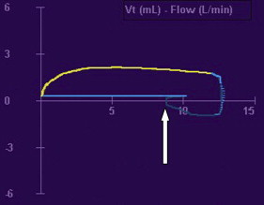
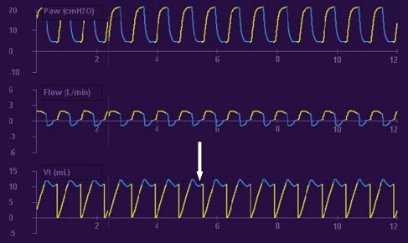

Slide 11
Compliance, surfactant and loops
The usual effect of giving surfactant is an improvement of STATIC lung compliance (which can only be measured in a non-breathing patient in whom you take PEEP down to 0)
If static compliance is improved: at the same PEEP end-expiratory lung volume is higher
This shifts the lung up the pressure-volume curve, and the end-inspiratory portion is on a flatter part of the curve

Slide 12
Effects of Surfactant on Dynamic Compliance
 | Surfactant |  | Control
 | Before | After | Before | After
Compliance (ml/cm H20/kg) | 0.43 _+ 0.21 | 0.45 _+ 0.45 | 0.33 _+ 0.14 | 0.33 ___ 0.13
Resistance (cm H20/L/sec) | 141 _+ 90 | 175 _+ 97 | 160 _+ 90 | 173 + 98
Tidal volume (ml/kg) | 6.3 _+ 1.7 | 5.3 _+ 1.5 | 6.9 _+ 2.1 | 6.0 + 1.9
Table II. Combined pulmonary mechanics data
Values are expressed as mean _+ SD.
Immediately before and 1 hour after
Couser, R., T. Ferrara, et al. (1990). "Effects of exogenous surfactant therapy on dynamic compliance during mechanical breathing in preterm infants with hyaline membrane disease." The Journal of Pediatrics 116(1): 119-124.

Slide 13
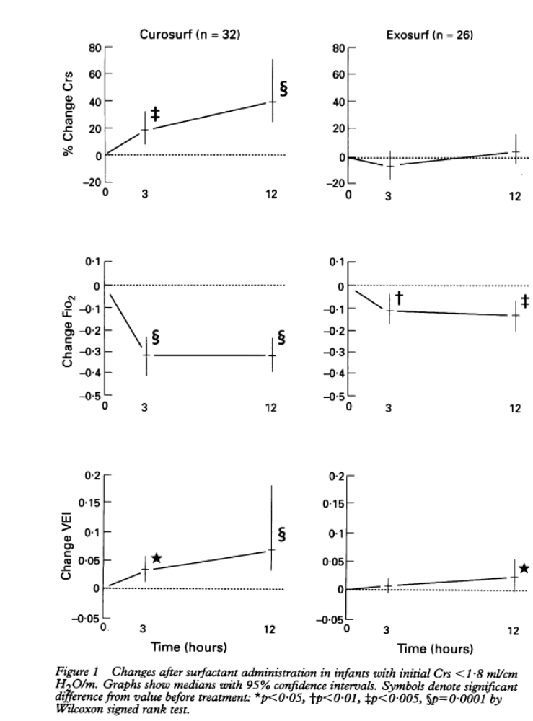
Static Compliance
Stenson, B. J., R. M. Glover, et al. (1994). "Static respiratory compliance in the newborn. III: Early changes after exogenous surfactant treatment." Arch Dis Child Fetal Neonatal Ed 70(1): F19-24.

Slide 14
This means that you cannot use the pulmonary graphics to determine whether the PEEP is optimal or if the baby is ready to wean
A better way to determine whether the surfactant has had an effect is simply to watch the FiO2
When the FiO2 falls, reduce the PEEP: you will immediately afterward see the pip fall (on volume ventilation) or the volume increase (on pressure ventilation)
Infants who reduce to 21% after surfactant can be managed with a reduction in PEEP to 3 cmH2O
    Dimitriou, G., A. Greenough, et al. (1999). "Appropriate positive end expiratory pressure level in surfactant-treated preterm infants." Eur J Pediatr 158: 888-891.

Slide 15
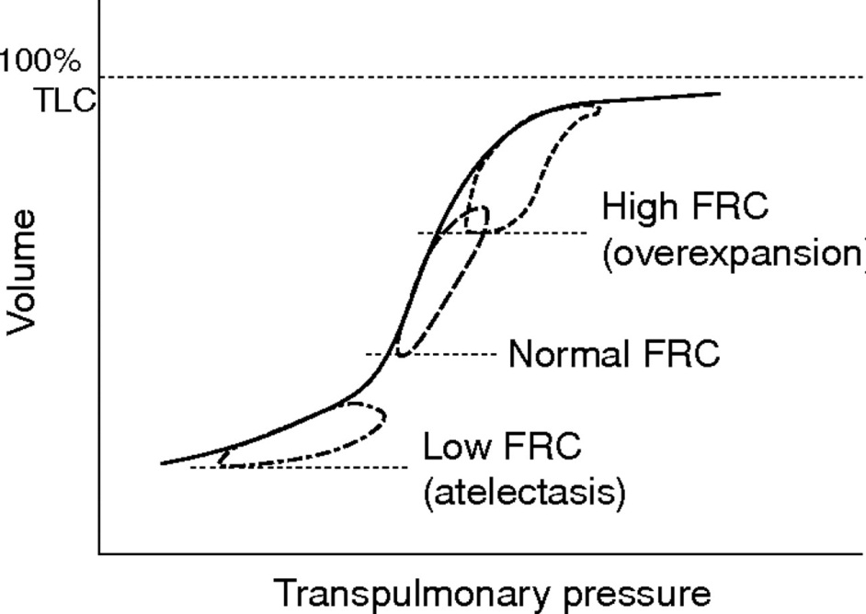
Reducing Overdistension
Preventing overdistension requires
  Preventing end-expiratory lung volumes from being too high
  Preventing tidal volumes from being too high

Slide 16
Preventing Atelectasis
Requires adequate PEEP
  varies by patient, depending on static compliance
Adequate tidal volume
  Less variable but pressures required very variable
What is the right tidal volume?
  Probably between 3 and 6 mL/kg
  Normal physiologic Vt lies between 3 and 8 mL/kg

Slide 17
Ventilator Parameters
Volume ventilation mode (VGV or volume control)
4 to 5 mL/kg (or 4 mL/kg plus 0.5 mL for the ETT)
If in more than 21% O2: PEEP of 5 to 8 before surfactant, increase PEEP to keep FiO2 less than 60%
Surfactant as early as possible
After surfactant reduce PEEP to 4 if in 21% O2, if remains in 21% reduce to 3, if remains in 21%, WEAN.

Slide 18
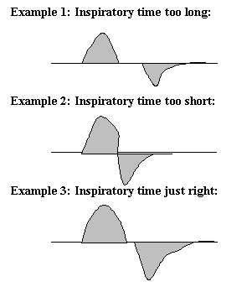
A potential useful application of ventilator graphics

Slide 19
Ventilator paramteres
What are you going to wean, and what are you going to monitor?
If on an SIMV mode, wean rate, but if your ventilator gives PSV then you are switching to pressure ventilation….
If on an A/C mode watch pressures and spontaneous rate, reduce the back up rate progressively (maybe) and extubate when the pip is below a certain thershold.
What to do about CO2?

Slide 20
Permissive hypercapnia
Increasing ventilation to normalize a CO2 risks increasing lung injury for questionable benefit
Permissive hypercapnia does not mean forcing the CO2 to increase!!
It means not chasing the CO2 if the tidal volume is OK, the FiO2 is OK and the baby is clinically OK
It means being prepared to wean the vent if all those factors are OK, even in the face of elevated CO2
But is there a limit?

Slide 21
Respiratory acidosis is good for you!
Despite numerous concerns about the effects of CO2 there is little evidence that an elevated CO2 has permanent adverse effects
There is some evidence of short term benefit in the critically ill.
1. Chonghaile MN, Higgins BD, Costello J, Laffey JG: Hypercapnic acidosis attenuates lung injury induced by established bacterial pneumonia. Anesthesiology 2008, 109(5):837-848.
2. Costello J, Higgins B, Contreras M, Chonghaile MN, Hassett P, O'Toole D, Laffey JG: Hypercapnic acidosis attenuates shock and lung injury in early and prolonged systemic sepsis. Critical care medicine 2009, 37(8):2412-2420.
3. O'Toole D, Hassett P, Contreras M, Higgins BD, McKeown ST, McAuley DF, O'Brien T, Laffey JG: Hypercapnic acidosis attenuates pulmonary epithelial wound repair by an NF-kappaB dependent mechanism. Thorax 2009, 64(11):976-982.

Slide 22
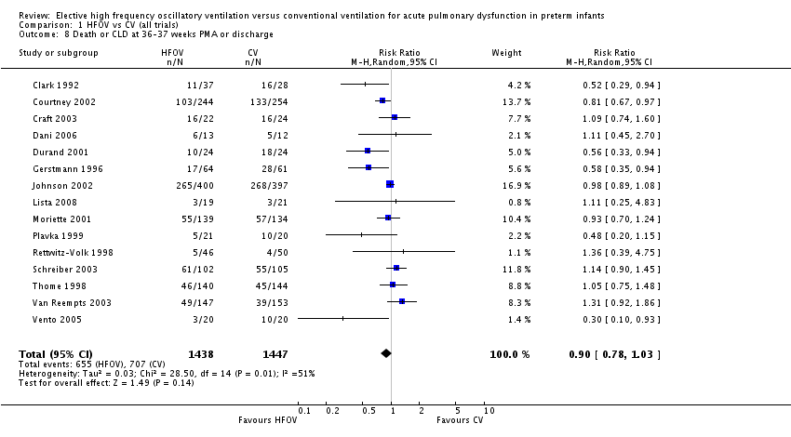
High Frequency Ventilation?

Slide 23
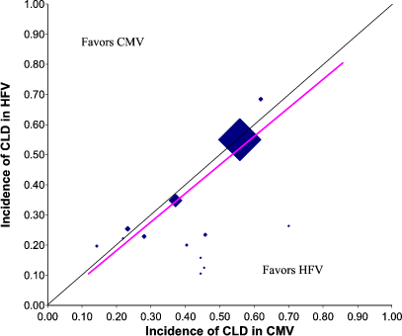

Slide 24
Early extubation
Removing the tube as fast as appropriate
Or not intubating if you can avoid it
Self-evident that never being ventilated is better than being ventilated (BPD does occur in never intubated babies, but only mild forms)
But if you need surfactant: the sooner the better, even an hour of delay makes a difference
The challenge to identify quickly infants who will need surfactant

Slide 25
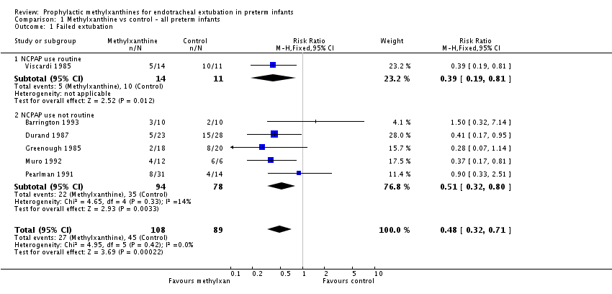
Improving the success of early extubation
Caffeine

Slide 26
Non-invasive ventilation
Intermittent positive pressure ventilation by non-invasive means has been studied in the preterm newborn
Synchronized nIPPV decreases the frequency of extubation failure in the VLBW
The only method to synchronize (the infantstar capsule) is no longer available.
A new method (NAVA) is probably capable to synchronize, but not yet tested in preterms
Studies of non-synchronized IPPV are needed

Slide 27
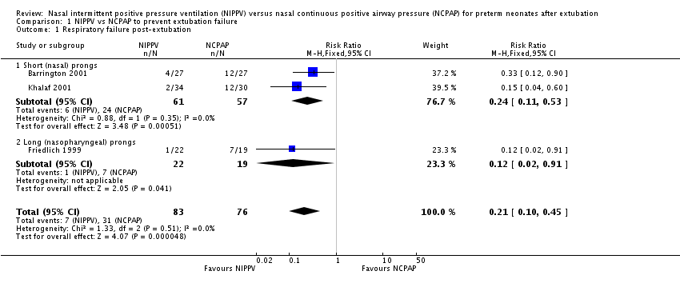

Slide 28
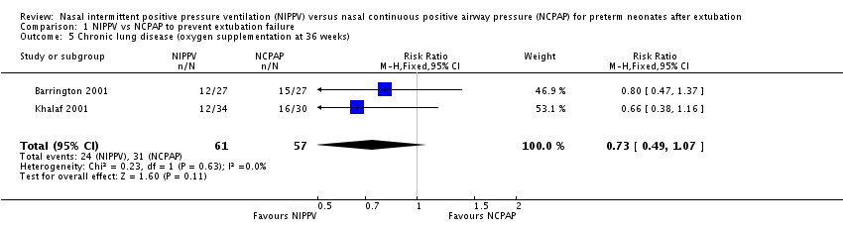

Slide 29
Synchronization?
1 RCT of non-synchronized nIPPV published (Kumar et al 2011) but the controls did not get CPAP (already proven to reduce extubation failure)

Slide 30
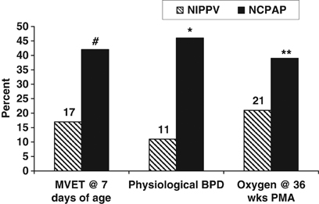
RCT of nIPPV vs CPAP after early surfactant and extubation
Ramanathan R J Perinatol 2012 (non-synchronized)

Slide 31
RCT of early nIPPV vs CPAP
Kishore M et al, Acta Paediatrica 2009
Initial mode of ventilatory support or after surfactant
Fewer re-intubations with nIPPV

Slide 32
Summary
Avoidance of intubation if possible
Careful attention to optimal PEEP
Limitation of tidal volumes
Early extubation to nIPPV with caffeine
When used in carefully protocolized fashion
Will reduce lung injury in preterm infants.

